Slide 1
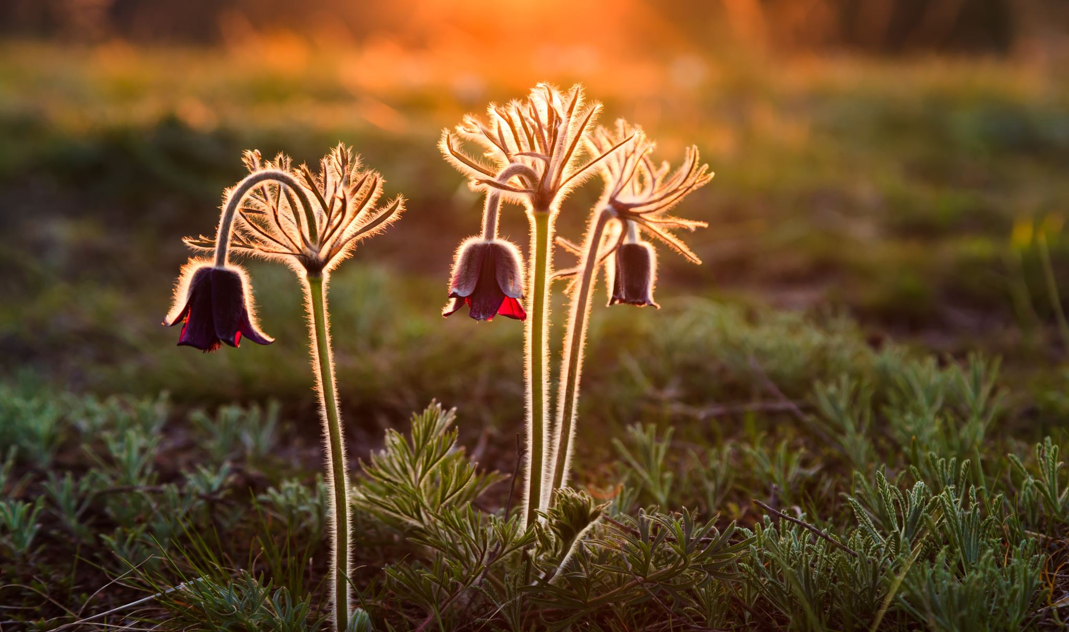
Being happy doesn’t mean that
Everything is perfect.
It’s just you’ve decided to see life
Beyond the imperfections.

