Slide 1
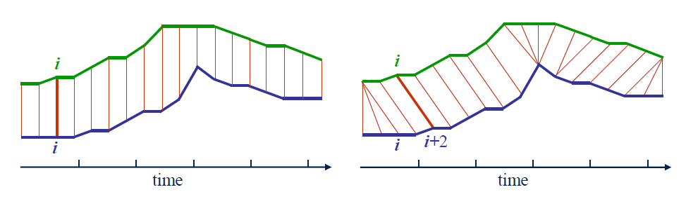
Time series A
Time series B

Slide 2
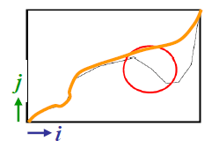
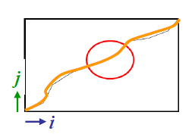
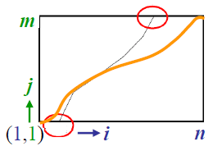
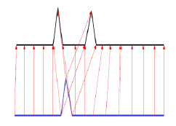
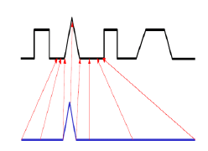
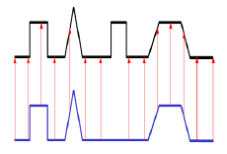
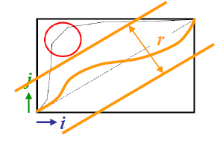
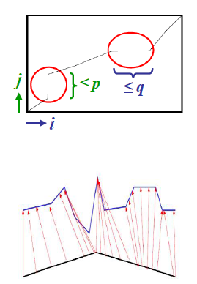
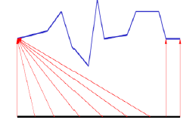
Monotonicity
Continuity
Boundary Conditions
Warping Window
Slope Constraint

Slide 3
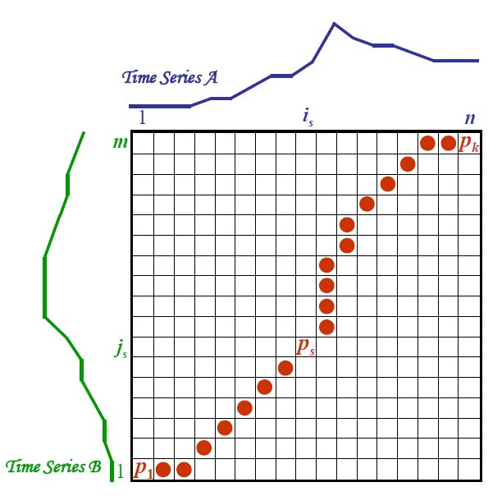

Slide 4
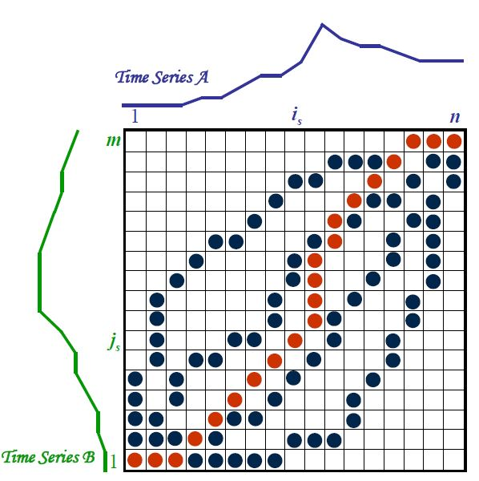

Slide 5







Time series A
Time series B
 | i | 1 | 2 | 3 | 4 | 5 | 6 | 7
j |  | 3 | 2 | 2 | 3 | 5 | 5 | 6
1 | 1 | 2
2 | 3
3 | 2
4 | 2
5 | 3
6 | 5
$P_{s}=(1,1)$
$d\left(P_{s}\right)= {\left\|3 −1\right\|}_{1}=2$
$$γ\left(i−1,j−1\right)=0$$
min
$$γ\left(i−1,j\right)=0$$
$=0$
$$γ\left(i,j−1\right)=0$$
$$γ\left(i,j\right)=2+0=2$$

Slide 6






Time series A
Time series B
 | i | 1 | 2 | 3 | 4 | 5 | 6 | 7
j |  | 3 | 2 | 2 | 3 | 5 | 5 | 6
1 | 1 | 2 | 3 | 4 | 6 | 10 | 14 | 19
2 | 3 | 2 | 3 | 4 | 4
3 | 2 | 3 | 2 | 2 | 3
4 | 2 | 4 | 2 | 2 | 3
5 | 3 | 4 | 3 | 3
6 | 5 | 6 | 6 | 6
$P_{s}=(4,4)$
$d\left(P_{s}\right)= {\left\|3 −2\right\|}_{1}=1$
$$γ\left(i−1,j−1\right)=2$$
min
$$γ\left(i−1,j\right)=2$$
$$γ\left(i,j−1\right)=3$$
$$γ\left(i,j\right)=1+2=3$$

Slide 7
Time series A
Time series B
 | i | 1 | 2 | 3 | 4 | 5 | 6 | 7
j |  | 3 | 2 | 2 | 3 | 5 | 5 | 6
1 | 1 | 2 | 3 | 4 | 6 | 10 | 14 | 19
2 | 3 | 2 | 3 | 4 | 4 | 6 | 8 | 11
3 | 2 | 3 | 2 | 2 | 3 | 6 | 9 | 12
4 | 2 | 4 | 2 | 2 | 3 | 6 | 9 | 13
5 | 3 | 4 | 3 | 3 | 2 | 4 | 6 | 9
6 | 5 | 6 | 6 | 6 | 4 | 2 | 2 | 3

Slide 8
Time series A
Time series A
Time series A
Time series B
 | i | 1 | 2 | 3 | 4 | 5 | 6 | 7
j |  | 3 | 2 | 2 | 3 | 5 | 5 | 6
1 | 1 | 2 | 3 | 4 | 6 | 10 | 14 | 19
2 | 3 | 2 | 3 | 4 | 4 | 6 | 8 | 11
3 | 2 | 3 | 2 | 2 | 3 | 6 | 9 | 12
4 | 2 | 4 | 2 | 2 | 3 | 6 | 9 | 13
5 | 3 | 4 | 3 | 3 | 2 | 4 | 6 | 9
6 | 5 | 6 | 6 | 6 | 4 | 2 | 2 | 3
Time series B
 | i | 1 | 2 | 3 | 4 | 5 | 6 | 7
j |  | 3 | 2 | 2 | 3 | 5 | 5 | 6
1 | 1 | 2 | 3 | 4 | 6 | 10 | 14 | 19
2 | 3 | 2 | 3 | 4 | 4 | 6 | 8 | 11
3 | 2 | 3 | 2 | 2 | 3 | 6 | 9 | 12
4 | 2 | 4 | 2 | 2 | 3 | 6 | 9 | 13
5 | 3 | 4 | 3 | 3 | 2 | 4 | 6 | 9
6 | 5 | 6 | 6 | 6 | 4 | 2 | 2 | 3
Time series B
 | i | 1 | 2 | 3 | 4 | 5 | 6 | 7
j |  | 3 | 2 | 2 | 3 | 5 | 5 | 6
1 | 1 | 2 | 3 | 4 | 6 | 10 | 14 | 19
2 | 3 | 2 | 3 | 4 | 4 | 6 | 8 | 11
3 | 2 | 3 | 2 | 2 | 3 | 6 | 9 | 12
4 | 2 | 4 | 2 | 2 | 3 | 6 | 9 | 13
5 | 3 | 4 | 3 | 3 | 2 | 4 | 6 | 9
6 | 5 | 6 | 6 | 6 | 4 | 2 | 2 | 3
… …

