Slide 1
The Conformal Bootstrap
Philip Clarke

Slide 2
The aim of this talk is to outline the methods of the conformal bootstrap.
In the last decade the bootstrap has
accelerated progress in exploring quantum field theories that describe physics with conformal symmetry, CFTs.
For example, this has resulted in the most precise
predictions to date of the behaviour of physical quantities at certain phase transitions.

Slide 3
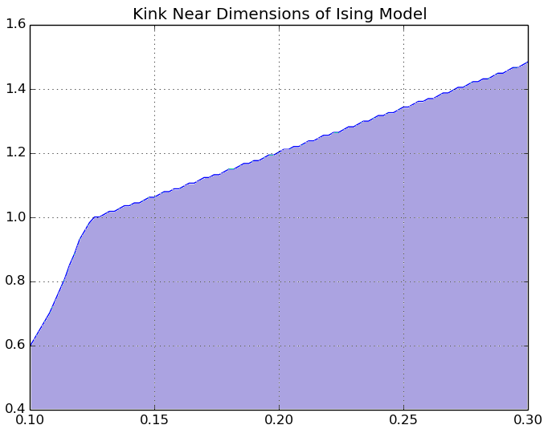


The bootstrap method constrains the space of possible CFTs.
Numerical but non-perturbative.
Applicable in great generality.
Excluded region
$$Δ_{ε}$$
Allowed region
The plot shows a bound on the properties of the fields present in the 2D critical Ising model. We’ll be a bit more precise later.
$$Δ_{σ}$$
Equivalent plot for 3D due to El-Showk, Paulos, Poland, Rychkov, Simmons-Duffin, Vichi (2012)

Slide 4
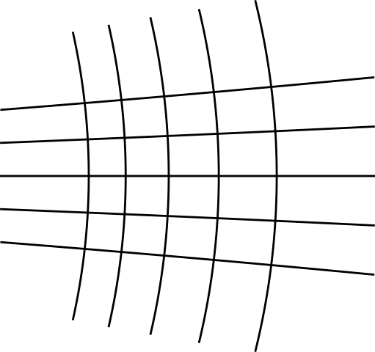
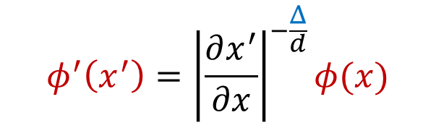
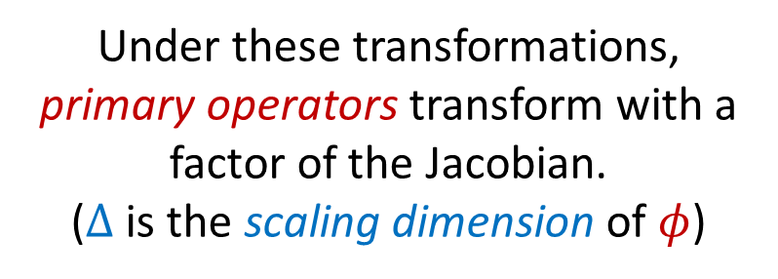
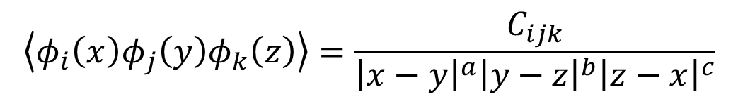
Basics
Conformal transformations change the coordinates in a way that preserves angles.
Under these transformations, primary operators transform with a factor of the Jacobian.
($Δ$ is the scaling dimension of $φ$)
$$φ^{′}\left(x^{′}\right)={\left|\frac{∂x^{′}}{∂x}\right|}^{−\frac{Δ}{d}}φ(x)$$
Demanding covariance fixes the form of the 3-pt function.
$$\left\langle φ_{i}\left(x\right)φ_{j}\left(y\right)φ_{k}\left(z\right)\right\rangle =\frac{C_{ijk}}{{\left|x−y\right|}^{a}{\left|y−z\right|}^{b}{\left|z−x\right|}^{c}}$$

Slide 5



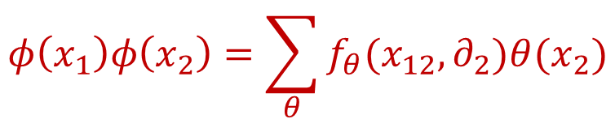
The 4-pt is not so easy, but this is a good thing.
Let’s just consider identical operators: $\left\langle φ\left(x_{1}\right)φ\left(x_{2}\right)φ\left(x_{3}\right)φ(x_{4})\right\rangle$
Now have enough points to construct conformal invariants, on which we could have complicated dependence.
$$u=\frac{x_{12}^{2}x_{34}^{2}}{x_{13}^{2}x_{24}^{2}}$$
$$v=\frac{x_{23}^{2}x_{14}^{2}}{x_{13}^{2}x_{24}^{2}}$$
$$φ\left(x_{1}\right)φ\left(x_{2}\right)=\sum_{θ}{f_{θ}(x_{12},∂_{2})θ(x_{2})}$$
To progress, we expand products:
The sum is over primary operators $θ$; it is called the operator product expansion, or OPE.
This turns an n-pt function into a sum of (n-1)-pt functions!

Slide 6
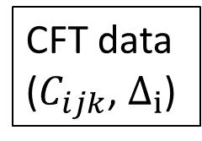
But which pairs to expand?
It shouldn’t matter; we should get the same result regardless.
This is the consistency condition leveraged by the conformal bootstrap.
Main idea: demanding this mathematical consistency
constrains the space of possible conformal quantum field theories.
Consistency
conditions
D=2: 1980’s
CFT data
($C_{ijk}$, $Δ_{i}$)
1980’s
All correlators between fields
D>2: 2008 on
(Using the conformal algebra)

Slide 7
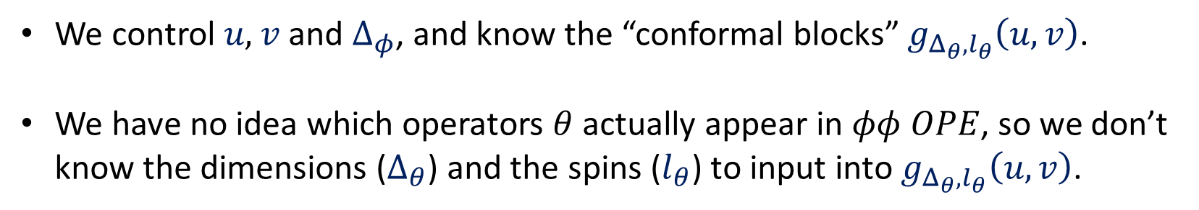
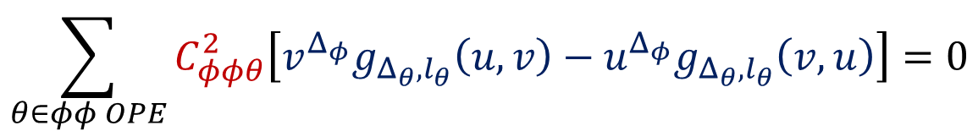
So, how do we do this?
$$\sum_{θ∈φφ OPE}{C_{φφθ}^{2}\left[v^{Δ_{φ}}g_{Δ_{θ},l_{θ}}\left(u,v\right)−u^{Δ_{φ}}g_{Δ_{θ},l_{θ}}\left(v,u\right)\right]}=0$$
The actual condition:
Positive, real numbers
(we saw these in the 3-pt)
Known function, with some unknown inputs.
We control $u\text{,} v$ and $Δ_{φ}$, and know the “conformal blocks” $g_{Δ_{θ},l_{θ}}\left(u,v\right)$.
We have no idea which operators $θ$ actually appear in $φφ OPE$, so we don’t know the dimensions ($Δ_{θ}$) and the spins ($l_{θ}$) to input into $g_{Δ_{θ},l_{θ}}\left(u,v\right)$.

Slide 8
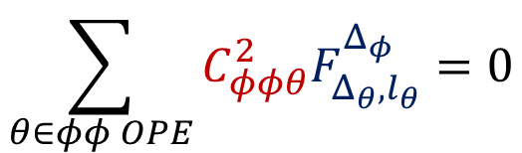
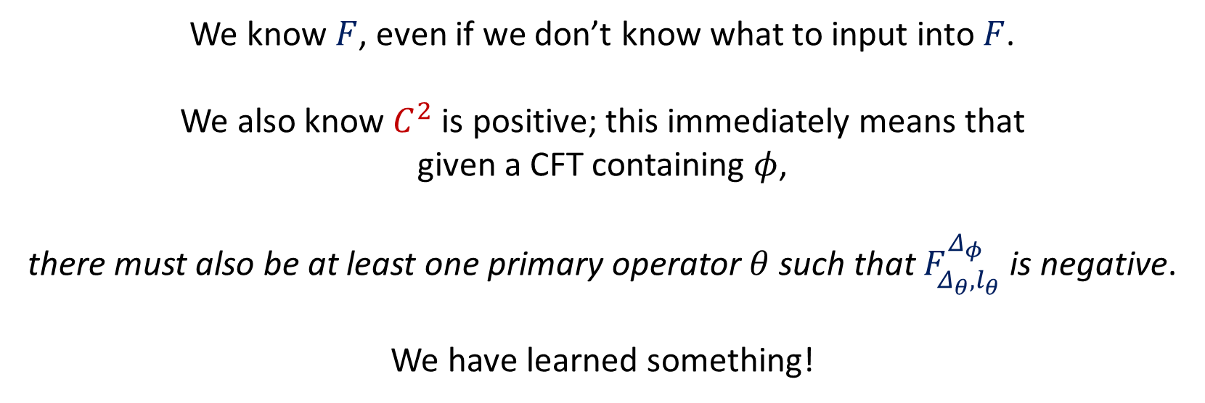
Next, we guess.
$$\sum_{θ∈φφ OPE}{C_{φφθ}^{2}F_{Δ_{θ},l_{θ}}^{Δ_{φ}}}=0$$
Let’s shrink the notation:
We know $F$, even if we don’t know what to input into $F$.
We also know $C^{2}$ is positive; this immediately means that
given a CFT containing $φ$,
there must also be at least one primary operator $θ$ such that $F_{Δ_{θ},l_{θ}}^{Δ_{φ}}$ is negative.
We have learned something!

Slide 9
$$\sum_{θ∈φφ OPE}{C_{φφθ}^{2}F_{Δ_{θ},l_{θ}}^{Δ_{φ}}}=0$$
That was a naïve example of how we could use this constraint, but the strategy is clear:
Certain assumptions about the spectrum of primary operators can be shown to be inconsistent with the above constraint, ruling out swathes of possible CFTs.

Slide 10

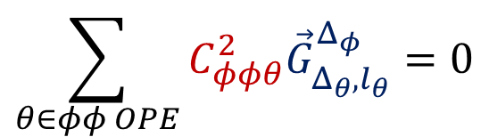
We still have freedom in choosing $u$ and $v$; we can use this to create a vector of quantities which should all sum to zero with positive coefficients.
$$\sum_{θ∈φφ OPE}{C_{φφθ}^{2}{\vec{G}}_{Δ_{θ},l_{θ}}^{Δ_{φ}}}=0$$
This was the insight of Rattazzi, Rychkov, Tonni and Vichi in 2008.
This formulation translates the problem into one amenable to methods such as linear programming.

Slide 11
Undergrad project:
understand theory
calculate example of 4-pt correlator
use JuliBootS software to generate bounds shown.
Excluded region
$$Δ_{ε}$$
Allowed region
$$Δ_{σ}$$
I am very grateful to Prof. Dmytro Volin for his guidance and enthusiasm throughout this project.
Equivalent plot for 3D due to El-Showk, Paulos, Poland, Rychkov, Simmons-Duffin, Vichi (2012)

Slide 12

Using symmetry only found in 2D,
one can classify the possible unitary
QFTs with conformal symmetry.
For example, the exact 2D Ising critical exponents are known:
Excluded region
$$Δ_{ε}=1$$
$$Δ_{σ}=0.125$$
$$Δ_{ε}$$
Allowed region
Region shown was the bootstrap state of the art in 2012; modern constraints are much tighter.
Although, note the bound has already ‘found’ the Ising model.
$$Δ_{σ}$$
Equivalent plot for 3D due to El-Showk, Paulos, Poland, Rychkov, Simmons-Duffin, Vichi (2012)

Slide 13
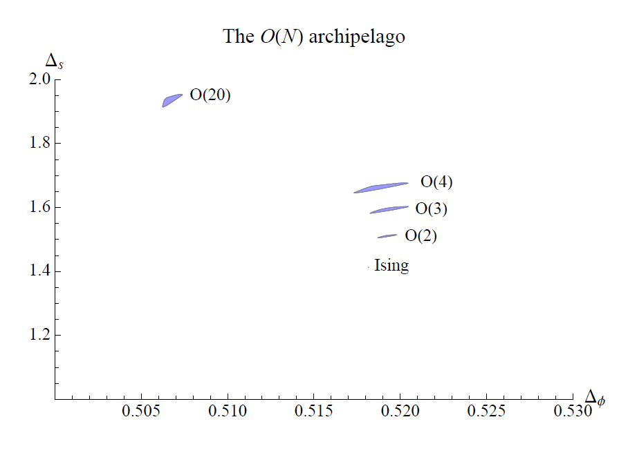
Improvements:
Using correlators of non-identical operators.
Better numerics.
Taking further symmetry into account.
Bounds on scaling dimensions for 3D CFTs with $O(N)$ symmetry
Kosa, Poland, Simmons-Duffin, Vichi (2015)

Slide 14
Thank you!

