Slide 1
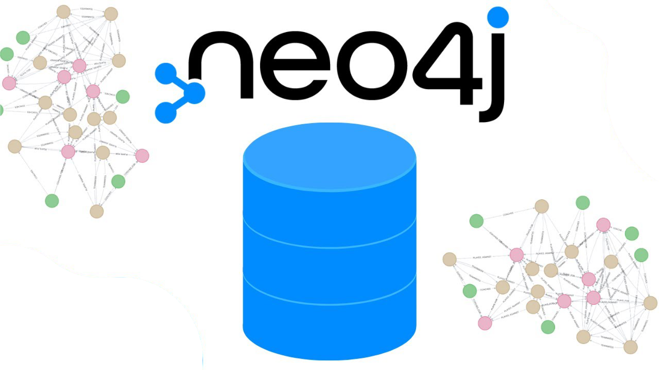
NoSQL Databases Docker and Spark implementation
Eddie Aguilar Ceballos
Konrad Schindler

Slide 2
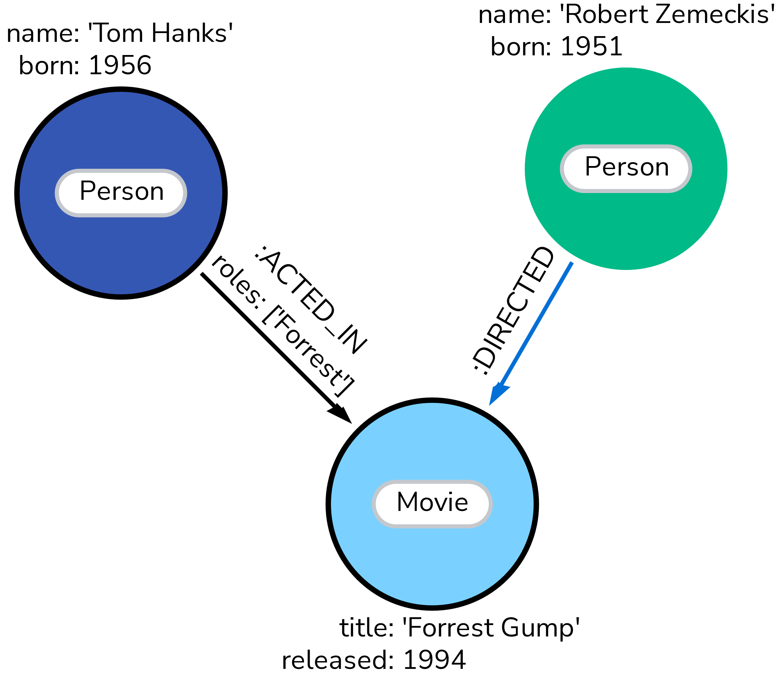
neo4j facts
= Neo4j is a non-open-source software for ACID-compliant graph databases
Datastructure:
Stores attributes of
Nodes
= entities, can have labels
Edges
= Relationships, are directed, must have a type
→ Naming of both is case-sensitive
Code:
Implemented in Java
Accessible in other languages via CYPHER queries
or through a „Bolt“ Protocol
→ Offers end-to-end encryption
https://neo4j.com/docs/getting-started/appendix/graphdb-concepts/
https://en.wikipedia.org/wiki/Neo4j

Slide 3
Create a Docker Image
Basic example:
Docker run -d --name neo4j-iteso \
--network spark_cluster_default \
--restart always \
--publish=7474:7474 --publish=7687:7687 \
--env NEO4J_AUTH=neo4j/123456789 \
neo4j:2025.02.0
Explication:
Set docker image name
Connect to existing spark instance
Control whether Neo4j containers start automatically
“ always” restarts on boot of docker
“=no” does not restart automatically
4. Gates
7474 = localhost gate
Log into localhost:7474 with your username and password
7687 = gate to connect the Neo4j database
via a “Bolt” protocol to other applications in the host machine
5. Create authentication with
Username “=neo4j”
Password “/123456789”
Can also disable authentication by setting “=none”
Define the base image of neo4j. This one is a free community edition
https://neo4j.com/docs/operations-manual/current/docker/introduction/

Slide 4
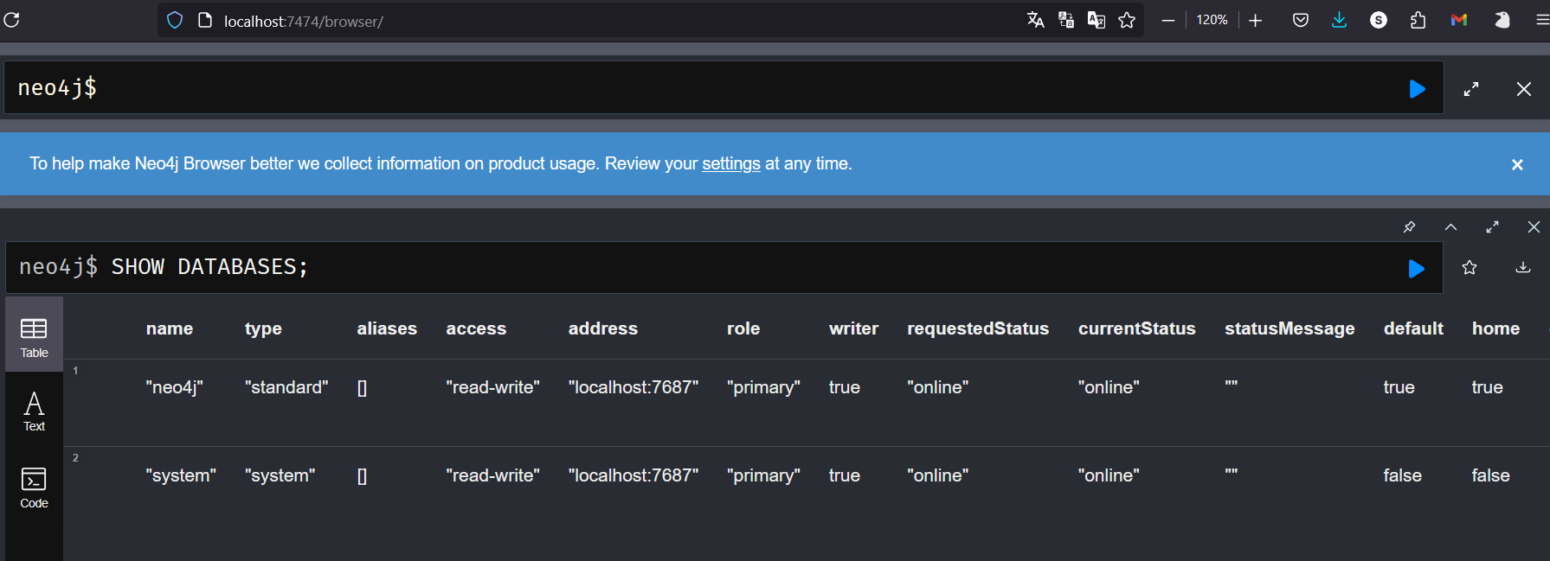

Slide 5
Jupyter Notebook Example

Slide 6
Implement jdbc Connector

Slide 7
Problems we faced

