Slide 1
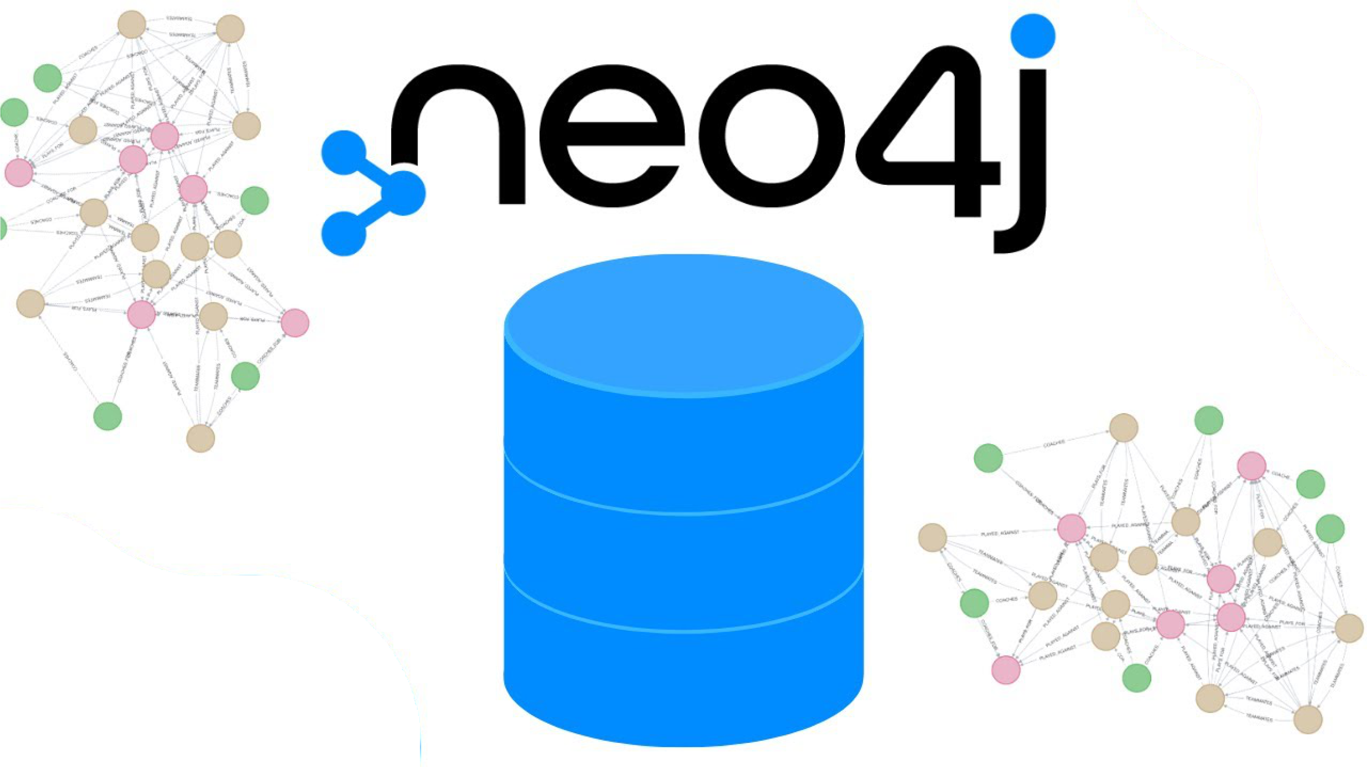
NoSQL Databases Docker and Spark implementation
Eddie Aguilar Ceballos
Konrad Schindler

Slide 2
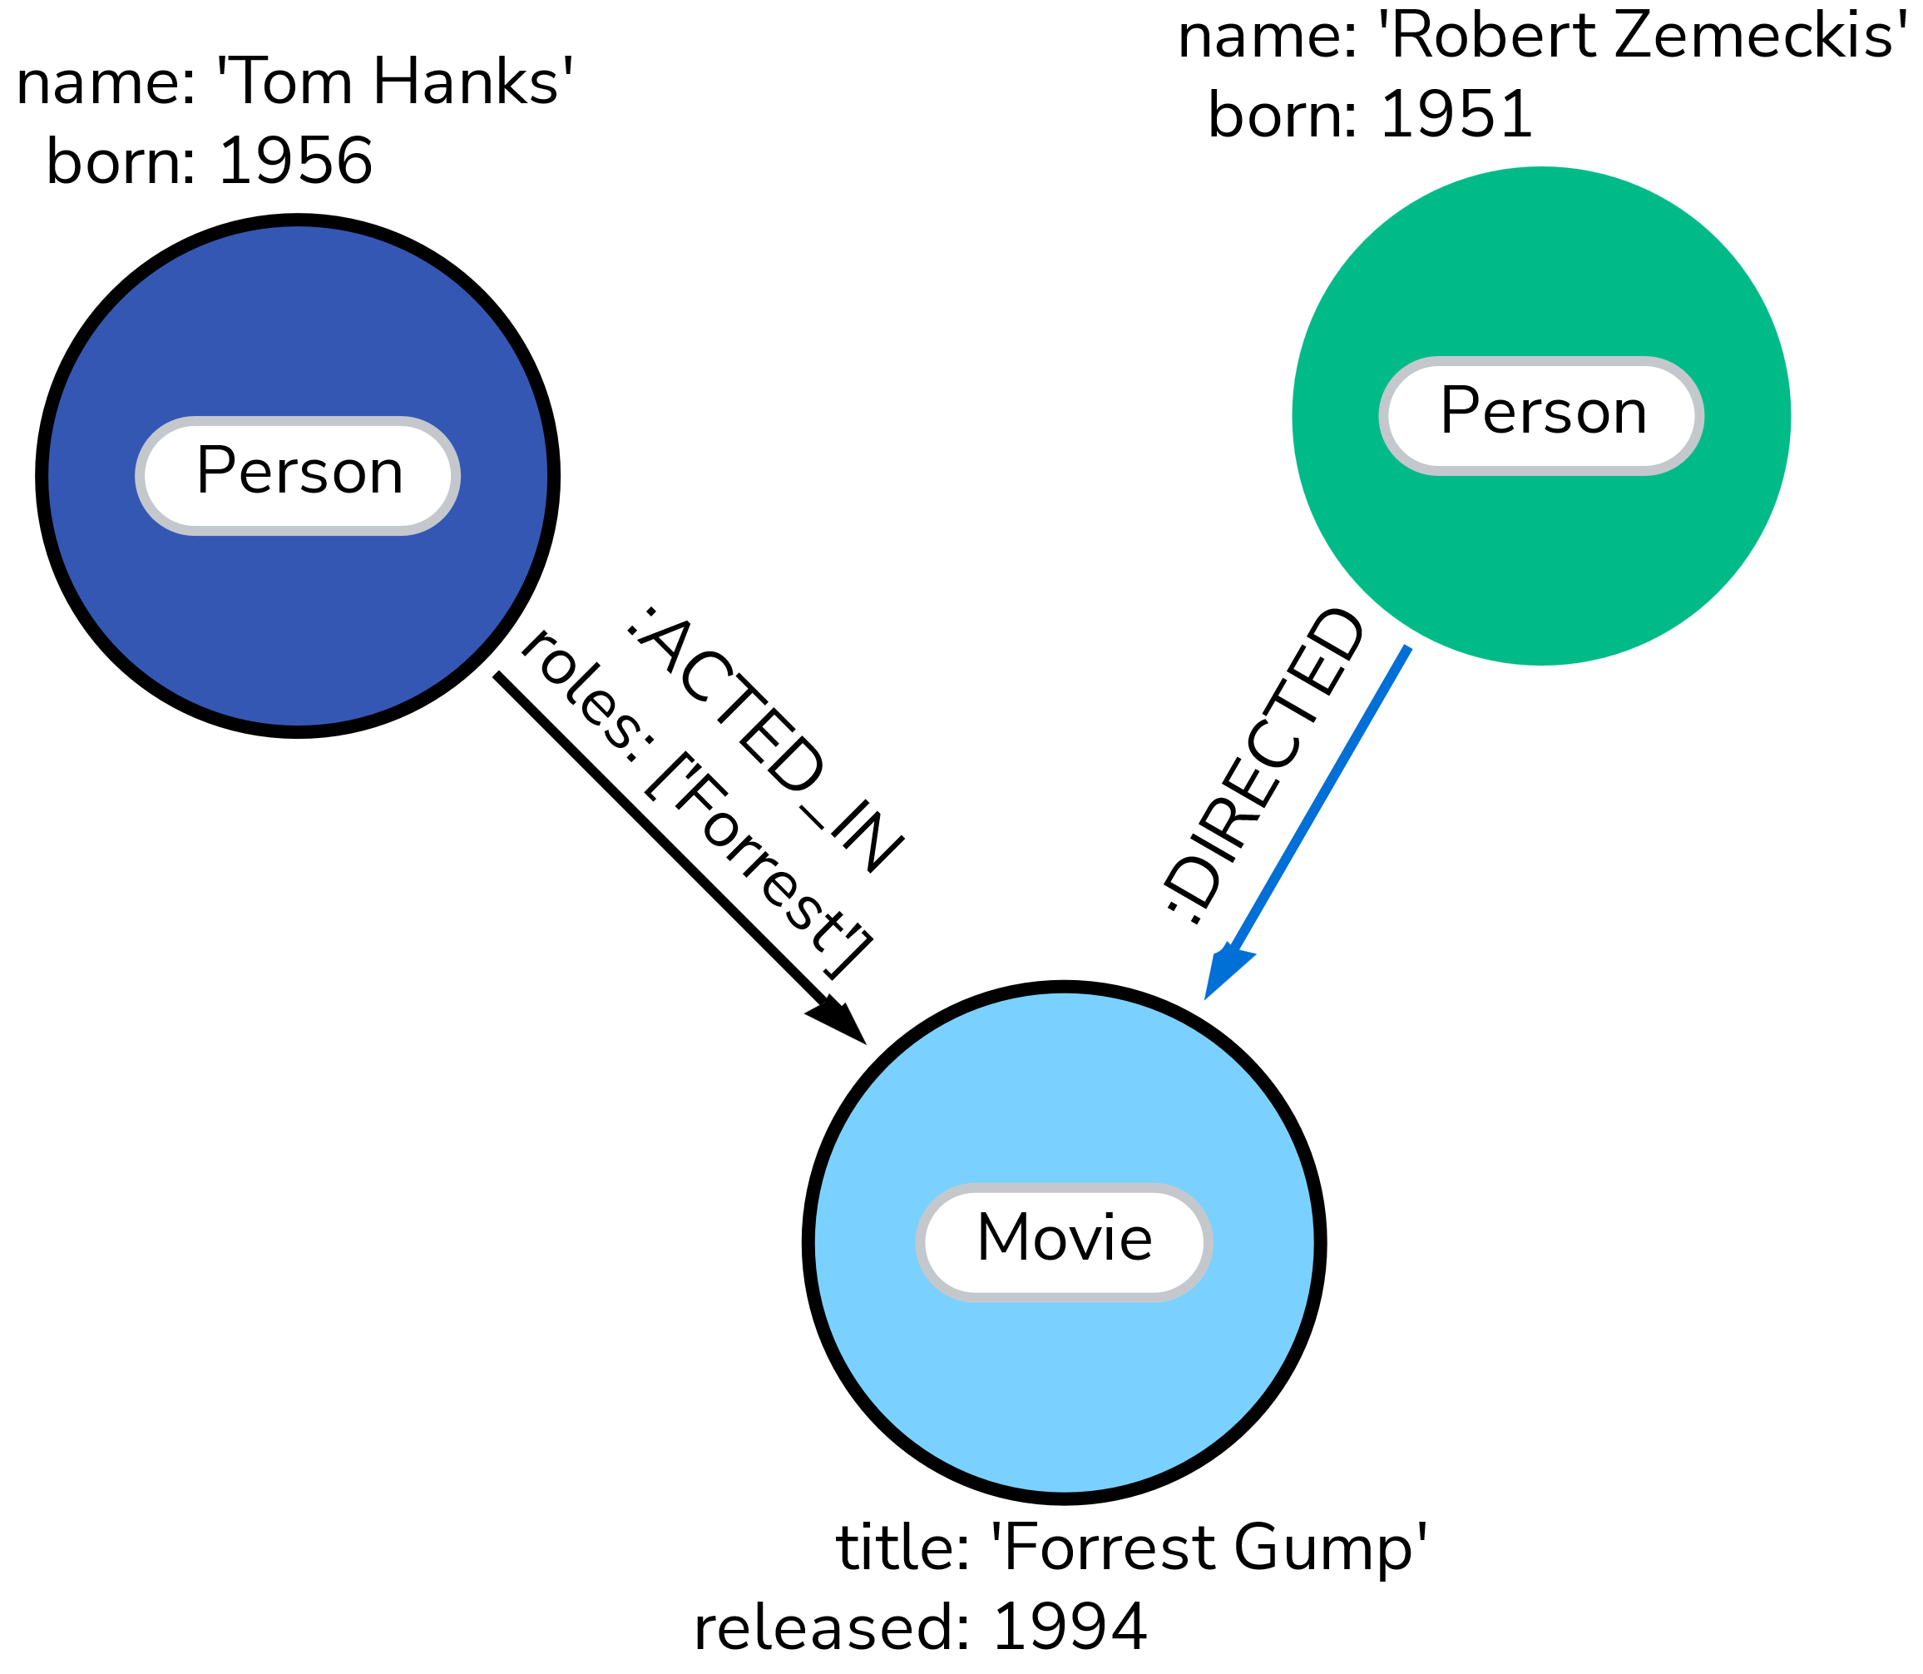
neo4j facts
= Neo4j is a non-open-source software for ACID-compliant graph databases
Datastructure:
Stores attributes of
Nodes
= entities, can have labels
Edges
= Relationships, are directed, must have a type
→ Naming of both is case-sensitive
Code:
Implemented in Java
Accessible in other languages via CYPHER queries
or through a „Bolt“ Protocol
→ Offers end-to-end encryption
https://neo4j.com/docs/getting-started/appendix/graphdb-concepts/
https://en.wikipedia.org/wiki/Neo4j

Slide 3
Create a Docker Image
Basic example:
Docker run -d --name neo4j-iteso \
--network spark_cluster_default \
--restart always \
--publish=7474:7474 --publish=7687:7687 \
--env NEO4J_AUTH=neo4j/123456789 \
neo4j:2025.02.0
Explication:
Set docker image name
Connect to existing spark instance
Control whether Neo4j containers start automatically
“ always” restarts on boot of docker
“=no” does not restart automatically
4. Gates
7474 = localhost gate
Log into localhost:7474 with your username and password
7687 = gate to connect the Neo4j database
via a “Bolt” protocol to other applications in the host machine
5. Create authentication with
Username “=neo4j”
Password “/123456789”
Can also disable authentication by setting “=none”
Define the base image of neo4j. This one is a free community edition
https://neo4j.com/docs/operations-manual/current/docker/introduction/

Slide 4
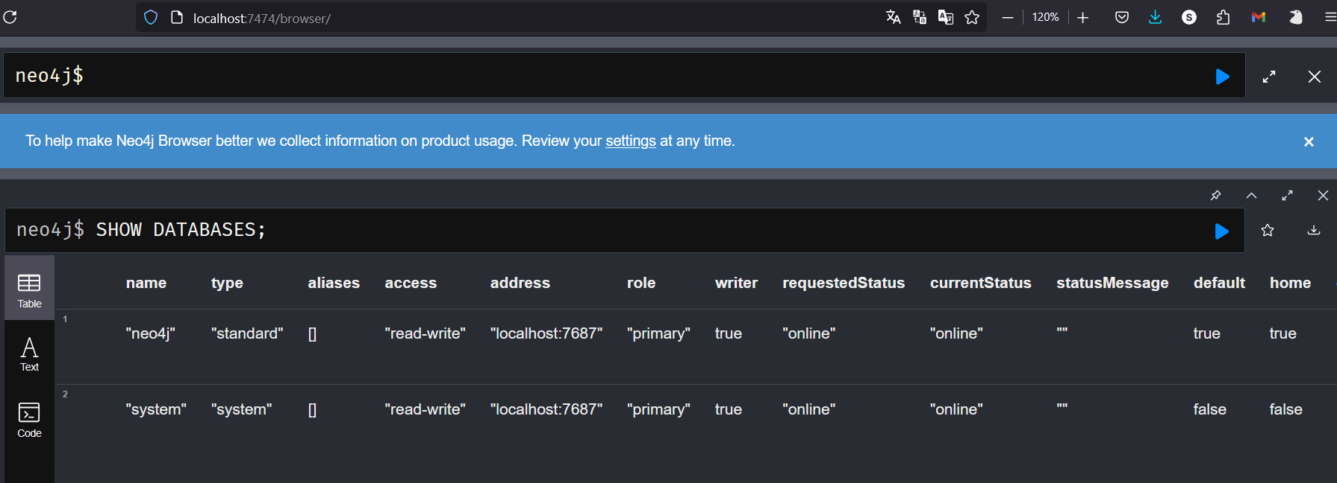

Slide 5
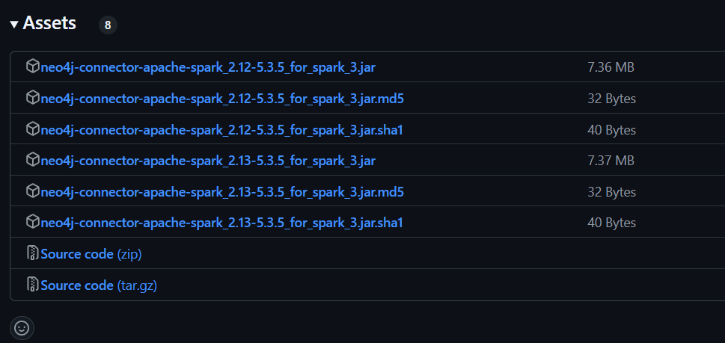
Neo4j connector download
Link:
https://github.com/neo4j/neo4j-spark-connector/releases
Scala version:
2.13.8
Neo4j connector version:
neo4j-connector-apache-spark_2.13-5.3.5_for_spark_3.jar
Put the jar file in a shared location:
Home/jovyan/notebooks/jars

Slide 6
Spark session
1. spark = SparkSession.builder \
2. .appName("Spark-Nero4j-Integration") \
3. .master("spark://8776010e8f6a:7077") \
4. .config("spark.jars", "/home/jovyan/notebooks/jars/neo4j-connector-apache-spark_2.13- 5.3.5_for_spark_3.jar") \
5. .config("spark.ui.port","4040") \
6. .getOrCreate()

Slide 7
Write example
1 . neo4j_url = "bolt://neo4j-iteso:7687"
2. neo4j_user = "neo4j"
3. neo4j_password = "123456789“
4. ecommerce_df.write \
5. .format("org.neo4j.spark.DataSource") \
6. .mode("Overwrite") \
7. .option("url", neo4j_url) \
8. .option("authentication.type", "basic") \
9. .option("authentication.basic.username", neo4j_user) \
10. .option("authentication.basic.password", neo4j_password) \
11. .option("labels", ":Product") \
12. .option("node.keys", "product") \
13. .save()

Slide 8
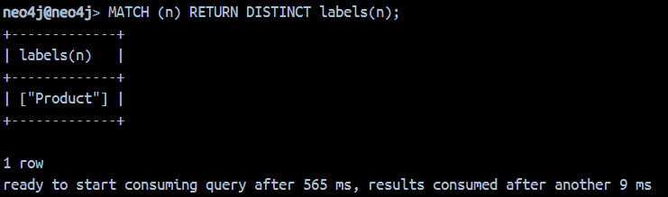
See label in Docker
Route:
- Docker desktop → Containers → neo4j_iteso -> EXEC
Run neo4j shell:
- cypher-shell -u neo4j -p 123456789
Display all labels:
- MATCH (n) RETURN DISTINCT labels(n);

Slide 9
Read example
1. df = spark.read \
2. .format("org.neo4j.spark.DataSource") \
3. .option("url", neo4j_url) \
4. .option("authentication.type", "basic") \
5. .option("authentication.basic.username", neo4j_user) \
6. .option("authentication.basic.password", neo4j_password) \
7. .option("labels", ":Product") \
8. .load()

Slide 10
Problems we faced
- Finding the connector .jar

