Slide 1
OUR NEW DIGITAL HOME
Platinum One Logistics
Website Overview
April 2026 · Presented by Michelle Casanova
Notes:
Welcome. 10-minute overview — what we built, why it matters, and what's still coming.

Slide 2
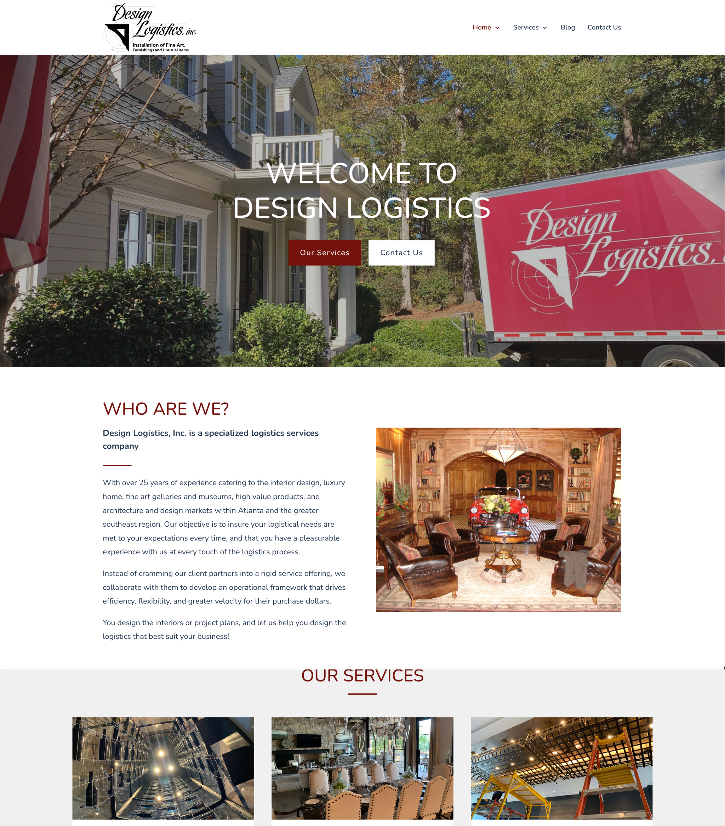
WHERE WE STARTED
The Old Site Was Holding Us Back
Hard to Find on Google
Zero search setup — the old site was invisible when potential clients searched for our services.
Looked Outdated
The design was years old and did not reflect the premium, white-glove service we actually deliver.
No Pricing, No Detail
Clients had no way to understand our services or rates without picking up the phone first.
Generic • Dated • No pricing • Not mobile-friendly
Notes:
The old designlogisticsinc.com site was working against us. Not findable, didn't look premium, gave visitors no reason to stay or reach out.

Slide 3
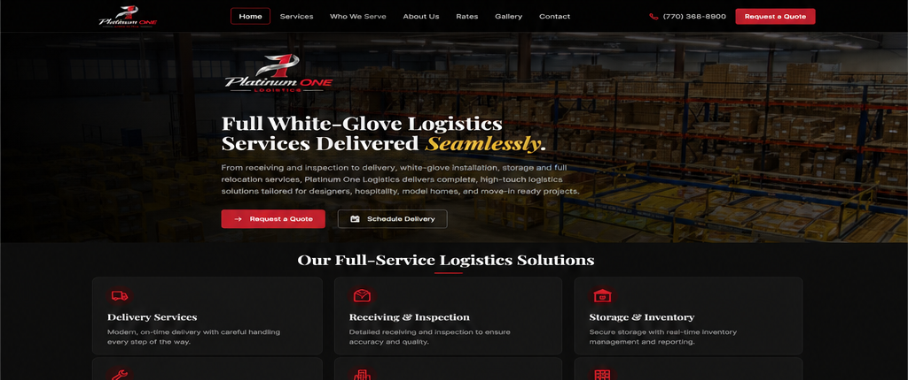
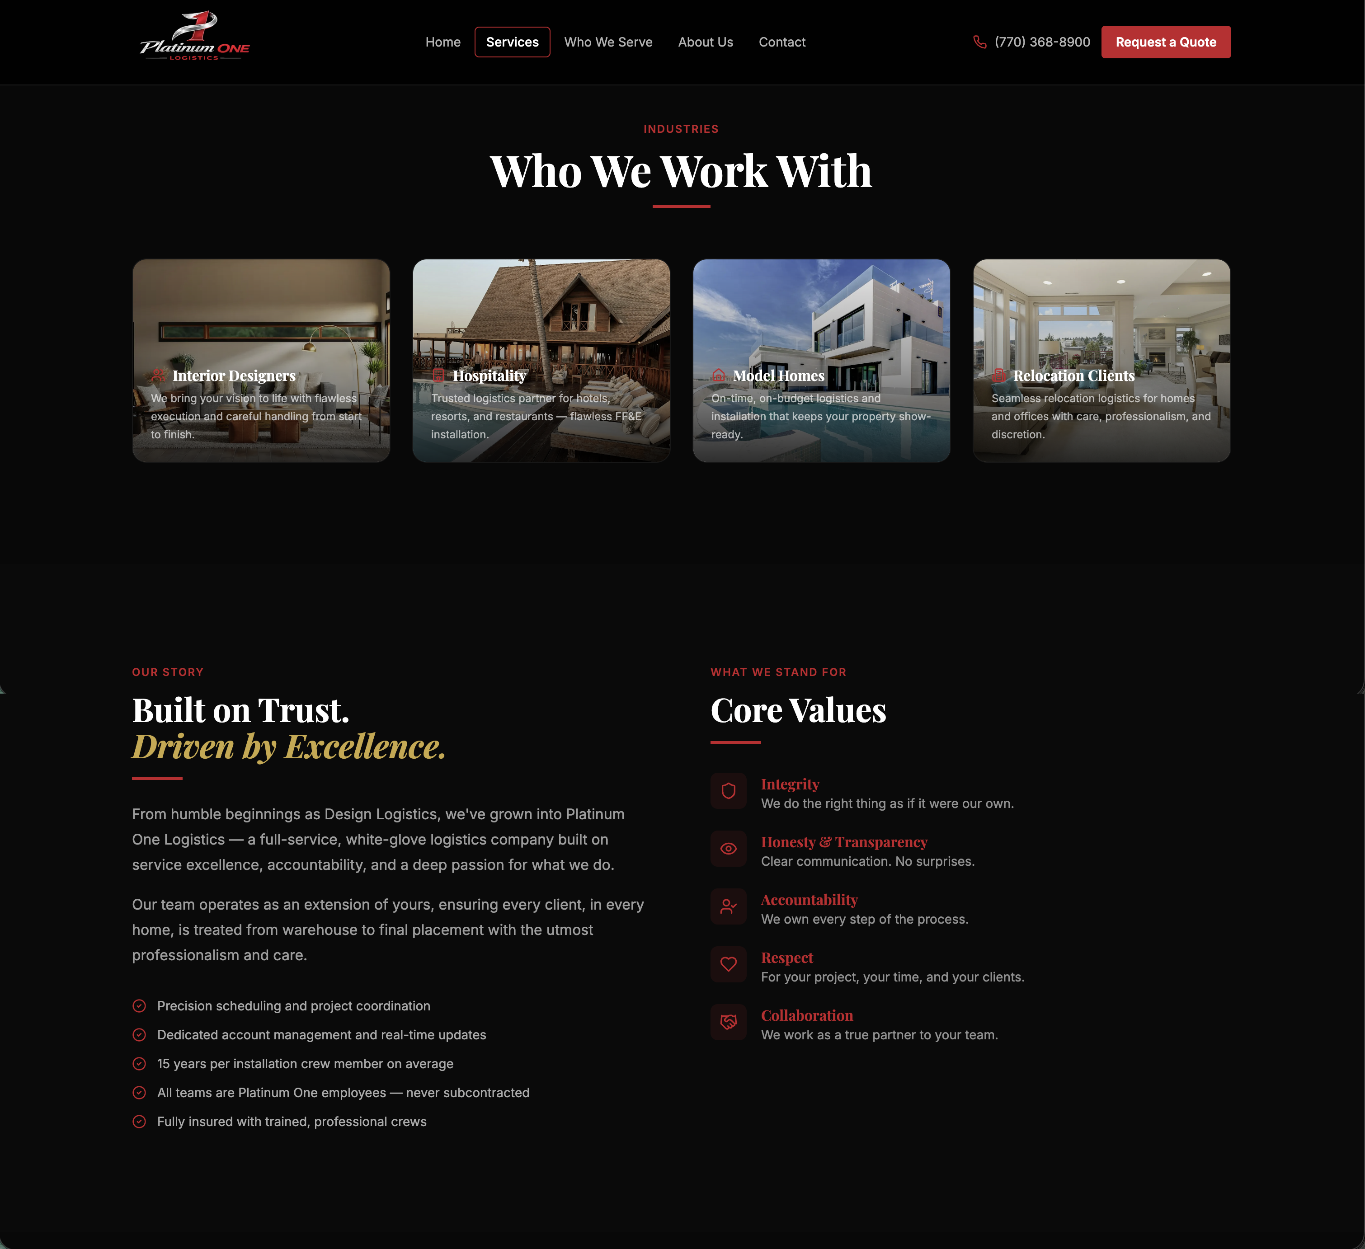
WHAT WE BUILT
Two Sites, One Brand
FULL WEBSITE — 7 PAGES
ONE-PAGE SITE
Built to Inform
Built to Convert
Home, Services, Who We Serve, About, Rates, Gallery, Contact
Single scrolling page — same brand, same content
Full detail on every service and audience
Designed for ad campaigns and quick pitches
Best for clients who want to research before calling
One clear path: learn → contact us
Notes:
We built two versions sharing the same brand. The full site handles research-driven clients. The one-page is for ad spend and fast introductions. We'll revisit which should be primary later in this presentation.

Slide 4
REACH
Built to Show Up on Google
AUDIENCES WE NOW REACH ON GOOGLE
Interior Designers
Search-Ready from Day One
"white-glove logistics for interior designers"
Every page is set up so Google knows exactly who we are, what we do, and where we work. The old site had none of this.
Hospitality
Targeting the Right Audiences
"hotel FF&E installation Southeast"
Dedicated pages for Interior Designers, Hospitality, Model Homes, and Relocation — built for how each audience actually searches.
One Item Still to Confirm
Model Homes
We currently say 'Georgia' on the site. Confirming our actual service area (the greater Southeast) significantly extends our Google reach.
"model home staging logistics Georgia"
Relocation Clients
"luxury relocation white-glove service"
Notes:
Think of this as putting up a proper sign. Before, we had no sign at all. The one open question is confirming our exact service area with Michelle — that directly affects how far our Google reach extends.

Slide 5
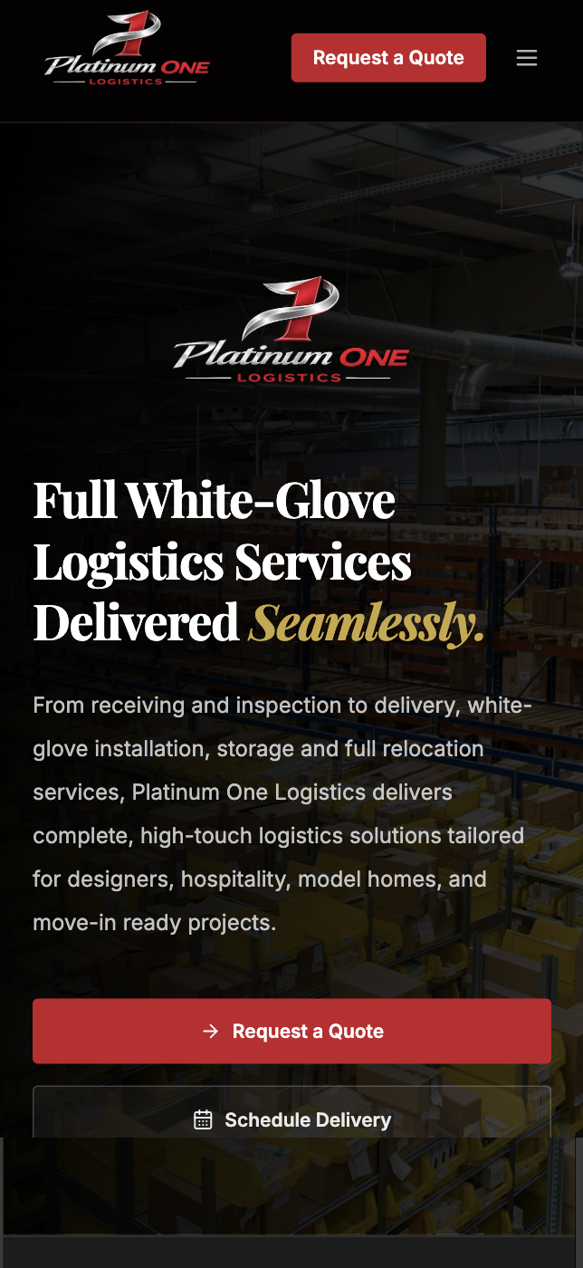
ACCESSIBILITY & MOBILE
Works for Everyone, Everywhere
LOOKS GREAT ON ANY DEVICE
Phone, tablet, or desktop — the site adapts perfectly. The old site was designed for desktop only and broke on mobile devices.
BUILT FOR EVERY VISITOR
Optimized for visitors who are visually impaired or use screen readers
People who cannot see images or use a mouse can still navigate, read, and contact us.
Works with keyboard-only navigation
Clients who cannot use a mouse can still browse the full site and submit a quote request.
Meets the standard expected of professional business websites
Accessibility also signals quality to Google — sites that work for everyone rank higher in search results.
Notes:
We built the site to work for everyone — including people who rely on screen readers or keyboard navigation. Beyond doing the right thing, accessible sites rank higher on Google and reach a broader audience.

Slide 6
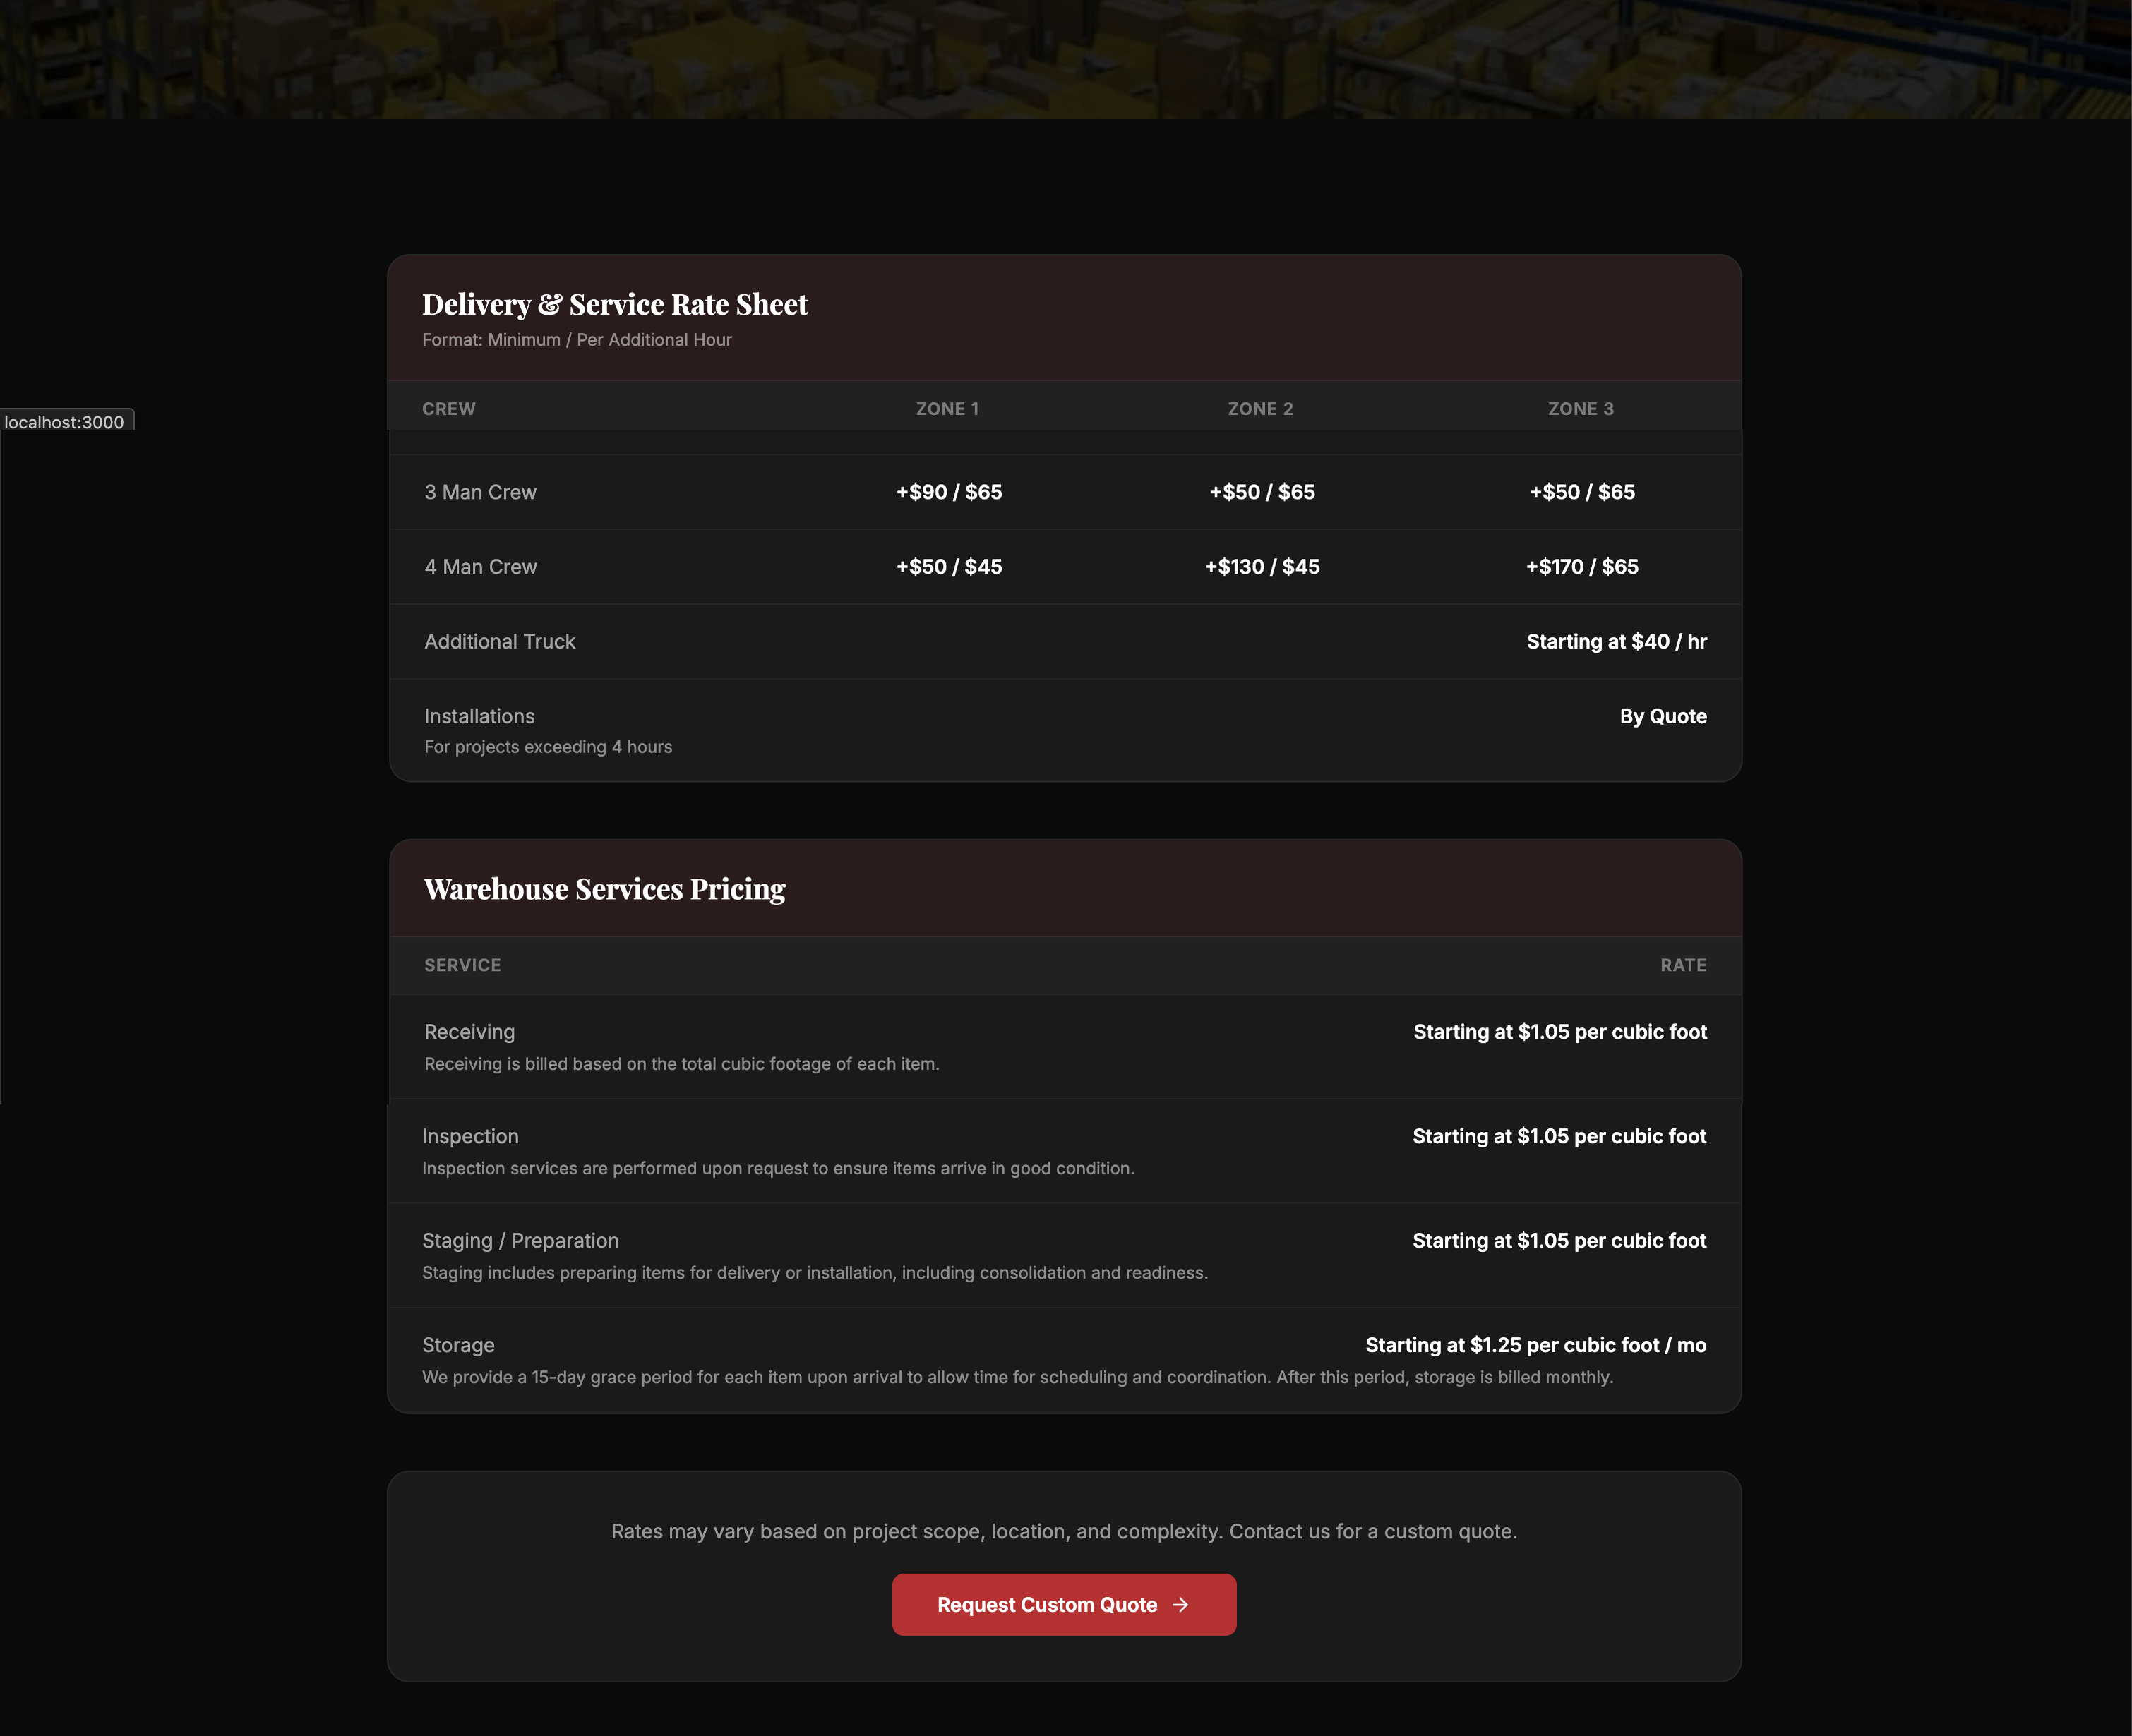
PRICING
No More "Call Us for Pricing"
"Clients who see pricing upfront are more likely to reach out — because they already know we're in their budget."
Delivery zone rates and crew sizes — clearly listed
Warehouse pricing — clearly listed
Downloadable rate sheet is one click away
Being upfront about pricing sets us apart from competitors
Notes:
Interior designers and hospitality managers get pitched by logistics companies constantly. Being upfront about pricing is a differentiator. It saves everyone time and builds immediate trust.

Slide 7
STATUS
Almost There — Here's What's Left
ITEM
OWNER / ACTION
STATUS
Contact form — live email sending
IT team
Waiting on email server settings
Service coverage area copy
Michelle
Confirm exact states we serve
Years in business on the site
Michelle
Confirm the number (25+ years?)
Google Analytics — traffic tracking
One-time setup — 30 min
Ready to action
Google Maps business listing
One-time setup
Ready to action
Truck photo — rebrand the logo
AI image edit
In progress
Notes:
Everything on this list is days, not weeks. The site is live and fully functional — this is finishing work. The biggest dependency is email server settings from IT.

Slide 8
A RECOMMENDATION
Should the One-Page Site Become Our Primary Home?
TRADITIONAL MULTI-PAGE SITE
RECOMMENDED PATH
ONE-PAGE SITE
7 pages to maintain separately
Single page — one scroll, one decision: contact us
Visitors can get lost navigating
No navigation confusion — visitors stay focused
Each page needs its own SEO upkeep
Simpler to maintain — update once, done everywhere
More complex to update over time
Perfect for ad spend — link directly to it
Ad campaigns link to homepage, not a focused page
Same content, same brand — no loss of information
Our Recommendation: After 6–12 months of traffic data, consider making the one-page site the primary web presence.
Notes:
We built both for good reason — but the one-page site is proving to be the cleaner, more focused experience. Less maintenance, less confusion for visitors, and a natural fit for any ad spend. The recommendation is to keep both for now while we gather data, then evaluate making the one-page the primary destination.

Slide 9
THE BOTTOM LINE
What This Means for the Business
01
02
03
More Visibility
Better First Impression
Less Friction for New Clients
We now show up where our clients are searching. The old site did not.
The site reflects the quality of work we deliver. Designers and hospitality clients will take us seriously.
Pricing is visible, services are clear, quote request is on every page. Getting in touch is easy.
Estimated fully complete within 2 weeks of receiving the remaining information from the team.
Notes:
The new site is a sales tool. Every decision — pricing page, audience-specific pages, mobile design, accessibility — was made to reduce the distance between a potential client finding us and picking up the phone.

