Slide 1


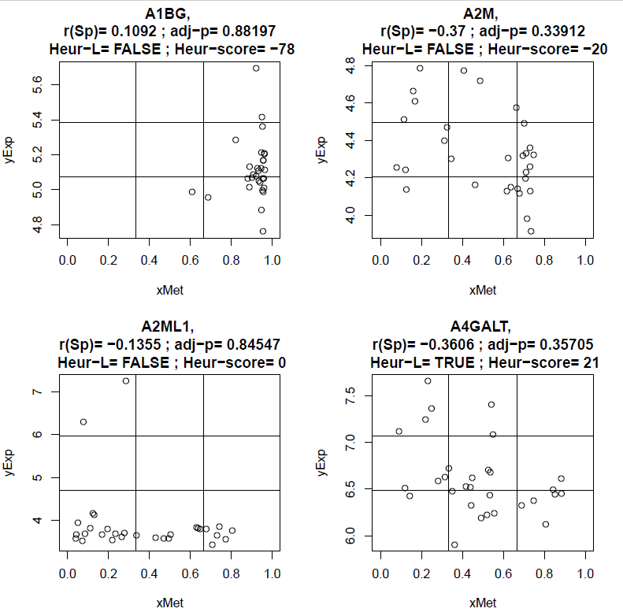



Selection of genes potentially regulated by Methylation

