Slide 1

C# 8.0
New features

Slide 2
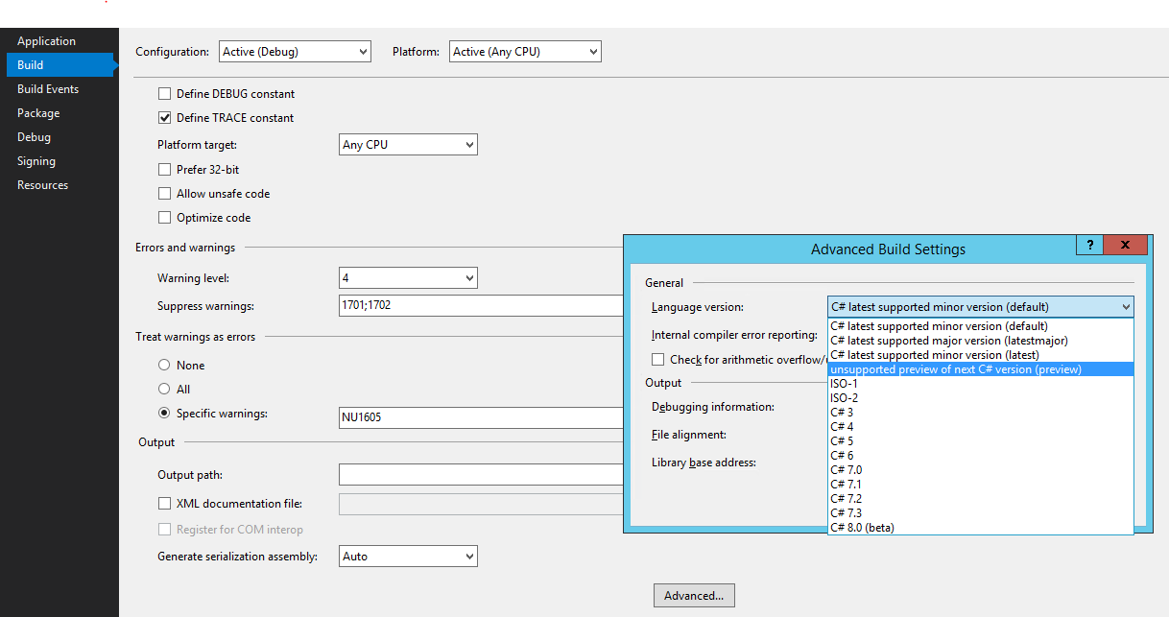
Setup environment
Before you start coding you need to enable c# 8.0 new feature in visual studio 2019,

Slide 3
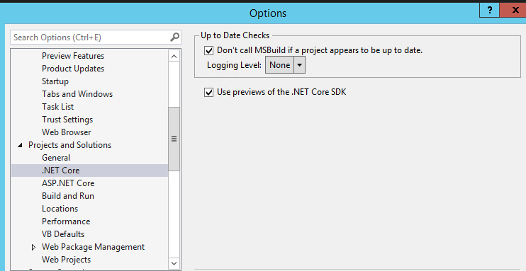
Setup environment
You need to enable previews of the .NET core SDK in visual studio.

Slide 4
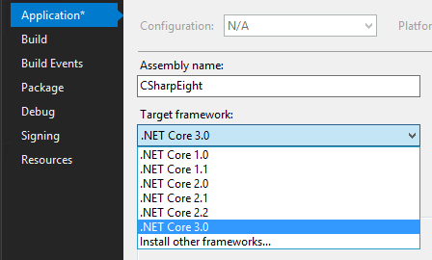
Setup environment
You need to enable previews of the .NET core SDK in visual studio and to install .NET core 3.0 https://dotnet.microsoft.com/download/thank-you/dotnet-runtime-3.0.0-preview5-windows-x64-installer

Slide 5
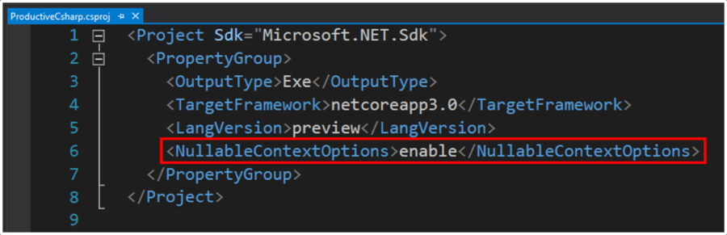
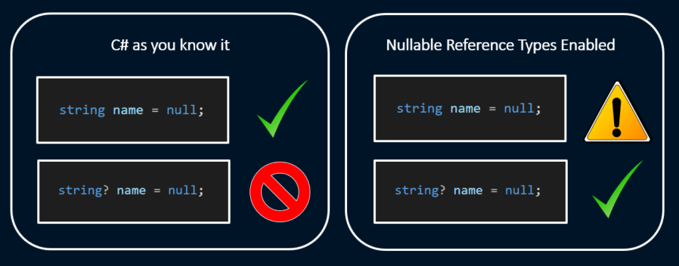
Nullable reference types
You need to enable this feature in the csproj file.

Slide 6
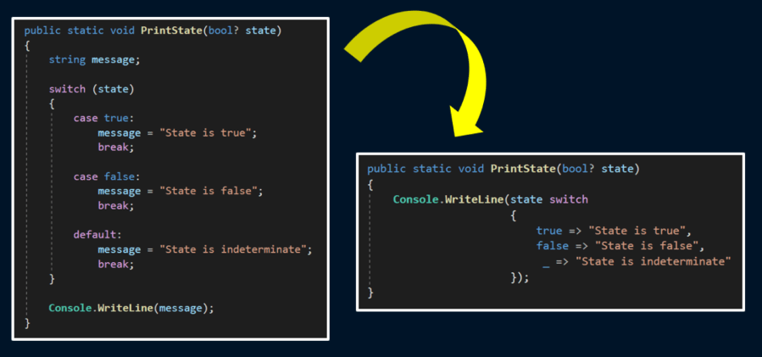
Switch expression with pattern matching
By the fact that is an expression you must always return a value.

Slide 7
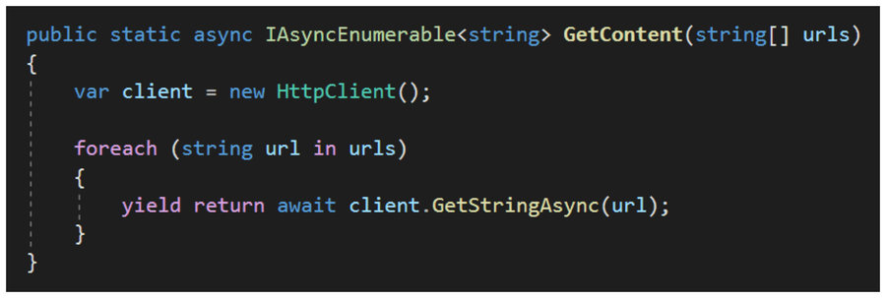
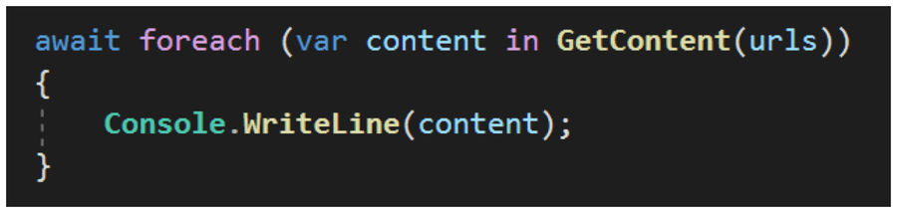
Async streams
https://www.youtube.com/watch?v=L6R08ajgZpU

Slide 8
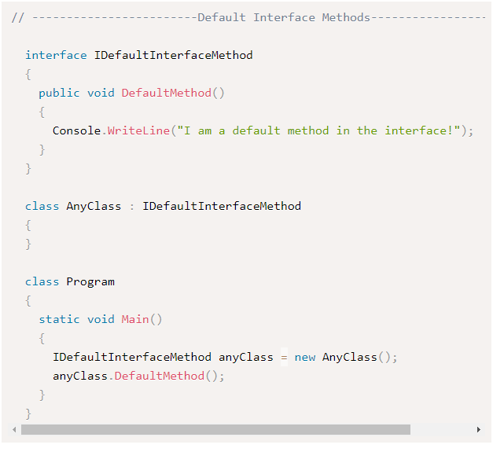
Default interface methods
You need at least the 16,1,1 of visual studio 2019 to make it work this feature.

Slide 9
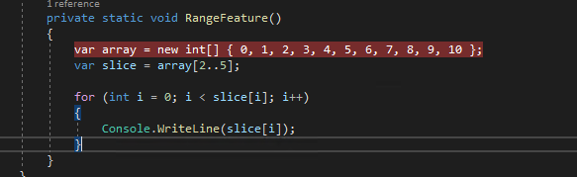
Ranges
You need at least the 16,1,1 of visual studio 2019 to make it work this feature.

Slide 10
Links
https://www.youtube.com/watch?v=L6R08ajgZpU
https://docs.microsoft.com/en-us/dotnet/csharp/whats-new/csharp-8#nullable-reference-types
https://www.codejourney.net/2019/02/csharp-8-default-interface-methods/
https://devblogs.microsoft.com/dotnet/take-c-8-0-for-a-spin/
https://buildazure.com/2019/05/15/top-3-features-c-8-will-change-way-write-code/
https://www.infoq.com/articles/cs8-ranges-and-recursive-patterns/
https://github.com/dotnet/roslyn/releases

