Slide 1

SOLID
Principles which help to create good software architecture

Slide 2
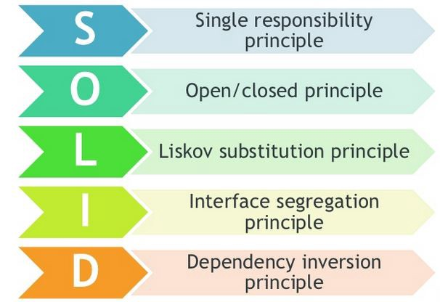
SOLID Principles
Make software more understandable, extendable, maintainable and testable.

Slide 3
Single Responsibility Principle

Slide 4
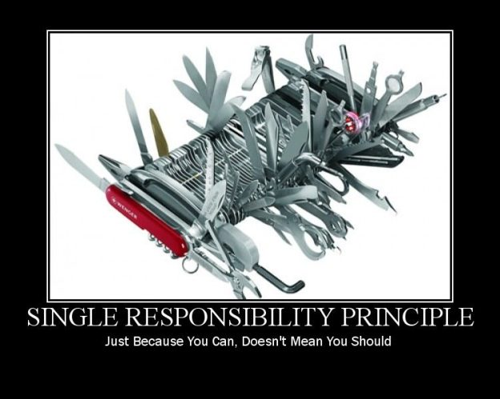
Single Responsibility Principle
Every module or class should have one, and only one responsibility in the software.
This responsibility should be fully encapsulated.
When you have more than one responsibility in a class, it will generate a coupled code in your application.
Use simple naming, long function names imply that there is something fishy.
Big is bad, small is good….

Slide 5
Single Responsibility Principle - Benefits
Low coupling.
When it’s necessary to change a class, this will not impact any other classes.
Maintainable software.
If your class implements multiple responsibilities, they are no longer independent of each other. With this principle you avoid it.
Save time doing a refactor. if you have a coupled code and it’s necessary to do a big change, it will be necessary to test all the app again.
Classes that have only one responsibility are much easier to explain, understand and implement than the ones that provide a solution for everything.
Writing tests for code with single responsibility is easier.
What is the responsibility of your class/component/?

Slide 6
Single Responsibility Principle - Examples
Wrong Practice
Implement SRP
Class User {
Public Id;
Public Name;
Public Age;
Public Email;
ValidateEmail();
ValidateUser();
SaveUser();
}
IEmailValidator {
{
Validate (string email);
};
IUserValidator {
{
// Business Rules
Validate (User userInfo);
};
IUserCreateService {
{
// The strategy to save the user can be changed
Save (User userInfo);
};

Slide 7
Open/Closed Principle

Slide 8
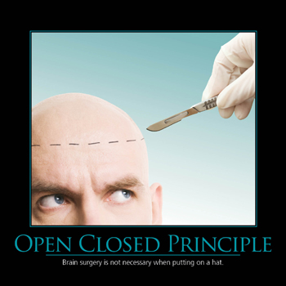
Open/Closed Principle
Bertrand Meyer wrote about Open/Closed in 1988 in his book Object-Oriented Software Construction.
“Software entities (classes, modules, functions, etc.) should be open for extension, but closed for modification.”
BUT He proposes to use inheritance:
“A class is closed, since it may be compiled, stored in a library, baselined, and used by client classes. But it is also open, since any new class may use it as parent, adding new features. When a descendant class is defined, there is no need to change the original or to disturb its clients.”
Object Oriented Software Construction: https://www.amazon.es/Object-Oriented-Software-Construction-Prentice-Hall-Resource/dp/0136291554

Slide 9

Open/Closed Principle
Bertrand Meyer wrote about Open/Closed in 1988 in his book Object-Oriented Software Construction.
“Software entities (classes, modules, functions, etc.) should be open for extension, but closed for modification.”
BUT He proposes to use inheritance:
“A class is closed, since it may be compiled, stored in a library, baselined, and used by client classes. But it is also open, since any new class may use it as parent, adding new features. When a descendant class is defined, there is no need to change the original or to disturb its clients.”
it generates coupling issues, if the subclasses depends on details of the superclass
Object Oriented Software Construction: https://www.amazon.es/Object-Oriented-Software-Construction-Prentice-Hall-Resource/dp/0136291554

Slide 10
Open/Closed Principle
Robert C. Martin (1996) and others redefined the Open/Closed Principle base on polymorphism. Keep the concepts:
you will be able to add new functionality without changing the existing code
Change one class doesn’t mean change the classes that depends on it
BUT The interfaces are closed for modifications, and you can provide new implementations to extend the functionality of the software.
Polymorphic : the ability of a variable, function or object to take on multiple forms

Slide 11
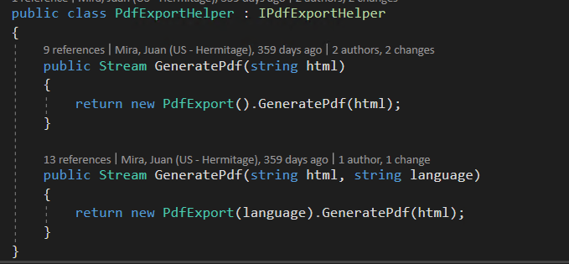
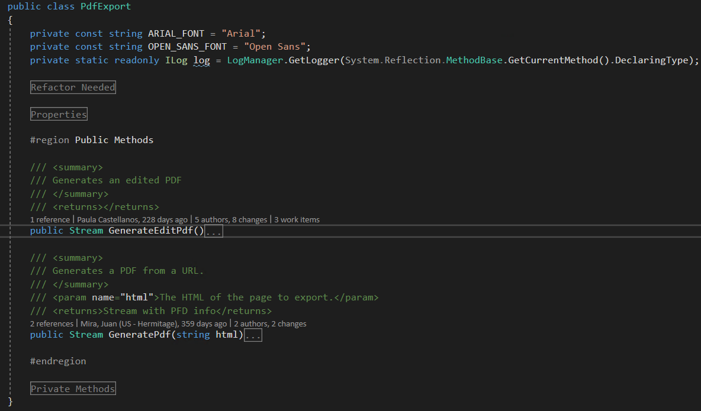
Sometimes, we forgot Open/Closed Principle ☹

Slide 12
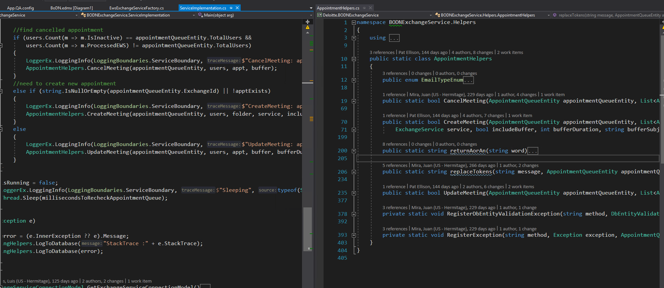
Sometimes, we forgot Open/Closed Principle ☹

Slide 13
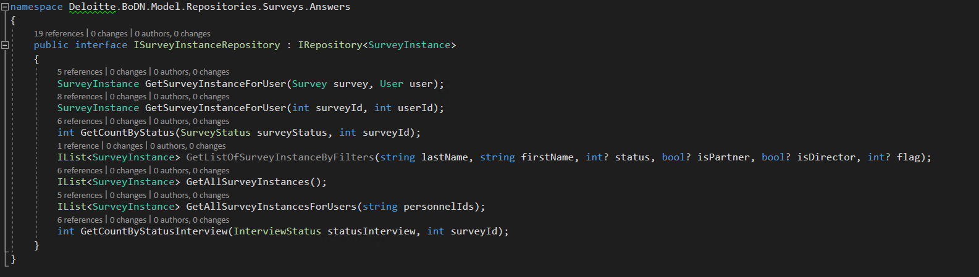
Sometimes, we remember Open/Closed Principle ☺ ☺

Slide 14
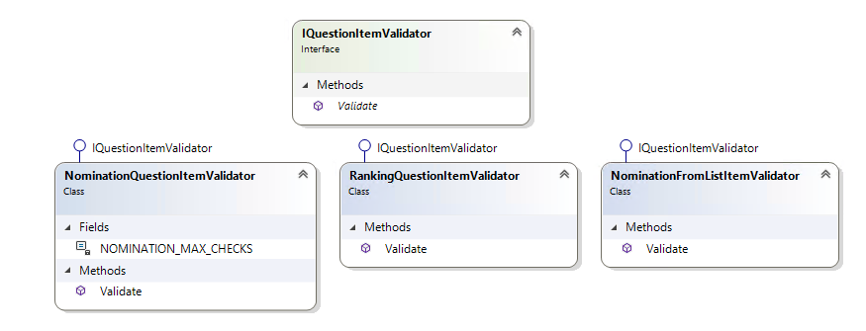
Sometimes, we remember Open/Closed Principle ☺ ☺

Slide 15
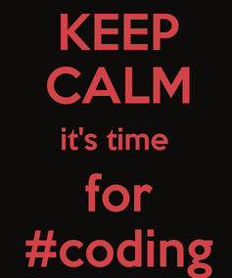


Let’s check
an example ☺ ☺ ☺

Slide 16

File Printer Sample
Simple program that allows to “print” a PDF file

Slide 17

File Printer Sample
Simple program that allows to “print” a PDF file
Now the client wants to “print” a friendly message while the PDF is been generating
Single responsibility AWESOME!!!
But what happens with the Open/Closed principle?

Slide 18
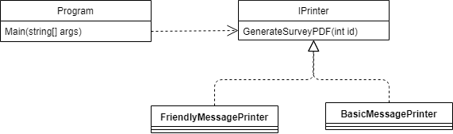
File Printer Sample
Now the client wants both message and they are thinking about the third one
Let’s keep Single responsibility and Open/closed principles

Slide 19
Liskov Substitution Principle

Slide 20
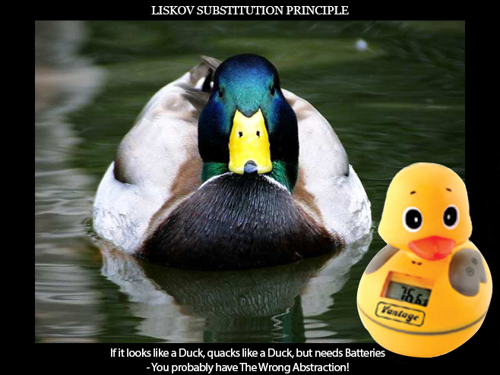
What is LSP?
Named for Barbara Liskov, who first described the principle in 1988.
“Subtypes must be substitable for their base types”

Slide 21
What is LSP?
Always for inheritance we read and use the IS-A to describe child classes.
LSP suggest that we should replace this with IS-SUBSTITABLE-FOR
Also, frequently uses unit test to specify expected behaviour of a method or class.
foreach (var emp in Employees)
{
if (emp is Manager)
{
……
}
if (emp is External)
{
……
}
}

Slide 22
Interface Segregai Principle

Slide 23
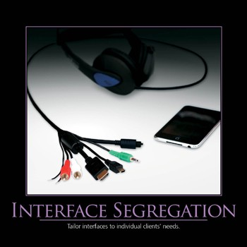

Interface Segregation Principle
The interface-segregation principle (ISP) states that no client should be forced to depend on methods it does not use.
Correct abstraction is the key to Interface Segregation Principle
Keep cohesion
It’s important to kwon the business domain
This principle is easy to violate

Slide 24
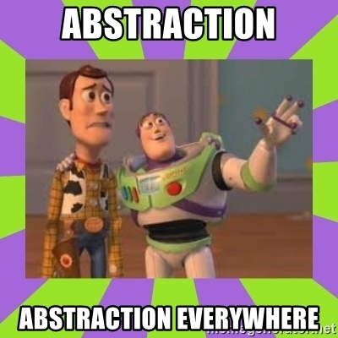
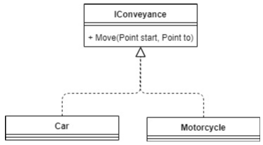
Interface Segregation Principle

Slide 25
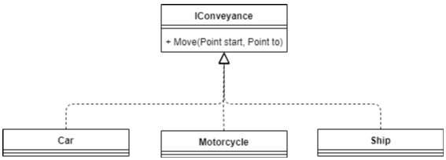
Interface Segregation Principle
“Do really need all the methods on this interface I’m using? If not, how can I break them into smaller interfaces?”.

Slide 26
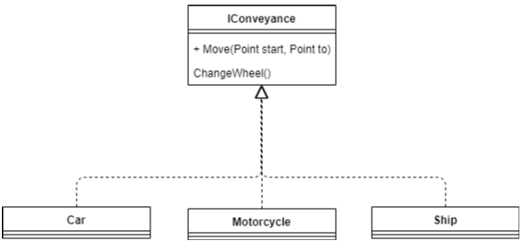
Interface Segregation Principle
“Do really need all the methods on this interface I’m using? If not, how can I break them into smaller interfaces?”.

Slide 27
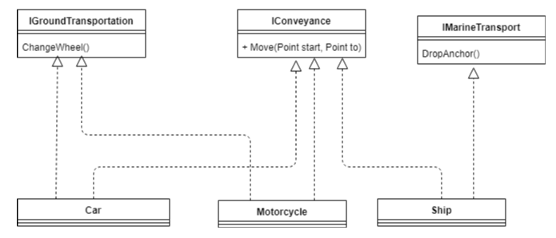
Interface Segregation Principle
“Do really need all the methods on this interface I’m using? If not, how can I break them into smaller interfaces?”.

Slide 28
Dependency Inversion

Slide 29


Dependency Inversion Principle
DIP States:
High level modules should not depend upon low level modules. Both should depend upon abstractions.
Abstractions should not depend upon details. Details should depend upon abstractions.
By Robert C. Martin 1995

Slide 30
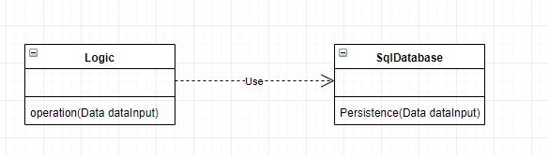
Normal Implementation (Not good)
Some issues:
The classes are strongly coupled. If now I want to store the data in an Oracle or MySQL database I have to modify the code of the Logic class. it means I am forced to make changes in an important and stable class, Logic, because of a modification in a less stable, the way of storing that data.
Difficulty to test. I can not easily test the 'operation' method of the 'Logic' class without using the database.

Slide 31
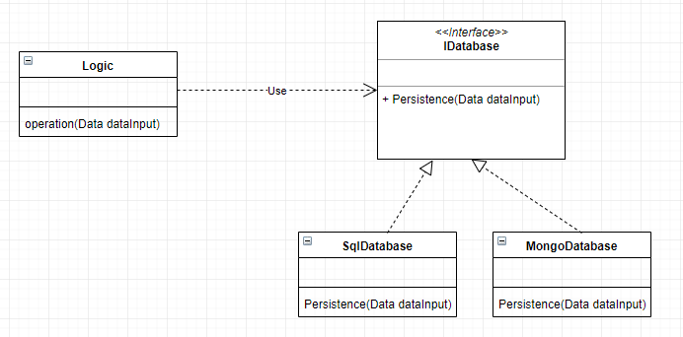
Good Implementation

Slide 32
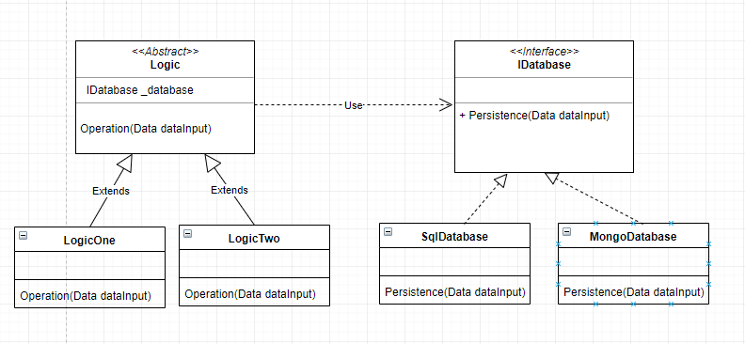
Improve Implementation

