Slide 1
Military, Health, and Education Spending (2015-2020)
Peter Castle

Slide 2
Dataset
SIPRI
Military Spending in Absolute
Military Spending Per Capita
Military Spending as Percent of GDP
World Bank
Education Spending as Percent of GDP
Healthcare Spending as Percent of GDP
Healthcare Spending Per Capita
GDP
GDP Per Capita
Population

Slide 3
Custom Dataframes
Education Spending
(Education Percent of GDP) / (100) * (GDP)
Healthcare Spending
(Healthcare Spending Per Capita) * (Population)

Slide 4
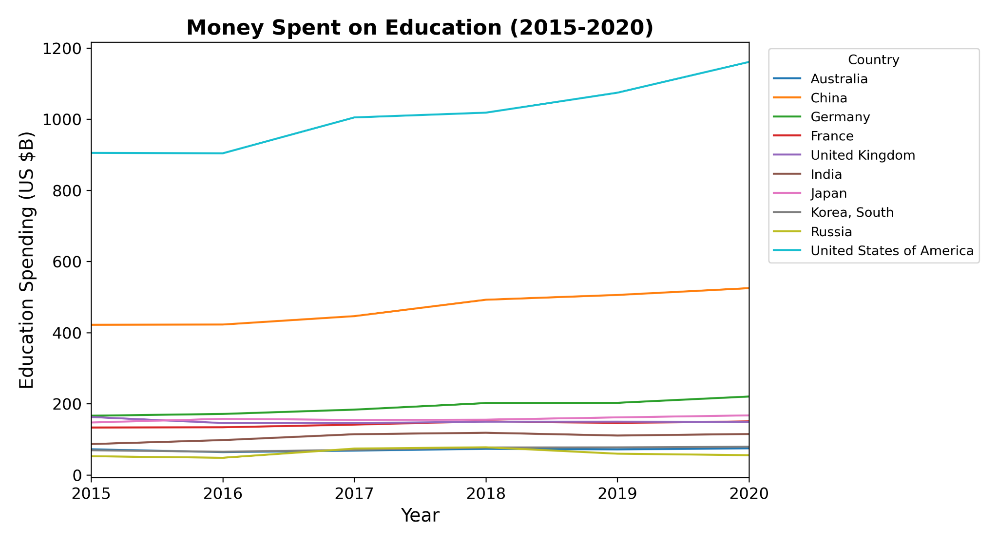
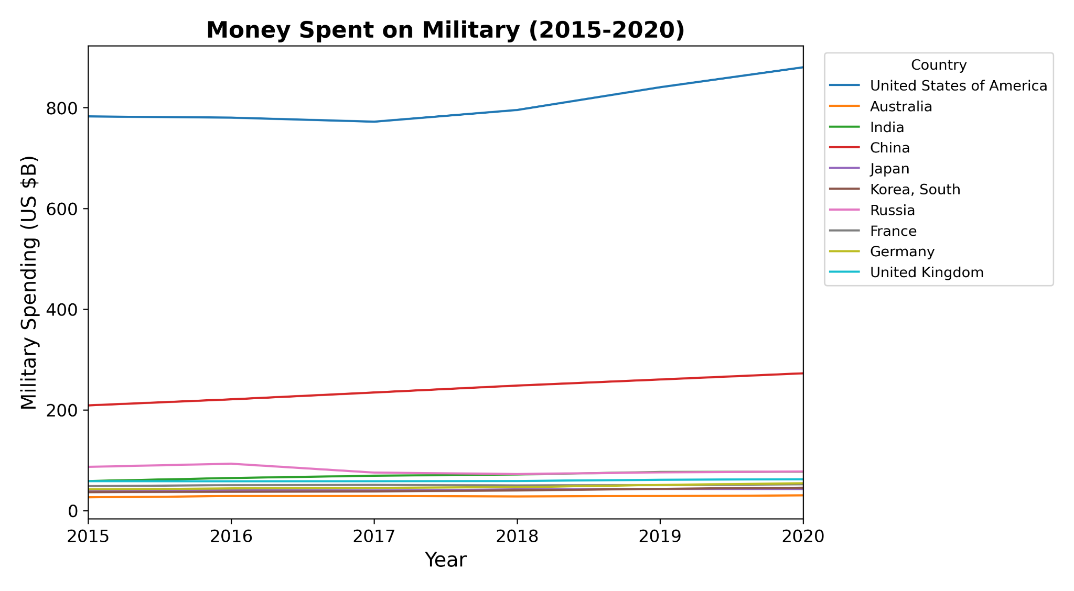
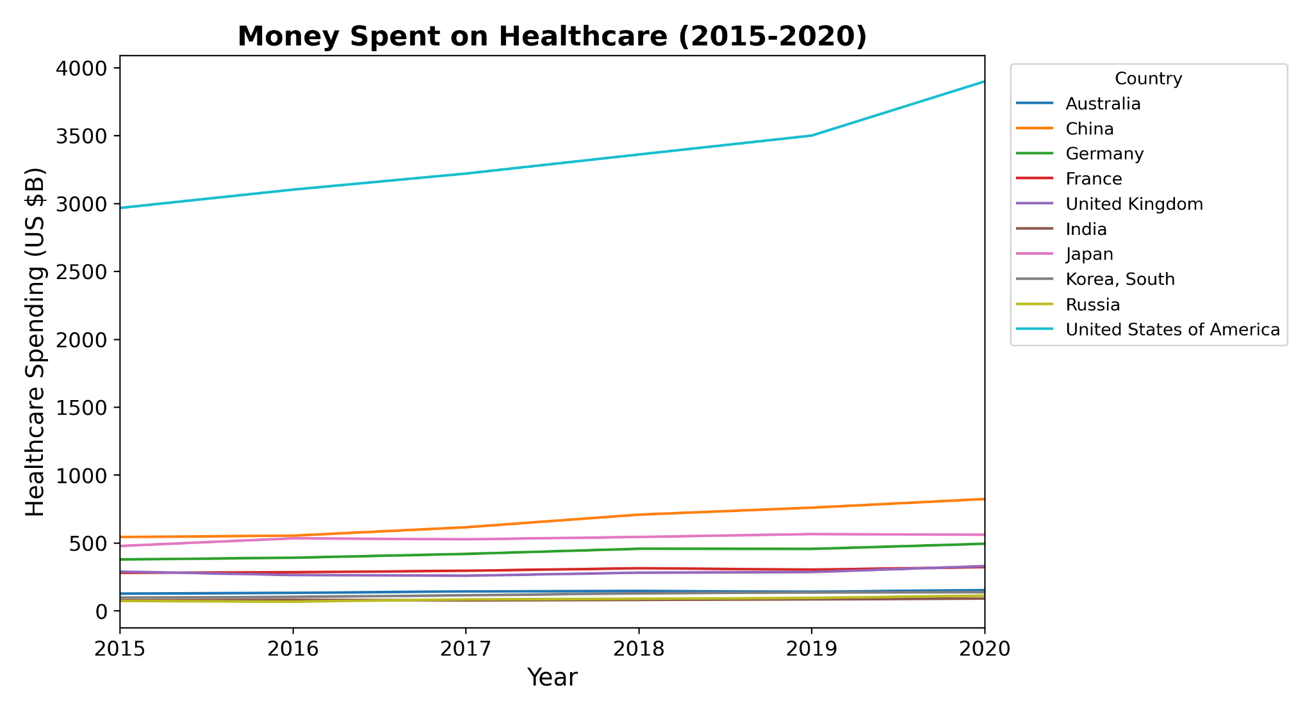
Money Spent Per Category

Slide 5
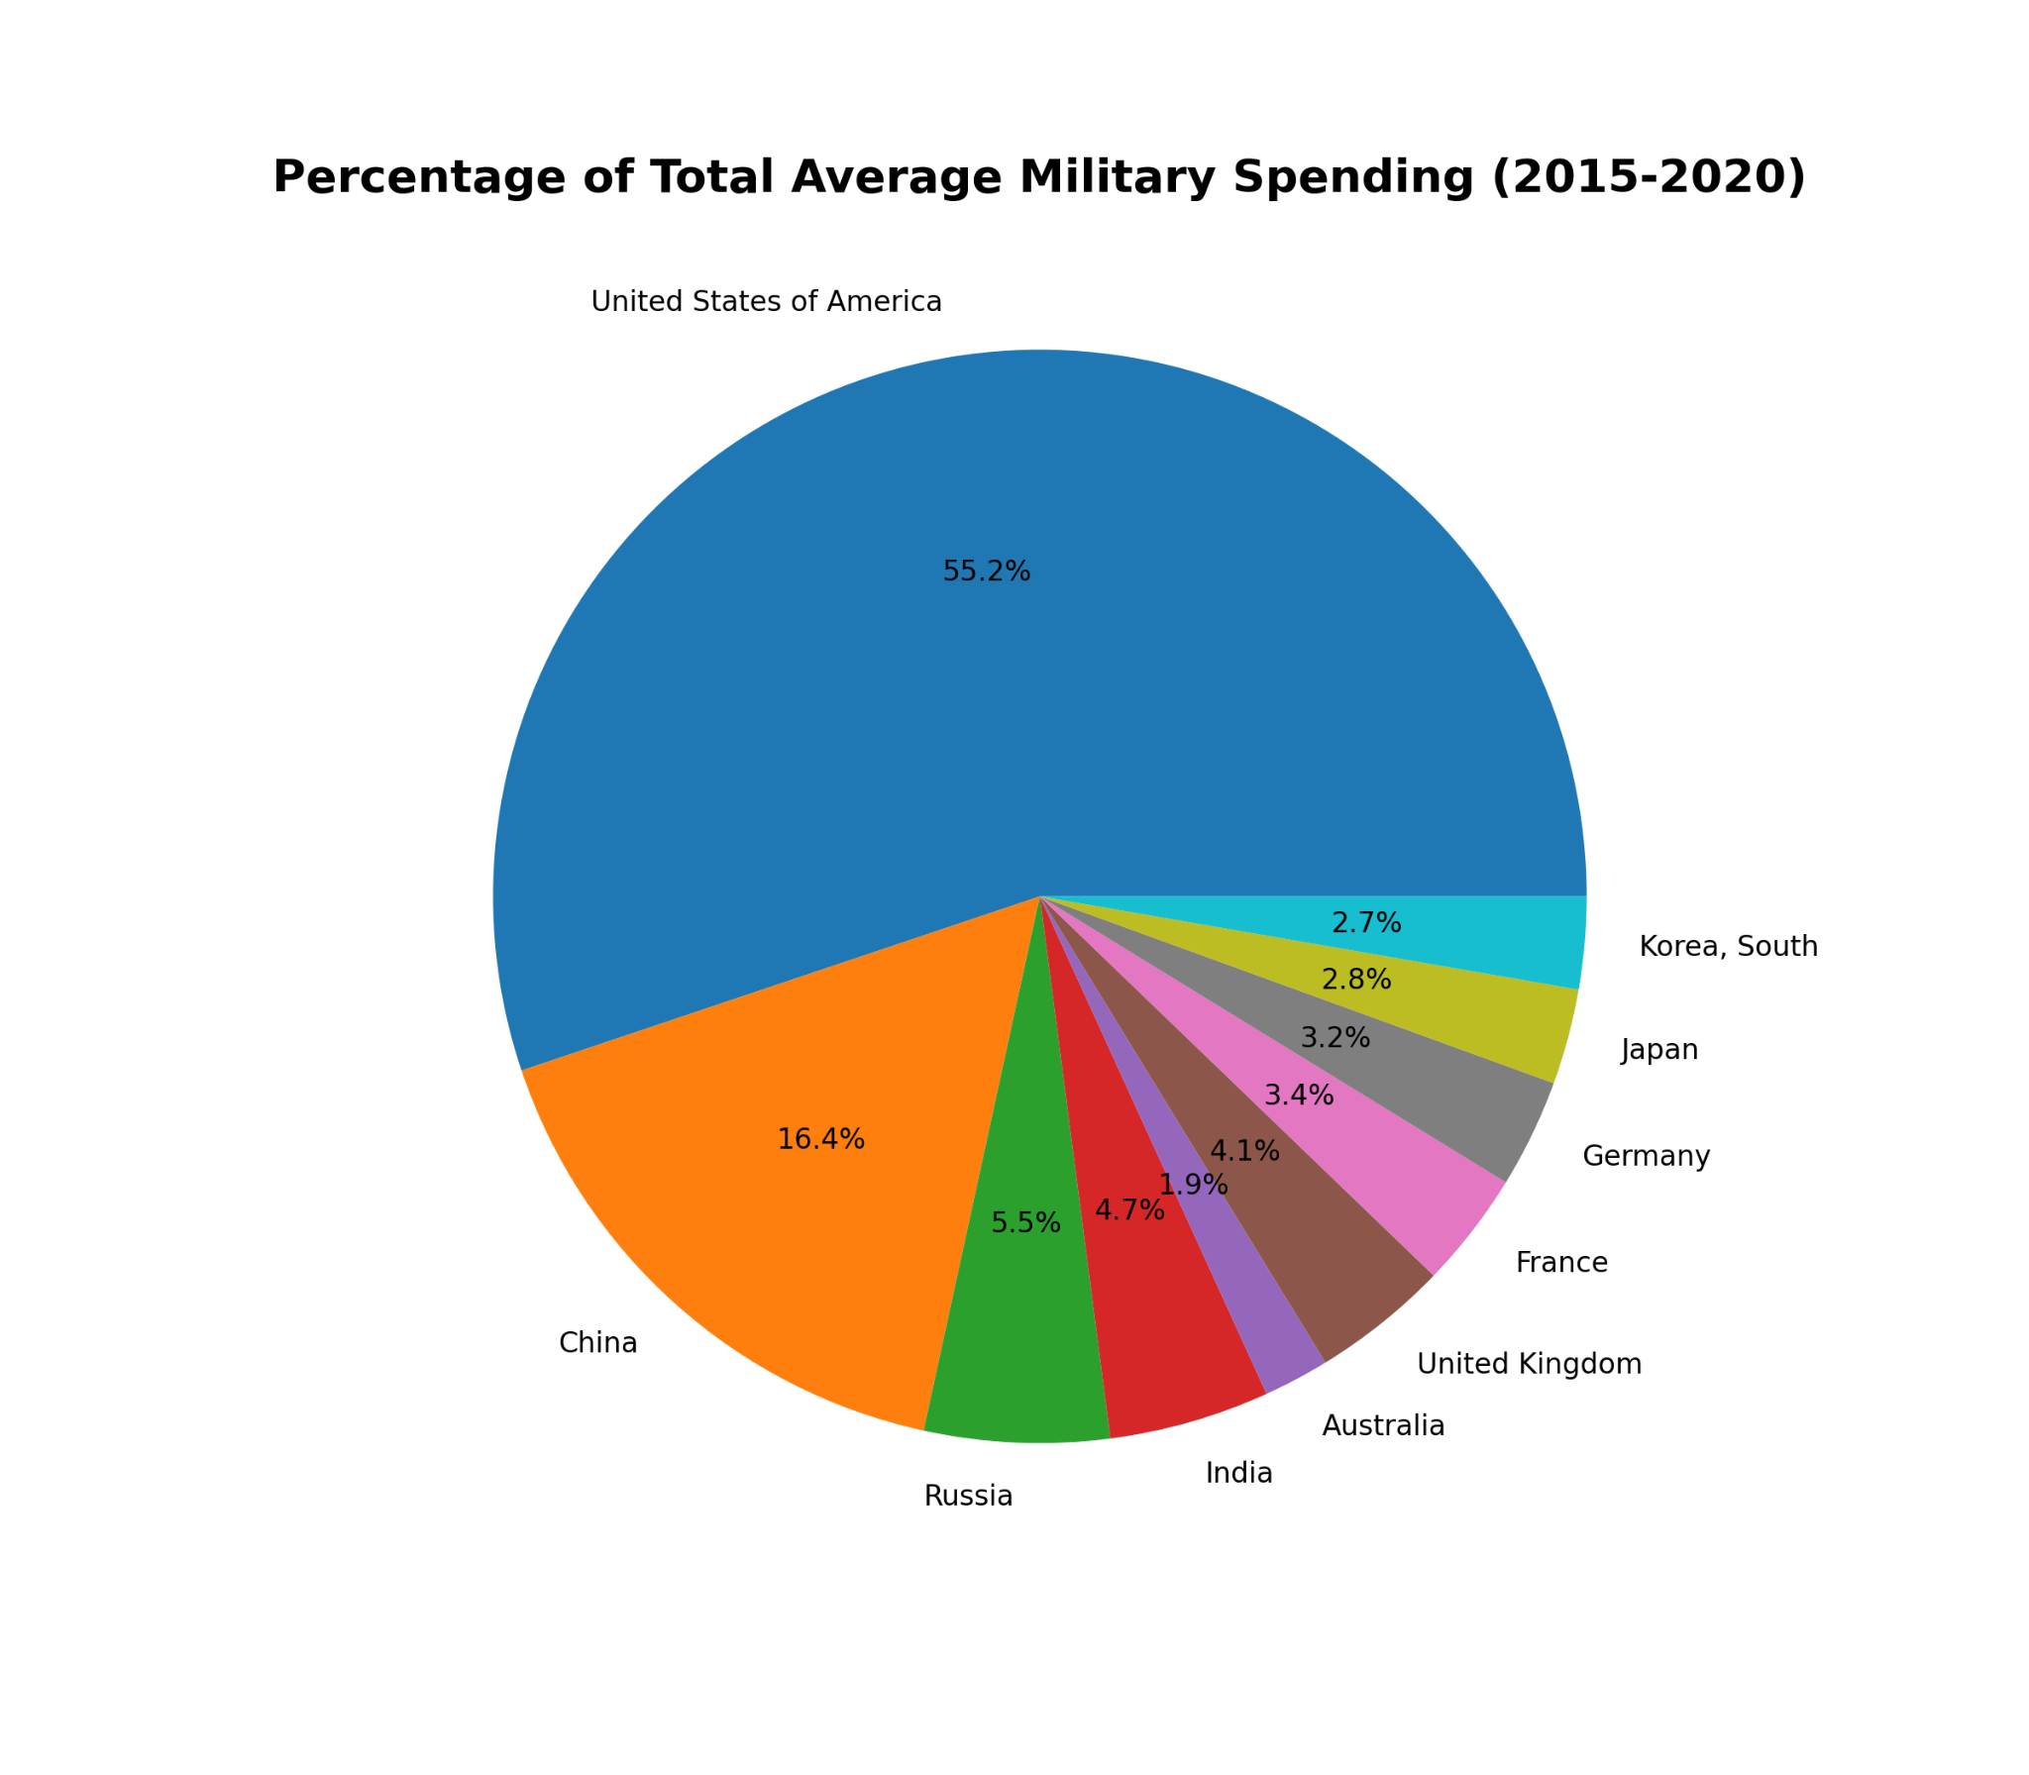
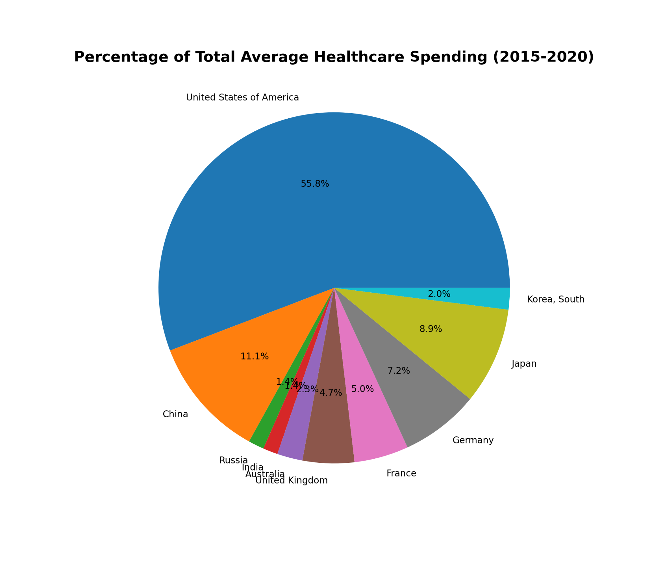
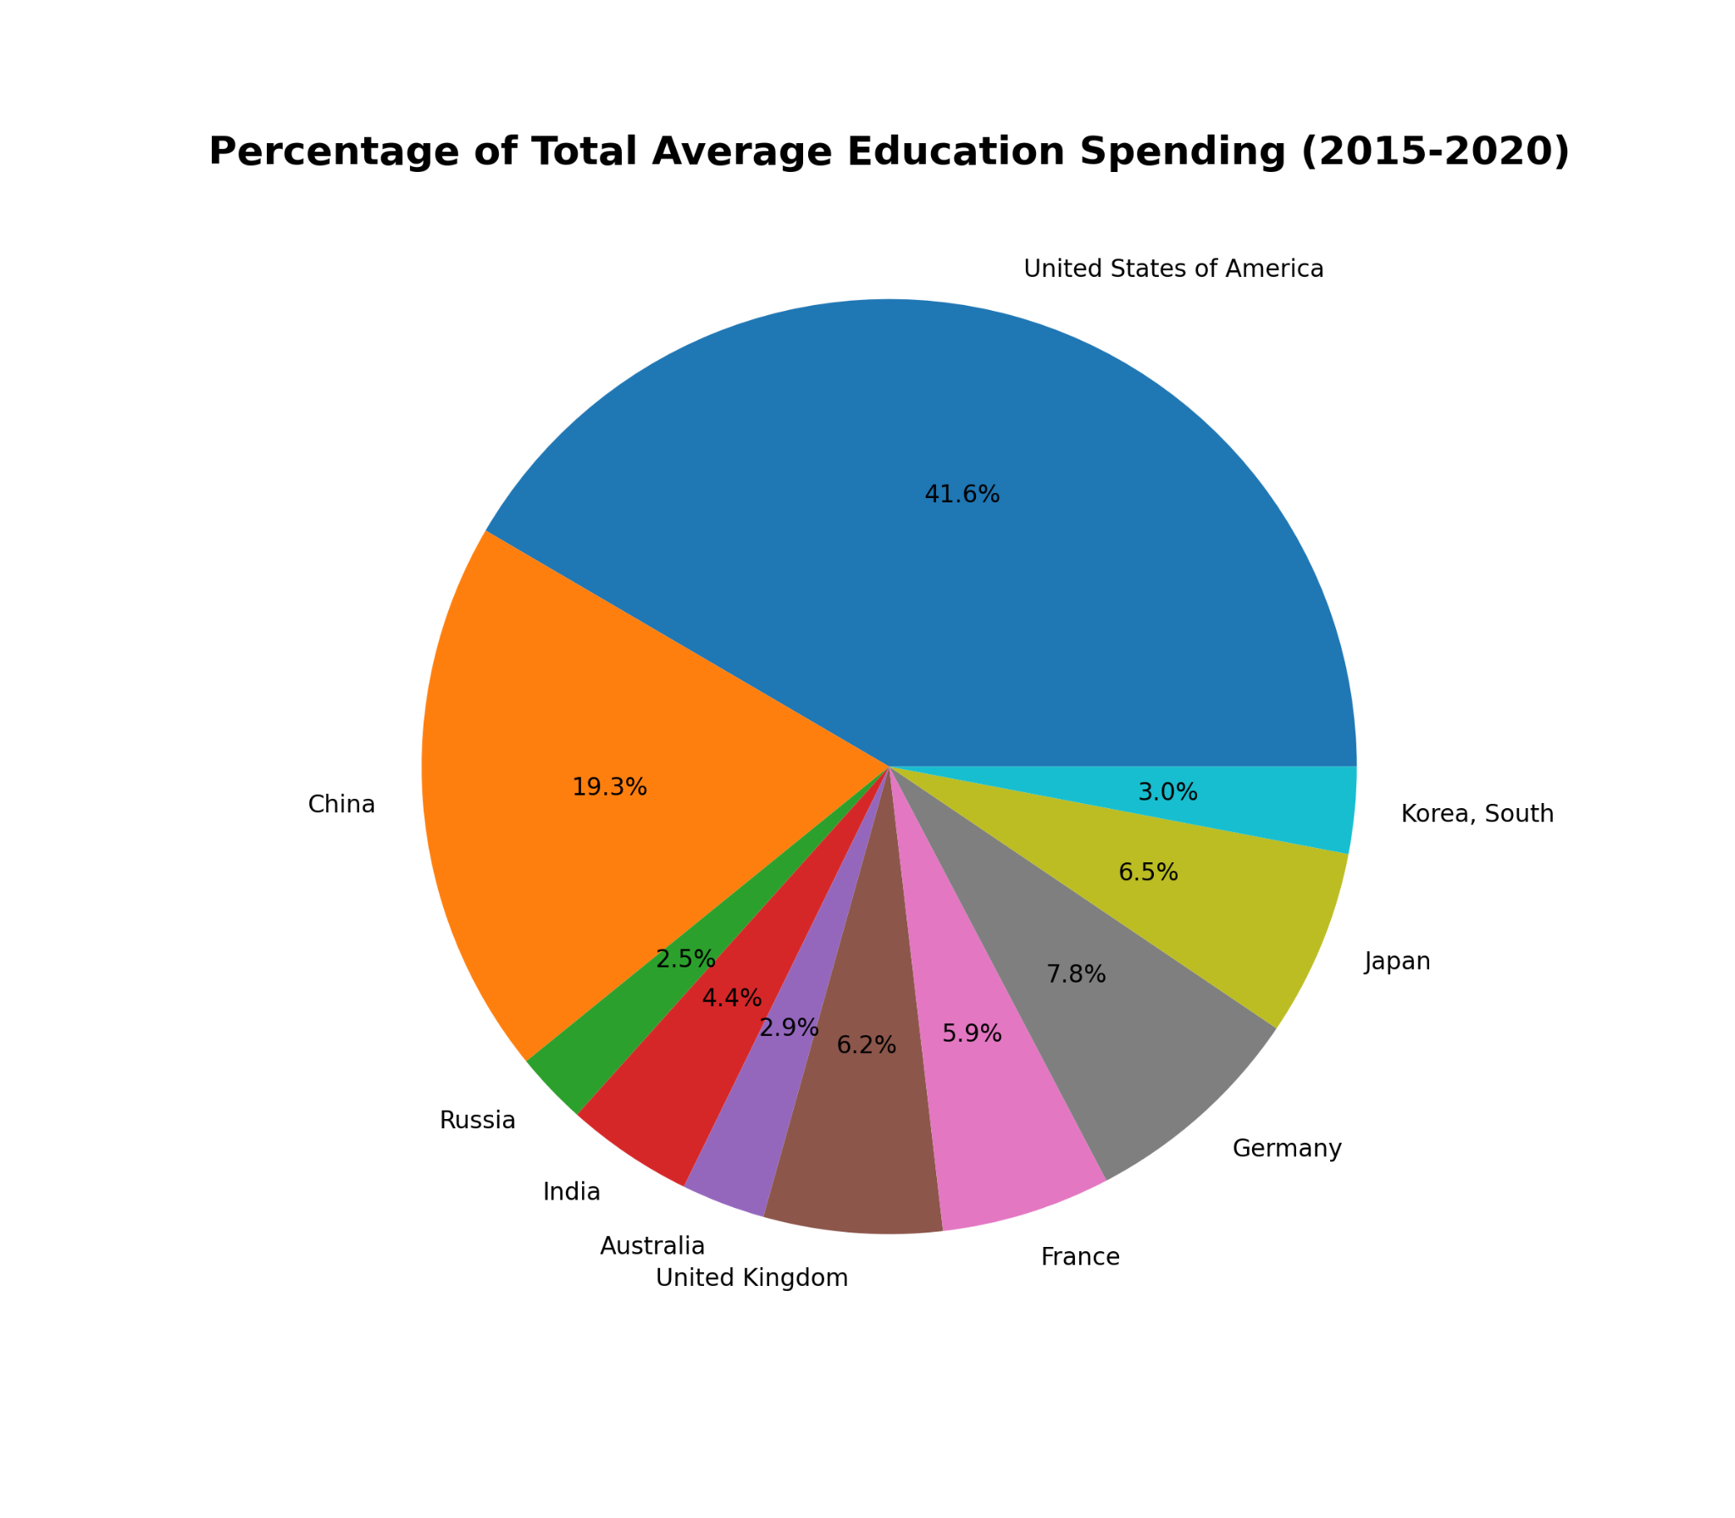
Percentage of Total Average Spending Per Category

Slide 6
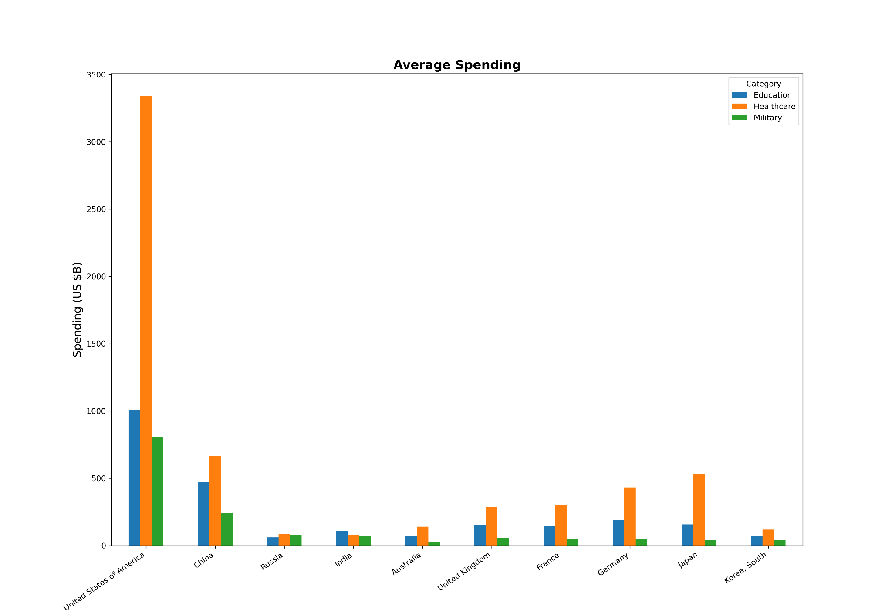

Slide 7
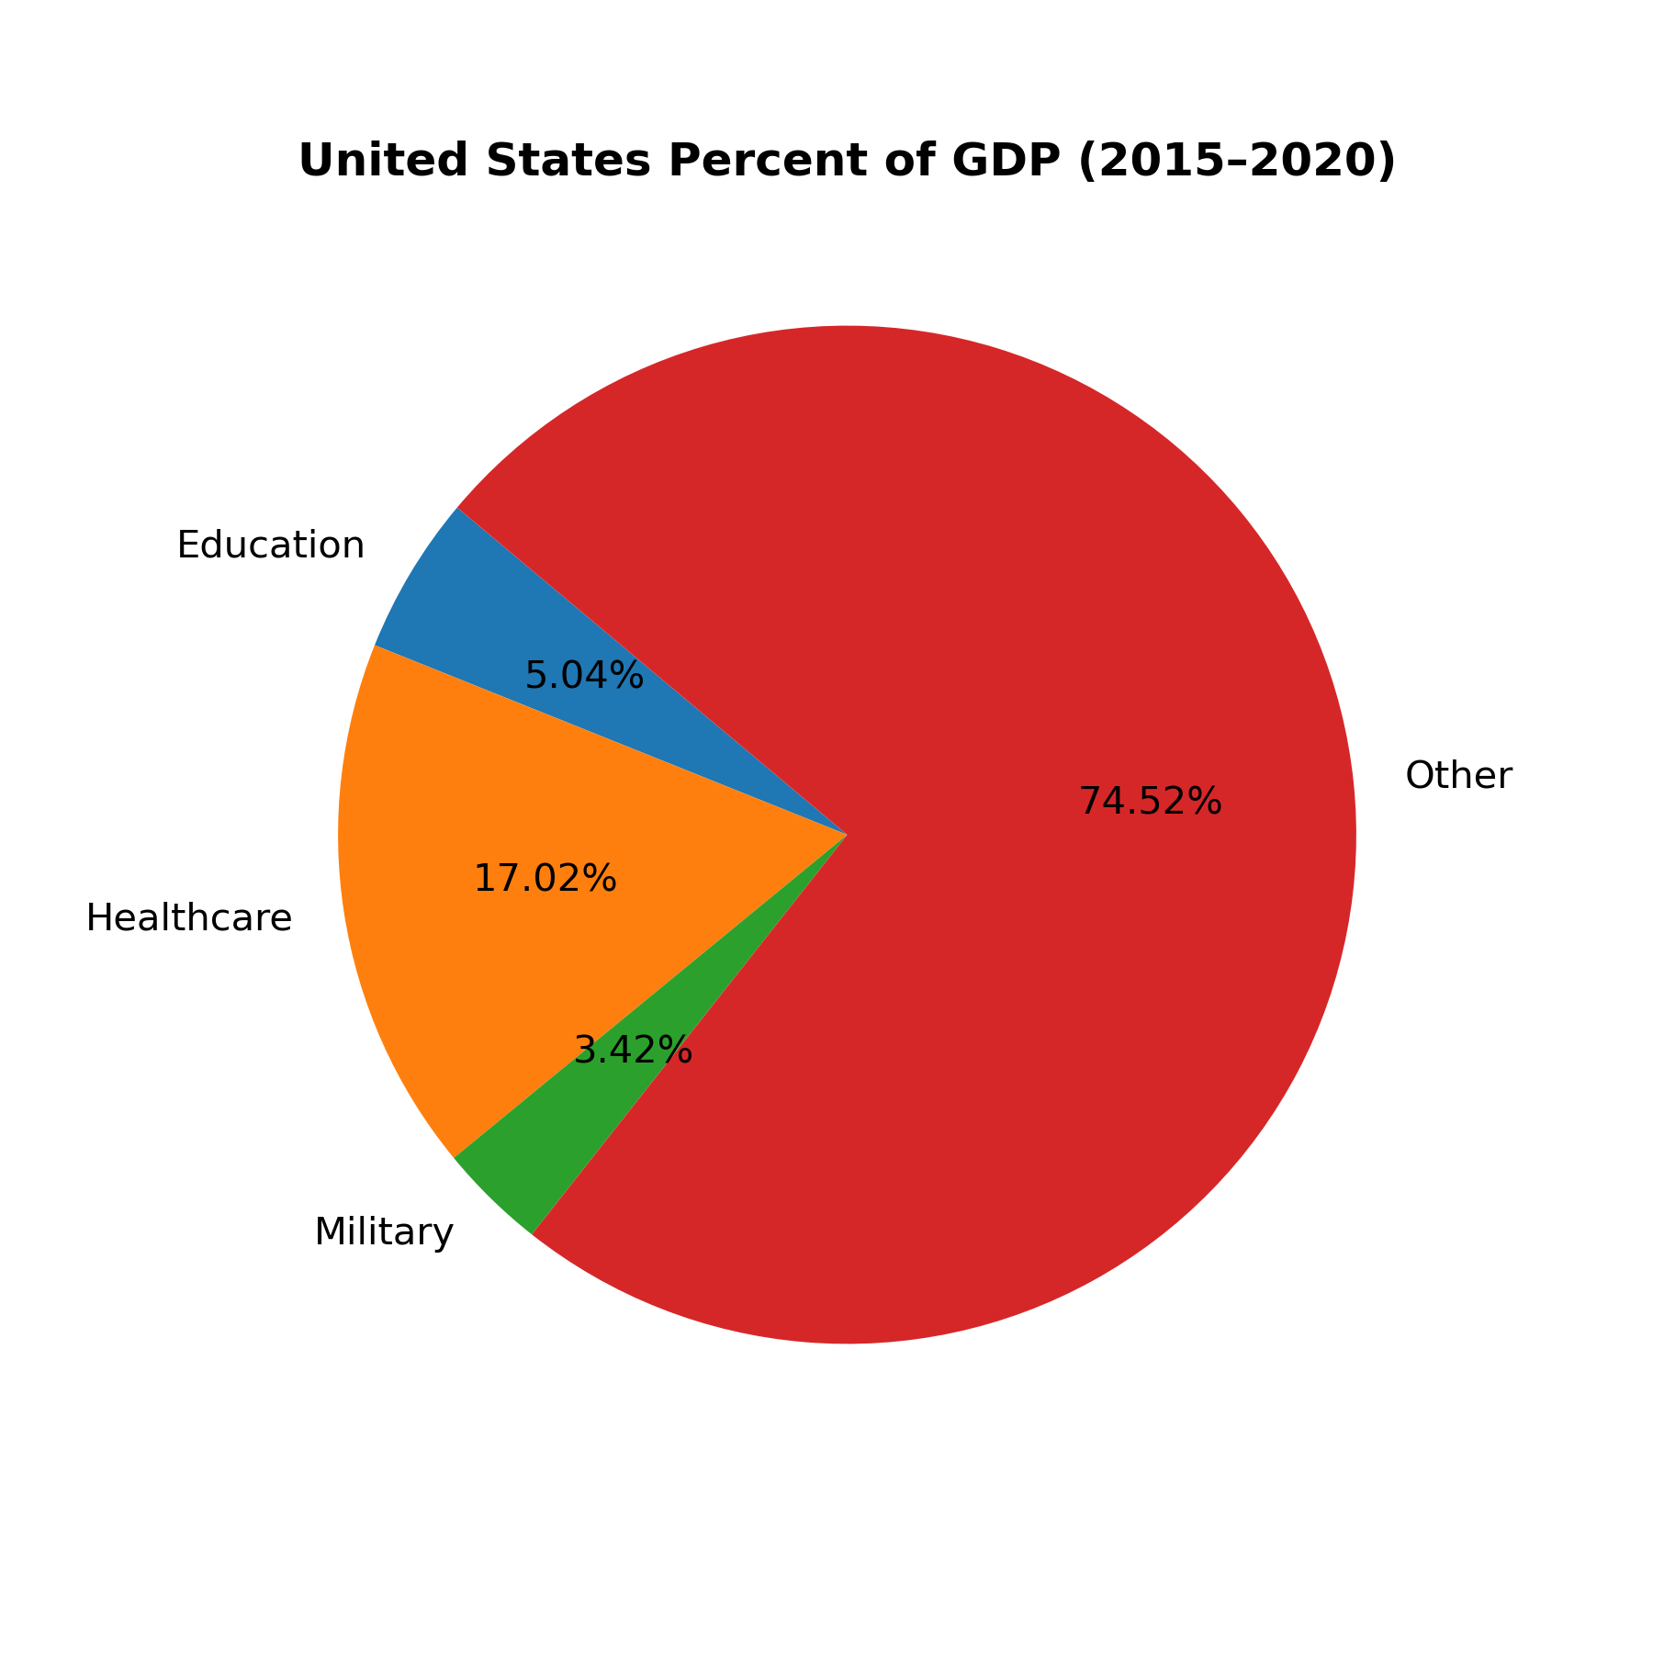
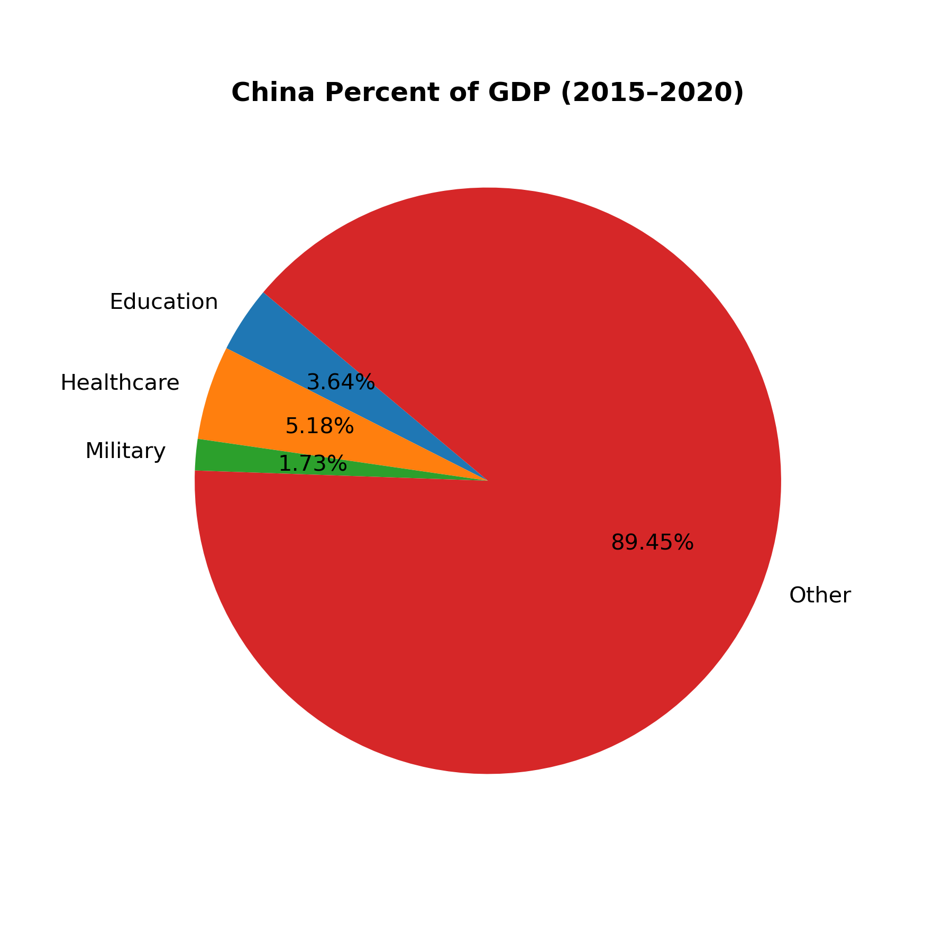

Slide 8
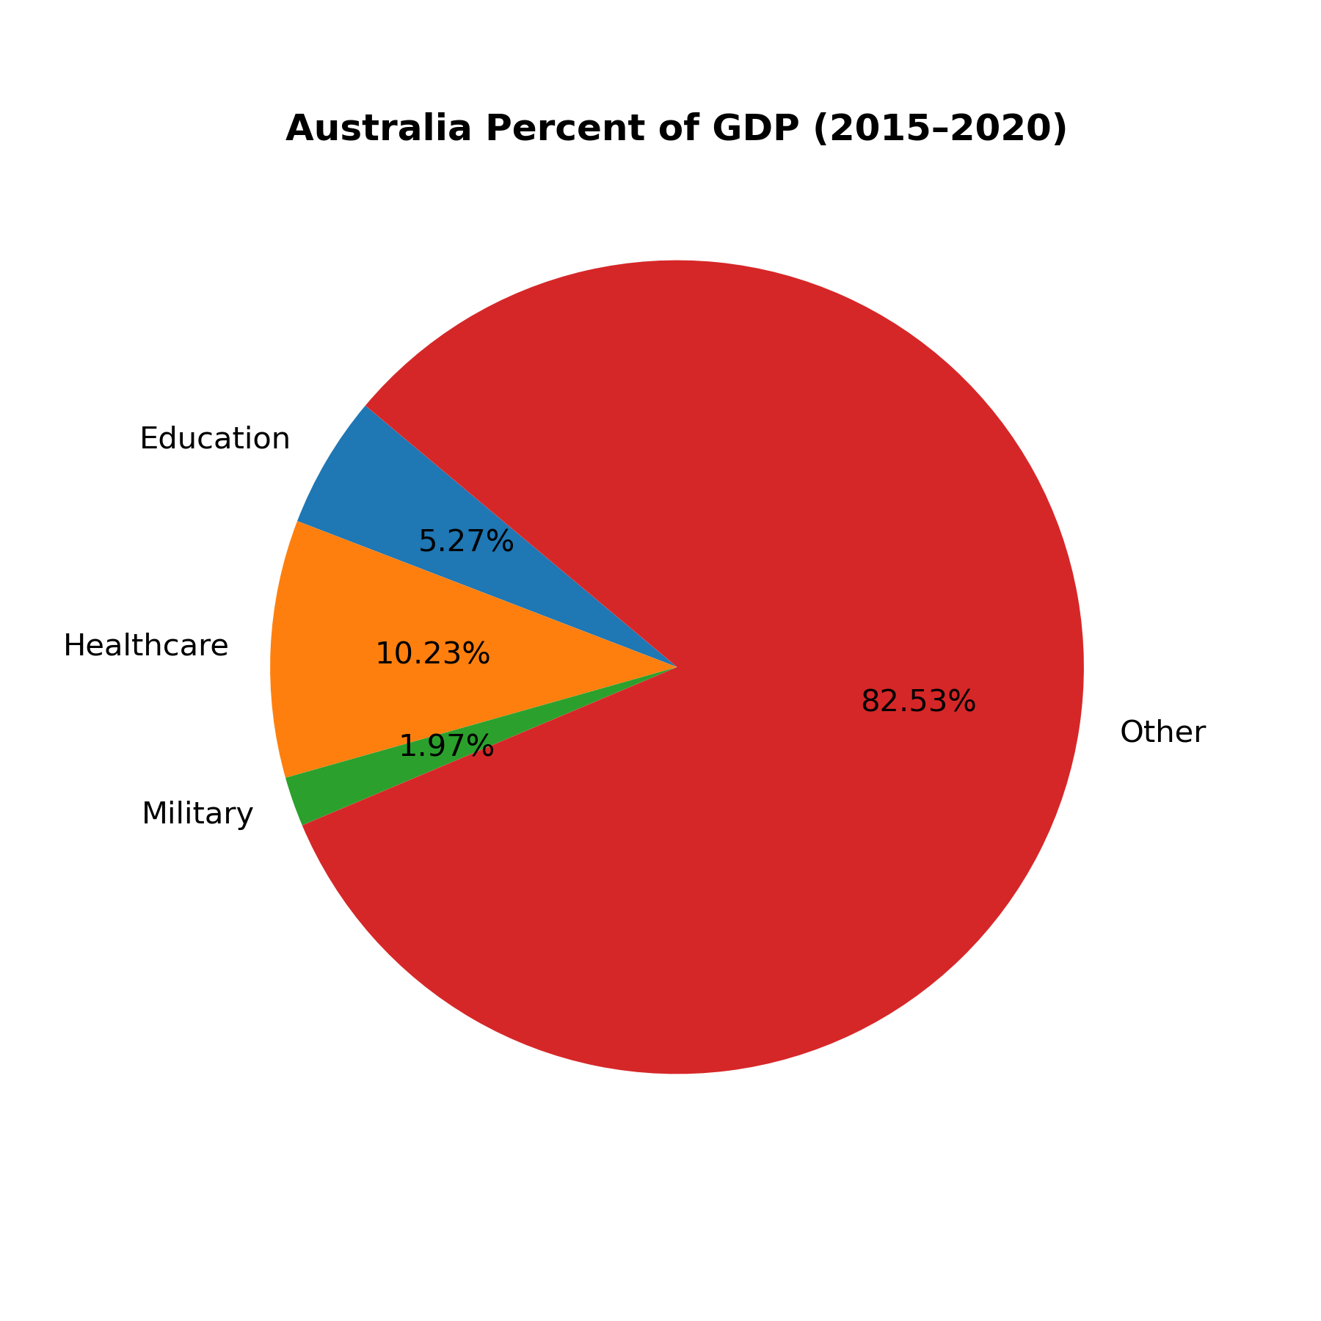
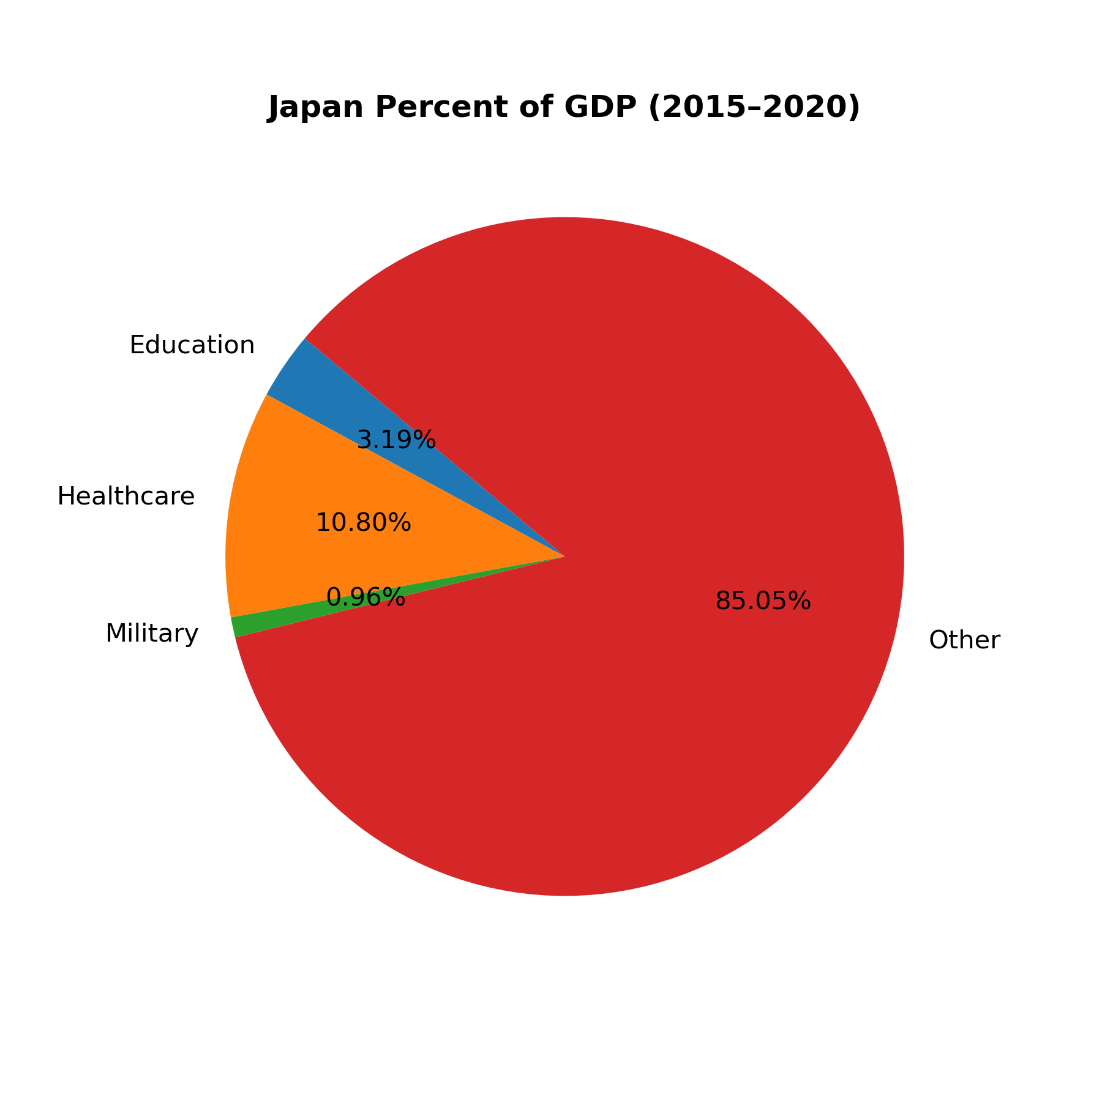
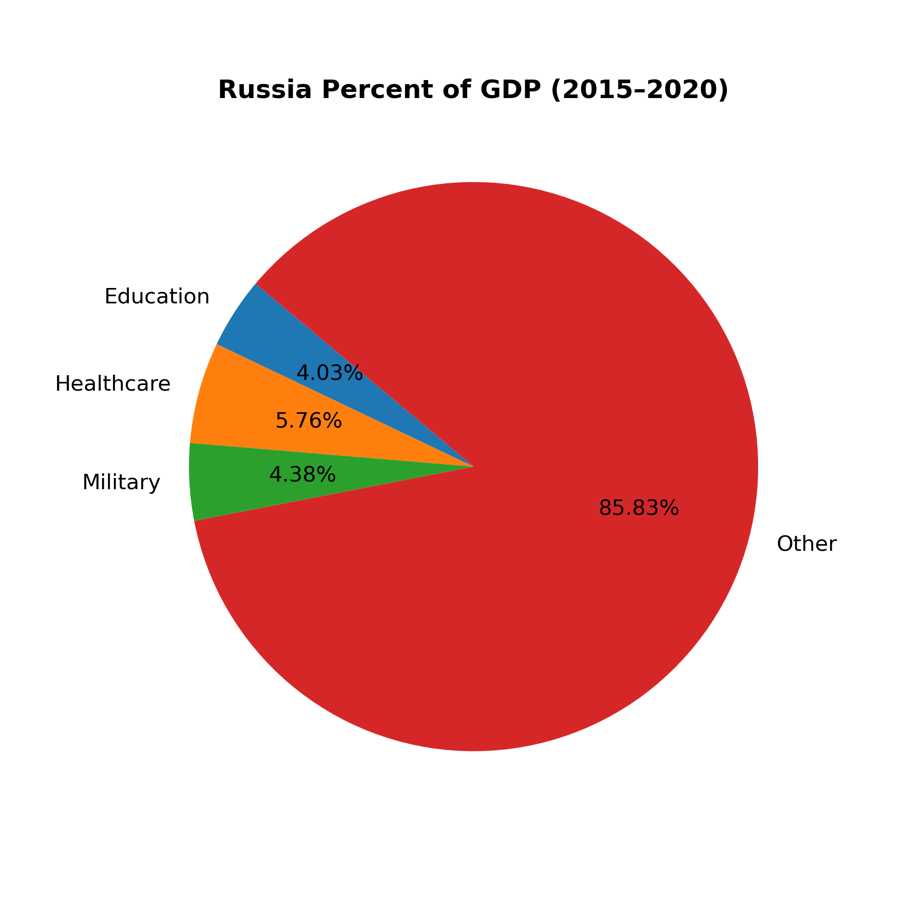
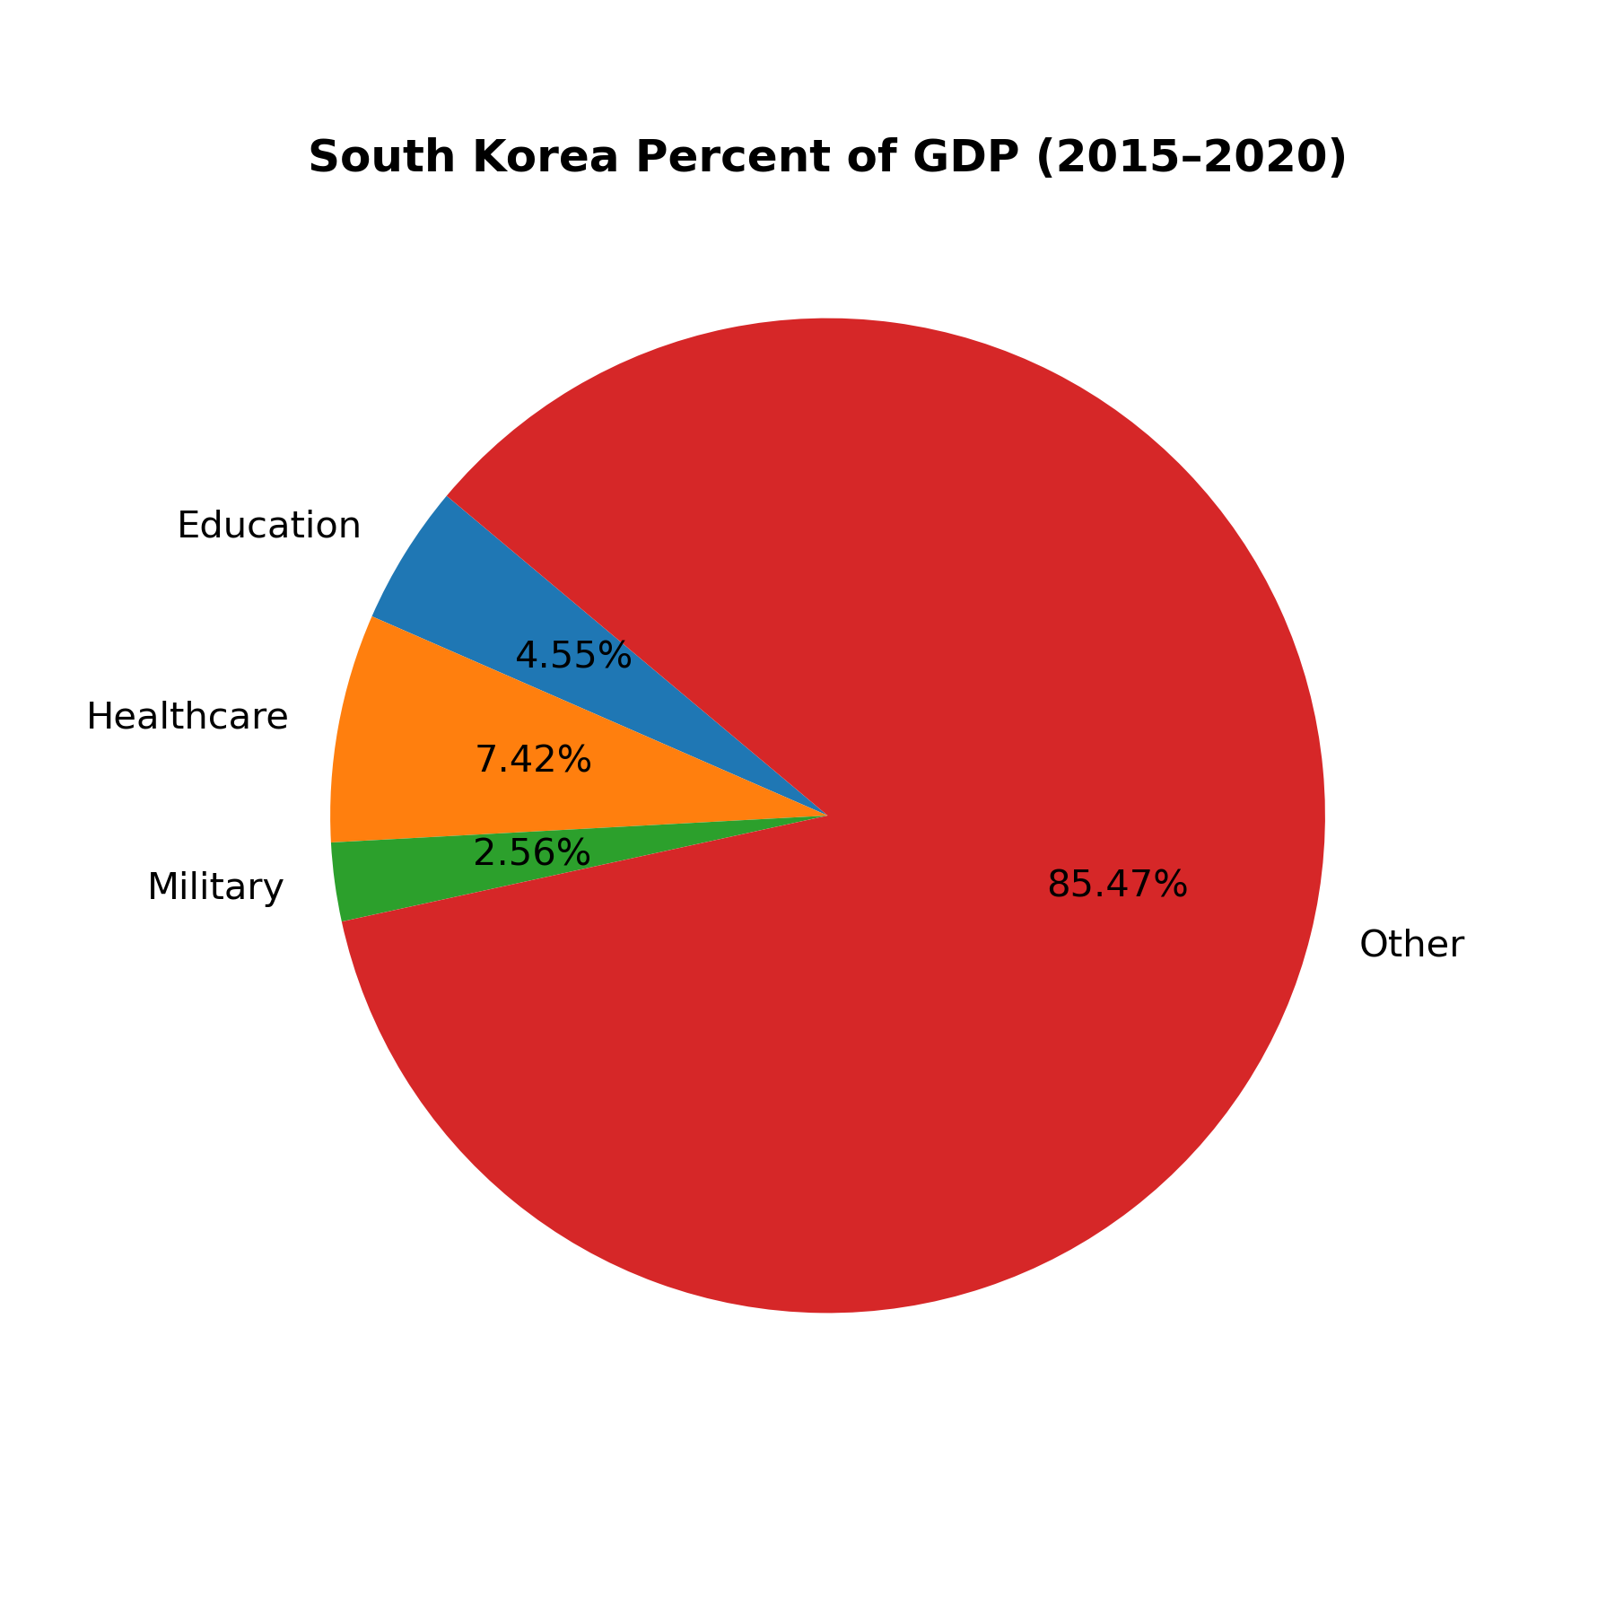
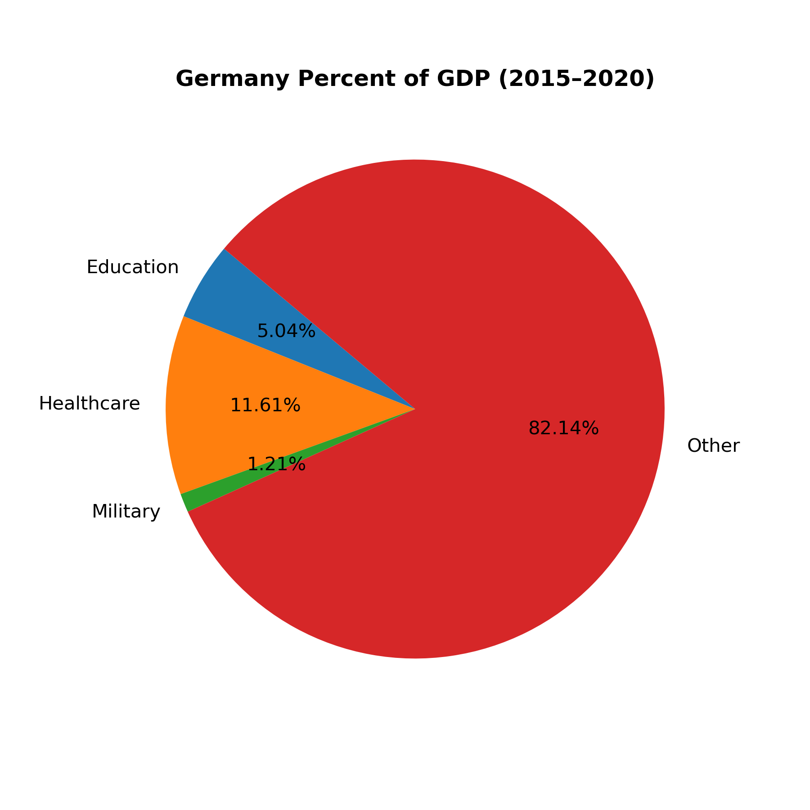
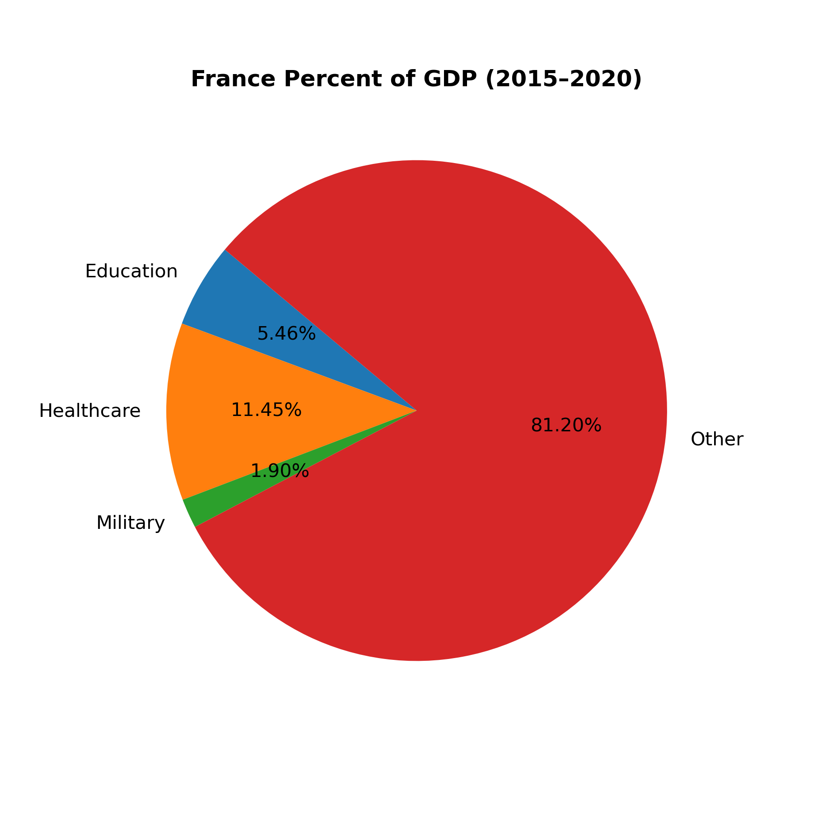
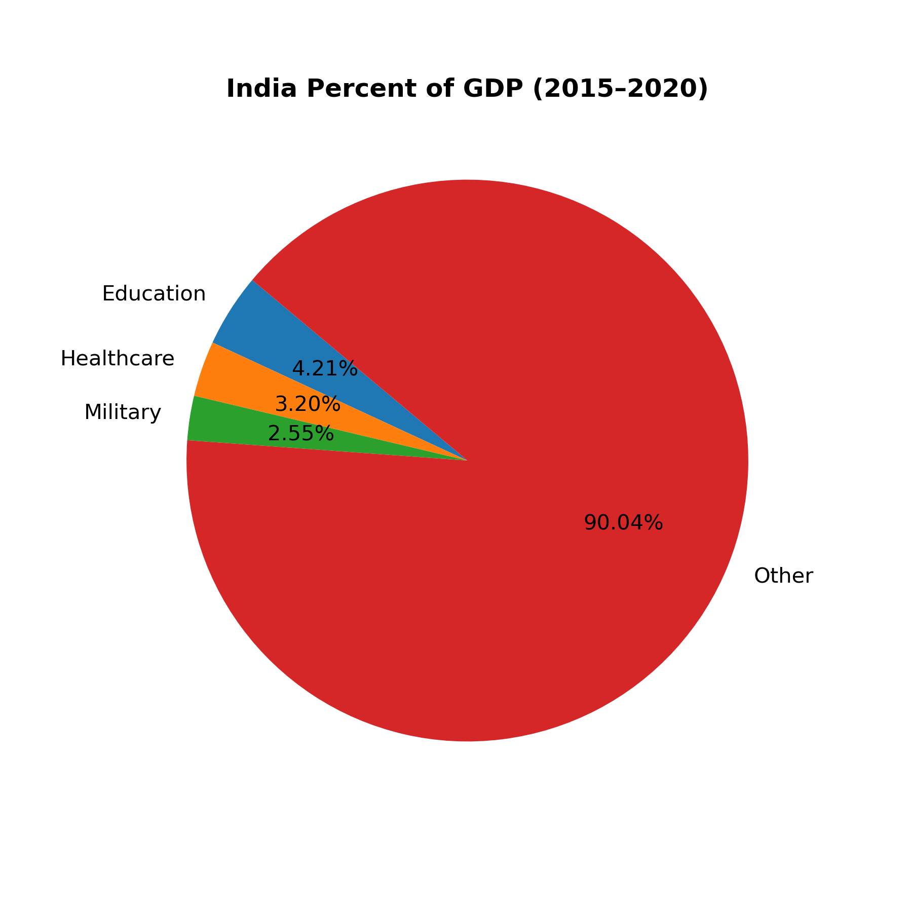
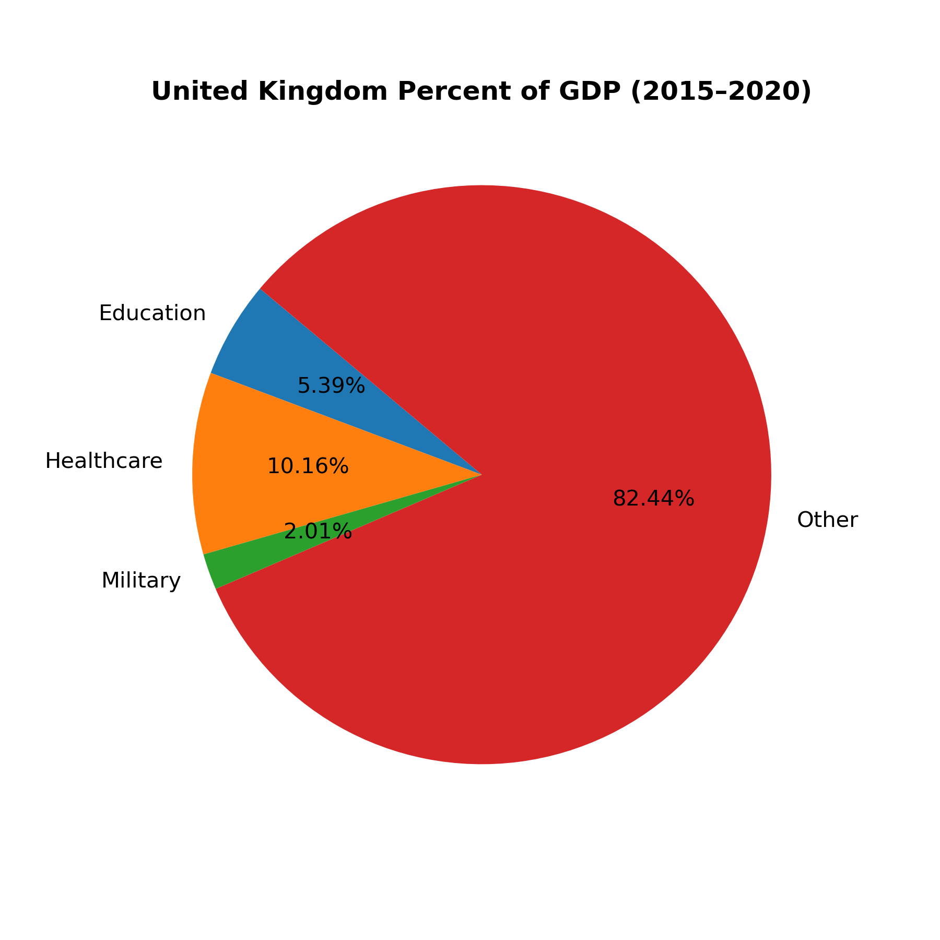

Slide 9
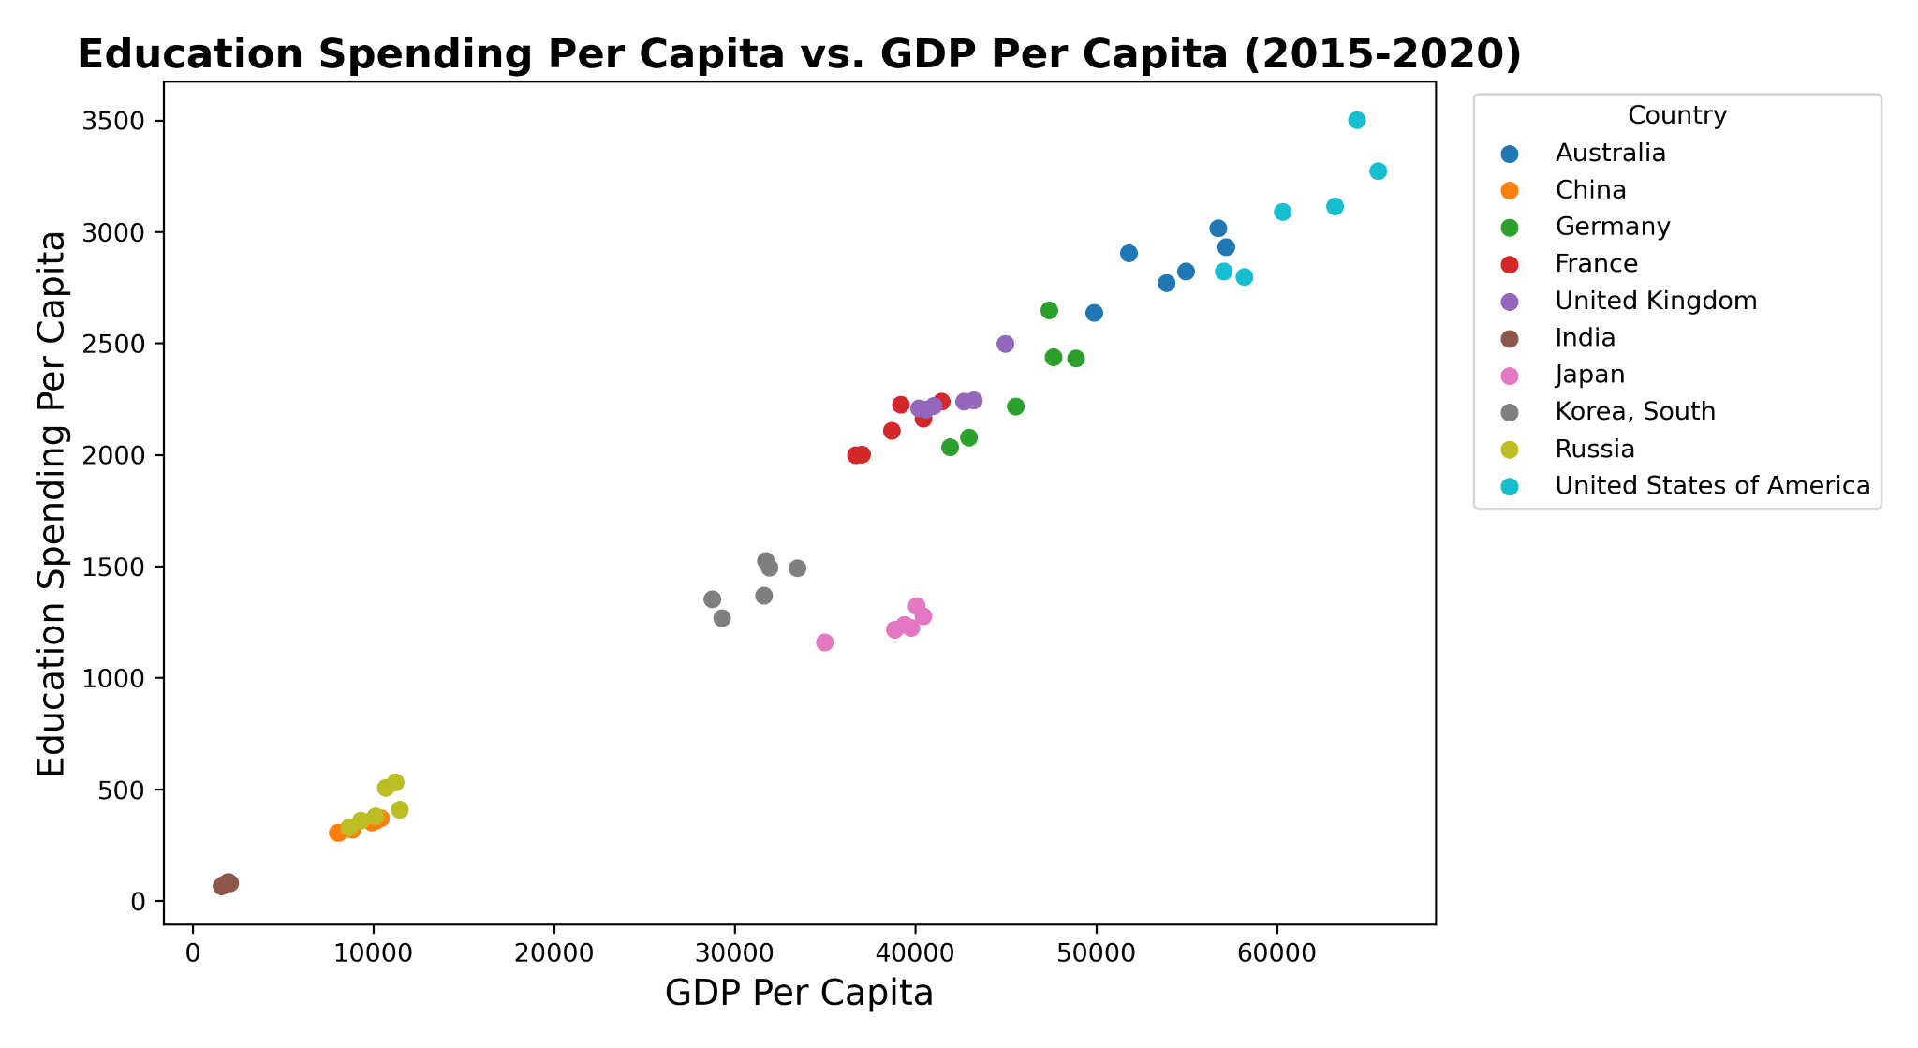
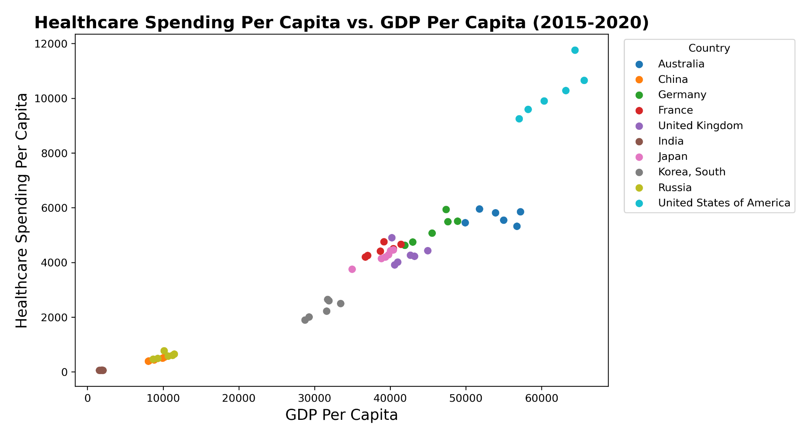
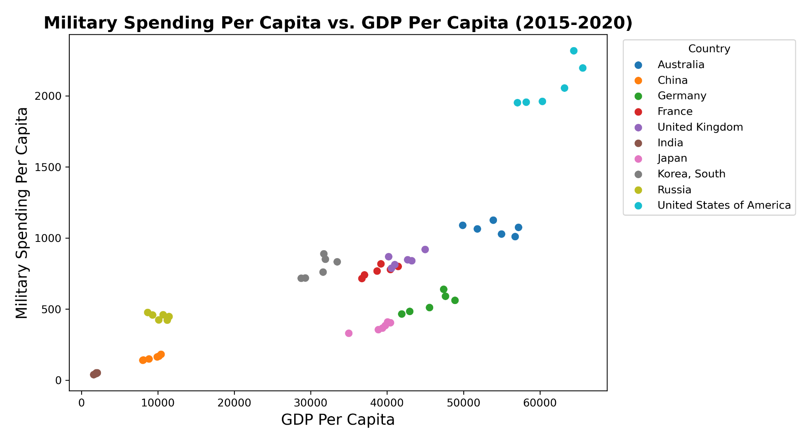
Spending Per Capita vs. GDP Per Capita

Slide 10
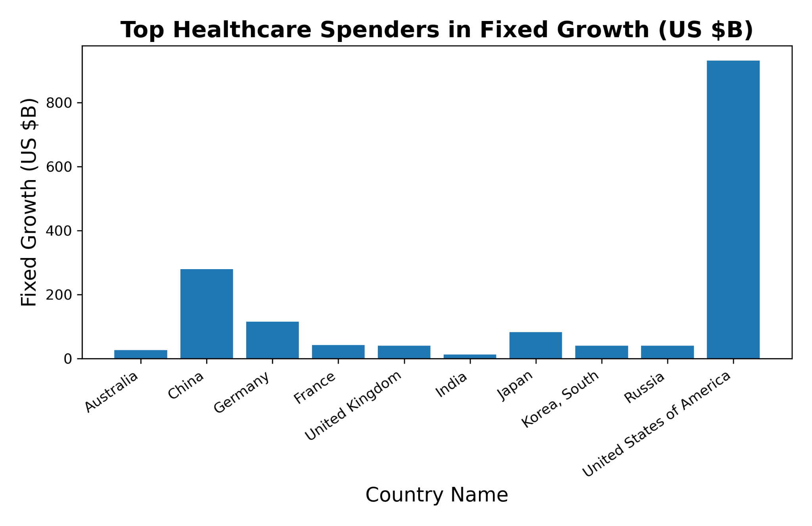
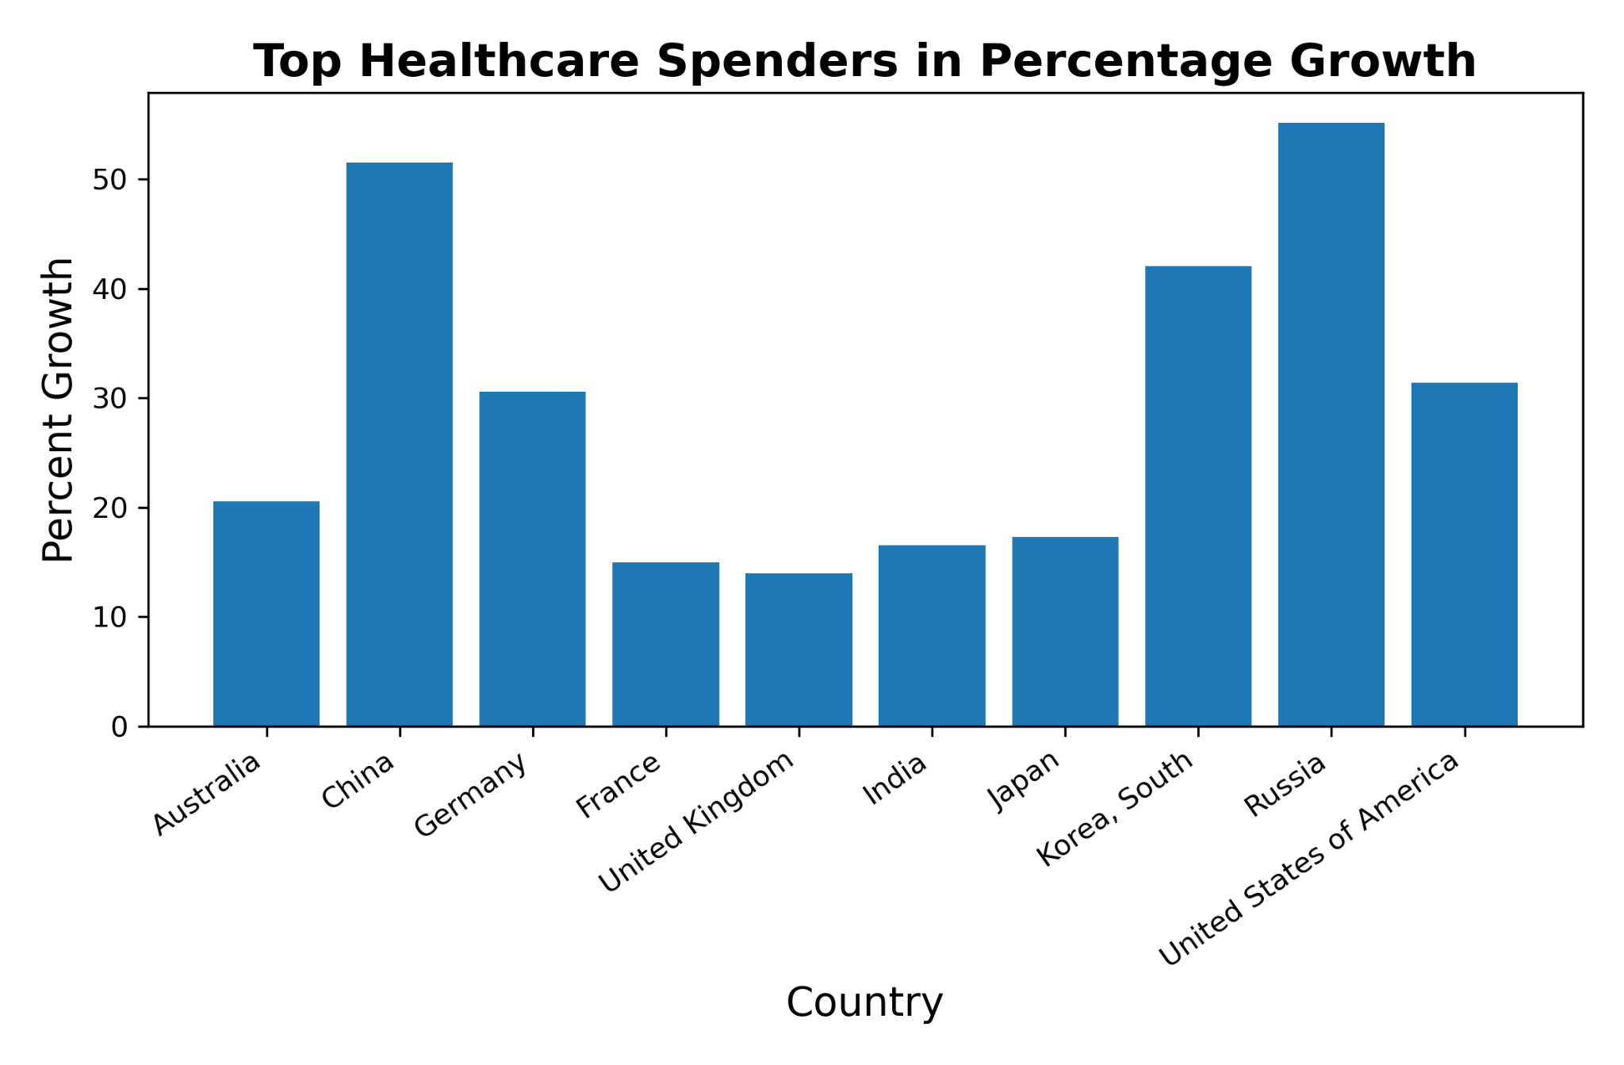

Slide 11
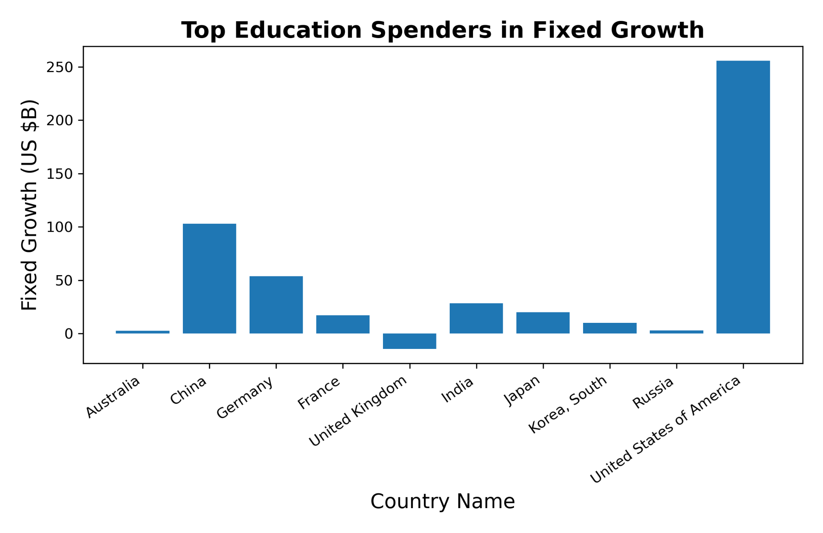
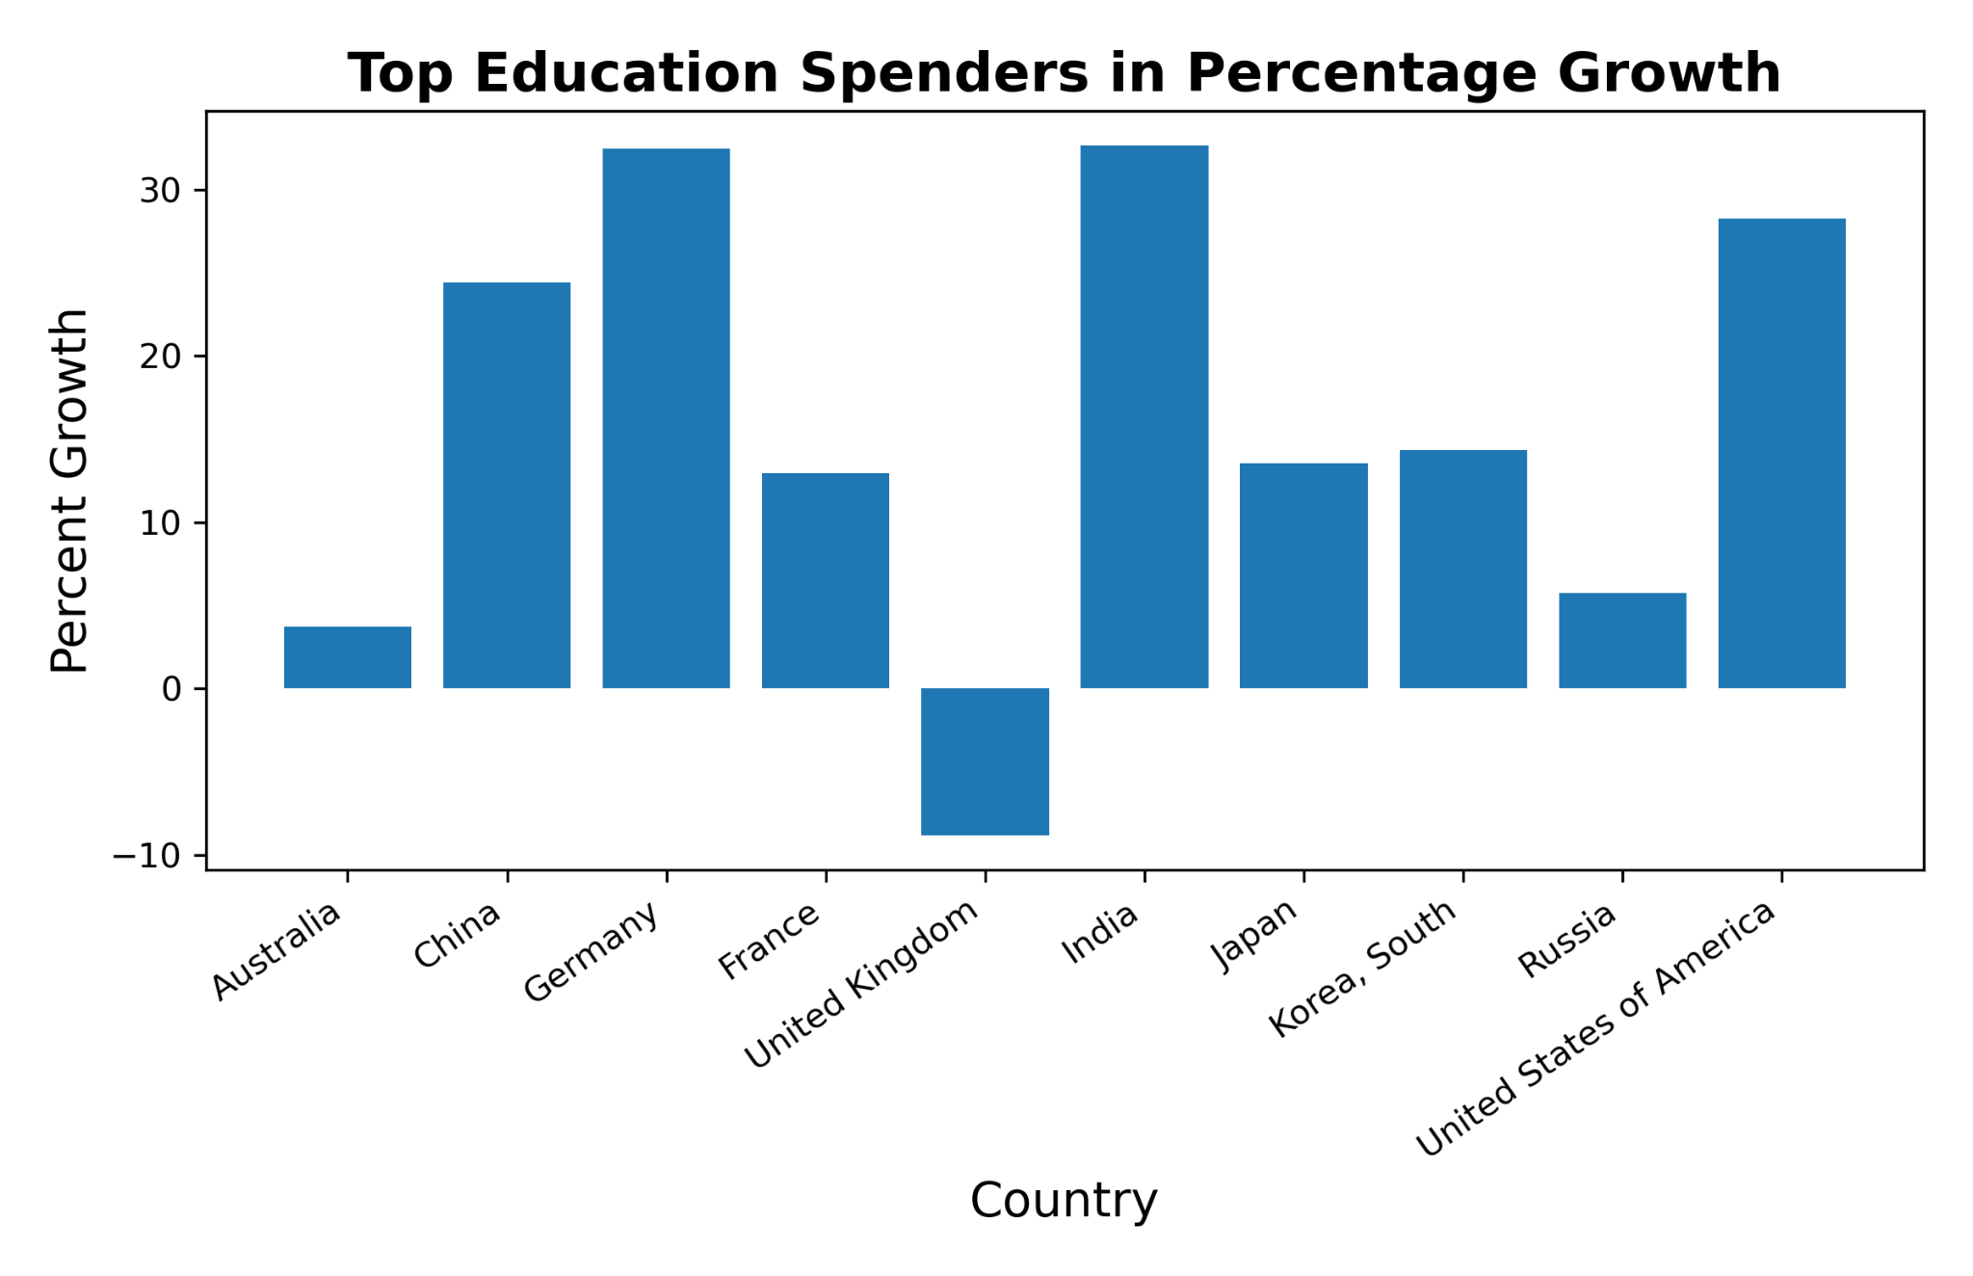

Slide 12
Conclusion
United States spends the most in each category by far with China in second
Almost all Countries spend the most on Healthcare
Positive correlation between GDP Per Capita and all Categories
China is rapidly growing

