Slide 1
Log Analysis &
The XY Problem

Slide 2

What are logs?

Slide 3
Logs
a file or files that record either events that occur in an operating system, application execution, or network traffic
Keeps track of type, content, time
Used for system auditing, forensics, error diagnosis, user tracking, etc.

Slide 4
The XY Problem
“The XY problem is asking about your attempted solution rather than your actual problem.”
“I want to do X.”
“I don't know how to do X, but I think I can solve this if I at least to Y.”
“I don't know how to do Y either.

Slide 5
The XY Problem (cont’d)
Y wasn't even a suitable solution for X.
The problem occurs when we get stuck on what we believe is a solution and are unable step back and explain the issue in full

Slide 6


Slide 7
BECAUSE
Causes confusion (for ourselves and others)
  Lose sight of bigger picture
  Unless proven otherwise, there are usually multiple
  ways to do thing, with different trade-offs
Is harder to learn thing good
  Remembering our original task
  Retention

Slide 8
Example NCL Challenge
Nginx log
How many different IP addresses reached the server?
How many requests yielded a 200 status?
What IP address rang at the doorbell?

Slide 9
Useful commands
Use shell commands (sort, uniq, cut, etc.)
Use awk (awk ‘{print $N}’ is really useful!)
Use grep
Combine them all!

Slide 10
COMING SOON

Slide 11


Slide 12


Slide 13
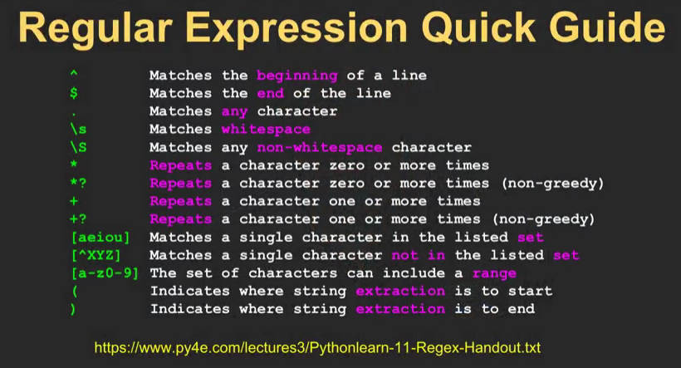
Regex

Slide 14
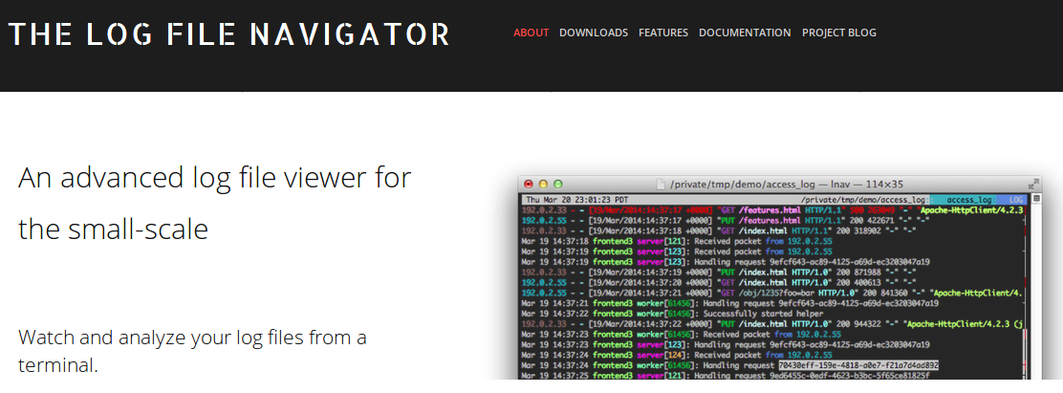
LNAV

Slide 15

THANKS!

Slide 16
Sources
http://xyproblem.info/
https://easyengine.io/tutorials/nginx/log-parsing
https://www.thegeekstuff.com/2009/03/15-practical-unix-grep-command-examples/
https://stackoverflow.com/questions/21584727/using-linux-cut-sort-and-uniq
https://dl.icewarp.com/online_help/203030104.htm

