Slide 1
Demo – Scenario
1) Customers arrive at restaurant and sits at a numbered table
2) Scan QR code on table (GET …/menu/restaurantId)
3) Place and confirm order (POST …/order/new)
req body contains restaurantId, tableNumber, foods [{foodId, quantity}]
4) Review order and total payable (GET …/order/id)
Place and confirm order
Client
(Customer)
Server
(Order System)
Client
(Restaurant)
Review placed order
Notifies placed order

Slide 2
Demo – Scaling Problem
Client
Client
Server
Database
Client
Simultaneous requests and responses
10 customers – OK
100 customers – OK
1,000 customers ?
10,000 customers ?
Client

Slide 3
Demo – Scaling Solution (part 1)
Client 1
Server 1
Client 2
Database
Client 2
Server 2
Client 4

Slide 4
Demo – Scaling Solution (part 2)
Client 1
Server 1
Client 2
Load
Balancer
Server 2
Database
Client 3
Server 3

Slide 5
Demo – Techstack
Server 1
ASP.NET Core
React
JS
Native
Entity Framework
Nginx
Server 2
Express (Node.js)
Client
Load
Balancer
Prisma
Server 3
Spring Boot
Hibernate
Database
MySQL

Slide 6
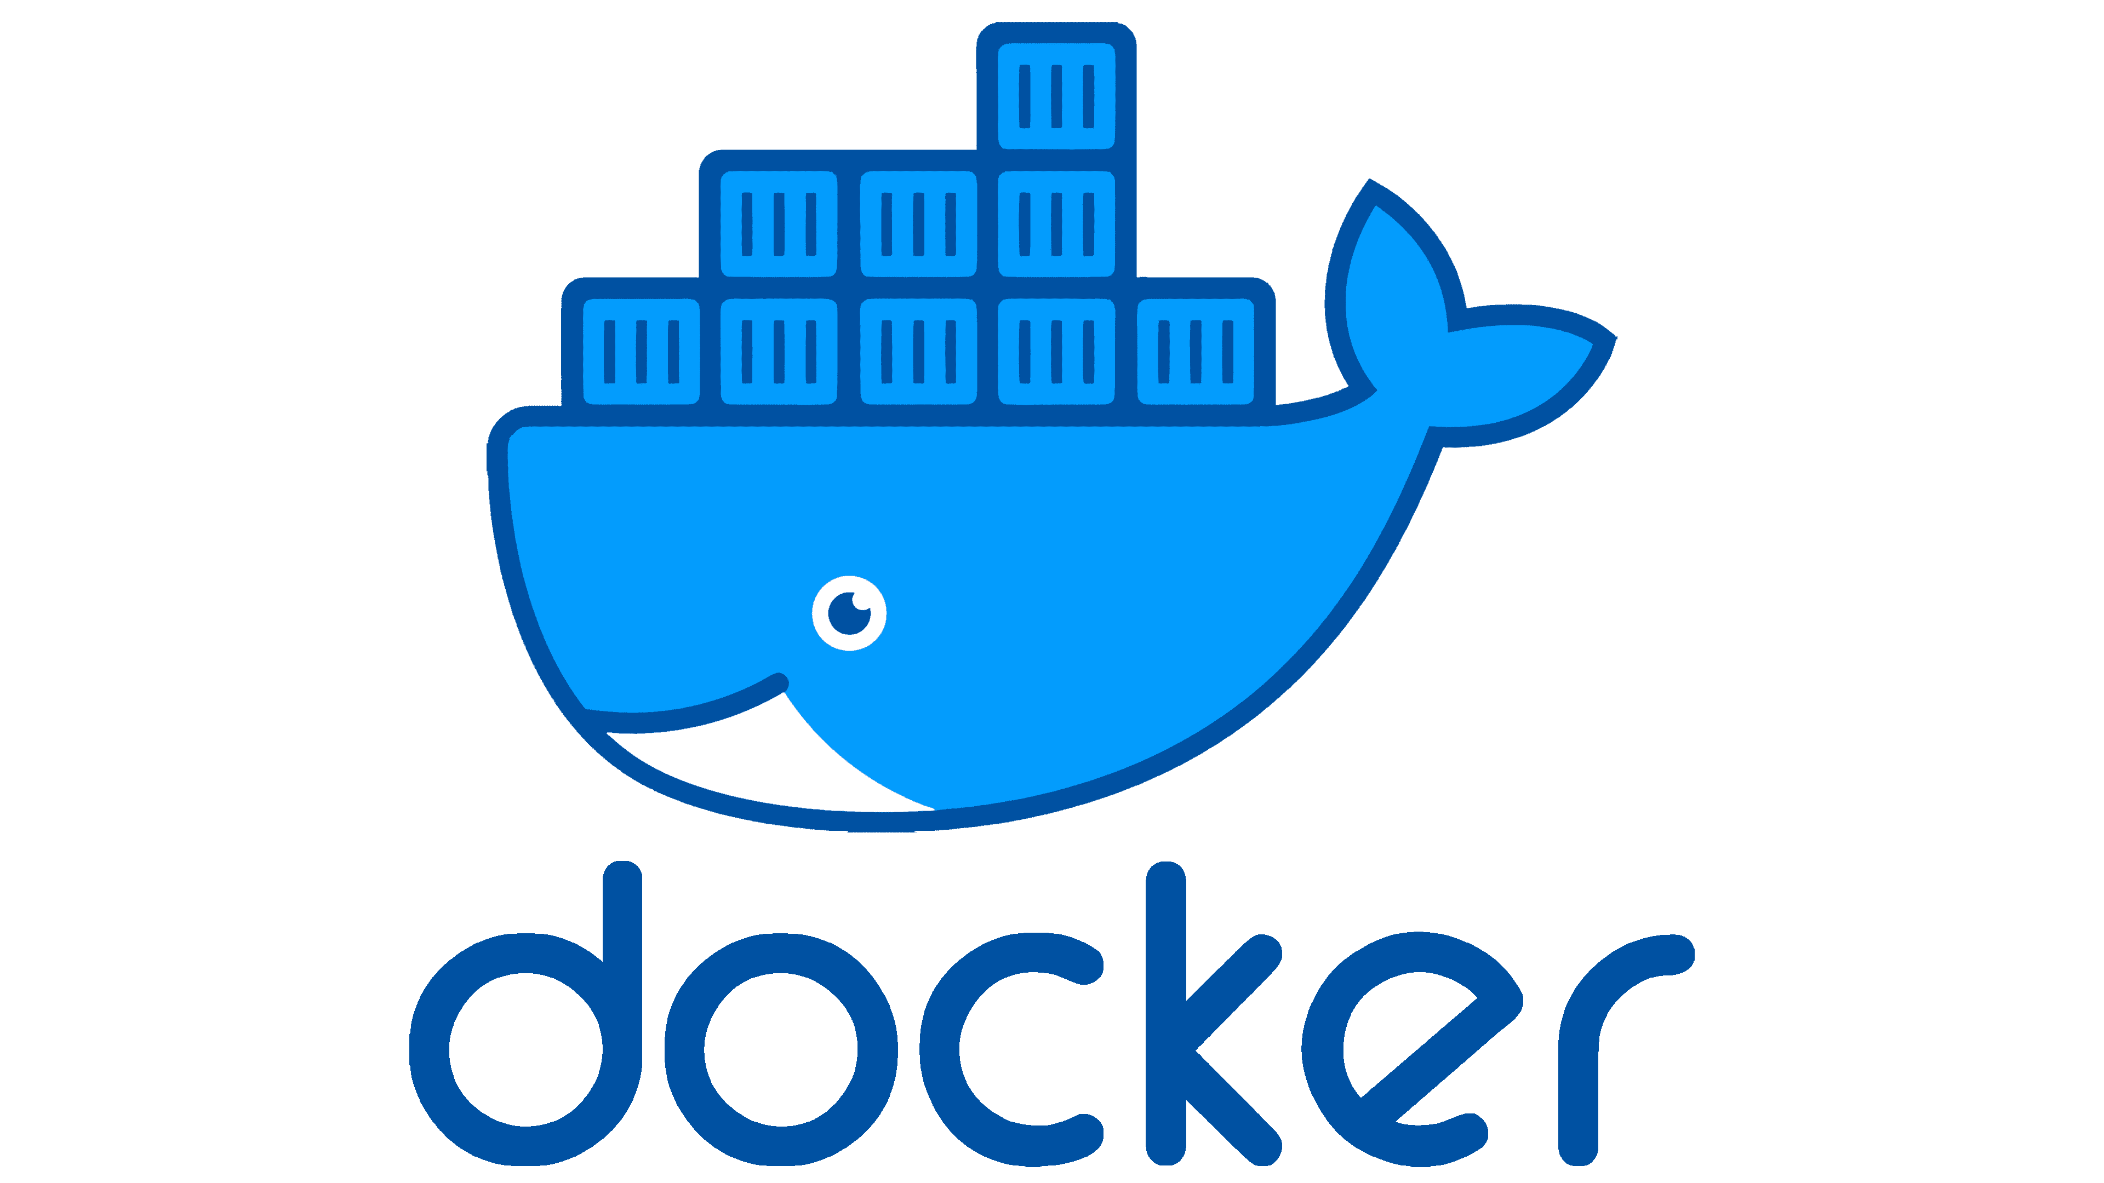



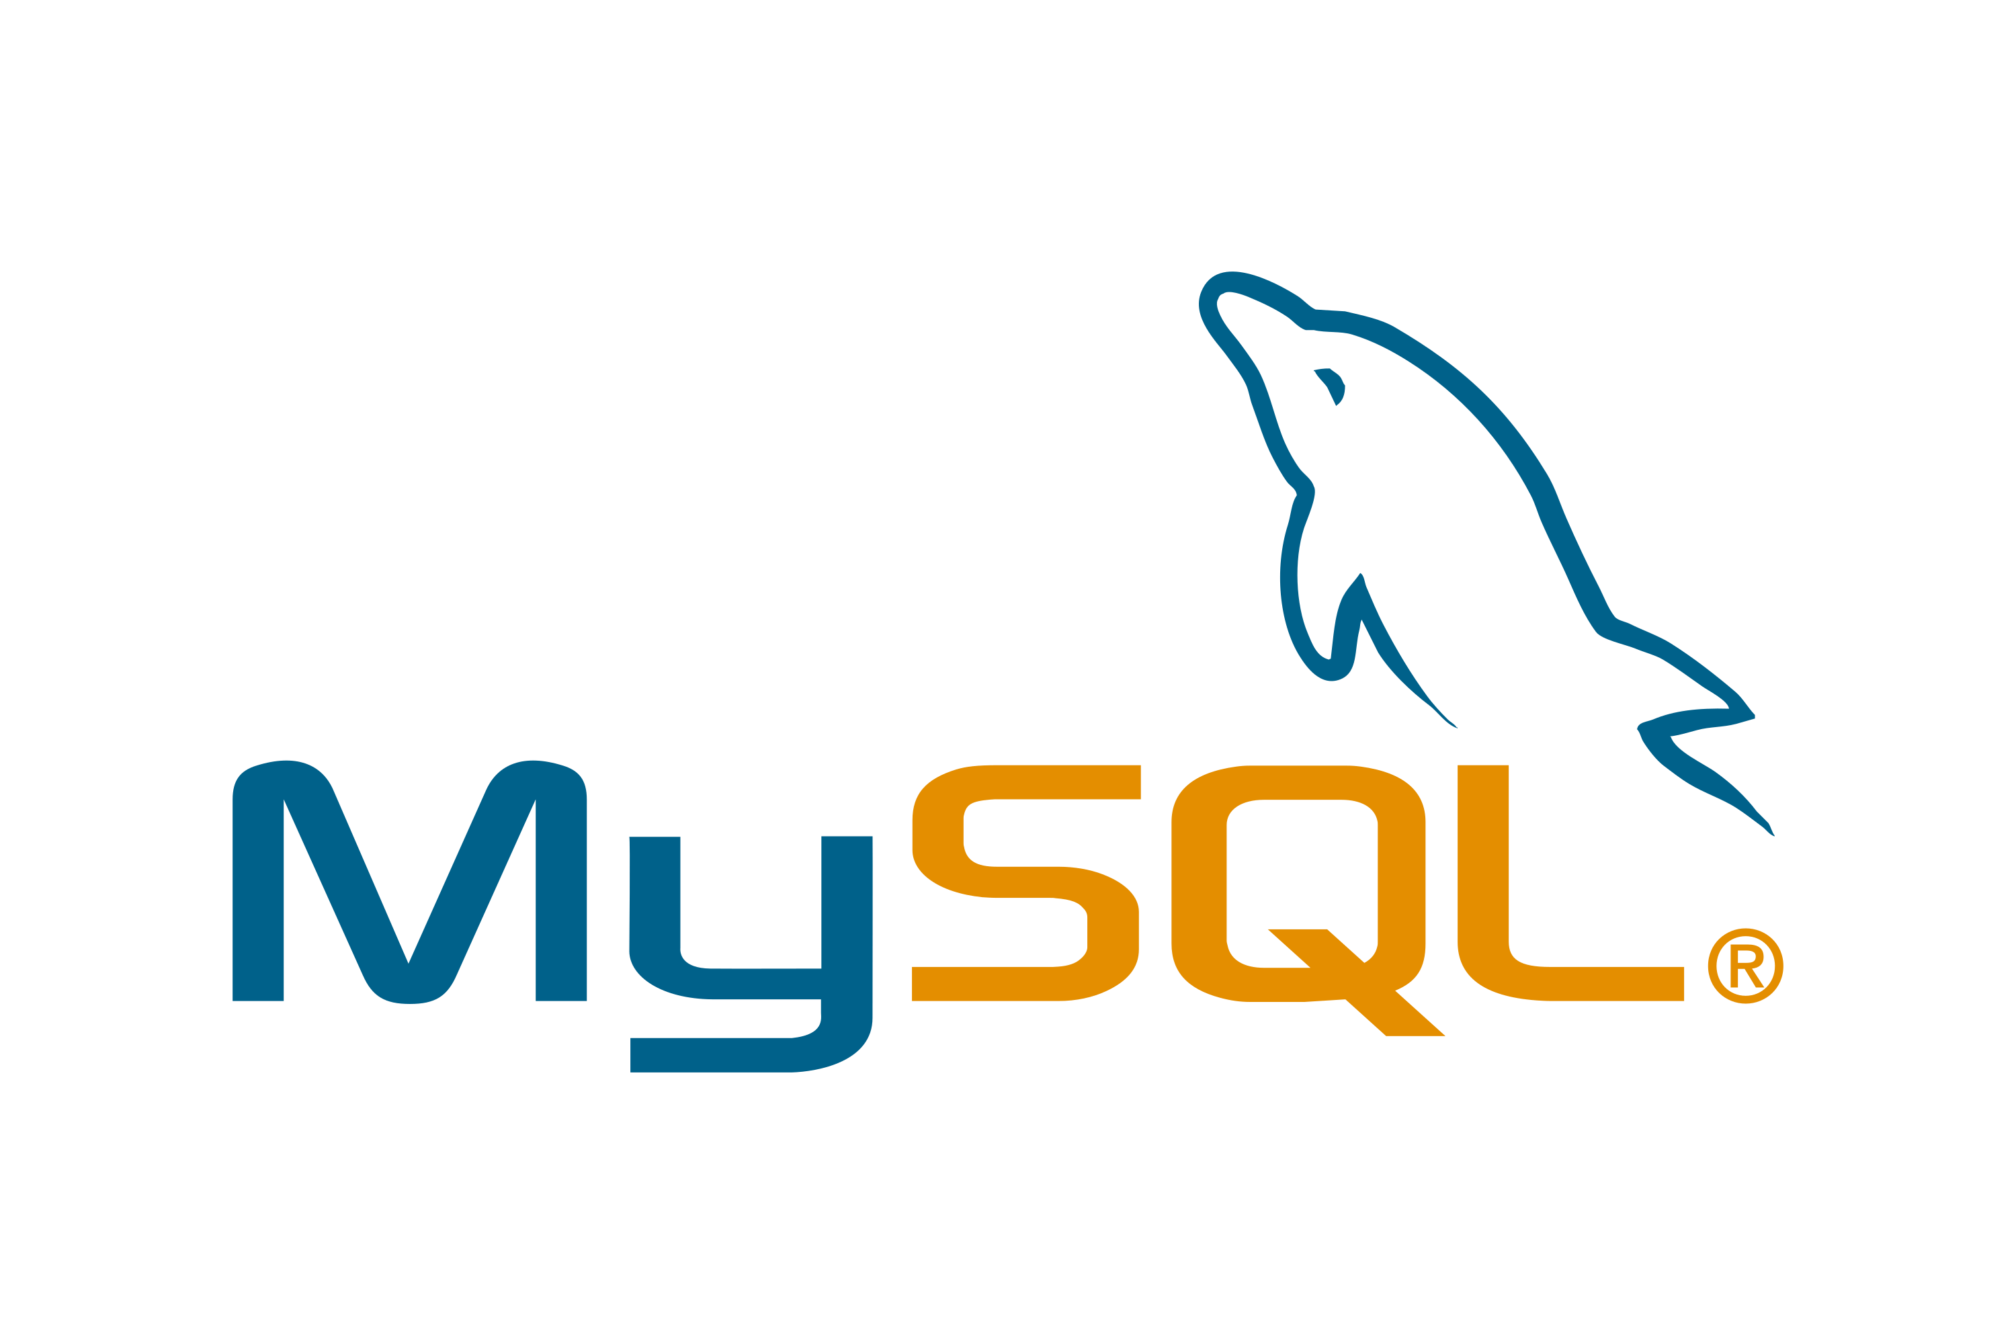


Demo – Techstack (Visualized)

