Slide 1
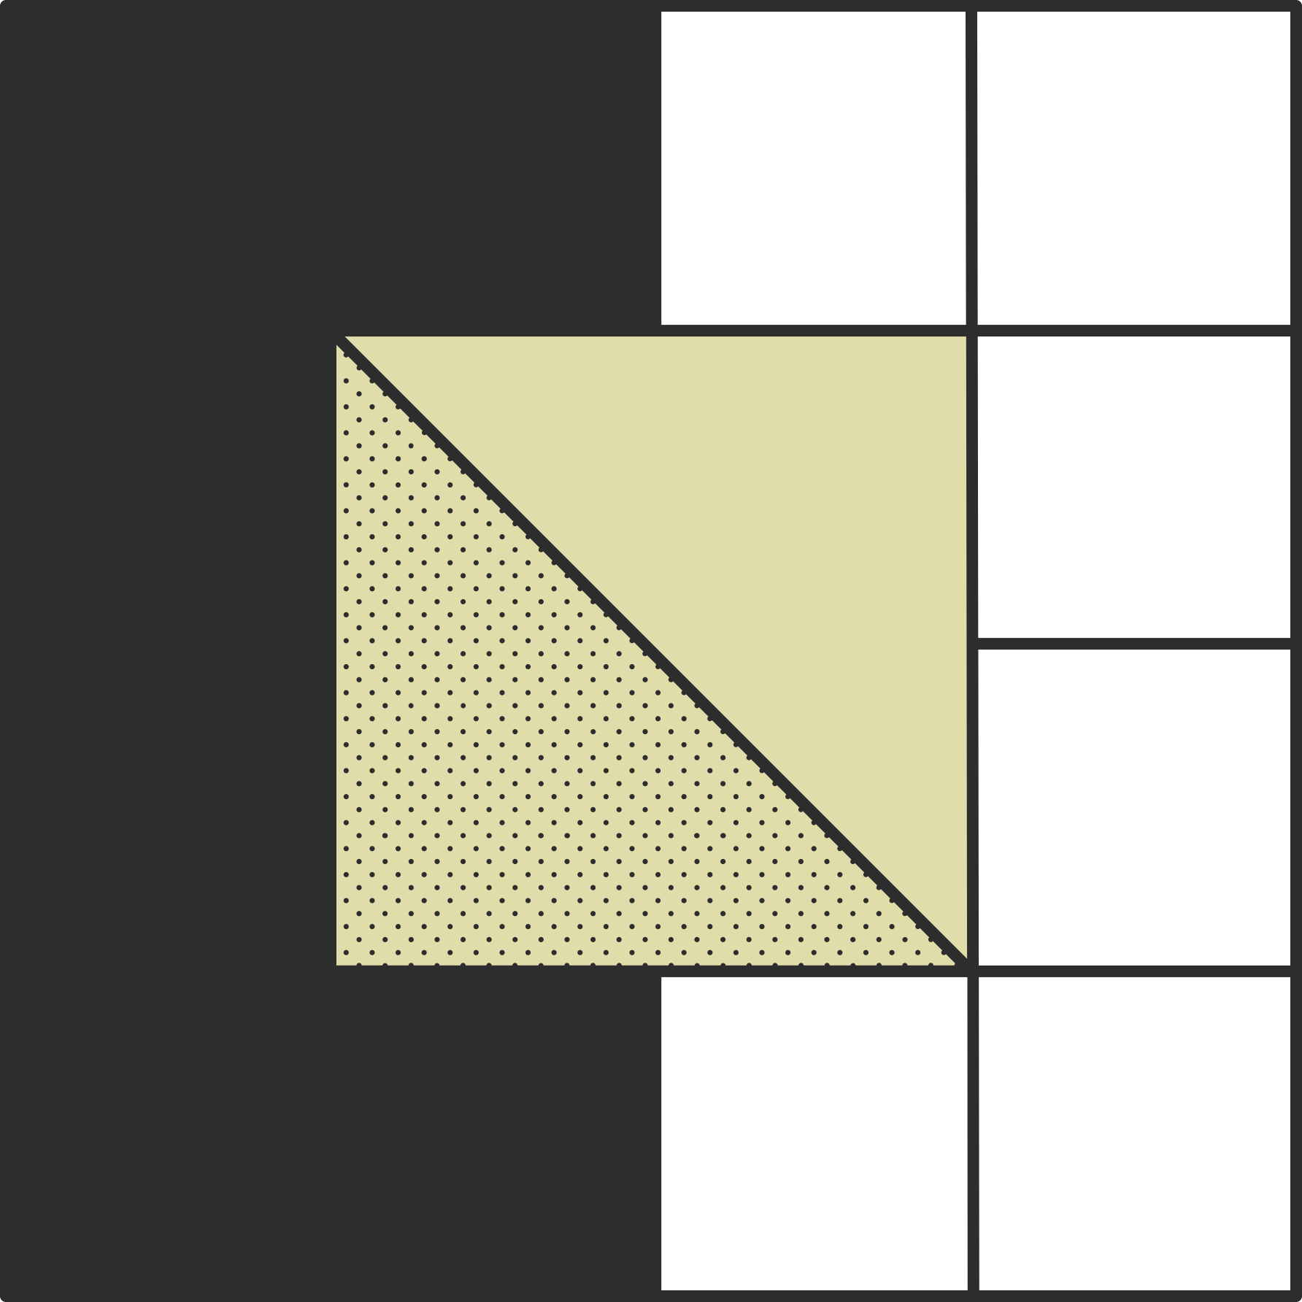

112-1 Machine Learning
HW2_indiv_1(k)
Advisor: Chih-Hua Hsu
Student: Pao-Chang Chiu
Present Date: 2023/10/11

Slide 2
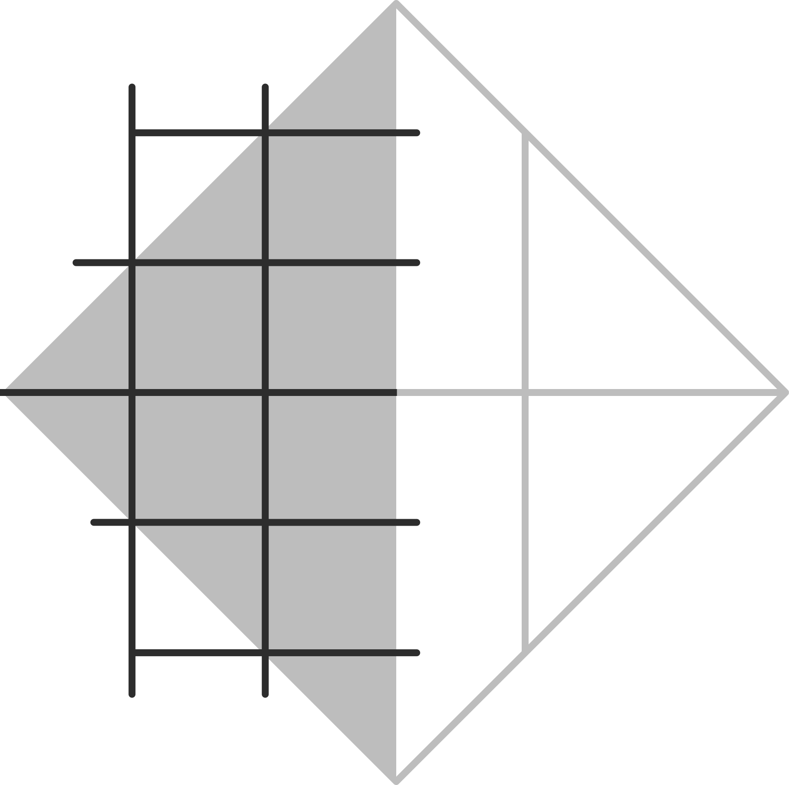

Contents
Introduction
Problems
The expective result of the figures
Setting conditional statement in for loop
Hints

Slide 3
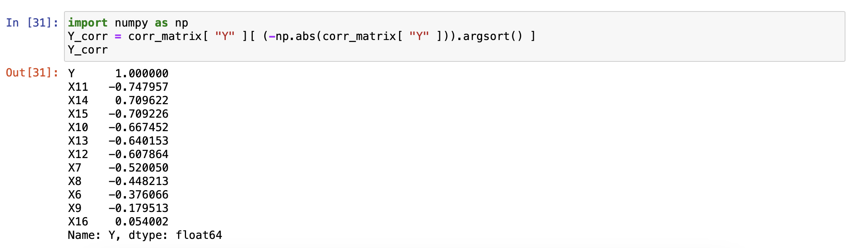
Introduction
All the variables correlated to Y

Slide 4
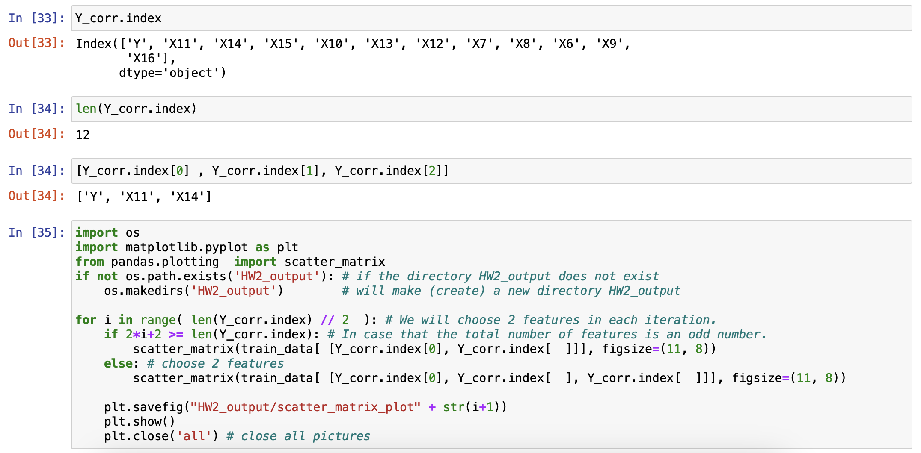
Introduction
The index of all the variables correlated to Y
The length of all the variables correlated to Y

Slide 5
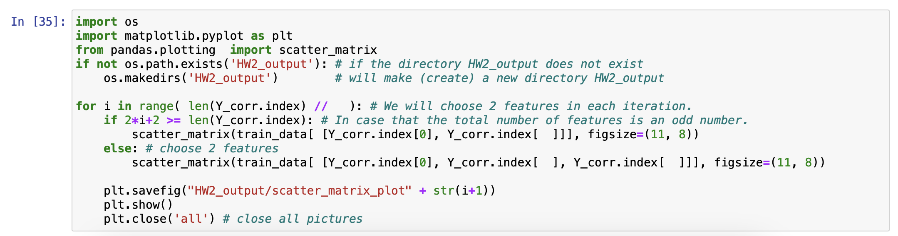
Problems
What you want to solve
The total number of features is odd: plot one correlation scatter matrix with Y
The total number of features is even: plot two correlation scatter matrices with Y
How many times do you need to run in for loop

Slide 6
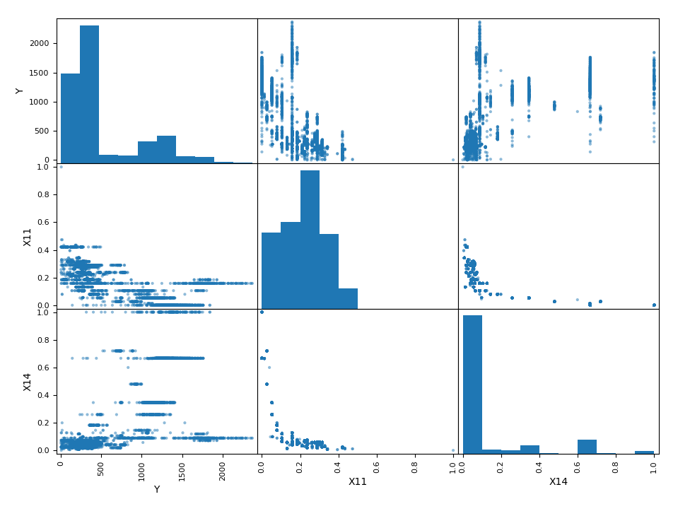
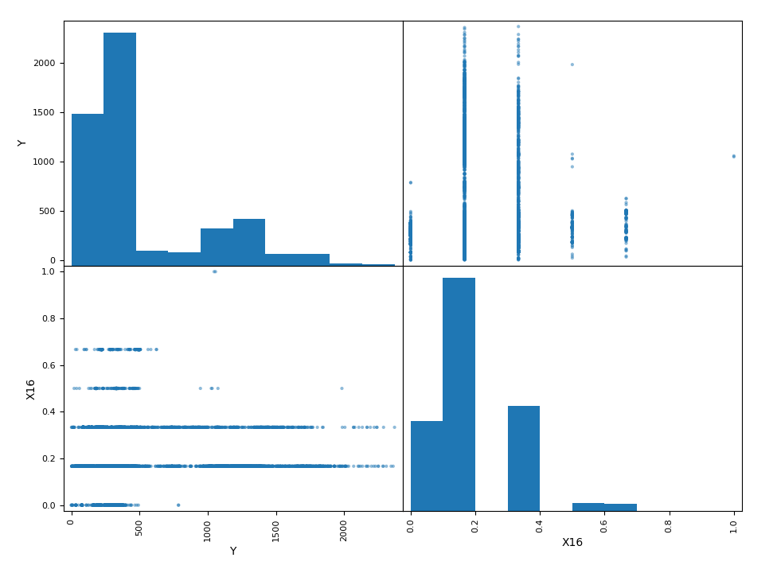
The expective result of the figures
The total number of features is odd: plot 2*2 correlation scatter matrix
The total number of features is even: plot 3*3 correlation scatter matrix
The total number of features is even
The total number of features is odd

Slide 7
Setting conditional statement in for loop
Counter: i
Variables: X₁, X₂
i | X₁ | X₂
0 | 1 | 2
1 | 3 | 4
2 | 5 | 6
… | … | …
m | n - 1 | n
i | X₁ | X₂
0 | 1 | 2
1 | 3 | 4
2 | 5 | 6
… | … | …
m | n
The total number of features is even
The total number of features is odd

Slide 8
Hints
Think about those hints in the relative place
Comparison with the previous slide
X₁
X₂

