Slide 1
COS80027 Machine Learning Final Project Presentation
Team 5

Slide 2
Team Members
Aditi Puri 103139868
Christopher Choong 103573738
Cindy Tao 101579598
Jiangli Shi 103456826
Justin Fang 103552313
Mingyang Hou 103471845
Thee Woon Xuen 101585249

Slide 3
Data Explanation & Problem Formation
The CIFAR-10 dataset contains 60,000 32x32 color images in 10 different classes: airplanes, cars, birds, cats, deer, dogs, frogs, horses, ships, and trucks. There are 6,000 images of each class.
Multiclass image classification using deep learning and machine learning.

Slide 4
Deep Learning Approach and Processes
Data loading
Data split into training and test sets
Normalisation
Importing a pre-trained model (ResNet50)
Fine tuning the model by using pre-trained model
Model training on CIFAR-10 datasets
Model evaluation

Slide 5
Data splitting & preprocessing
Normalisation:
Normalize data pixels into a number between 0 and 1
.preprocess_input() function in ResNet50 model
Normalize data into floating values
Data Spitting:
80% for training 20% for validation
Training dataset: (40000, 32, 32, 3) (40000,)
Validation dataset: (10000, 32, 32, 3) (10000,)
Test dataset: (10000, 32, 32, 3) (10000,)

Slide 6
Pre-trained Model - ResNet50
Convolutional neural network that is 50 layers deep.
Powered by an Artificial Neural Network - Residual Neural Network (ResNet).
Improves the efficiency of deep neural networks.
Pre-trained on ImageNet.
Fully-connected layer removed.

Slide 7
Fine-tuning process
Remove the fully-connected layers at the top of the network.
Replace the removed fully connected layer with a new set of fully connected layers.
Train the new model with training dataset.
Evaluate the new model with validation dataset.
Perform prediction on test dataset.

Slide 8
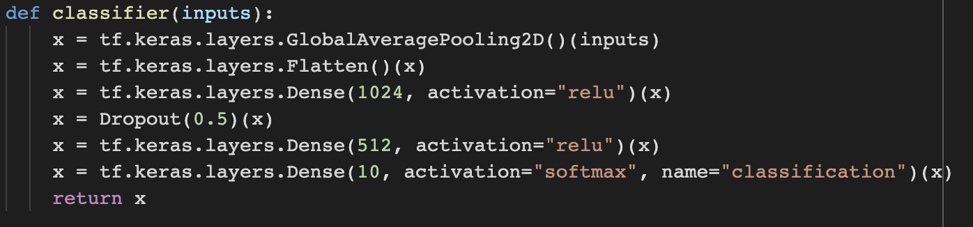
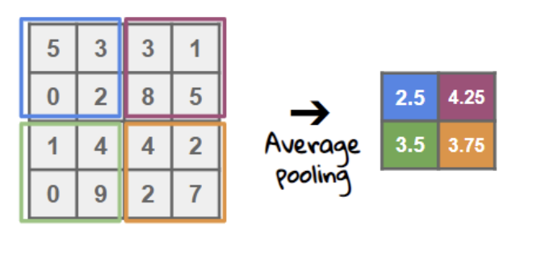
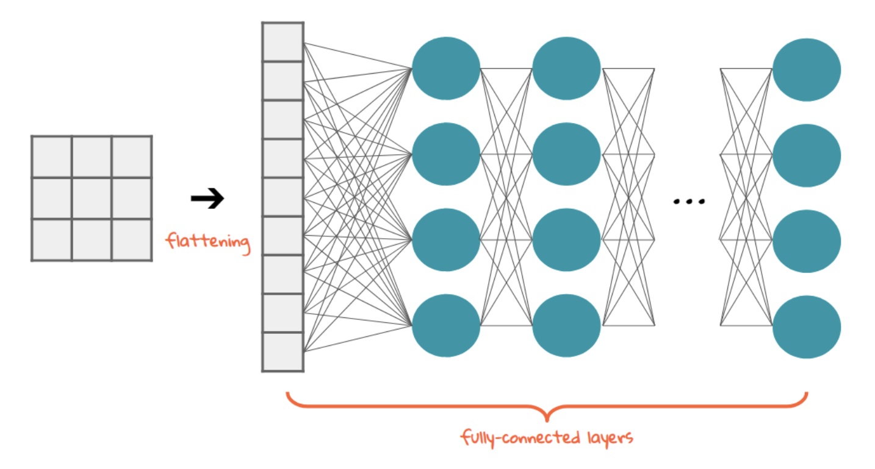
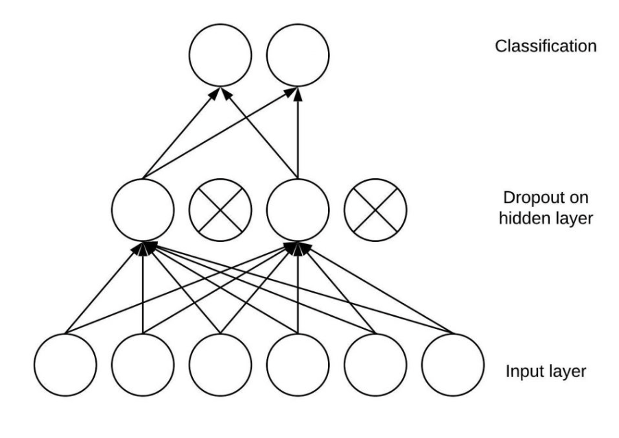
New Fully Connected Layer
Global average pooling 2D
Flattening layer
Dropout layer

Slide 9
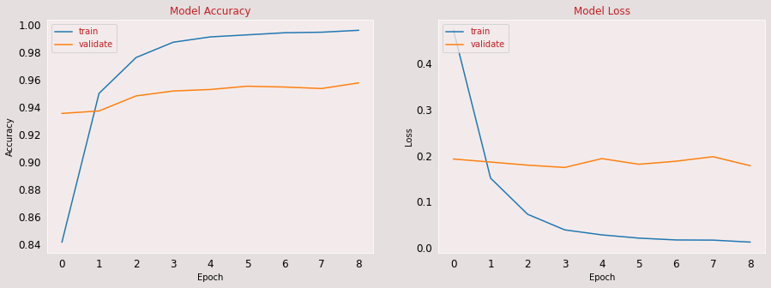
Evaluation of
Train and Val performance
Fine-tuned ResNet50 improved validation lose to 0.18
Train lose decreased towards 0 since epoch 3
Train and validation acc are both over 94%

Slide 10
Comparison of DL models
 | Training speed on large datasets | Complexity to improve performance | Accuracy
Vision Transformer (ViT) | Slow | Knowledge gap, time limits, GPU costs | Overfitting
Non pre-trained CNN + hyperparameter tuning | Average | Computational complexity | Train acc: 85% Val acc: 85%
Fin-tuning Pre-trained ResNet50 | Faster | Easier | Minimized overfitting E.g. Dropout layer in fully connected layers

Slide 11
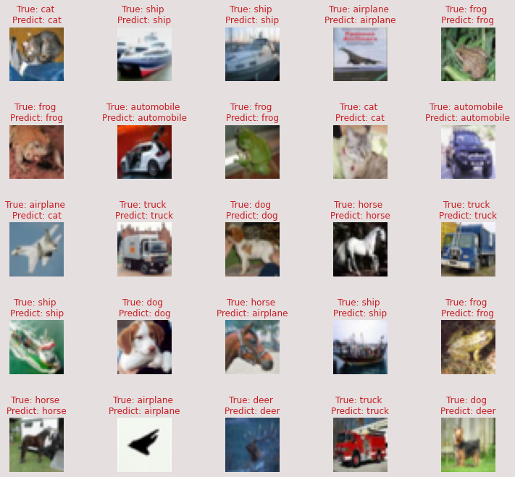
Test case
ResNet50 model has 95% accuracy on test data.
Only 5% difference from training accuracy.

Slide 12
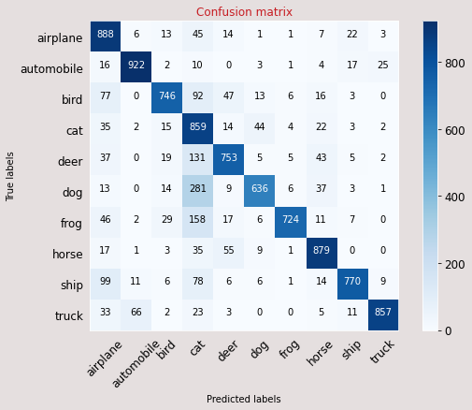
Evaluation
on Test case
Most classes are predicted correct.
Ambiguity on small amount of features e.g. Cat, Dog, Bird & Airplane

Slide 13
Machine Learning Approach and Processes
Data loading, preprocessing and splitting
Four learning algorithms implemented
Accuracy comparison and model selection
Hyperparameter tuning
Model evaluation

Slide 14
Data Preprocessing and Splitting
Dimension reduction:
Reshape X data from 4D array to a 2D array.
Reshape y data from 2D array to 1D array.
Normalisation:
Divide by 255
Data Spitting:
Same partition as DL
Training dataset: (40000, 3072) (40000,)
Validation dataset: (10000, 3072) (10000,)
Test dataset: (10000, 3072) (10000,)

Slide 15
ML Algorithms
Random Forest Classifier
KNN Classifier
Decision Tree Classifier
Naive Bayes Classifier

Slide 16
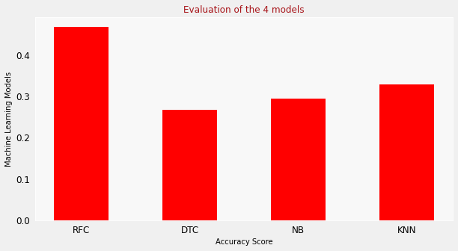
Comparison of Four Models
Accuracy Scores
Random Forest classifier: 0.48
KNN classifier: 0.33
Decision Tree classifier: 0.27
Naive Bayes classifier: 0.30

Slide 17
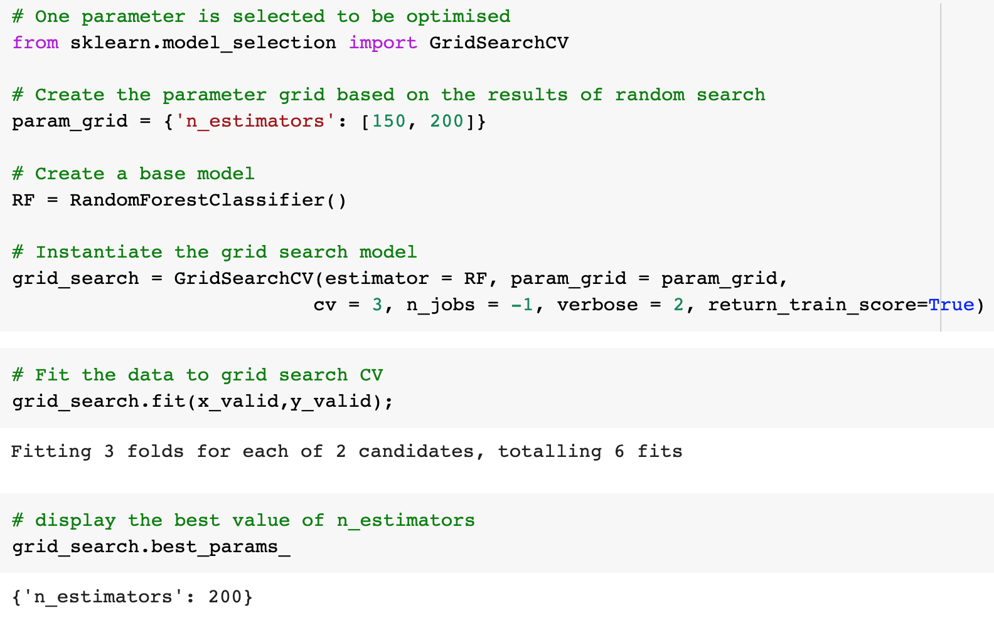
Random Forest Model Hyperparameter Tuning
n_estimators estimation with Grid search cross validation.

Slide 18
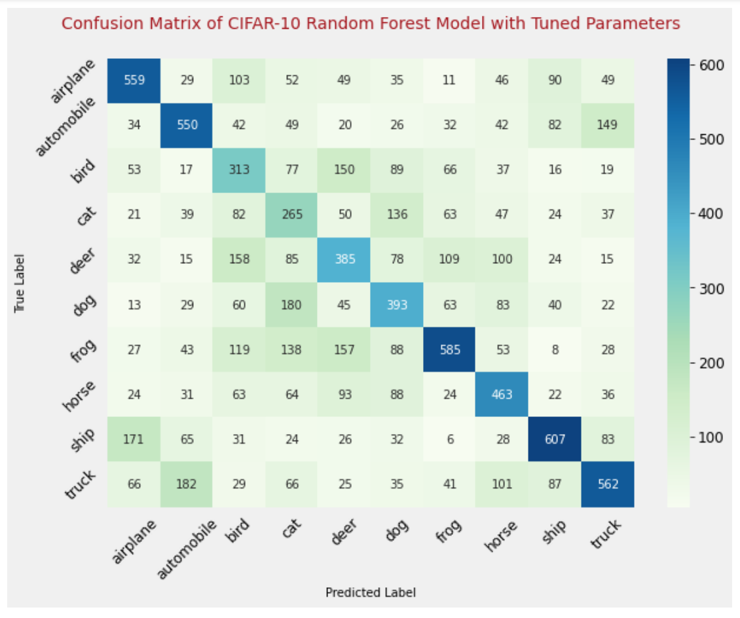
Random Forest Model Evaluation
With default parameters, Random Forest has a 46.81 (47%) accuracy.
With tuned parameter, Random Forest has a 48.03 (48%) accuracy.

Slide 19
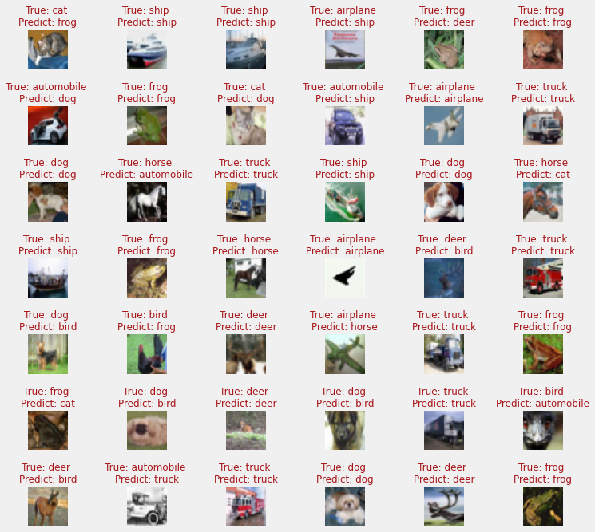
Test Case
Sample data of test results
Better accuracy predicting some ships and trucks according to confusion matrix

Slide 20
Main Findings
Deep learning achieves higher accuracy on unseen data (95% accuracy to 48% accuracy).
The deep learning model CNN has better performance on image processing and classification over the machine learning model.

Slide 21
Test Results
ML Random Forest 48% accuracy
DL CNN ResNet50 95% accuracy

Slide 22
Reference
Koehrsen, W 2018, 'Hyperparameter Tuning the Random Forest in Python', Medium, 10 Jan, viewed 03 May 2022, <https://towardsdatascience.com/hyperparameter-tuning-the-random-forest-in-python-using-scikit-learn-28d2aa77dd74>.
Nithyashree, V 2022, Image Classification using Machine Learning, Analytic Vidhya, viewed 01 June 2022 <https://www.analyticsvidhya.com/blog/2022/01/image-classification-using-machine-learning/#h2_3>.
‘Guide | TensorFlow Core’ n.d., TensorFlow, viewed 27 May 2022, <https://www.tensorflow.org/guide>.
He, K, Zhang, X, Ren, S & Sun, J 2015, ‘Deep Residual Learning for Image Recognition’, arXiv:1512.03385 [cs], viewed 30 June 2022, <http://arxiv.org/abs/1512.03385>.
Jeong, J 2019, ‘The Most Intuitive and Easiest Guide for CNN’, Medium, viewed 2 June 2022, <https://towardsdatascience.com/the-most-intuitive-and-easiest-guide-for-convolutional-neural-network-3607be47480>.

Slide 23
Thank you!

