Slide 1
Programming for Cultural Data Analysis
Week 2
January 25, 2018

Slide 2
What is Cultural Analytics
d

Slide 3
What is Cultural Analytics
The use of data to study literature, culture, media, and history
Computation plus culture
Not a focus on the what, the content, this or that subject
More a focus on the how, the method, on how computation will change the study of culture and how culture will change the study of computation
Piper, Andrew. “There will be Numbers.” Journal of Cultural Analytics 1, no. 1 (May 23, 2016).

Slide 4
On cultural studies
What counts as evidence?
What is the relationship between theory and practice?
How do we account for the technological mediations of our critique?
Piper, Andrew. “There will be Numbers.” Journal of Cultural Analytics 1, no. 1 (May 23, 2016).

Slide 5
On cultural studies
Computation shows us how the traditional media of cultural studies are flawed portals to understanding culture
The anthropologists notebook
The historian’s archive
The media theoretician’s screen or platform
The art historian’s collection
The literary historian’s book
Piper, Andrew. “There will be Numbers.” Journal of Cultural Analytics 1, no. 1 (May 23, 2016).

Slide 6
On computation
Challenges universalism and neutrality in computing
Reminds us that knowledge is always situated
Allows for greater critical engagement with the ways in which computation structures meaning
Computation in the field of cultural analytics becomes part of the structure of cultural knowledge more generally
Piper, Andrew. “There will be Numbers.” Journal of Cultural Analytics 1, no. 1 (May 23, 2016).

Slide 7
Gaps in the study of culture by computation
Evidence -> a New Generality
Theory -> a New Explicitness
Self-reflexivity -> a New Recursivity
Relevance -> a New Impactfulness
Piper, Andrew. “There will be Numbers.” Journal of Cultural Analytics 1, no. 1 (May 23, 2016).

Slide 8
Gaps in the study of culture by computation
Evidence -> a New Generality
The crisis of metonymy as the fundamental structure of cultural criticism
The power of the local insight
Challenge:
To focus on “the representativeness”
To be self-conscious about being implicated in the knowledge being created
Values the curation of rather than the quantity of data
Piper, Andrew. “There will be Numbers.” Journal of Cultural Analytics 1, no. 1 (May 23, 2016).

Slide 9
Gaps in the study of culture by computation
Theory -> a New Explicitness
Complexity is not inherent to the object but is emergent through the aggregation of lower-level phenomena
We see what does and does not fit into a theory (explanation or prediction)
Lays bare as much as possible of the intellectual practices used to arrive at an argument about culture
Architectonic rather than agonistic
Piper, Andrew. “There will be Numbers.” Journal of Cultural Analytics 1, no. 1 (May 23, 2016).

Slide 10
Gaps in the study of culture by computation
Self-reflexivity -> a New Recursivity
Marks out more clearly the contingencies of knowledge, circumscribes the space of knowledge
Considering methods as models leads us to arguments that reflect the contingencies of representativeness
Part of the process through which culture is generated
Piper, Andrew. “There will be Numbers.” Journal of Cultural Analytics 1, no. 1 (May 23, 2016).

Slide 11
Gaps in the study of culture by computation
Relevance -> a New Impactfulness
Critique is not outside but implicated in the institutional ligatures that make research possible
Promotes agency and advocacy for cultural change
Piper, Andrew. “There will be Numbers.” Journal of Cultural Analytics 1, no. 1 (May 23, 2016).

Slide 12
Cultural Data Analysis
Address head on the representativeness of evidence
Make explicit theoretical terms as well as the relationship between theory and implementation
Reflect on the extent to which the process of modeling has helped construct knowledge
Attempt to address and intervene in contemporary debates
Piper, Andrew. “There will be Numbers.” Journal of Cultural Analytics 1, no. 1 (May 23, 2016).

Slide 13
Cultural Data Analysis
Has an argument that takes into account and engages critically with research embedded within existing paradigms and debates.
Asks, What precisely does computation allow one to claim that has not been seen before?
Piper, Andrew. “There will be Numbers.” Journal of Cultural Analytics 1, no. 1 (May 23, 2016).

Slide 14
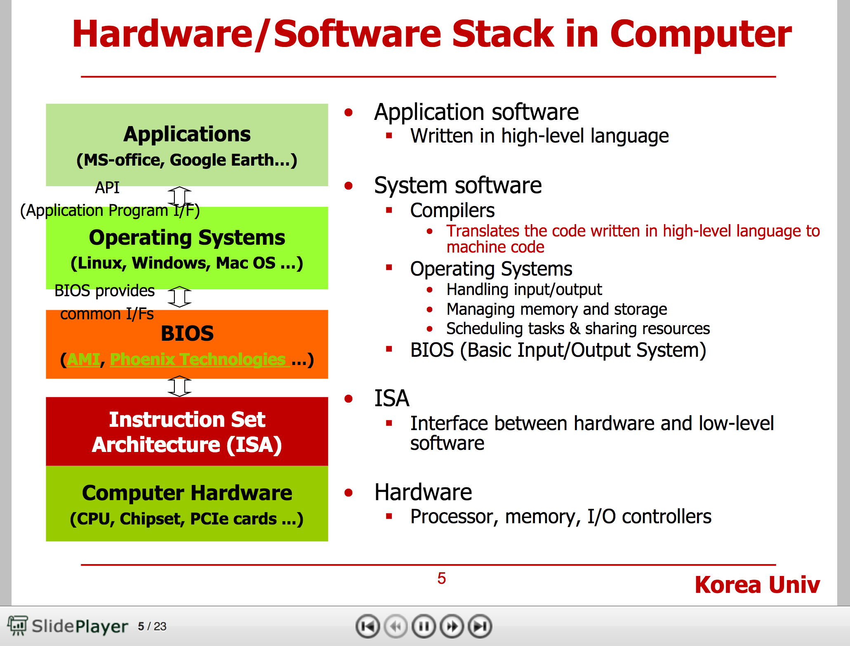
Hardware/Software Stack
http://player.slideplayer.com/36/10573982/#
Notes:
Play through slide #14.

Slide 15
Linux
“Linux is worth trying. It is a strange country indeed, but you don’t have to live there; a brief sojourn suffices to give some flavor of the place and – more importantly to lay bare everything that is taken for granted, and all that could have been done differently, under Windows or MacOS.”

Slide 16
“When working with something as powerful as Linux, you can easily devote a full half-hour to engineering a single command line”
GUIs tend to impose a large overhead on every single piece of software, even the smallest, and this overhead completely changes the programming environment. Small utility programs are no longer worth writing.
The only way that Apple and Microsoft can get away with [selling Oses for money] is by pursuing technological advancements as aggressively as they can, and by getting people to believe in and to pay for, a particular image: in the case of Apple, that of the creative thnker, and in the case of Microsoft, that of the respectable techno-bourgeois. Just like Disney, they are making money from selling an interface, a magic mirror

