Slide 1
The Operating System (OS) in Context
Week 2
September 18, 2017

Slide 2
What is Cultural Analytics
The use of data to study literature, culture, media, and history
Computation plus culture
Not a focus on the what, the content, this or that subject
More a focus on the how, the method, on how computation will change the study of culture and how culture will change the study of computation
Piper, Andrew. “There will be Numbers.” Journal of Cultural Analytics 1, no. 1 (May 23, 2016).

Slide 3
On cultural studies
What counts as evidence?
What is the relationship between theory and practice?
How do we account for the technological mediations of our critique?
Piper, Andrew. “There will be Numbers.” Journal of Cultural Analytics 1, no. 1 (May 23, 2016).

Slide 4
On cultural studies
Computation shows us how the traditional media of cultural studies are flawed portals to understanding culture
The anthropologists notebook
The historian’s archive
The media theoretician’s screen or platform
The art historian’s collection
The literary historian’s book
Piper, Andrew. “There will be Numbers.” Journal of Cultural Analytics 1, no. 1 (May 23, 2016).

Slide 5
On computation
Challenges universalism and neutrality in computing
Reminds us that knowledge is always situated
Allows for greater critical engagement with the ways in which computation structures meaning
Computation in the field of cultural analytics becomes part of the structure of cultural knowledge more generally
Piper, Andrew. “There will be Numbers.” Journal of Cultural Analytics 1, no. 1 (May 23, 2016).

Slide 6
Gaps in the study of culture by computation
Evidence -> a New Generality
Theory -> a New Explicitness
Self-reflexivity -> a New Recursivity
Relevance -> a New Impactfulness
Piper, Andrew. “There will be Numbers.” Journal of Cultural Analytics 1, no. 1 (May 23, 2016).

Slide 7
Gaps in the study of culture by computation
Evidence -> a New Generality
The crisis of metonymy as the fundamental structure of cultural criticism
The power of the local insight
Challenge:
To focus on “the representativeness”
To be self-conscious about being implicated in the knowledge being created
Values the curation of rather than the quantity of data
Piper, Andrew. “There will be Numbers.” Journal of Cultural Analytics 1, no. 1 (May 23, 2016).

Slide 8
Gaps in the study of culture by computation
Theory -> a New Explicitness
Complexity is not inherent to the object but is emergent through the aggregation of lower-level phenomena
We see what does and does not fit into a theory (explanation or prediction)
Lays bare as much as possible of the intellectual practices used to arrive at an argument about culture
Architectonic rather than agonistic
Piper, Andrew. “There will be Numbers.” Journal of Cultural Analytics 1, no. 1 (May 23, 2016).

Slide 9
Gaps in the study of culture by computation
Self-reflexivity -> a New Recursivity
Marks out more clearly the contingencies of knowledge, circumscribes the space of knowledge
Considering methods as models leads us to arguments that reflect the contingencies of representativeness
Part of the process through which culture is generated
Piper, Andrew. “There will be Numbers.” Journal of Cultural Analytics 1, no. 1 (May 23, 2016).

Slide 10
Gaps in the study of culture by computation
Relevance -> a New Impactfulness
Critique is not outside but implicated in the institutional ligatures that make research possible
Promotes agency and advocacy for cultural change
Piper, Andrew. “There will be Numbers.” Journal of Cultural Analytics 1, no. 1 (May 23, 2016).

Slide 11
Cultural Data Analysis
Address head on the representativeness of evidence
Make explicit theoretical terms as well as the relationship between theory and implementation
Reflect on the extent to which the process of modeling has helped construct knowledge
Attempt to address and intervene in contemporary debates
Piper, Andrew. “There will be Numbers.” Journal of Cultural Analytics 1, no. 1 (May 23, 2016).

Slide 12
Cultural Data Analysis
Has an argument that takes into account and engages critically with research embedded within existing paradigms and debates.
Asks, What precisely does computation allow one to claim that has not been seen before?
Piper, Andrew. “There will be Numbers.” Journal of Cultural Analytics 1, no. 1 (May 23, 2016).

Slide 13
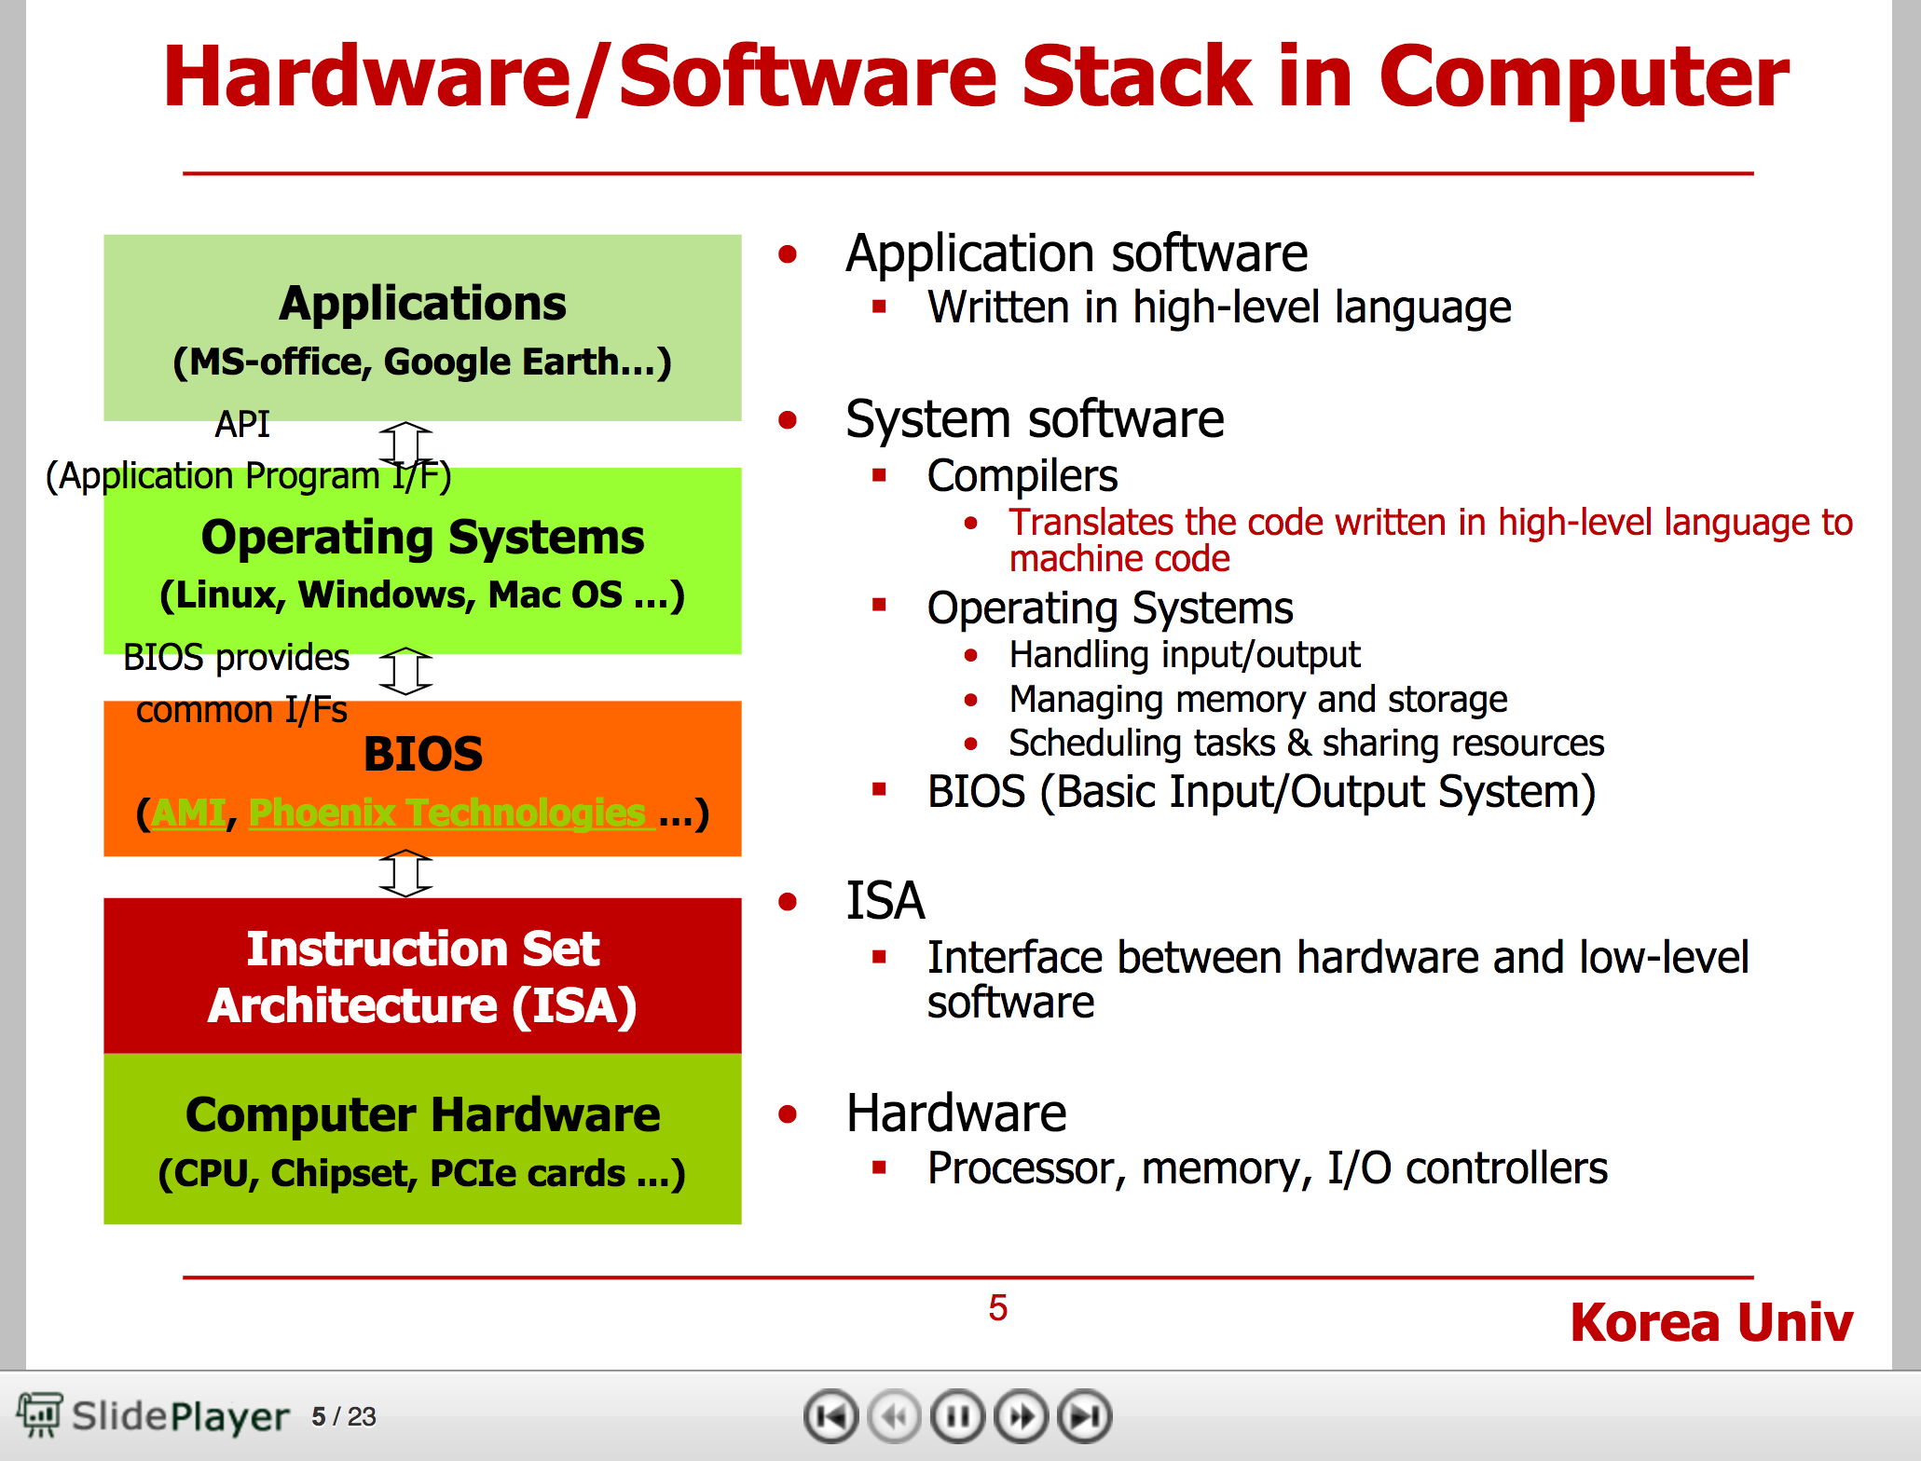
Hardware/Software Stack
http://player.slideplayer.com/36/10573982/#
Notes:
Play through slide #14.

Slide 14
Linux
“Linux is worth trying. It is a strange country indeed, but you don’t have to live there; a brief sojourn suffices to give some flavor of the place and – more importantly to lay bare everything that is taken for granted, and all that could have been done differently, under Windows or MacOS.”

Slide 15
“When working with something as powerful as Linux, you can easily devote a full half-hour to engineering a single command line”
GUIs tend to impose a large overhead on every single piece of software, even the smallest, and this overhead completely changes the programming environment. Small utility programs are no longer worth writing.
The only way that Apple and Microsoft can get away with [selling Oses for money] is by pursuing technological advancements as aggressively as they can, and by getting people to believe in and to pay for, a particular image: in the case of Apple, that of the creative thnker, and in the case of Microsoft, that of the respectable techno-bourgeois. Just like Disney, they are making money from selling an interface, a magic mirror

Slide 16
Macintosh Metaphors, 1984
https://www.youtube.com/watch?v=zIE-5hg7FoA

Slide 17
1984 Explained
https://www.youtube.com/watch?v=PsjMmAqmblQ

Slide 18
Piper does seem to lean too hard into the binary between cultural analyst and cultural critic when discussing a lack of self-reflection that directs work and its conclusion. The most recent trend in cultural criticism has been primarily a refocusing on the individual and particular, but in dialogue with extant research.
I ask myself if cultural analytics delivers on the self-reflective as well as Piper states? It appears to point more toward the direction that standardization and accessibility to method creates easier engagement rather than preventative frameworks for generalization and self-reflection.
Joshua Baco

Slide 19
Can data science accommodate broad critiques of Western knowledge?
Andrew Akhlaghi
How then can the humanities/social sciences and computer sciences develop new ontologies that represent the world in a productive way and also recognize the need for reflexivity? Paul Flynn
These types of misogynist metaphors I find incredibly pervasive among tech writers (see Ian Bogost’s The Geek’s Chihuahua, which I read several years ago but still remember as being a particularly severe offender), and they are assuredly 1) gatekeeping women from computation and 2) reflexively dictating what computation looks like. Emily Higgs
I'd like to step back from this question to ask a broader (read: less focused) one about the kinds of metaphors we use to discuss computers in general something like: why do the metaphors we use to think through computers matter? Or, perhaps more precisely, how do these metaphors matter?

