Slide 1

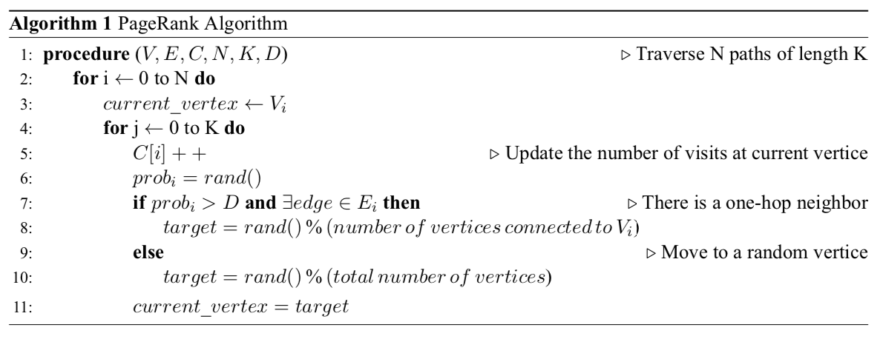
CptS 411: Welcome to Parallelism 101 Paul Valdez, School of EECS, Washington State University, Pullman WA (paul.valdez@wsu.edu)
IMD
Proposed Approach
I will be targeting a shared memory approach to the algorithm, using the openMP system.
Mainly the project is focused on recognizing that randomly traversing through the graph should result in a convergence of rankings given enough trials.
A Brief look into parallel programming regarding a Page Ranking algorithm
Problem and challenges
Main Outcomes
PROBLEM STATEMENT:
Input: A graph G, represented as an adjacency list
Damping Factor D, path length K, N Trials
Output: Top five most heavily visited vertices in G
SIGNIFICANCE: Its anticipated that the end results will converge to the serial results. The reason is because they will have the most links.
CHALLENGES: Figuring out load balances, synchronization, conversion of sequential to parallelism.
We will be presented evidence in the usefulness of parallel programming through runtime, speedup, and efficiency analysis.
We will have a deeper understanding of the different ways parallel programming is used today.
Overall, we will be able to see and recognize many different things that have been parallelized today.
Hopefully this piqued your interest in parallel programming. See you out there!
Date Prepared

