Slide 1



Sirius by Example
Build your own diagram, tables
and tree editors in 20 minutes
Pierre-Charles David (Obeo)
Stéphane Bonnet (Thales)
Alex Lagarde (Obeo)
http://www.eclipse.org/sirius

Slide 2
What is Sirius?

Slide 3
Sirius in a nutshell
A system to quickly define custom multi-view worbenches
  Based on graphical editors/modelers
Based on Eclipse Modeling Technologies
  No need to be an expert for most uses
New Eclipse Project
  But already proven technology

Slide 4
What benefits?
For developers: reduce cost & complexity
  No need to be a GMF expert
  Dynamic & iterative (live) development
For end-users
  Tools adapted to their needs and workflows
  Improved experience (compared to raw GMF)

Slide 5
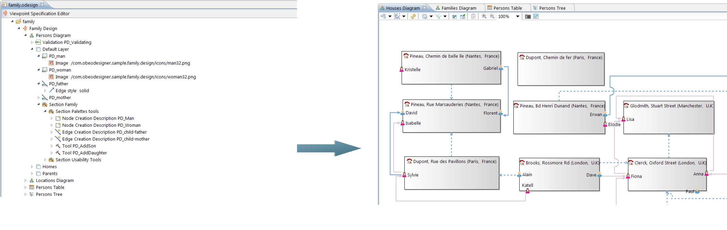
Two parts for two kinds of users
Specification Environment
(Specifier/Developer)
Runtime Environment
(End-user)

Slide 6
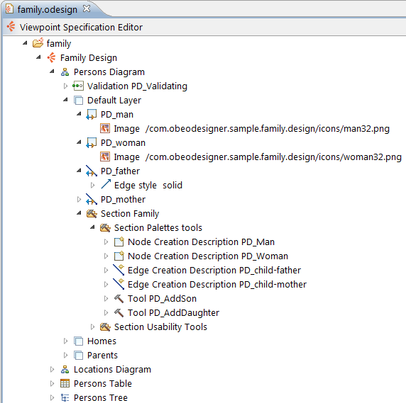
The Specification Environment
Define custom multi-view worbenches
  Diagrams, Trees, Tables
With little technical knowledge
Get a working modeler fast
  instant feedback
Highly customizable
  native tooling
  Java or extension points

Slide 7
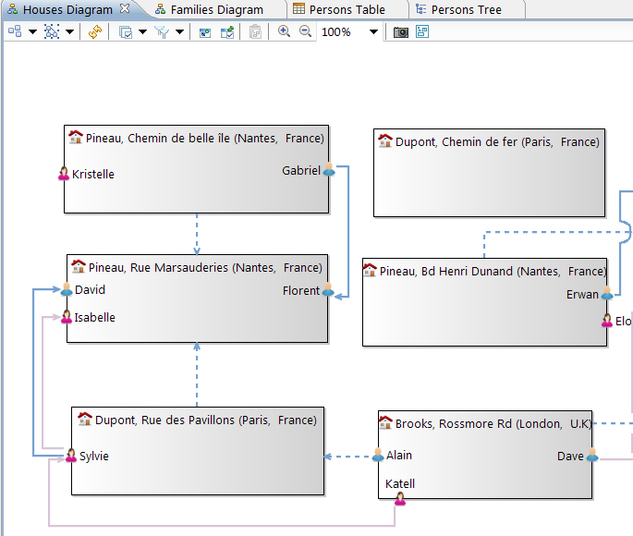
The Runtime
Executes the specification
  No code generation
Users manipulate models
  Not just a drawing tool
Environment adapted to user needs
  Viewpoint-based
Simplified workflow
  Modeling Project

Slide 8


A bit of history (1/2)
Thales original needs
Thales previous experiences with UML profiling | Poor adoption by system engineers Metamodels constrained byUML concepts Representations constrained by existing UML diagram
Need for DSLs | More freedom in representations Heavier and more technical (GMF) developments Originally 2 or 3 foreseen modeling tools
Workbench/Business concerns separation | Generic infrastructure for model management and representation Focus on business added-value Capitalization

Slide 9
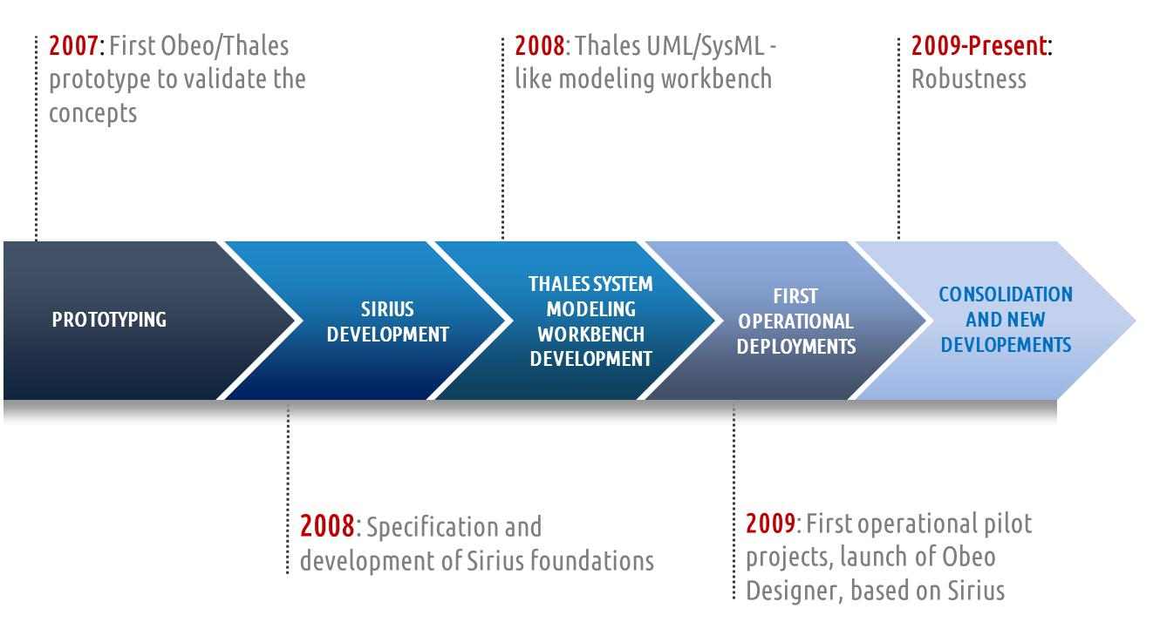
A bit of history (2/2)

Slide 10
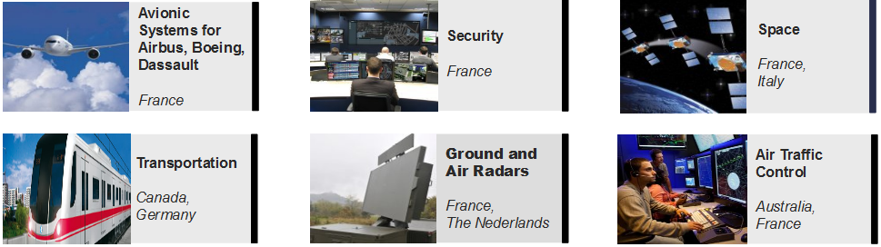
Who already uses Sirius?
Thales Operational Deployment Figures
XXX Modeling Tools | XXX Everyday Users
XX Operational or Pilot Projects | XXX Diagrams in Some Models
XXX Engineers Trained per day | XXXX Graphical Elements in Biggest Diagrams

Slide 11
Who already uses Sirius?
Embedded in the Obeo Designer and Obeo SmartEA (proprietary) products for 4 years
  many use cases & customers
Open Source modelers on Github and the MarketPlace
  Many fields (UML, Risk Analysis, SysML, TOGAF, Entity...)
  1300+ installs in September 2013
And now... you!
  Integation builds for v0.9 available now
  Version v1.0 planned for Eclipse 4.4 (Luna)

Slide 12
Sirius in Action

Slide 13
Live Demo
Eclipse 4.3 (Kepler)
Sirius 0.9 (integration build)
All materials available on GitHub
  https://github.com/pcdavid/eclipsecon-europe-2013
Alex will play the Customer
Expresses the needs
No technical knowledge
Pierre-Charles will play the Specifier
Implements the modelers

Slide 14
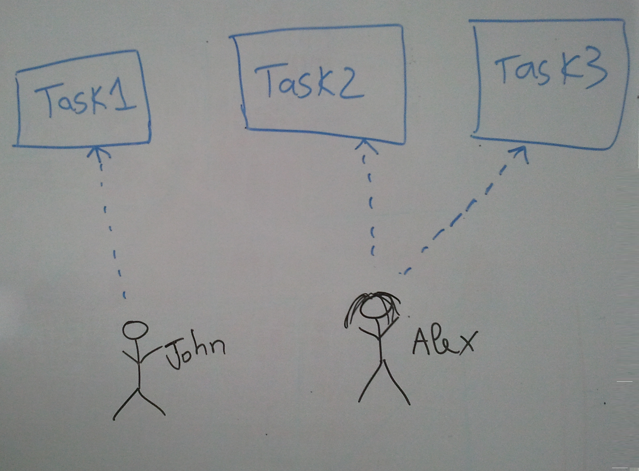
Sirius in Action
What the customer wants:

Slide 15
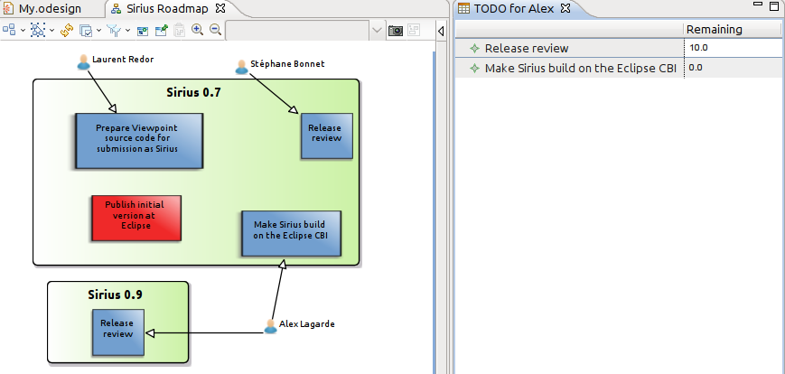
Sirius in Action
What the customer
asked for:
What he actually
needed and got:

Slide 16
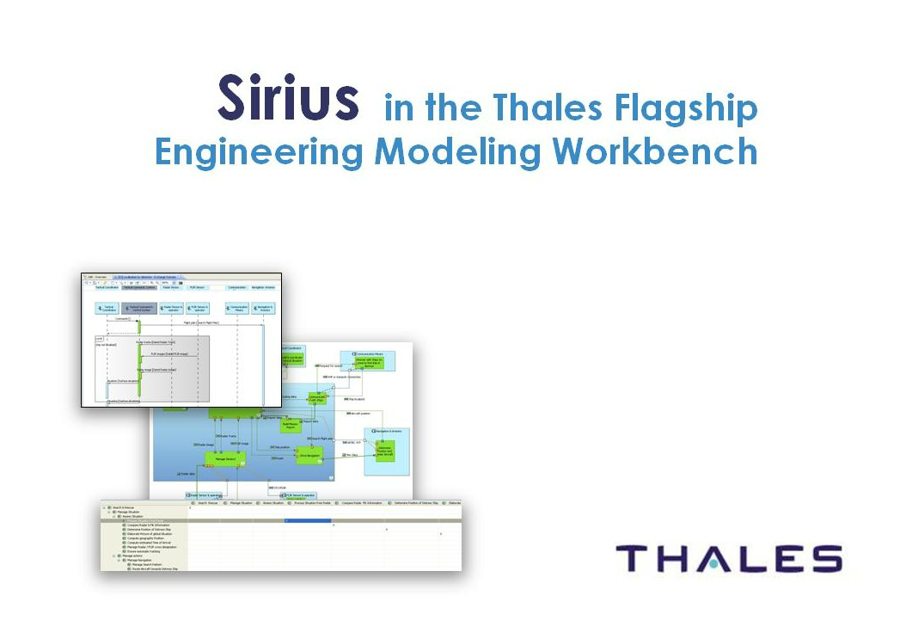
What the customer can get in more than 20 minutes

Slide 17
Conclusion

Slide 18
Three things to remember about Sirius
A full-featured environment to create custom modelers
Mature, many deployements
Official Eclipse project
  around 10 full-time commiters
  v0.9 release soon, v1.0 will be in Luna

Slide 19
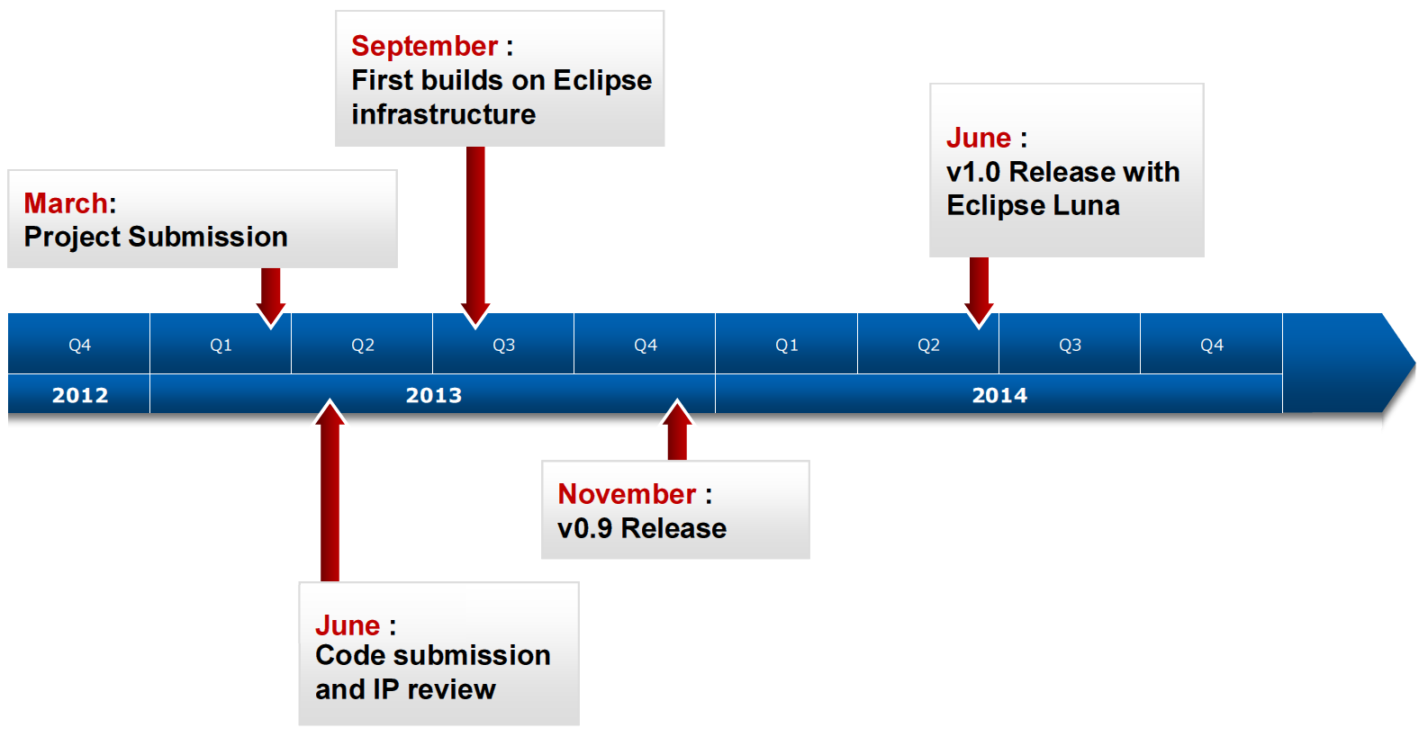
Roadmap

Slide 20

Thank You!
Project Web Site
  http://www.eclipse.org/sirius
How to get started
  http://wiki.eclipse.org/Sirius/Getting_Started
Forum
  http://www.eclipse.org/forums/eclipse.sirius
Don't forget to give feedback
See you at the BOF tonight!

