Slide 1
Fuse
Prime Array Fusing Methodology
Joseph

Slide 2

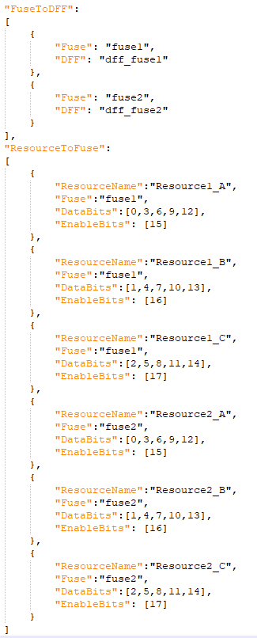

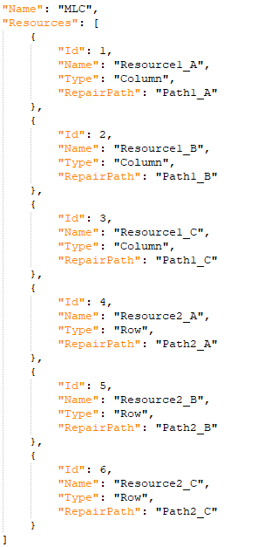

Array Fusing Test Method
json
Id: 6 = 30
Get previous solution from DFF or Default
From
DFF
dff_fuse1
0x09200
Previous
solutions
dff_fuse2
0x24920
Id: 1= 24
Previous
solutions
15
12
9
6
3
0
11000 => 24
fuse1
0000_1001_0010_0000_0000
0000_1001_0010_0000_0000
0000_1001_0010_0000_0000
0000_1001_0010_0000_0000
Apply
FuseOverride
0000_1001_0010_0000_0000
Resource1_A = 24
17
14
11
8
5
2
fuse2
0010_0100_1001_0010_0000
0010_0100_1001_0010_0000
0010_0100_1001_0010_0000
0010_0100_1001_0010_0000
0010_0100_1001_0010_0000
Resource2_C = 30
Find Repair
Solution
Id: 2 = 20
Resource1_B = 10100
fuse1
0001_1011_0010_1000_0000
Apply
FuseOverride
0000_1001_0010_0000_0000
fuse2
0000_0100_1001_0010_0100
Set Solution to
DFF
dff_fuse1
0x1B280
dff_fuse2
0x24920

Slide 3
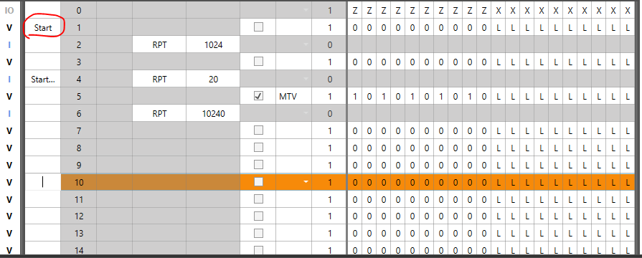
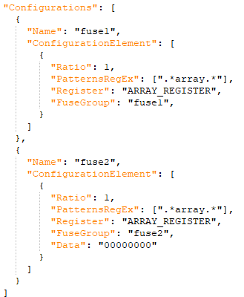
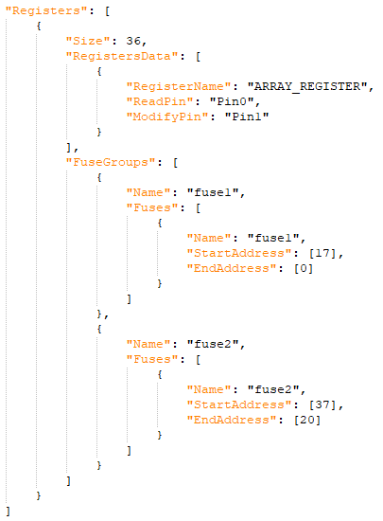
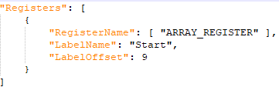
Array Repair Test Method
Get previous solution from DFF or Default
From Default
000…000
Previous
solutions
json
Apply
FuseOverride
Find Repair
Solution
fuseDataLabel.json
Apply
FuseOverride
Set Solution to
DFF
fuseconfig.json
fusedef.json

Slide 4
End

