Slide 1
Repair Algorithm
Prime Array Repair Methodology
Wajde - Joseph

Slide 2
What is array repair algorithm?
This is repair algorithm that takes array defects and array resources and return a possible solution.
This algorithm is implemented through a prime callback for ArrayRepair test method.

Slide 3
General Description of the Algorithm
The algorithm chosen for this callback is greedy by nature, that looks for the optimal solution.
In our case, the algorithm will prefer to start wasting the “local” resources over the “global” resources.
“local” and “global” are terms that describes the “tree level depth” distance of a resource from a defect. In the actual implementation this is referred as a “priority”

Slide 4
Resource-Defect repair priority
Array Structure
2
Slice0
R1
2
A priority is value calculated on a given defect and a resource, to describe the “importance” of the resource in relation to the defect location.
In this example for “Defect1”: R1 priority is 2 and is the highest among the other priorities because R1 in the array hierarchical structure can solve many other defects that can exist under difference tree branches.
Half-Slice0
Half-Slice1
R2
1
Q1
Q2
Q1
Q2
Q3
R3
0
Defect 2
Defect 1
priorities

Slide 5
Repair Algorithm High Level Overview
High-level pseudo code
Given the defects & resources. Create a table that will contain in each row: resource, priority & defects it can fix.
Sort table to have at the first line the lowest priority resource.
Use the resource on the first line, and update table.
If table is NOT empty go to step 2.
If table is empty & NO defects left to solve -> report out solution. Otherwise fail.

Slide 6
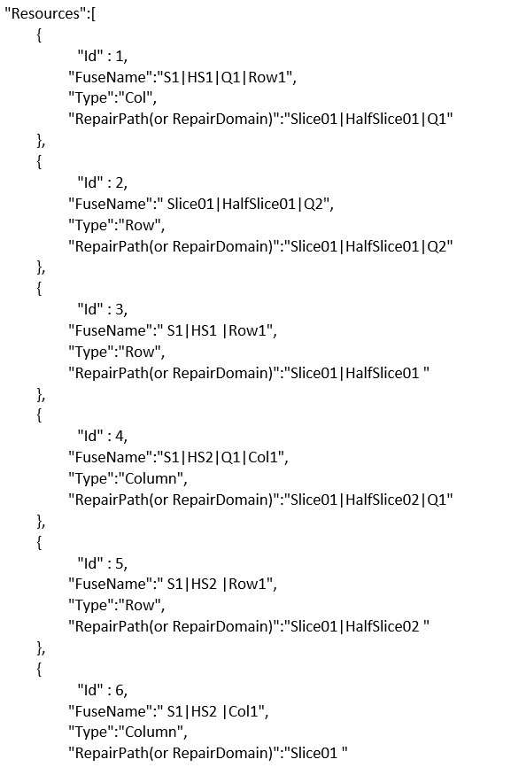
RESOURCE
Slice01
Id: 6, Type: col
Half-Slice01
Half-Slice02
Id: 3, Type: row
Id: 5, Type: row
Q1
Q2
Q1
Id: 1, Type: col
Id: 2, Type: row
Id: 4, Type: col

Slide 7

Example (Create Table)
RESOURCE
DEFECT
Slice01
Priority | Number of defects this resources fix | Resource Id | Value | Defects Id This Resource Id Fixes
0 | 1 | 1 | 4 | 1
1 | 1 | 3 | 5 | 1
2 | 1 | 6 | 4 | 1
0 | 1 | 1 | 2 | 2
1 | 1 | 3 | 3 | 2
2 | 1 | 6 | 2 | 2
0 | 1 | 1 | 2 | 3
1 | 1 | 3 | 6 | 3
2 | 1 | 6 | 2 | 3
0 | 1 | 2 | 3 | 4
1 | 1 | 3 | 3 | 4
2 | 1 | 6 | 2 | 4
0 | 1 | 4 | 7 | 5
1 | 1 | 5 | 5 | 5
2 | 1 | 6 | 7 | 5
Id: 6, Type: col
Half-Slice01
Half-Slice02
Id: 3, Type: row
Id: 5, Type: row
Q1
Q2
Q1
Id: 1, Type: col
Id: 2, Type: row
Id: 4, Type: col
D1 (row=5, col=4)
D4 (row=3, col=2)
D5 (row=5, col=7)
D2 (row=3, col=2)
* See full repair example on attached document.
D3 (row=6, col=2)

Slide 8
Example (Merge Table)
RESOURCE
DEFECT
Slice01
Priority | Number of defects this resources fix | Resource Id | Value | Defects Id This Resource Id Fixes
0 | 1 | 1 | 4 | 1
1 | 1 | 3 | 5 | 1
2 | 1 | 6 | 4 | 1
0 | 1 | 1 | 2 | 2
1 | 1 | 3 | 3 | 2
2 | 1 | 6 | 2 | 2
0 | 1 | 1 | 2 | 3
1 | 1 | 3 | 6 | 3
2 | 1 | 6 | 2 | 3
0 | 1 | 2 | 3 | 4
1 | 1 | 3 | 3 | 4
2 | 1 | 6 | 2 | 4
0 | 1 | 4 | 7 | 5
1 | 1 | 5 | 5 | 5
2 | 1 | 6 | 7 | 5
Id: 6, Type: col
Half-Slice01
Half-Slice02
Id: 3, Type: row
Id: 5, Type: row
Q1
Q2
Q1
Id: 1, Type: col
Id: 2, Type: row
Id: 4, Type: col
D1 (row=5, col=4)
D4 (row=3, col=2)
D5 (row=5, col=7)
D2 (row=3, col=2)
* See full repair example on attached document.
D3 (row=6, col=2)

Slide 9
Example (Merge Table)
RESOURCE
DEFECT
Slice01
Priority | Number of defects this resources fix | Resource Id | Value | Defects Id This Resource Id Fixes
0 | 2 | 1 | 2 | 2,3
0 | 1 | 1 | 4 | 1
0 | 1 | 2 | 3 | 4
0 | 1 | 4 | 7 | 5
1 | 2 | 3 | 3 | 2,4
1 | 1 | 3 | 5 | 1
1 | 1 | 3 | 6 | 3
1 | 1 | 5 | 5 | 5
2 | 3 | 6 | 2 | 2,3,4
2 | 1 | 6 | 4 | 1
2 | 1 | 6 | 7 | 5
Id: 6, Type: col
Half-Slice01
Half-Slice02
Id: 3, Type: row
Id: 5, Type: row
Q1
Q2
Q1
Id: 1, Type: col
Id: 2, Type: row
Id: 4, Type: col
D1 (row=5, col=4)
D4 (row=3, col=2)
D5 (row=5, col=7)
D2 (row=3, col=2)
* See full repair example on attached document.
D3 (row=6, col=2)

Slide 10
Example (Use First Resource)
RESOURCE
DEFECT
Slice01
Priority | Number of defects this resources fix | Resource Id | Value | Defects Id This Resource Id Fixes
0 | 2 | 1 | 2 | 2,3
0 | 1 | 1 | 4 | 1
0 | 1 | 2 | 3 | 4
0 | 1 | 4 | 7 | 5
1 | 2 | 3 | 3 | 2,4
1 | 1 | 3 | 5 | 1
1 | 1 | 3 | 6 | 3
1 | 1 | 5 | 5 | 5
2 | 3 | 6 | 2 | 2,3,4
2 | 1 | 6 | 4 | 1
2 | 1 | 6 | 7 | 5
Id: 6, Type: col
Half-Slice01
Half-Slice02
Id: 3, Type: row
Id: 5, Type: row
Q1
Q2
Q1
Id: 1, Type: col
Id: 2, Type: row
Id: 4, Type: col
D1 (row=5, col=4)
D4 (row=3, col=2)
D5 (row=5, col=7)
D2 (row=3, col=2)
* See full repair example on attached document.
D3 (row=6, col=2)

Slide 11
Example (Use First Resource)
RESOURCE
DEFECT
Slice01
Priority | Number of defects this resources fix | Resource Id | Value | Defects Id This Resource Id Fixes
0 | 2 | 1 | 2 | 2,3
0 | 1 | 2 | 3 | 4
0 | 1 | 4 | 7 | 5
1 | 1 | 3 | 3 | 4
1 | 1 | 3 | 5 | 1
1 | 0 | 3 | 6
1 | 1 | 5 | 5 | 5
2 | 1 | 6 | 2 | 4
2 | 1 | 6 | 4 | 1
2 | 1 | 6 | 7 | 5
Id: 6, Type: col
Half-Slice01
Half-Slice02
Id: 3, Type: row
Id: 5, Type: row
Q1
Q2
Q1
Id: 1, Type: col
Id: 2, Type: row
Id: 4, Type: col
D1 (row=5, col=4)
D4 (row=3, col=2)
D5 (row=5, col=7)
D2 (row=3, col=2)
* See full repair example on attached document.
D3 (row=6, col=2)

Slide 12
Example (Use the Next Resource again)
RESOURCE
DEFECT
Slice01
Priority | Number of defects this resources fix | Resource Id | Value | Defects Id This Resource Id Fixes
0 | 1 | 2 | 3 | 4
0 | 1 | 4 | 7 | 5
1 | 1 | 3 | 3 | 4
1 | 1 | 3 | 5 | 1
1 | 1 | 5 | 5 | 5
2 | 1 | 6 | 2 | 4
2 | 1 | 6 | 4 | 1
2 | 1 | 6 | 7 | 5
Id: 6, Type: col
Half-Slice01
Half-Slice02
Id: 3, Type: row
Id: 5, Type: row
Q1
Q2
Q1
Id: 1, Type: col
Id: 2, Type: row
Id: 4, Type: col
D1 (row=5, col=4)
D4 (row=3, col=2)
D5 (row=5, col=7)
D2 (row=3, col=2)
* See full repair example on attached document.
D3 (row=6, col=2)

Slide 13
Example (Use the Next Resource again)
RESOURCE
DEFECT
Slice01
Priority | Number of defects this resources fix | Resource Id | Value | Defects Id This Resource Id Fixes
0 | 1 | 2 | 3 | 4
0 | 1 | 4 | 7 | 5
1 | 0 | 3 | 3
1 | 1 | 3 | 5 | 1
1 | 1 | 5 | 5 | 5
2 | 0 | 6 | 2
2 | 1 | 6 | 4 | 1
2 | 1 | 6 | 7 | 5
Id: 6, Type: col
Half-Slice01
Half-Slice02
Id: 3, Type: row
Id: 5, Type: row
Q1
Q2
Q1
Id: 1, Type: col
Id: 2, Type: row
Id: 4, Type: col
D1 (row=5, col=4)
D4 (row=3, col=2)
D5 (row=5, col=7)
D2 (row=3, col=2)
* See full repair example on attached document.
D3 (row=6, col=2)

Slide 14
Example (Use the Next Resource again)
RESOURCE
DEFECT
Slice01
Priority | Number of defects this resources fix | Resource Id | Value | Defects Id This Resource Id Fixes
0 | 1 | 4 | 7 | 5
1 | 1 | 3 | 5 | 1
1 | 1 | 5 | 5 | 5
2 | 1 | 6 | 4 | 1
2 | 1 | 6 | 7 | 5
Id: 6, Type: col
Half-Slice01
Half-Slice02
Id: 3, Type: row
Id: 5, Type: row
Q1
Q2
Q1
Id: 1, Type: col
Id: 2, Type: row
Id: 4, Type: col
D1 (row=5, col=4)
D4 (row=3, col=2)
D5 (row=5, col=7)
D2 (row=3, col=2)
* See full repair example on attached document.
D3 (row=6, col=2)

Slide 15
Example (Use the Next Resource again)
RESOURCE
DEFECT
Slice01
Priority | Number of defects this resources fix | Resource Id | Value | Defects Id This Resource Id Fixes
0 | 1 | 4 | 7 | 5
1 | 1 | 3 | 5 | 1
1 | 0 | 5 | 5
2 | 1 | 6 | 4 | 1
2 | 0 | 6 | 7
Id: 6, Type: col
Half-Slice01
Half-Slice02
Id: 3, Type: row
Id: 5, Type: row
Q1
Q2
Q1
Id: 1, Type: col
Id: 2, Type: row
Id: 4, Type: col
D1 (row=5, col=4)
D4 (row=3, col=2)
D5 (row=5, col=7)
D2 (row=3, col=2)
* See full repair example on attached document.
D3 (row=6, col=2)

Slide 16
Example (Use the Next Resource again)
RESOURCE
DEFECT
Slice01
Priority | Number of defects this resources fix | Resource Id | Value | Defects Id This Resource Id Fixes
1 | 1 | 3 | 5 | 1
2 | 1 | 6 | 4 | 1
Id: 6, Type: col
Half-Slice01
Half-Slice02
Id: 3, Type: row
Id: 5, Type: row
Q1
Q2
Q1
Id: 1, Type: col
Id: 2, Type: row
Id: 4, Type: col
D1 (row=5, col=4)
D4 (row=3, col=2)
D5 (row=5, col=7)
D2 (row=3, col=2)
* See full repair example on attached document.
D3 (row=6, col=2)

Slide 17
Example (Use the Next Resource again)
RESOURCE
DEFECT
Slice01
Priority | Number of defects this resources fix | Resource Id | Value | Defects Id This Resource Id Fixes
1 | 1 | 3 | 5 | 1
2 | 1 | 6 | 4
Id: 6, Type: col
Half-Slice01
Half-Slice02
Id: 3, Type: row
Id: 5, Type: row
Q1
Q2
Q1
Id: 1, Type: col
Id: 2, Type: row
Id: 4, Type: col
D1 (row=5, col=4)
D4 (row=3, col=2)
D5 (row=5, col=7)
D2 (row=3, col=2)
* See full repair example on attached document.
D3 (row=6, col=2)

Slide 18
DEMO

