Slide 1
[PRIME] FuseRead and FuseBurn File-based MiniFlow User Guide (v2)

Slide 2
Methodology
Allow user to create flow with Json file without the need to reload test program.
TestMethod will execute Mini Flow instead of CustomExecute (or Any User Code Extension).
User can create tests with supported mini flow API and control the next step/action depending on test execute result and OnTrue/OnFalse setting.
Mini Flow API and Supported TestMethod
Mini Flow API | FuseReadMaskULTDecode | FuseBurnMask | FuseBurnSspec
SetStorage | ✔ | ✔ | ✔
CompareStorage | ✔ | ✔ | ✔
CallBack | ✔ | ✔ | ✔
Datalog | ✔ | ✔ | ✔
ReadMask | ✔ | ✘ | ✘
ULTDecode | ✔ | ✘ | ✘
MaskBurn | ✘ | ✔ | ✘
SspecBurn | ✘ | ✘ | ✔
ULTEncode | ✘ | ✔ | ✔

Slide 3
Test Instance Setup
Test Instance Parameter | Data Type | Description | Example
MiniFlowFile | File | Mini flow full file path. | “~HDMT_TPL_DIR/TestPrograms/Modules/Fuse/InputFiles/MiniFlowFile.json”
MiniFlowTest | String | Mini flow test to execute. | “ValidMiniFlowName”

Slide 4
Test Instance Setup (PrimeFuseReadMaskUltDecodeTestMethod)
Example PrimeFuseReadMaskUltDecodeTestMethod
Test PrimeFuseReadMaskUltDecodeTestMethod MiniFlow_StorageCompare_P1
{
ConfigurationFile = "~HDMT_TPL_DIR/TestPrograms/FuseRead/Modules/FuseRead/InputFiles/Hdmt/scenario27.fuseRead.json";
ConfigName = "Config27";
RegisterName = "CPU3,CPU4";
ExecutionMode = "SimulationMode";
Patlist = "ctv_plist";
PrePlist = "";
LevelsTc = "FuseRead::basic_func_lvl_nom";
TimingsTc = "FuseRead::basic_func_timing_10MHz_20MHz";
LogLevel = "Enabled";
DieIdNames = "U2.U1,NA";
PostUltExecuteMaskName = "";
PackageEfuse = "U2.U1";
MiniFlowFile = "~HDMT_TPL_DIR/TestPrograms/FuseRead/Modules/FuseRead/InputFiles/Hdmt/MiniFlow/MiniFlowCompareStorageA.json";
MiniFlowName = "ValidMiniFlowName";
}
When using Mini Flow, PassingMaskName and FailingMaskName required to be removed.
The Registers that defined with test instance parameter “RegisterName” (CPU3 and CPU4) will be execute the same mini flow.

Slide 5
Test Instance Setup (PrimeFuseBurn*TestMethod)
Example PrimeFuseBurnMaskTestMethod
Test PrimeFuseBurnMaskTestMethod MiniFlow_Burn_P1
{
ConfigurationFile = "~HDMT_TPL_DIR/TestPrograms/FuseBurn/Modules/FuseBurn/InputFiles/scenario1.fuseBurn.json";
ConfigName = "Config1";
RegisterNames = "CPU0";
Patlist = "ctv_plist";
LevelsTc = "FuseBurn::basic_func_lvl_nom";
TimingsTc = "FuseBurn::basic_func_timing_10MHz_20MHz";
LogLevel = "Enabled";
MiniFlowFile = "~HDMT_TPL_DIR/TestPrograms/FuseBurn/Modules/FuseBurn/InputFiles/MiniFlow/MiniFlowExecuteBurnMask.json";
MiniFlowName = "ValidMiniFlowName";
}
When using Mini Flow, MaskNames required to be removed.
Example PrimeFuseBurnSspecTestMethod Test PrimeFuseBurnSspecTestMethod MiniFlow_Sspec_StorageCompare_P1
{
ConfigurationFile = "~HDMT_TPL_DIR/TestPrograms/FuseBurn/Modules/FuseBurn/InputFiles/scenario1_sspec.fuseBurn.json";
ConfigName = "Config1";
RegisterNames = "CPU0";
Patlist = "ctv_plist";
LevelsTc = "FuseBurn::basic_func_lvl_nom";
TimingsTc = "FuseBurn::basic_func_timing_10MHz_20MHz";
LogLevel = "Enabled";
MiniFlowFile = "~HDMT_TPL_DIR/TestPrograms/FuseBurn/Modules/FuseBurn/InputFiles/MiniFlow/MiniFlowCompareStorageSspecA.json";
MiniFlowName = "ValidMiniFlowName";
}

Slide 6
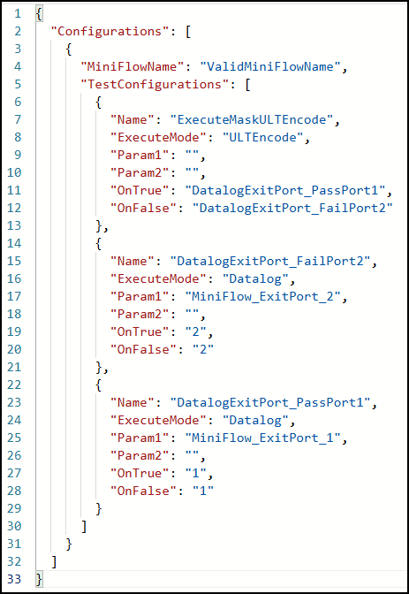
Mini Flow File Setup (Json)
Json Attribute (Required) | Explanation
“MiniFlowName” | TestMethod will execute test instance parameter “MiniFlowTest” that match this name.
“TestConfigurations” | Test Setup(s)
“Name” | Test identifier. Use for “OnTrue”/”OnFalse”. Cannot have duplicate name.
“ExecuteMode” | MiniFlow API to execute.
“Param1” “Param2” | Input parameter for MiniFlow API.
“OnTrue” | Action when current Test execute return True. Can be test “Name” or “ExitPort”.
“OnFalse” | Action when current Test execute return False. Can be test “Name” or “ExitPort”.
Json Attribute (Optional) | Explanation
“DataType” | Optional parameter when “ExecuteMode” is “CompareStorage”.
Sample File

Slide 7
Common API for FuseRead and FuseBurn : SetStorage
MiniFlow API | Description | Param1 | Param2
SetStorage | Support Set Storage to Storage Set Static String to Storage Data Type String Supported Storage SharedStorage (S) UserVar (U) DFF (D) | Storage to Set SharedStorage S|Key|Context (Default ResetPolicy "RESET_AT_DEVICE_START“) S|Key|Context|ResetPolicy Uservar U|CollectionName.VarName DFF D|DFFName|DieID|OpType | Data to Set (Dynamic) Get from 1 of 3 Storage Literal String
Execute Result
True
Retrieved Data (Param2) can set to storage (Param1).
False
Data to set (Param2) not exist or is empty.
Fail to set data to storage (Param1).
Notes:
uservar example:
U|SCVars.SC_INTRO_METHOD

Slide 8
Usage Scenario
User want to set Uservar with static value.
When OnTrue, execute next test. When OnFalse, exit port 2.
{
"Name": “MyTest1",
"ExecuteMode": "SetStorage",
"Param1": "U|SCVars.SC_INTRO_METHOD",
"Param2": “ENG",
"OnTrue": “MyTestNext",
"OnFalse": "2"
}
User want to set Uservar with SharedStorage value.
When OnTrue, execute next test. When OnFalse, exit port 2.
{
"Name": “MyTest1",
"ExecuteMode": "SetStorage",
"Param1": "U|FUSEUFGL.S_U2U1_FULLBINARY",
"Param2": "S|fusestring_CPU0|DUT",
"OnTrue": “MyTestNext",
"OnFalse": "2"
}
Notes:
uservar example:
U|SCVars.SC_INTRO_METHOD

Slide 9
Common API for FuseRead and FuseBurn : CompareStorage
MiniFlow API | Description | Param1 | Param2 | DataType
CompareStorage | Support Compare Storage to Storage Compare Storage to Static String Data Type String Supported Storage SharedStorage (S) UserVar (U) DFF (D) | Storage to Compare (Actual) SharedStorage S|Key|Context Uservar U|CollectionName.VarName DFF D|DFFName|DieID|OpType | Data to Compare (Expected) (Dynamic) Get from 1 of 3 Storage Literal String Support ‘s’ (skip) character. | When is “Literal” Do literal string comparison. It is not case sensitive. When is “Binary” (Default) Apply data format check for Param1 and Param2. Do bit by bit comparison.
Execute Result
True
Actual Data (Param1) matched Expected Data (Param2).
False
Actual Data (Param1) not exist or is empty or contain invalid character (allowed 01u).
Expected Data (Param2) not exist or is empty or contain invalid character (allowed 01s).
Compare result having mismatch.

Slide 10
Usage Scenario (Binary Comparison)
User want to compare actual Uservar with expected static value.
When OnTrue, execute next test. When OnFalse, exit port 2.
{
"Name": “MyTest1",
"ExecuteMode": “CompareStorage",
"Param1": "U|FUSEUFGL.S_U2U1_FULLBINARY",
"Param2": “00110101001010101010100000110101001010101010100000",
"OnTrue": “MyTestNext",
"OnFalse": "2"
}
User want to compare actual Uservar with expected SharedStorage value.
When OnTrue, execute next test. When OnFalse, exit port 2.
{
"Name": “MyTest1",
"ExecuteMode": "SetStorage",
"Param1": "U|FUSEUFGL.S_U2U1_FULLBINARY",
"Param2": "S|fusestring_CPU0|DUT",
"DataType": "Binary",
"OnTrue": “MyTestNext",
"OnFalse": "2"
}
Notes:
uservar example:
U|SCVars.SC_INTRO_METHOD

Slide 11
Usage Scenario (Literal Comparison)
User want to compare actual Uservar with expected static (literal) value.
When OnTrue, execute next test. When OnFalse, exit port 2.
{
"Name": “MyTest1",
"ExecuteMode": “CompareStorage",
"Param1": "U|SCVars.SC_INTRO_METHOD ",
"Param2": “PROD",
"DataType": "Literal",
"OnTrue": “MyProdTest",
"OnFalse": "MyTest2"
},
{
"Name": “MyTest2",
"ExecuteMode": “CompareStorage",
"Param1": "U|SCVars.SC_INTRO_METHOD ",
"Param2": “ENG",
"DataType": "Literal",
"OnTrue": “MyEngTest",
"OnFalse": "2"
}
User want to compare actual Uservar with expected SharedStorage value.
When OnTrue, execute next test. When OnFalse, exit port 2.
{
"Name": “MyTest1",
"ExecuteMode": "SetStorage",
"Param1": "U|FUSEUFGL.S_U2U1_FULLBINARY",
"Param2": "S|fusestring_CPU0|DUT",
"DataType": "Literal",
"OnTrue": “MyTestNext",
"OnFalse": "2"
}
Notes:
uservar example:
U|SCVars.SC_INTRO_METHOD

Slide 12
CompareStorage execution scenario
 | Data | Execute Result | Console
Actual Data (param1) Expected Data (param2) | 0000 0ss0 | Pass OnTrue | CompareStorage=[Pass]
Actual Data (param1) Expected Data (param2) | 0110 0ss0 | Pass OnTrue | CompareStorage=[Pass]
Actual Data (param1) Expected Data (param2) | 000u 000s | Pass OnTrue | CompareStorage=[Pass]
Actual Data (param1) Expected Data (param2) Actual Data (param1) Expected Data (param2) | 1001 0ss0 000u 0000 | Fail OnFalse | CompareStorage=[Fail] Reason=[Mismatch Data] Actual Data=[1001] Expected Data=[0ss0] CompareStorage=[Fail] Reason=[Mismatch Data] Actual Data=[000u] Expected Data=[0000]
Actual Data (param1) Expected Data (param2) | 00001 0ss0 | Fail OnFalse | CompareStorage=[Fail] Reason=[Mismatch Length, ExpectedData Length=[4], ActualData Length=[5]] Actual Data=[00001] Expected Data=[0ss0]
Actual Data (param1) Expected Data (param2) | 000s 0000 | Fail OnFalse | CompareStorage=[Fail] Reason=[Data Invalid Format, only binary format allow and ‘u’] Actual Data=[000s]
**The Fail case scenario will return False, not throw Exception.

Slide 13
Common API for FuseRead and FuseBurn : CallBack
MiniFlow API | Description | Param1 | Param2
CallBack | Execute callback function . | CallBack Name | CallBack Input
Execute Result
True
Successful execute Callback.
False
Callback not exist.
Callback execute fail.

Slide 14
Usage Scenario
User want to execute callback “PrimeSetSimulationString(CPU0@1111100000,PCH0@0000011111)”.
When OnTrue, execute next test. When OnFalse, exit port 2.
{
"Name": “MyTest1",
"ExecuteMode": "CallBack",
"Param1": "PrimeSetSimulationString",
"Param2": "CPU0@1111100000,PCH0@0000011111“,
"OnTrue": “MyTestNext",
"OnFalse": "2"
}
User want to execute callback “PrimePostProcessUltDecode(U2.U1,true,true)”.
When OnTrue, execute next test. When OnFalse, exit port 2.
{
"Name": “MyTest1",
"ExecuteMode": "CallBack",
"Param1": "PrimePostProcessUltDecode",
"Param2": " U2.U1,true,true “,
"OnTrue": “MyTestNext",
"OnFalse": "2"
}

Slide 15
Common API for FuseRead and FuseBurn : Datalog
MiniFlow API | Description | Param1 | Param2
Datalog | This does not affect existing test method printing, it is additional print to ITUFF as 2_comnt Support Static String to print Get Storage to print Supported Storage SharedStorage (S) UserVar (U) DFF (D) | Storage to Get SharedStorage S|Key|Context Uservar U|CollectionName.VarName DFF D|DFFName|DieID|OpType Literal String | “”
Execute Result
True
Able to write Data (Param1) to ituff.
False
Static Data (Param1) is empty or contain space.
Storage Data (Param1) not exist or is empty or contain space.

Slide 16
Usage Scenario
User want to compare actual Uservar with expected static value then datalog actual Uservar name and value.
When OnTrue, execute next test. When OnFalse, exit fail port.
{
"Name": “MyTest1",
"ExecuteMode": “CompareStorage",
"Param1": "U|FUSEUFGL.S_U2U1_FULLBINARY",
"Param2": “00110101001010101010100000110101001010101010100000",
"OnTrue": “MyDatalogUserVarName ",
"OnFalse": "2"
},
{
"Name": “MyDatalogUserVarName",
"ExecuteMode": “Datalog",
"Param1": "FUSEUFGL.S_U2U1_FULLBINARY",
"Param2": “",
"OnTrue": “MyDatalogUserVarValue ",
"OnFalse": “3"
},
{
"Name": “MyDatalogUserVarValue",
"ExecuteMode": “Datalog",
"Param1": "U|FUSEUFGL.S_U2U1_FULLBINARY",
"Param2": “",
"OnTrue": “1",
"OnFalse": “4"
}
Notes:
uservar example:
U|SCVars.SC_INTRO_METHOD

Slide 17
API for FuseRead (FuseReadMaskULTDecode):
MiniFlow API | Description | Param1 | Param2
ReadMask | Execute Mask. | Mask Name to Execute Must be valid name in “ConfigurationFile” Only single mask name | “”
Execute Result
True
Successful execute mask.
Fuse String and Mask Value is matched.
False
Requirement to execute mask not meet.
Fuse String and Mask Value is not matched.

Slide 18
Usage Scenario
User want to execute multiple PassingMask (MaskP1, MaskP2).
{
"Name": “MyTest1",
"ExecuteMode": “ReadMask",
"Param1": “MaskP1",
"Param2": “",
"OnTrue": “MyTest2 ",
"OnFalse": "2"
},
{
"Name": “MyTest2 ",
"ExecuteMode": “ReadMask ",
"Param1": “MaskP2",
"Param2": “",
"OnTrue": “1 ",
"OnFalse": “3"
}
User want to execute multiple FailingMask (MaskF1, MaskF2).
{
"Name": “MyTest1",
"ExecuteMode": “ReadMask",
"Param1": “MaskF1",
"Param2": “",
"OnTrue": “2",
"OnFalse": "MyTest2"
},
{
"Name": “MyTest2 ",
"ExecuteMode": “ReadMask ",
"Param1": “MaskF2",
"Param2": “",
"OnTrue": “3",
"OnFalse": “1"
}
Notes:
uservar example:
U|SCVars.SC_INTRO_METHOD

Slide 19
API for FuseRead (FuseReadMaskULTDecode): ULTDecode
MiniFlow API | Description | Param1 | Param2
ULTDecode | Execute Decode. | “” | “”
Execute Result
True
Successful execute ULTDecode.
False
Requirement to execute ULTDecode not meet (Fuse Read ConfigurationFile and Test Instance Parameters).
Fail to execute ULTDecode.
Usage Scenario
User want to execute ULTDecode.
When OnTrue, execute next test. When OnFalse, exit port 2.
{
"Name": “MyTest1",
"ExecuteMode": “ULTDecode",
"Param1": “",
"Param2": “",
"OnTrue": “MyTestNext",
"OnFalse": "2"
},

Slide 20
API for FuseBurnMask: MaskBurn
MiniFlow API | Description | Param1 | Param2
“MaskBurn” | Execute fuse burn mask. | Mask Name to Execute Must be valid name in “ConfigurationFile” Only single mask name | “”
Execute Result
True
Successful execute mask.
False
Requirement to execute mask not meet.
Usage Scenario
User want to execute multiple burn mask (burn_0_full_string, burn_1_full_string).
{
"Name": “MyTest1",
"ExecuteMode": “MaskBurn",
"Param1": “burn_0_full_string",
"Param2": “",
"OnTrue": “MyTest2 ",
"OnFalse": "2"
},
{
"Name": “MyTest2 ",
"ExecuteMode": “MaskBurn ",
"Param1": “burn_1_full_string",
"Param2": “",
"OnTrue": “1 ",
"OnFalse": “3"
}

Slide 21
API for FuseBurnSspec: SspecBurn
MiniFlow API | Description | Param1 | Param2
SspecBurn | Execute Sspec. | “” | “”
Execute Result
True
Successful execute sspec.
False
Requirement to execute sspec not meet.
Usage Scenario
User want to execute Sspec.
When OnTrue, execute next test. When OnFalse, exit port 2.
{
"Name": “MyTest1",
"ExecuteMode": “SspecBurn",
"Param1": “",
"Param2": “",
"OnTrue": “MyTestNext",
"OnFalse": "2"
},

Slide 22
API for FuseBurnMask and FuseBurnSspec: ULTEncode
MiniFlow API | Description | Param1 | Param2
ULTEncode | Execute encode. | “” | “”
Execute Result
True
Successful execute ULTEncode.
False
Requirement to execute ULTEncode not meet.
Fail to execute ULTDecode.
Usage Scenario
User want to execute ULTEncode.
When OnTrue, execute next test. When OnFalse, exit port 2.
{
"Name": “MyTest1",
"ExecuteMode": “ULTEncode",
"Param1": “",
"Param2": “",
"OnTrue": “MyTestNext",
"OnFalse": "2"
},

Slide 23
Backup

Slide 24
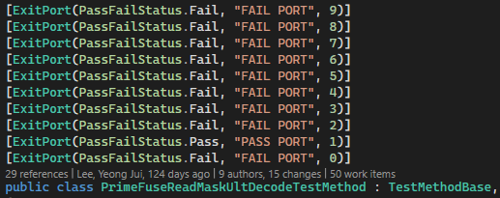
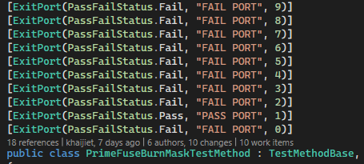
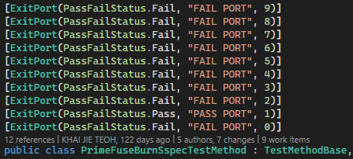
Exit Port
File Based Mini Flow only support 10 port (follow TestMethod).
Request TMM for expanding port.
Port | Status
0, 2-9 | Fail
1 | Pass

Slide 25
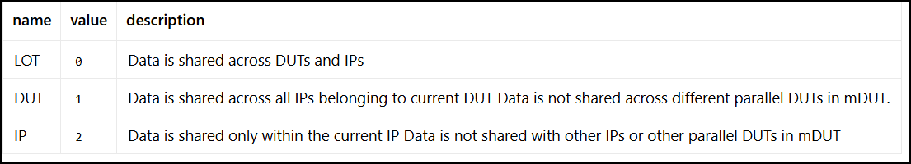
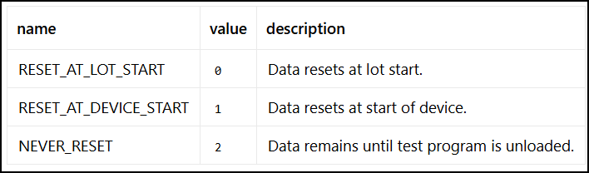
SharedStorage
Context:
ResetPolicy:

