Slide 1



Typing Test Website: Built with React.js
Welcome to the Typing Test website, a user-friendly platform designed to improve typing skills and track progress. This website utilizes React.js and various hooks to enhance functionality and create a seamless user experience.
Notes:
1

Slide 2
Leveraging React.js for a Seamless User Experience
Component-based Architecture
Virtual DOM
React.js promotes a component-based architecture, enabling developers to break down complex user interfaces into reusable and manageable components. This modularity enhances code organization and maintainability.
React.js utilizes a virtual DOM, which is a lightweight representation of the actual DOM. By comparing the virtual DOM with the actual DOM, React.js identifies only the necessary changes, resulting in optimized updates and improved performance.
Notes:
2

Slide 3


Implementing the useRef Hook for Tracking Typing Progress
1
Input Field Reference
The useRef hook allows developers to create a persistent reference to a DOM element, enabling us to track the user's typing progress by capturing the current value of the input field.
2
Tracking Progress
We can track the user's typing progress by continuously monitoring the value of the input field using the reference created by useRef.
Notes:
3

Slide 4
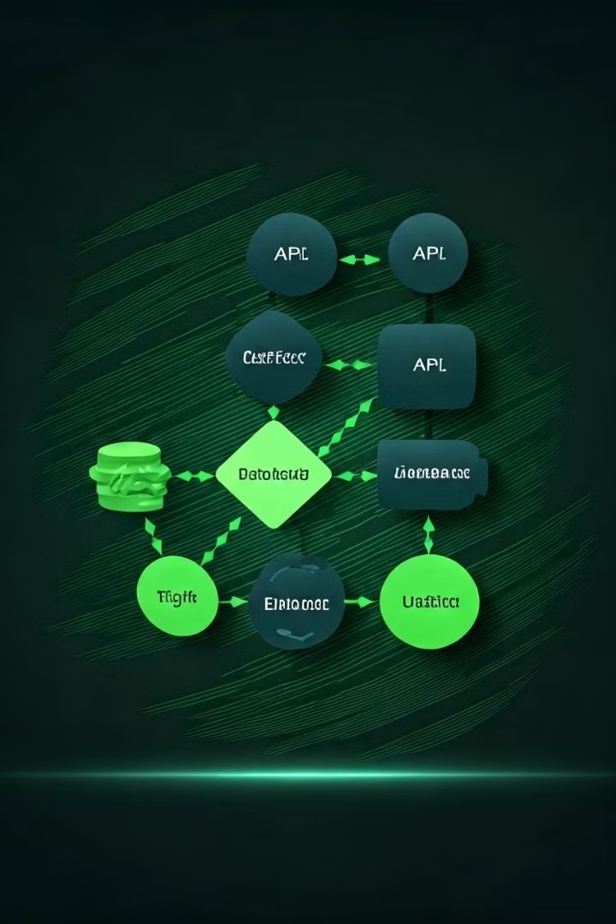
Utilizing the useEffect Hook
Subscription Setup
We can use useEffect to subscribe to events or streams of data, updating the component's state accordingly.
DOM Manipulation
useEffect allows us to make changes to the DOM directly, such as adding or removing elements or updating attributes.
Notes:
4

Slide 5

Managing State with the useState Hook
State Initialization
useState takes an initial value and returns an array containing the current state and a function to update the state.
State Updates
The update function provided by useState can be used to modify the component's state, triggering re-renders when necessary.
State Management
useState allows us to manage the state of a component effectively, ensuring that changes are propagated throughout the component tree.
Notes:
5

Slide 6



Providing Accurate Typing Speed and Accuracy Metrics
Speed
Typing speed is calculated by measuring the time taken to type a certain number of words.
Accuracy
Accuracy is determined by comparing the user's typed text with the correct text, highlighting any errors.
Notes:
6

Slide 7
Thank You!
Notes:
7

