Slide 1
Power analyses for refining experimental design and reducing animals in experimental research
Paul Johnson

Slide 2
What I’ll talk about
Using simulations for power analysis
Exploring the effect on power of
Getting the analysis wrong
Using more animals vs more replicates per animal

Slide 3
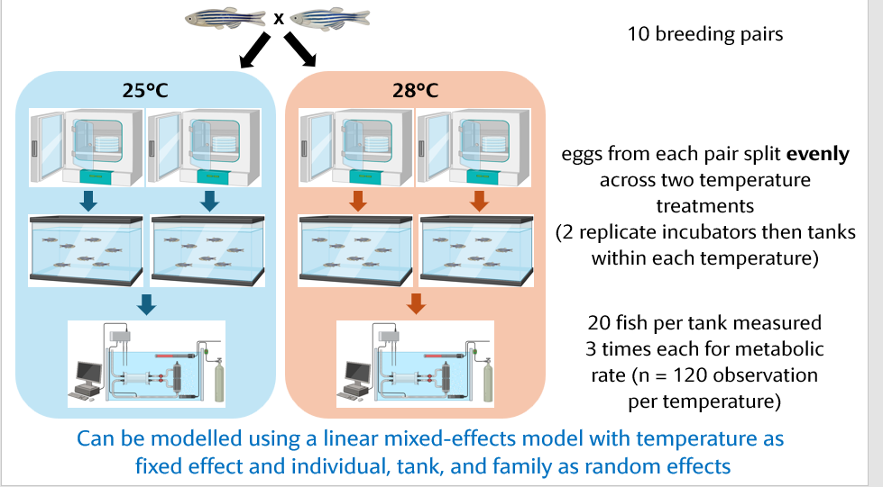

Slide 4
