Slide 1
Modernizing pytmc template: Legacy to FB_MotionStage & StreamDevice

Slide 2
Modernizing pytmc template for Next-Generation Motion
From legacy ST_MotionStage/EthercatMC to FB_MotionStage/StreamDevice patterns

Slide 3
Motivation for Change
Beckhoff Baustein trend: axes as FB_MotionStage
Need flexible StreamDevice control and per-axis macros
Clear migration/separation, robust autosave/archiver/OPI handling

Slide 4
Legacy vs. Modern IOC Motor Support
Legacy: Only EthercatMC (asyn/ai/bo...); Modern: StreamDevice, per-axis macros
Legacy: EthercatMC.template etc.; Modern: motor.db + macro expansion
Legacy: Limited macros, mostly global; Modern: Fully macroized, per axis
Mix: Not supported in IOC, project-level switch only

Slide 5
Motor Symbol Discovery: get_motors Changes
Legacy: Discovers only Symbol_ST_MotionStage
New: Discovers both ST and FB motors; attaches is_fb_motionstage flag for template filtering
axis-link pragma required for FB motors
Ensures exactly one family per IOC

Slide 6
get_motors: Legacy vs Modern
# Legacy def get_motors(plc): symbols = get_symbols_by_type(plc) return [ stage for stage in symbols.get("Symbol_ST_MotionStage", []) if not stage.is_pointer and pragmas.has_pragma(stage) ] # Modern def get_motors(plc): symbols = get_symbols_by_type(plc) st_motors = ensure_list(symbols.get("Symbol_ST_MotionStage", [])) fb_motors = ensure_list(symbols.get("Symbol_FB_MotionStage", [])) motors = [] for stage in st_motors + fb_motors: if not stage.is_pointer and pragmas.has_pragma(stage) and has_axis_link(stage): is_fb = (stage.__class__.__name__ == "Symbol_FB_MotionStage") setattr(stage, "is_fb_motionstage", is_fb) motors.append(stage) return motors

Slide 7
Record Generator Changes: has_axis_link and ensure_list
has_axis_link ensures FB_MotionStage has axis-link pragma (motor validity gate)
ensure_list ensures all parsing/loops can handle list/nil/single uniformly

Slide 8
has_axis_link and ensure_list
def has_axis_link(stage): require_axis_link = isinstance(stage, parser.Symbol_FB_MotionStage) aliases = getattr(stage, "symbol_aliases", []) required_aliases = {'Symbol_FB_MotionStageNC', 'Symbol_FB_MotionStageNCDS402'} if set(aliases) & required_aliases: require_axis_link = True if not require_axis_link: return True for pragma in pragmas.get_pragma(stage, name="pytmc"): for line in pragma.splitlines(): if line.strip().startswith("axis-link:"): return True return False def ensure_list(val): if isinstance(val, list): return val elif val is None: return [] else: return [val]

Slide 9
Template: Legacy EthercatMC
Legacy motors use classic EthercatMC records and controller/axis instantiation.

Slide 10
Template: Legacy EthercatMC
{% if legacy_motors %} EthercatMCCreateController("$(MOTOR_PORT)", "$(ASYN_PORT)", "$(NUMAXES)", ...) {% for motor in legacy_motors %} # Macros for axis EthercatMCCreateAxis("$(MOTOR_PORT)", "$(AXIS_NO)", ...) dbLoadRecords("EthercatMC.template", ...) ... {% endfor %} {% endif %}

Slide 11
Template: Modern FB_MotionStage with StreamDevice
Each FB axis loads motor.db with axis macros. No legacy EthercatMC code executes.

Slide 12
Template: Modern FB_MotionStage with StreamDevice
{% for motor in fb_motors %} epicsEnvSet("MOTOR_NAME", "{{motor|epics_suffix}}") dbLoadRecords("motor.db", "PORT=$(ASYN_PORT), ADSPORT=$(AMS_PORT), ADSPATH=$(MOTOR_ADS_PATH), PREFIX=$(MOTOR_PREFIX), M=$(MOTOR_NAME)") {% endfor %}

Slide 13
StreamDevice and Bulk Command Support
Records in motor.db loaded per axis with axis-specific macros
Command/status (and StreamDevice trigger) records are auto-generated

Slide 14
StreamDevice Command Example (motor.db)
record(bo, "$(PREFIX):$(M):MOVE_CMD") { field(DESC, "Trigger axis move batch via StreamDevice") field(DTYP, "stream") field(OUT, "@motor.proto move_cmd($(ADSPORT),$(ADSPATH),$(PREFIX),$(M)) $(PORT)") }

Slide 15
Template Logic: Family Selection
Ensures only one family block is active per IOC
All per-axis macros available regardless of type

Slide 16
Final Workflow and dbLoadRecords
# ASYN/trace config always set once {% if motors %} ... macros ... {% endif %} # Only one family block runs per IOC dbLoadRecords("motor.db", ...) # for FB EthercatMCCreateController(...) # for legacy

Slide 17
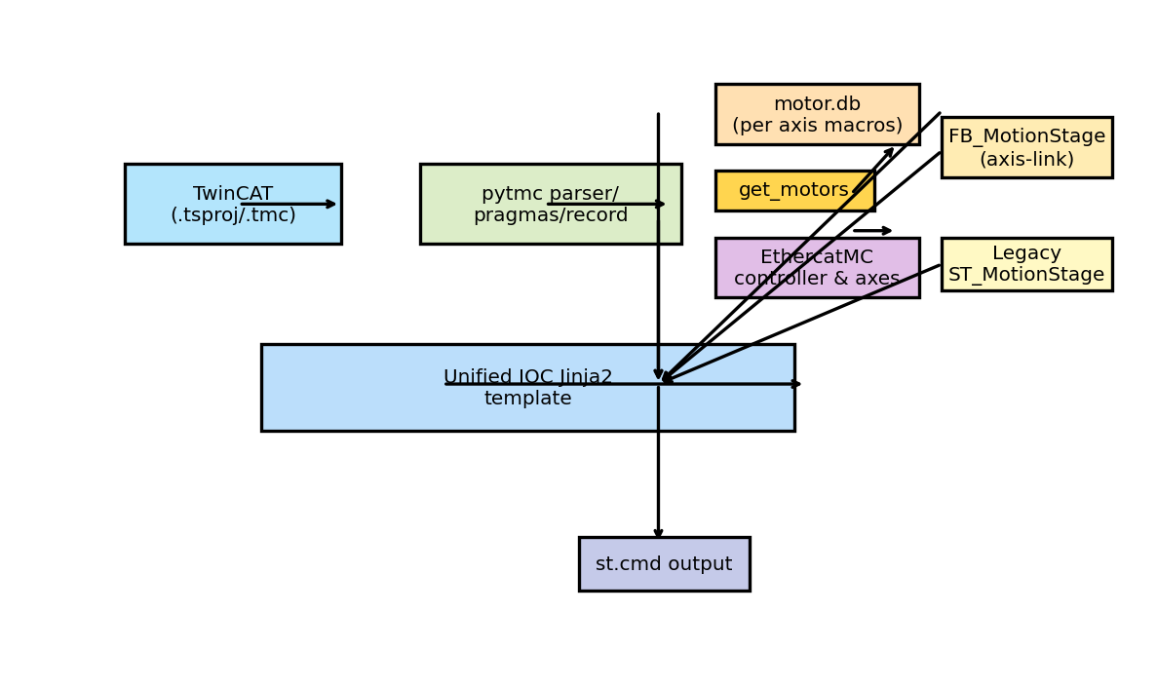
Modern pytmc Template Workflow

Slide 18
Summary & Next Steps
Clean, robust template for EthercatMC or FB_MotionStage motors
All macros and records auto-configured per axis
StreamDevice and command/status records handled with correct macros
Ready for large-scale facility automation

