Slide 1
Parsing TwinCAT Project Files to Python Objects
How pytmc transforms XML files into rich, type-specific Python symbol classes

Slide 2
Process Overview
- Parses .tsproj or .tmc XML files - Builds an in-memory tree of Python objects - Dynamically creates custom symbol classes - Example: ST_MotionStage → Symbol_ST_MotionStage

Slide 3
Step 1: Parsing Entry Point
User calls parse('my_project.tsproj') to start parsing. Code reads the XML, finds the root, and hands off to the recursive parser.
project = parse('my_project.tsproj')

Slide 4
Step 2: Recursive XML → Python Mapping
TwincatItem.parse(element, parent, filename) is called for each XML node. - Decides appropriate Python class for each tag - Recurses into child elements.
TwincatItem.parse(root, filename, parent=None)

Slide 5
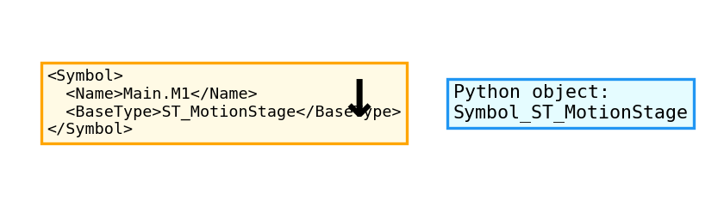
Step 3: Handling Symbol Elements
When parsing a <Symbol> element: - Looks up <BaseType> - Generates a custom Python class: Symbol_{BaseType} (e.g. Symbol_ST_MotionStage)

Slide 6
How Dynamic Class Creation Works
Checks if the class exists in the registry. If not, dynamically creates and registers the class.
cls = type("Symbol_ST_MotionStage", (Symbol,), {}) TWINCAT_TYPES["Symbol_ST_MotionStage"] = cls

Slide 7
Step 4: Building the Object Tree
Each XML element becomes a Python object instance. Objects keep references to parents and children. Symbols are available for searching/manipulation.

Slide 8
Step 5: Accessing Special Symbols
You can now search for special symbol types.
motion_stage_symbol = next(project.find(Symbol_ST_MotionStage)) print(motion_stage_symbol)

Slide 9
Why Dynamic Subclassing?
- Enables type-specific logic/behavior - Easy searching (find(Symbol_ST_MotionStage)) - Extensible for new symbol types

Slide 10
How is ST_MotionStage Symbol Connected to NC Axis?
Connection is established via TwinCAT's 'Link' objects, using naming conventions and XML references. The Symbol's .nc_axis property: - Finds the relevant Link for the symbol - Resolves the corresponding NC and axis name - Returns the correct Axis object

Slide 11
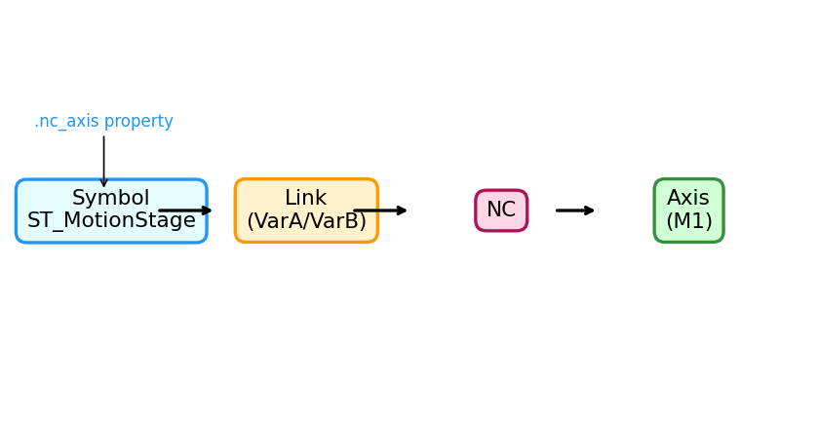
Symbol–NC Axis Connection Visual
ST_MotionStage symbol connects to an NC axis through a Link object. See how these objects relate in the parsed tree:

Slide 12
Example: XML and Python Code for Axis Connection
Let's trace the connection from XML definition, through parsing, to Python object lookup.
# XML fragments <NC> <Axis name="M1" ... /> </NC> ... <Symbol> <Name>Main.M1</Name> <BaseType>ST_MotionStage</BaseType> </Symbol> ... <Link VarA="^Main.M1.Axis.NcToPlc" VarB="^TINC.Task1.AxisSection.M1.Axis.NcToPlc" ... /> # Python code sym = next(project.find(Symbol_ST_MotionStage)) axis = sym.nc_axis # Returns the Axis object for 'M1'

Slide 13
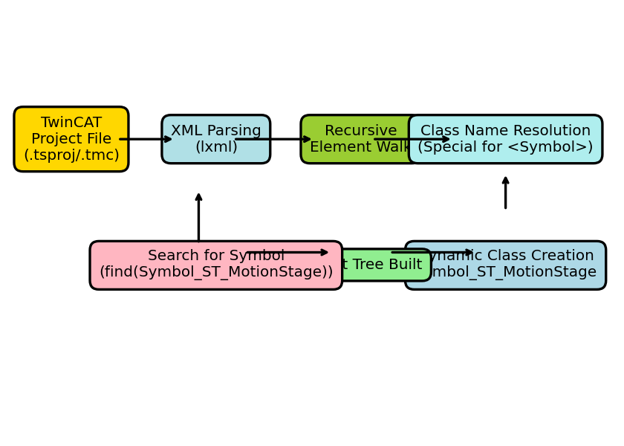
Complete Flow Diagram
Full process to parse a TwinCAT project file and create symbol objects.

Slide 14
Summary
- XML files are safely mapped to Python objects - Custom Symbol classes dynamically created - Handles complex TwinCAT project configurations

Slide 15
Q&A
Questions?

