Slide 1
Spotlight Platform Architecture
By Archikers
June 2022

Slide 2
Content
Executive Summary
Requirement Understanding
High level Use cases
Business and Architecture Principles
Conceptual Architecture
Solution Architecture
Technology Stack/Choices
Architecture Decisions
Non-Functional Requirement mapping
Assumptions and constraints

Slide 3
Business and Architecture Principles
Need to write commentary here -

Slide 4
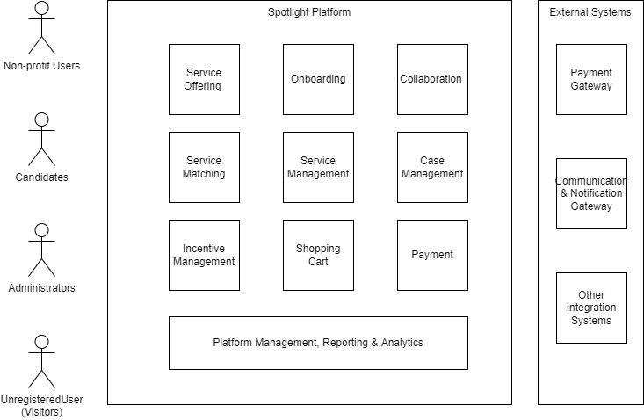
Conceptual Architecture
Need to write commentary here -

Slide 5
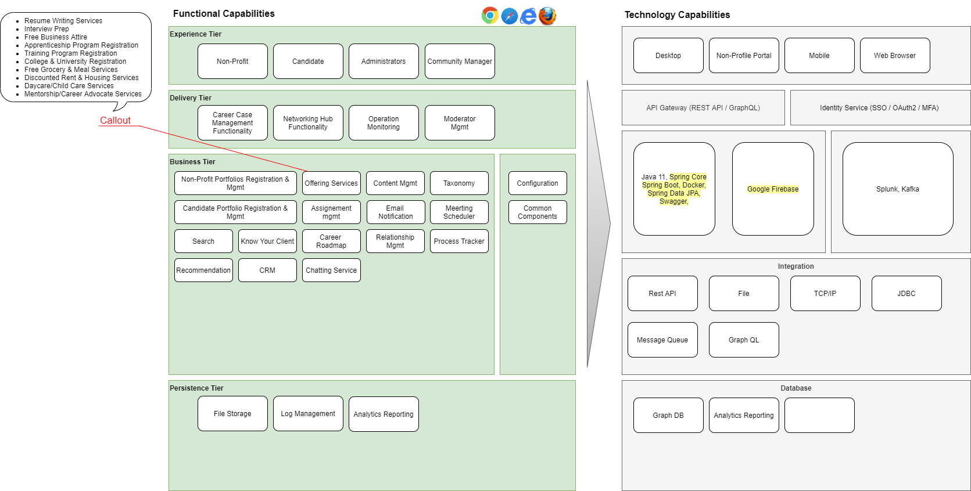
Solution Architecture

