Slide 1
Spotlight Platform Architecture
By Archikers
June 2022

Slide 2
Content
Executive Summary
Requirement Understanding
High level Use cases
Business and Architecture Principles
Conceptual Architecture
Solution Architecture
Technology Stack/Choices
Architecture Decisions (ADRs)
DevSecOps
Non-Functional Requirement mapping
Assumptions and constraints

Slide 3
Executive Summary
Vision - The Spotlight App Project is a sustained effort to amass a coalition of nonprofits in order to address specific needs within the communities we serve by leveraging a centralized platform as the base of operations to collaborate and make a collective impact
Archikers proposes to build and deliver flexible, maintainable, scalable and extensible platform to
Provide centralized avenue for Non-profits to deliver services
Promote collaboration among Non-profits as well as between Non-profits & candidates
Increase visibility and accessibility of services to aspiring candidates
Provide capability to raise any issues related to service and getting the resolution
Proposed solution is going to be secure, highly available and cost-effective meeting Non-profit current and future operational need

Slide 4
Business and Architecture Principles
Need to write commentary here -

Slide 5
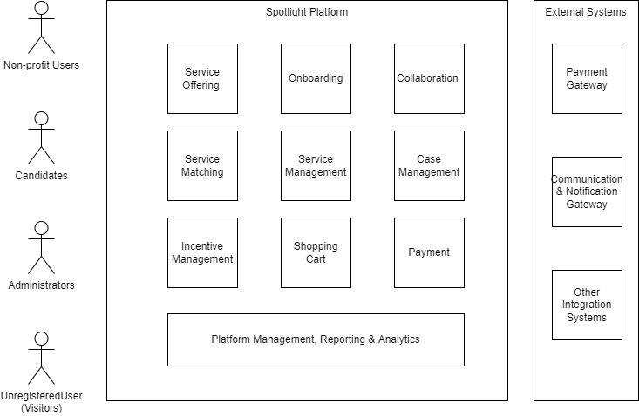
Conceptual Architecture
Need to write commentary here -

Slide 6
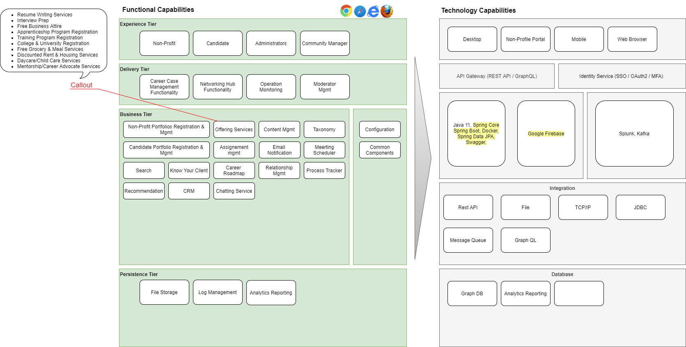
Solution Architecture

