Slide 2
Generator Current
Variation and cycles for deals with SAF

Slide 3
Assumptions
Values & Metrics
For this analysis, we classified any variation equal to or greater than 20A occurring in less than 4 seconds as an occurrence
The approximation of cycles was calculated by dividing the total number of occurrences by 2 (representing the variation both up and down)

Slide 4
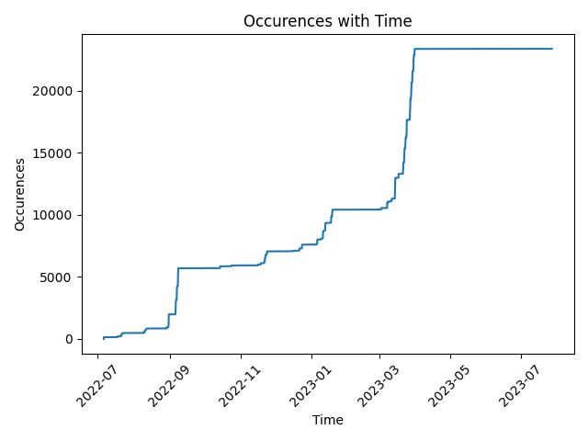
Deal A
Client A
From 01/07/2022 – 12/09/2023
23364 occurences
Distribution in current variation (A): 20-25: 30% | 25-30: 15% | 30-35: 20% | 35-40: 12% | 40+: 23%
11682 cycles

Slide 5
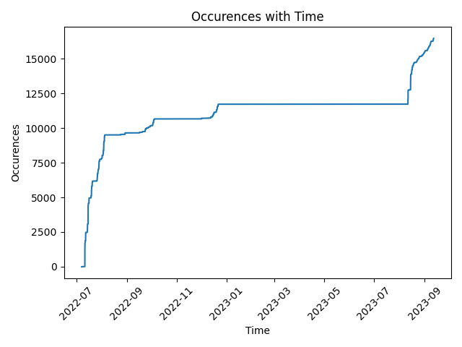
Deal B
Client B
From 01/07/2022 – 12/09/2023
16463 occurences
Distribution in current variation (A): 20-25: 28% | 25-30: 14% | 30-35: 15% | 35-40: 8% | 40+: 35%
8231 cycles

Slide 6
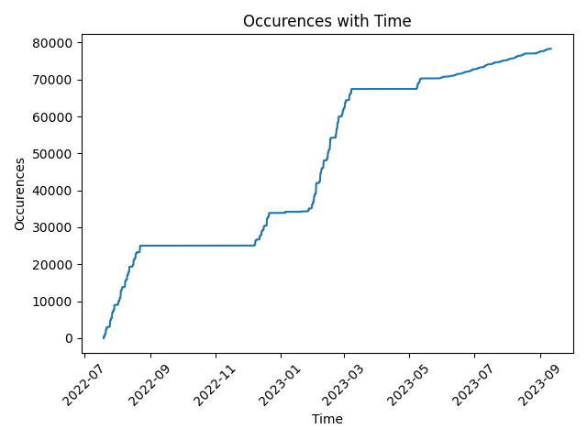
Deal C
Client C
Since the installation until 12/09/2023
78322 occurences
Distribution in current variation (A): 20-25: 31% | 25-30: 13% | 30-35: 18% | 35-40: 11% | 40+: 27%
39161 cycles

Slide 7
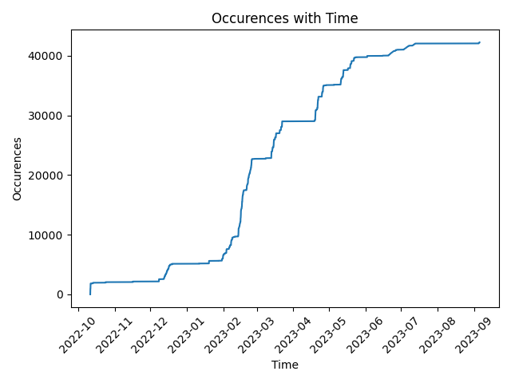
Deal D
Client D
From 01/07/2022 – 01/09/2023
42237 occurences
Distribution in current variation (A): 20-25: 28% | 25-30: 14% | 30-35: 16% | 35-40: 9% | 40+: 33%
21118 cycles

Slide 8
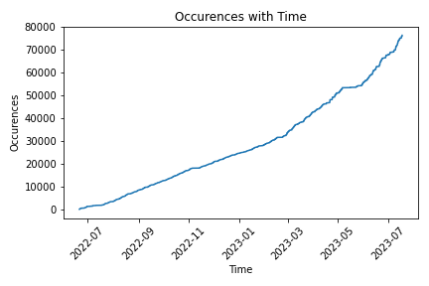
Deal E
Client E
From 01/06/2022 – 01/07/2023
76394 occurences
Distribution in current variation (A): 20-25: 21% | 25-30: 11% | 30-35: 14% | 35-40: 8% | 40+: 46%
38197 cycles

Slide 9


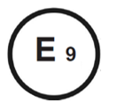
About AddVolt
AddVolt is a technology company which developed the World's First Plug-in Electric targeted for refrigerated vans, trucks, trailers or containers. It avoids the diesel usage, as well as CO2 and noise emissions, optimizing the operational costs of goods transportation.
Follow AddVolt: addvolt.com | LinkedIn | Facebook | Twitter
Germany - Dr. Bertold Biffar
M (+49) 179 10 55 123
E bertold.biffar@addvolt.com
Iberian Peninsula - Ing. Bruno Azevedo
M (+351) 913 485 508
E bruno.azevedo@addvolt.com

