Slide 1
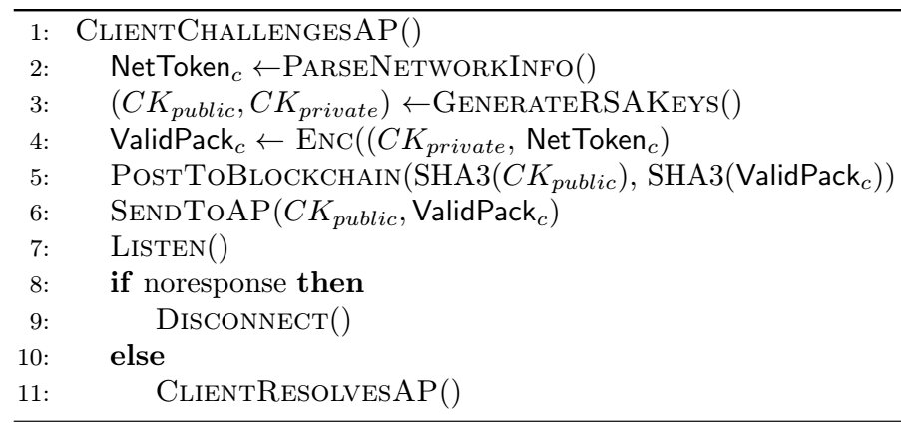
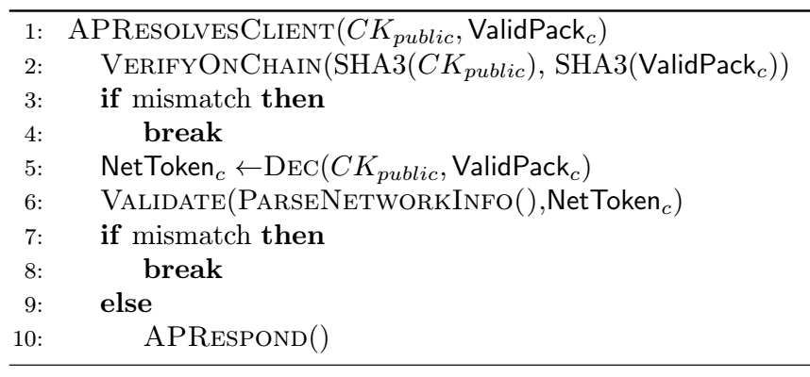
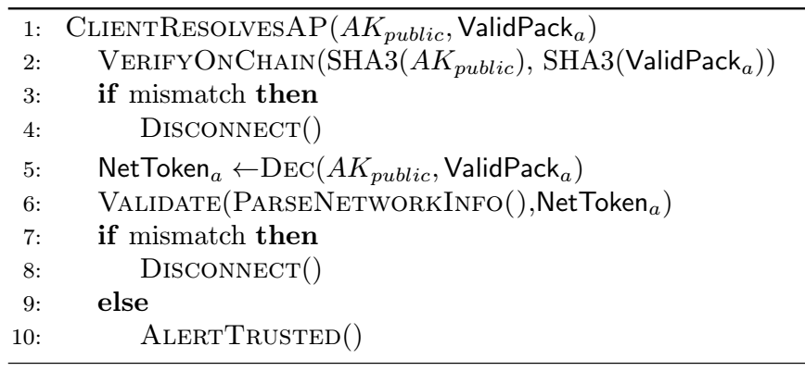
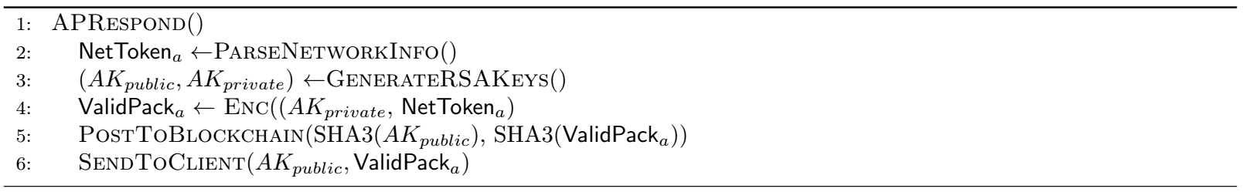
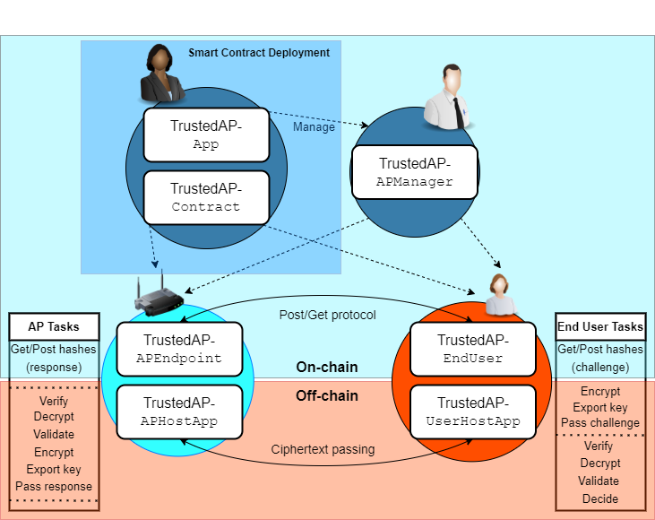

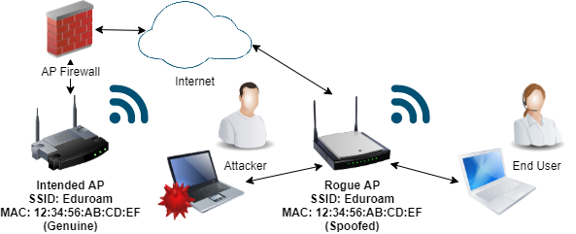




TrustedAP
Using the Ethereum Blockchain to Mitigate the Evil Twin Attack Phil Fox, pcfox@buffalo.edu, Bina Ramamurthy, bina@buffalo.edu Department of Computer Science and Engineering, SUNY University at Buffalo
Introduction
Evil Twin Attacks (ETAs) are only partially mitigated to-date despite an extensive, established attack history. TrustedAP leverages the smart contract and trust layers of the Ethereum blockchain for mitigating residual ETA vulnerabilities, aiming for complete practical mitigation¹.
Design
Trusted AP uses on and off-chain connections between end- users’ client devices and wireless APs enforcing integrity and establishing trust. Fig. 2 illustrates the interactions between on and off-blockchain applications therein. ESTABLISH AN OWNERSHIP CHAIN
Contract deployers, device managers, and APs are registered on-chain with an immutable custody record.
PASS, VERIFY, AND VALIDATE MESSAGES
Client devices post and retrieve challenge hashes on the blockchain, and APs post hashes of their responses for verification.
Client devices encrypt and send challenges over network connections and APs respond in-kind.
Client devices and APs verify messages received against logged blockchain hashes and validate decrypted message contents against network data.
The client considers the body of interactions and decides whether to remain connected or disconnect.
ENCRYPTION PRIMITIVES FOR OFF-CHAIN OPERATIONS
Messages passed between clients and APs are hashed on-chain using the SHA3 algorithm and passed off-chain using RSA encryption for integrity preservation. The Fig. 3 pseudo code explains relevant exchange mechanisms:
Evaluation
Proof of concept: The on-chain core and UI of TrustedAP is operational with supporting source code¹. Off-chain message passing is in-development.
Affordability: TrustedAP is agnostic to using testnet ETH or mainnet ETH for all pertinent operations.
Network Token Contingency: The uniqueness of network data passed and validated between clients and APs determines threat capability thresholds for future ETAs against TrustedAP, e.g.:
User specified/random key: Man in the Middle/network replay attack (MitM)+ETA (current version)
Destination IP+Mac address: 2-way MitM (requires rogue AP and client)+ETA (in-development)
Client to AP exchange (Challenge/Resolve):
Background
The ETA is a low-to-medium-skill wireless network Computer Network Attack (CNA) wherein a threat agent (attacker) uses hardware masquerading as (i.e., spoofing) an intended Access Point (AP) for unsuspecting end-users’ client devices. ETA success enables attackers’ straightforward network traffic eavesdropping, exposure to malicious captive portals, and unprotected attacker network pivoting onto client devices. ETAs are partially mitigated by ensuring all client web-traffic is made over VPN or TLS/SSL connections, but the above vulnerabilities persist in even a temporary lapse of strong web or network security.
Proposals for mitigating ETAs include establishing off-network, physical trust from client to AP (e.g., NFC connections between each) ². Alternative proposals include establishing on-network by (e.g., facilitating advanced connection protocols via a centralized certificate authority) ³. TrustedAP aims to establish sufficient trust while offering novel affordability and ease-of-use for all parties.
AP to Client exchange (Response/Resolve):
Future Work
Future work for TrustedAP brings on considerations for rigidifying off-chain connections and exchanges.
(Local) certificates: 1) Encrypt client-to-AP communications with TLS/SSL encryption. 2) Leverage certificate network token uniqueness for enhanced validation protocols.
Liveness and Safety: Evaluate TrustedAP for percentages of false negative trust adjudications (severe) and false positive AP disconnections (moderate).
Timing: Evaluate TrustedAP for response time and minimize requisite connection time for challenge/response message passing.
Figure 3: TrustedAP off-chain exchange pseudocode
Implementation
The current version of TrustedAP uses the following programming languages and software:
Solidity (Language): Encodes Ethereum blockchain smart contracts for on-chain operations
JavaScript, HTML, web3.js: Establishes a UI and interfaces it with smart contract functions
Truffle: Compiles and executes Solidity code for emulated and actual Ethereum (incl. testnet) blockchain interaction
Node.js: Manages libraries for web3, encryption, etc. and provides local webservers for relevant endpoints
MetaMask: Maintains wallets for Ethereum and testnet ETH for on-chain operational gas and payable functions
Figure 1: ETA diagram
References
P. Fox. 2021. TrustedAP. GitHub repository. https://github.com/pcfox-buf/TrustedAP
A. Matos, D. Romão, and P. Trezentos. 2012. Secure hotspot authentication through a Near Field Communication side-channel. In 2012 IEEE 8th International Conference on Wireless and Mobile Computing, Networking and Communications (WiMob). 807–814. https://doi.org/10.1109/WiMOB.2012.6379169
O. Nakhila, E. Dondyk, M. F. Amjad, and C. Zou. 2015. User-side Wi-Fi Evil Twin Attack detection using SSL/TCP protocols. In 2015 12th Annual IEEE Consumer Communications and Networking Conference (CCNC). 239–244. https://doi.org/10.1109/CCNC.2015.7157983
Figure 2: TrustedAP Application and Interaction Diagram
Department of Computer Science and Engineering School of Engineering and Applied Sciences
buffalo.edu

