Slide 1
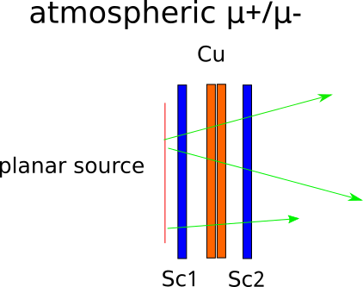
Detector

Slide 2
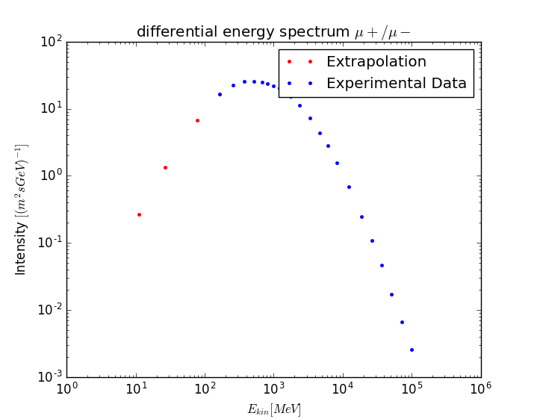
Low energy extrapolation

Slide 3
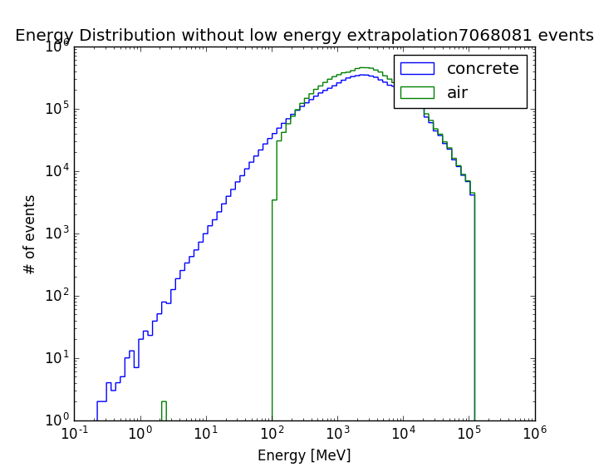
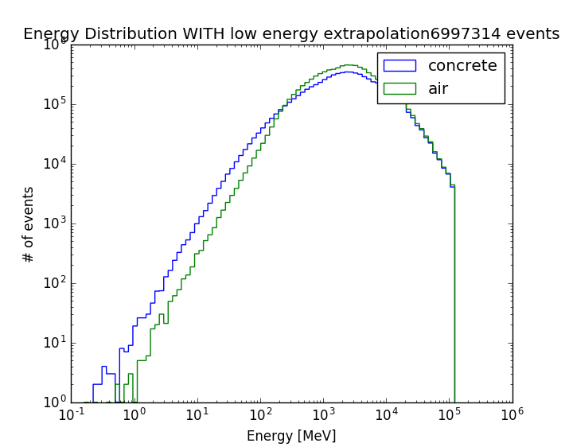
Concrete vs air

Slide 4
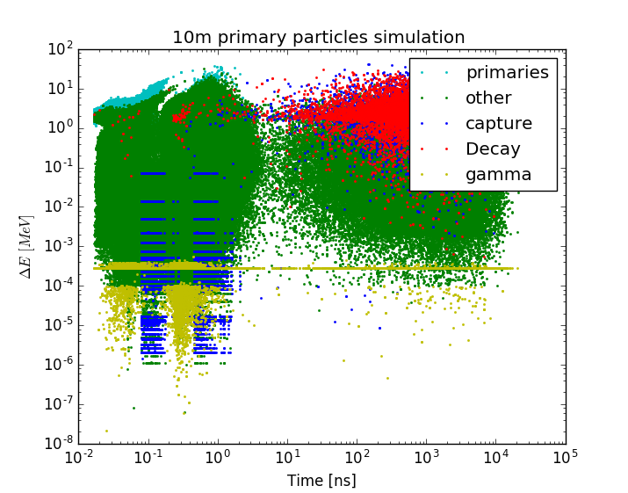
Energy-deposit vs time

Slide 5
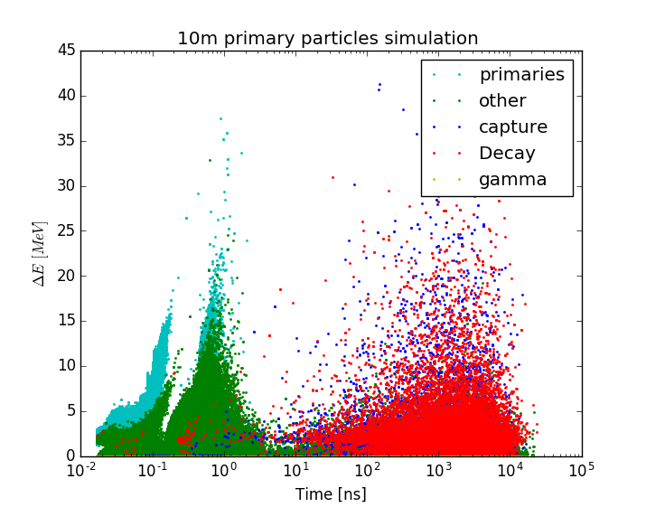
Energy-deposit vs time

Slide 6
10m muon simulation
Type | Quantity
Total | 29 195 113
Muons (primaries) | 19 747 494
Decay | 25 745
Capture | 67 915
Gamma | 212 288
Other (e+/e-) | 9 209 586

Slide 7
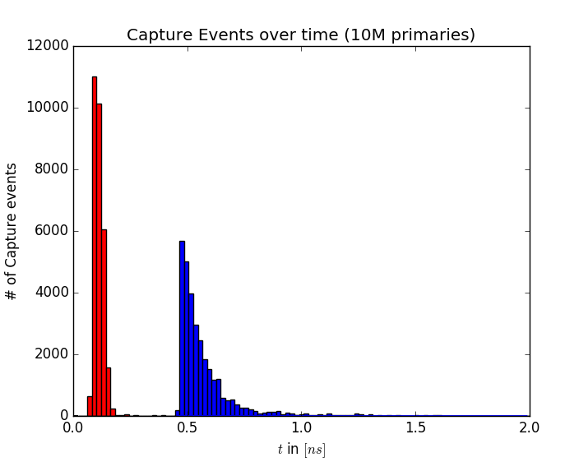
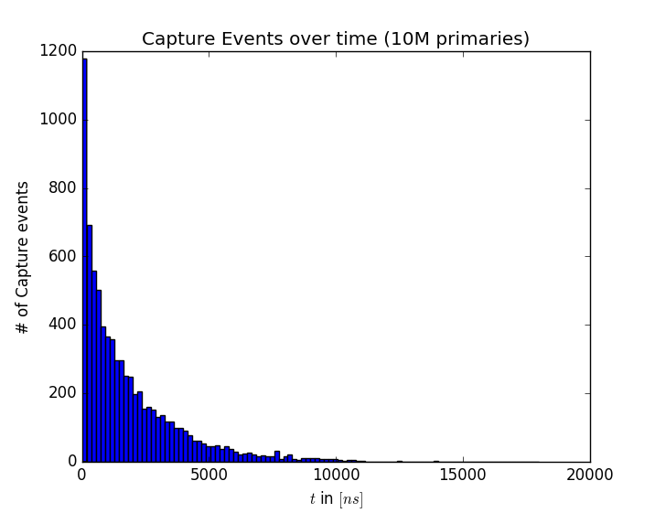
Capture time constant
T_1 = 0.03 ns
T_2 = 0.084 ns
T = 1682 ns

Slide 8
Realtime vs Simulation
 | Realtime | Simulation
Muons per min | 2160 | 1 400 000
Decay events per min | 1 | 3600
Decay per 1k muons | 4,6 | 25

