Slide 1
Reading a Reed
Name: Paul Chang
Advisor: Szymon Rusinkiewicz

Slide 2
What is a clarinet reed?
Notes:
A clarinet reed is a slim piece of wood that u put on your clarinet mouthpiece that allows you to make a sound on the clarinet.
When you blow through your instrument, the clarinet reed vibrates and is what causes the vibrations throughout the clarinet.
So you can think of it as the sound generator.
Now can you tell the difference between the reeds in front of you. Maybe a small, small difference?
Now let me play for you 2 reeds that were taken out of that box and see if you can hear the difference.
One is a lto darker, more coarse perhaps and the other is brighter, more focused, more in your face.
I gave it exactly the same amount of lip/air pressure.

Slide 3
Motivation
Reeds look the same but play different
Time consuming reed selection process
Goal
Predict the sound of a reed given a subset of its features, without playing on the reed
Notes:
Because small physical changes manifest themselves in large sound changes, it is necessary for clarinet players to make daily adjustments as clarinet reeds change over time (just like a pair of shoes start to deteriorate from wear and tear)
This also means that there is a lot of unpredictability between reed to reed. Hence when I open a box of 10 reeds and each reed is only slightly different from one another, they will all sound different.
This unpredictability makes things extremley time consuming:
I have to try every single reed in the box to know how each one reacts
Also, because reeds are extremely sensitivie this also means that I can actually change reeds until they match a certain sound that I want. But only experts can do this and it Is extremly difficult.

Slide 4
Sound
Quantitative:
H. v. Helmoltz (1862) : Musical timbre is characterized by distribution of partials summarized by spectral centroid.
Subjective:
Bright and Dark
Notes:
The goal is to predict the sound of a reed given its features.
But what is sound?
Sound can be divided into quantitiative and subjective.
There are many quantiative ways to measure sound but, for the purposes of a 1 semester IW project I will consider just the most fundamental results: that musical timbre or sound can be characterized by the distributin of partials. Or in other words the power of each frequency in the sound. This is what allows us to distinguish a clarinet from lets say a flute. This distributin can be summarzied using the spectral centoid, which is just a weighted average of all the frequencies.
There are also many different subjective caregorizations of sound. For the purposes of our project, let us consider 2 very common adjectives, a bright and darks sound
The next question then becomes, how do we connect the subjective and the quantiative.

Slide 5
How to link quantitative to subjective?
J.M. Grey (1975): Spectral centroid is positively correlated with brightness.
Notes:
Spectral centroid is positively correlated with brightness meaning that the higher the s.c. the brighter the sound.

Slide 6
Goal:
Predict brightness of reed given a subset of its features, without playing on it:
Part 1: Predict spectral centroid from reed’s features
Part 2: Verify: high spectral centroid => bright sound
Reed Features
Spectral Centroid
Brightness
Notes:
So here is a more focused version of my original goal.
I will attempt to predict the s.c. from the reeds features first.
And then verify that these s.c. are actually a good indicator for brightness.
Because even if we get 100% accuracy predicting reed features to spectral centroids, if there is only a 40% matching rate from spectral centroids to brightness then we only have a 40% accuracy matching reed features to the “brightness”.
Because if this implication does not hold, then just because we can predict a reed will have a high spectral centroid does not mean that that reed will also be considered “bright”

Slide 7
Related Work
Physics of a reed:
John Backus (acoustician):
Small Vibration Theory of Clarinet (1962)
Vibrations of the Reed and the Air Column (1961)
Reed to sound mapping:
Andre Almeida (2013):
How reed “hardness” affects spectral centroid.
Notes:
There has been a lot of reesearch done on calrient reed but most of them are related to the physcis of the clarinet. For example, 2 seminal papers on reed theory are from John Backus where he in detail lays out how the physical reed vibrations interact with the air column, mouthpiece. But this doesn’t relaly directly answer our goal because in none of these papers do they actually specify the specs of the reed they are using. They also do not discuss how the physics of the reed vibrations maps to a particular soudnd.
Found exactly 1 paper that did this, where they said that harder/stiffer reeds have lower spectral centroids. But even this analysis is flawed because reeds with the same hardness can sound very different from one another.

Slide 8
Approaches for Part 1
One approach: Use knowledge of physics to run computer simulations
My approach: Machine learning algorithms:
Little knowledge of physics required
Train algorithms with data set mapping features to spectral centroid.
Notes:
Now there are 2 approaches we can take to map the our reed features to spectral centroids.
The first is to use the massive maount of physics research that has been done on clarient reed vibrations and to run advanced comptuer simulations. This is obviously extremley difficult and would probalby be a Ph.D thesis topic. To caputre the minute vibration changes from a miniscule physical change is really, really hard.
The approach that I will use is to us e machine learning algorithms, where we train our M.L. algorithms with a data set that maps features to spectral centroids. This way we do not need to know an indepth knoweldge of physics.

Slide 9
Data Collection
Create data set that maps features to spectral centroids.
No public data set available.
Key questions:
Which features to measure?
How to obtain consistent recordings?
Notes:
So obviously to run machine learning algorithms, we need data, more specifically a data set that maps features to spectral centroids.
Unfortunately no such data set exists. In fact there is no public data on clarinet reeds, period… No reed company was willing to give me their private data sets.
Which means that I had to make my own...
Now 2 key questions arise:
What features should I measure and how?
How can I make consistent recordings to extract reliable spectral centroids.

Slide 10
Features
Water content of reed:
Measure moisture absorption:
Mass of reed before and after soaking in water for 10 sec.
Time stamp:
Use categories: 0, 1, 2, (3-5), >5
Thickness across reed:
Take pictures and do image processing.
Notes:
Now here are 3 features that I sought to measure, from my own personal experience:
The thickness across the reeds. I was originally going to use calipers but these were too imprecise. So instead I took a picture and extracted thickness from the image
The water content of the reed. Reeds that have moisture in them are more flexible and vibrate faster. But I can’t use a moisture meter becuae there are either too invasive. So I measured how much water they can take up by measuring the mass of reed before and after
Time stamp. Bascially I would put a 0 for the reed if its’ new, 1 if I played on its once… etc
All of these are pretty self explanatory except for the image processing. How can we use the image to identify how thickness is distributed accross the reed?

Slide 11
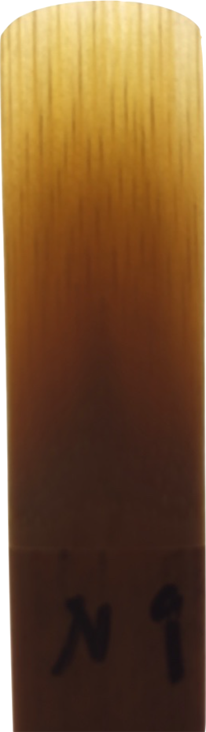
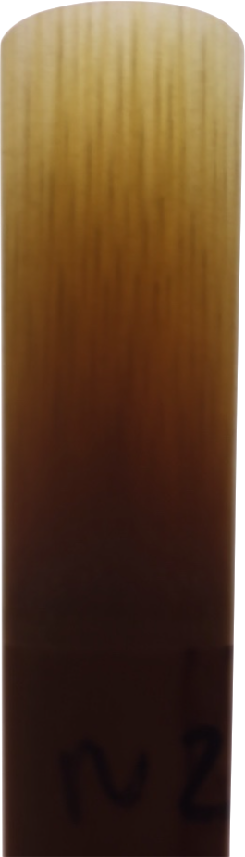
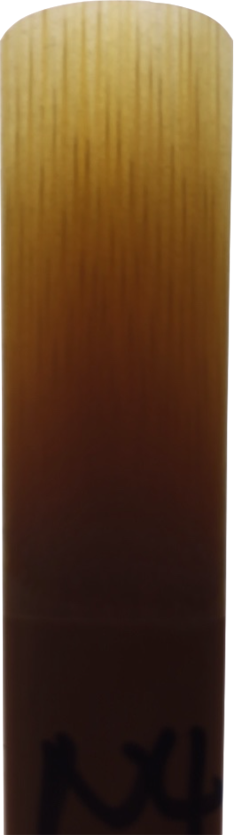
Image Processing
Example Reeds:
Light Box Apparatus:
Take pictures at constant angle and height
Use low flutter camera
Notes:
Here is the apparatus that I used to take the picture of a reed.
I placed my reed on a light box so that I could see the countours of the reed
I placed my iPhone on 2 boxes and took picture using a low-flutter camera app to avoid distortion.
The right has some example pictures

Slide 12
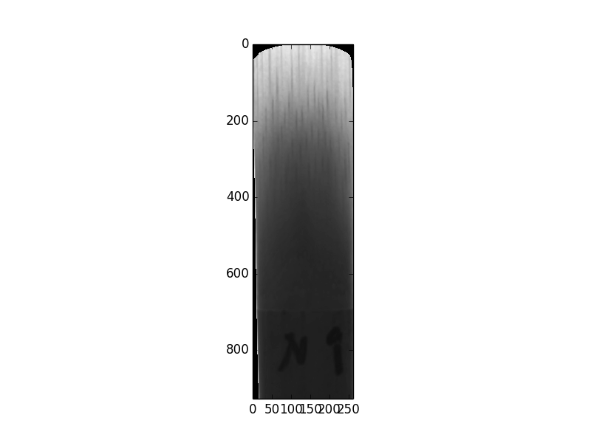
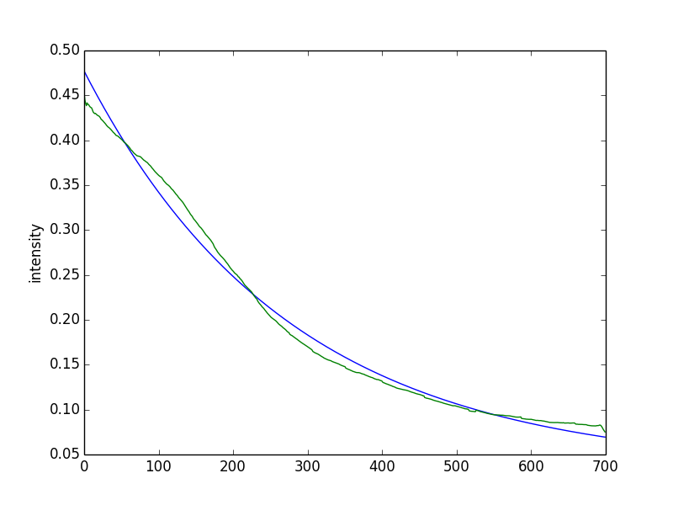
Image Processing
Intensity = ae^(-b(row)) + c
High Intensity: Bright; Little wood
Low Intensity: Dark; A lot of wood
:
To describe image: [a, b, c]
Notes:
Using the picture
I grey scaled image to convert all the RGB values into a single intensity value (higher intenisty means brighter, and lower intenity means darker)
Meaning that more light was passed through the reed meaning that the reed had less wood.
Then I cut off the reed at the line to avoid includign the permannet nmarker (also the bottom part of the reed does not really vibrate)
I took the average intensity in each row and graphed it.
The green line is what this graph looked like.
We see that the green line can be approxiamted by an exponentail function remarkably well. And all we need to describe an image are the three coefficients.

Slide 13
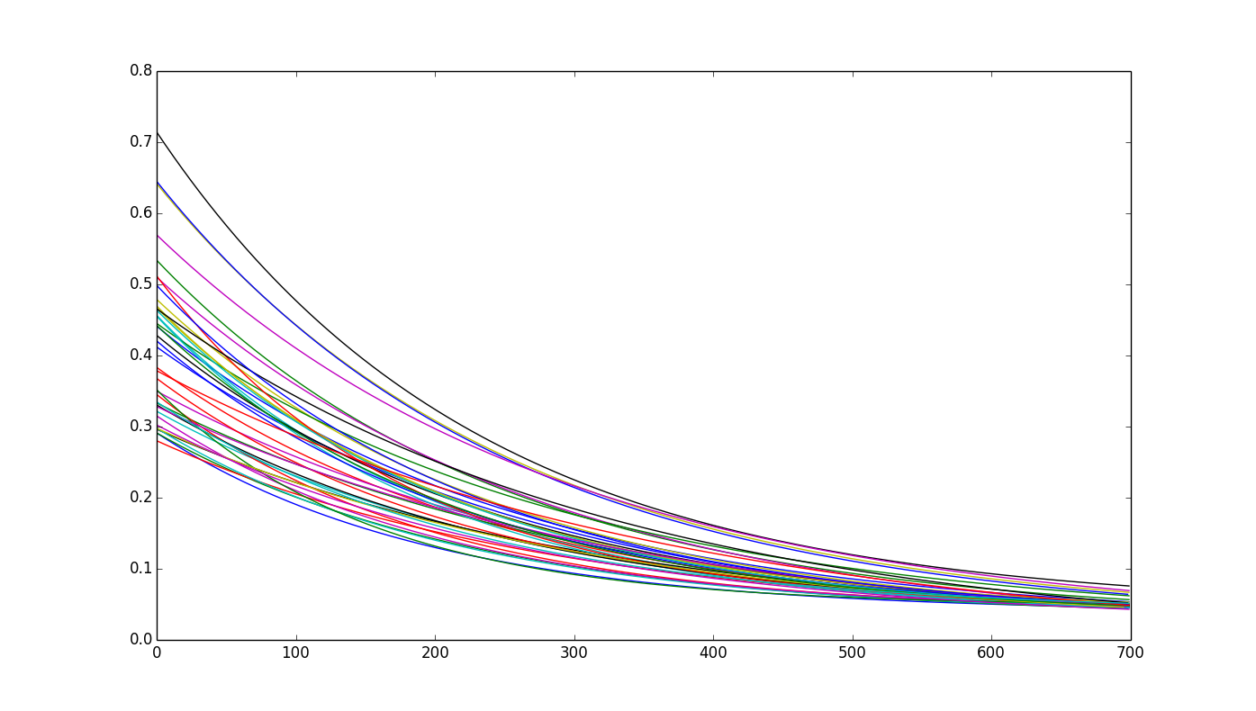
Fitted Exponentials for 40 reeds

Slide 14
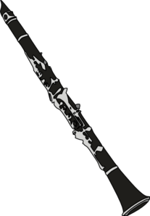
Recording Apparatus
Play G4 and G5
Constants:
Pitch (440 Hz)
Noise level (90 dB)
Angle of clarinet
Distance to recorder
Amount of reed in mouth
Humidity/ Temperature
Equipment
Recorder
Cushion
-1cm-
Box with hinge
Notes:
Now that we have a way to measure the features, how did we actually make the recordings to extract the spectral centrodis.
Here is the appartus that I set up.
I placed a recorder 1 cm from a box that contained a small hinge in the middle
The hinge is there so that I can rest my clarinet in the same position
I placed a cushion below my calrinet to maintain it at the same angle
To ensure the best possible measuring conditions:
1) I set my tuner to 440Hz and made sure that I wasn’t sharp or flat
2) I made sure that the sound that I made was 90 dB
3) I used the cushion, hinge to maingian constant angle and distance
4) I marked my reeds so that I would play with the same amount of reed in my mouth
5) I also obviously played on the same mouthpiece and kept the room at the same temperature.

Slide 15
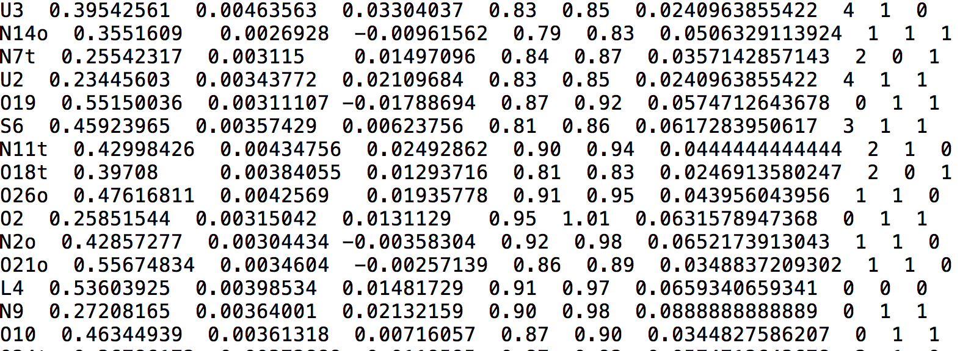
Sample data
Label
a
b
c
Mass Before
Mass After
% increase
Time
G4
G5
120 rows – 240 recordings
80 training, 40 test

Slide 16
Results
G5
Algorithm | Percentage Correct | Precision | Recall | F-Beta | Area under ROC curve
Gaussian Naïve Bayes | 45% | 0.60 | 0.46 | 0.57 | 0.51
Decision Tree | 60% | 0.68 | 0.57 | 0.66 | 0.61
K-Neighbors | 57.5% | 0.63 | 0.65 | 0.63 | 0.54
Random Forest | 70% | 0.77 | 0.77 | 0.77 | 0.60

Slide 17
Results
G4
Algorithm | Percentage Correct | Precision | Recall | F-Beta | Area under ROC curve
Gaussian Naïve Bayes | 45% | 0.60 | 0.46 | 0.57 | 0.51
Decision Tree | 60% | 0.69 | 0.69 | 0.69 | 0.63
K-Neighbors | 70% | 0.77 | 0.77 | 0.77 | 0.69
Random Forest | 62.5% | 0.79 | 0.57 | 0.74 | 0.61

Slide 18
Part 2: Random Sampler Experiment
Verification that spectral centroid correlates to brightness.
Experiment steps:
Choose 2 random sound samples (both G4 or G5)
Ask user which is brighter
Verify user input by checking true spectral centroid values
Notes:
Even though we can get upto 70% accuracy with Random Forest, is it even worth mapping to spectral centroids.
To see how well spectral centroids corresponds to what I consdier to be a bright sound, I ran the following experiment.

Slide 19
Random Sampler Experiment
10 experiments, each experiment with 10 pairs
~40% accuracy
Spectral centroids are not practical.
Notes:
Hence, what I consider to be a bright sound does not correspond with high or low spectral centroids.
Hence even if a reed is mapped to above a certain threshold this does not mean that the reed is “bright”.

Slide 20
Conclusion
Generated informative data set
Mapping reed’s features to bright and dark can be accurate but not practical
Future work
Tune algorithm parameters
New quantitative measure
Noise/signal ratio was not effective
Transform into regression problem

