Slide 1
BigInteger
CIS-3012, C++ Programming
Vermont State University
Peter Chapin

Slide 2
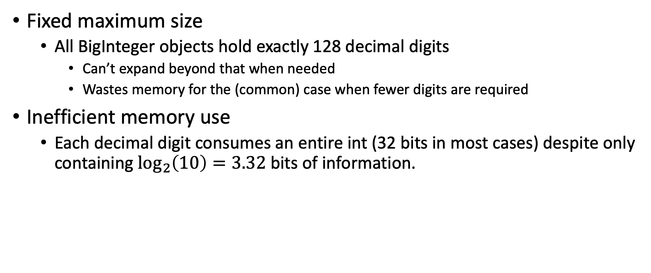
The Problem With BigInteger1
Fixed maximum size
All BigInteger objects hold exactly 128 decimal digits
Can’t expand beyond that when needed
Wastes memory for the (common) case when fewer digits are required
Inefficient memory use
Each decimal digit consumes an entire int (32 bits in most cases) despite only containing $\log_{2}\left(10\right)=3.32$ bits of information.

Slide 3
Dynamic Digits Array
BigInteger2 will use a dynamically allocated array for the digits.
Each object can allocate whatever space it needs… but no more.
This allows object to hold potentially millions (billions!) of digits.
But small numbers won’t waste space.
Different BigInteger objects will have different digit arrays…
... with (in general) different sizes.
The size of the array is not part of the type.

Slide 4
What About std::vector?
Aren’t we supposed to use std::vector instead of arrays?
Yes!
… but managing the allocations ourselves is educational.
It will help you understand how std::vector, and many other classes, are implemented.
BigInteger4 will use vectors
You will see a huge simplification!

Slide 5
Object Layout
BigInteger Object
Count to track how much space has been allocated
size_t digit_count;
storage_type *digits;
Storage Area
Pointer that points at the allocated space
Dynamically allocated space on the heap for the digits
Notice that the BigInteger object is only 16 bytes (on 64-bit architectures)… regardless of how many digits are stored!
Most of the BigInteger’s value is held externally to the object itself!

Slide 6
Now What?
This is our first encounter with a class that holds most of its value externally.
There are many implications!
How does the external data get released?
How does the external data get copied?
Isn’t it slow to copy potentially millions of bytes of data? How is that handled?
BigInteger2 gives us a chance to address these questions
Next up: Lifecycle Methods!
See the relevant slide deck for information on these special methods.

Slide 7
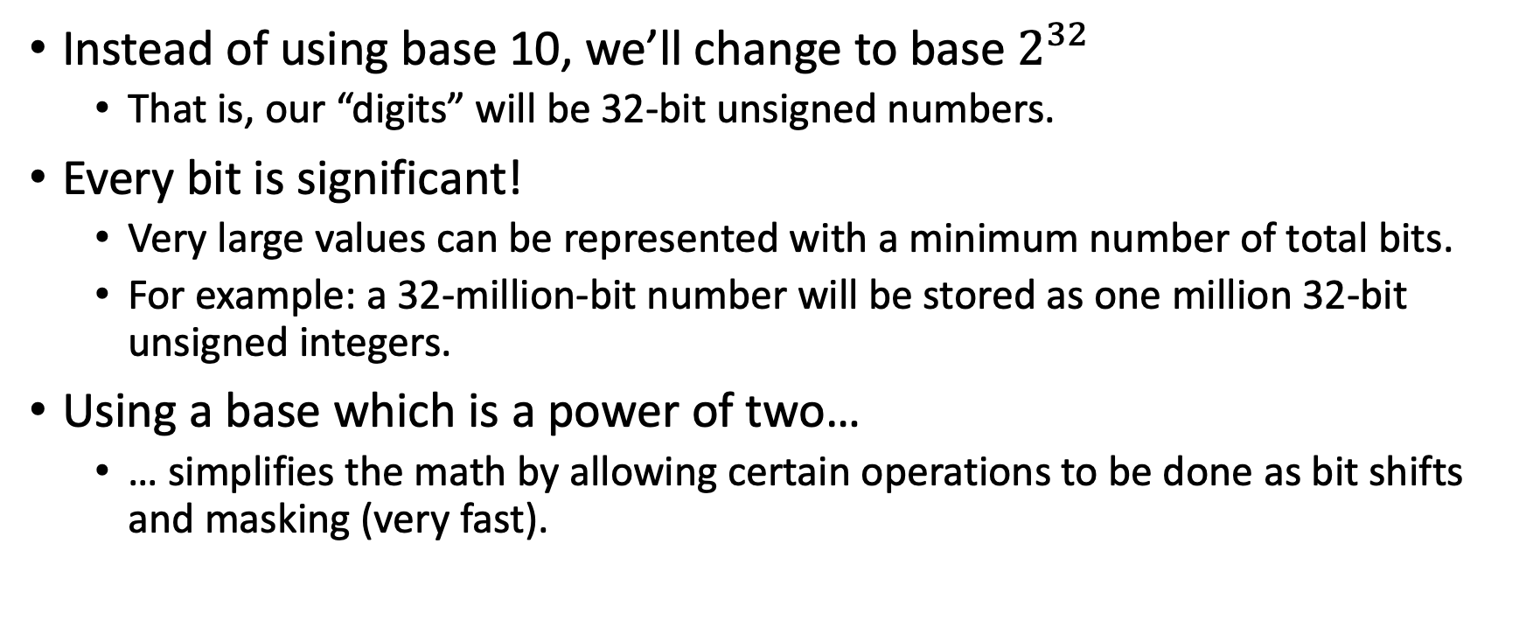

BigInteger3: Base $2^{32}$Digits
Instead of using base 10, we’ll change to base $2^{32}$
That is, our “digits” will be 32-bit unsigned numbers.
Every bit is significant!
Very large values can be represented with a minimum number of total bits.
For example: a 32-million-bit number will be stored as one million 32-bit unsigned integers.
Using a base which is a power of two…
… simplifies the math by allowing certain operations to be done as bit shifts and masking (very fast).

Slide 8
Compute Type vs Storage Type
Computations on digits require temporaries with twice as many bits.
For example, in base 10, multiplying two 2-digit numbers yields a 4-digit result: 99 * 99 = 9801.
Similarly, multiplying two 32-bit numbers yields, in general, a 64-bit result.
We will use two type aliases:
storage_type for holding a digit in memory (32 bits).
compute_type for holding temporary results of digit computation (64 bits).
Using type aliases improves code readability and documentation and allows us to modify their definition for different platforms.

Slide 9
What Platforms?
First, who cares about arbitrary precision integers?
A classic use-case is cryptography. Some cryptographic algorithms manipulate (and do arithmetic on) values with thousands of bits (e.g., RSA, DSA, ECC).
Will systems targeting microcontrollers ever want to use cryptography?
Yes!
So, it makes sense to ensure our code will work correctly even on a 16-bit processor. This requires attention to detail regarding the selection of integers types.
Hence the use of type aliases to make changes easy in the future.

