Slide 1
NetWeather
A Network Accessible Weather Station
SOFTWARE DESIGN
May 1, 2008
Cooper Bills, Michael Dominguez, Rebecca Favreau, Chadrick Hess

Slide 2
Outline
Console Interface (Cooper Bills)
Data Source (Michael Dominguez)
Database (Rebecca Favreau)
Web Interface (Chadrick Hess)

Slide 3
Console Interface
Cooper Bills

Slide 4
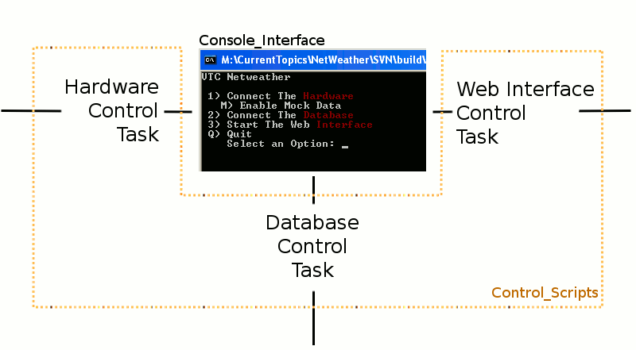
Console Packages
Console_Interface
Control_Scripts

Slide 5
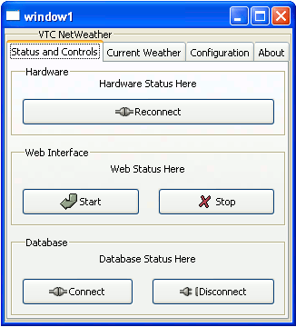
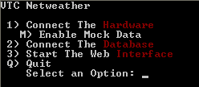
Console_Interface Package
Interacts With the Control_Scripts Package
Displays the Menu
Keeps Track of Statuses
Gives user Control

Slide 6
Control_Scripts Package
Allows the Console to interface Asynchronously with the various components of NetWeather

Slide 7
Data Source
Michael Dominguez

Slide 8
Package Data_Source
Connects with the serial port to receive information
Receives a range of integers, wind speed and direction, from 0-255
Uses COM1, Baud rate of 9600, no parity, eight bits and no stop bits
Can generate both mock and actual data
Flag sets are in Hex

Slide 9
Flags
case Tag is
when 16#01# =>
Speed := Speed_Type(Read);
when 16#02# =>
Direction := Direction_Type(Read);
when 16#FF# =>
Today := Ada.Calendar.Clock;
Database.Add_Wind_Speed(Speed, Today);
Database.Add_Wind_Direction(Direction, Today);

Slide 10
Mock and Actual Data
Can choose which through the Console Interface
Generate either a test data file
Generate an actual data file

Slide 11
Database
Rebecca Favreau

Slide 12
How It Fits
The database is used to store the data
Task and procedures are used to enter and access data
Provides functions for
  the hardware to software interface
  The web access
  The user interface

Slide 13
What It Does
It provides functionality to a database
Storage of data using postgresql
Allows for access of any piece of data
Organized storage

Slide 14
Does it work?
As of April 28th 2008, not entirely
Possible problems
  Mock data generator not doing as it should
  Database task not entering data into tables
Solutions?
  Experiment more with mock data generator
  Ensure data is making it to tables

Slide 15
Next?
Provide functionality for creating tables in the program
  Currently created by hand
Get it to work
  Still not operational
  Debugging is needed

Slide 16
NetWeather Web Interface
Chadrick Hess

Slide 17
Where AWS Fits In
Front-end to allow user to see data
Connects via Database package to retrieve results
Template parser allows easy modification to site design

Slide 18
Development Status
Currently compiles with no errors
On running should produce (see left)
Not sure how to further test with no data to feed into the template

Slide 19
Future Additions: What to add next
All values in results
Produces simple table on blank page
Web page only way to interact with data
Only table available
Fine-tune results to desired time-frame
Stylize template to have a better look
Mail and Jabber
Use back-end function to create a graph

Slide 20
Questions?

