Slide 1
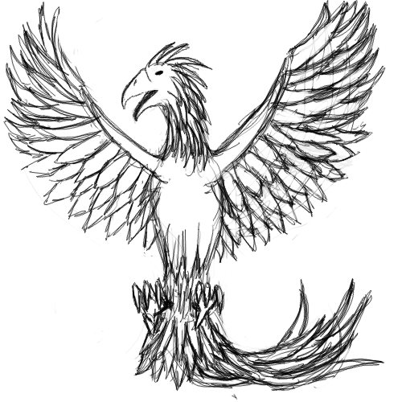
Phoenix
  Nick Guertin,Curtis Aube,Wei Yao Lin

Slide 2
Agenda
Phoenix Game Console
Design Of Phoenix
Direction
Questions

Slide 3
Phoenix Game Console

Slide 4
What is Phoenix?
A bootable, operating system (OS) driven, game console that runs on standard computer hardware.
Floppy disk used as a game 'cartridge', holding the game and the OS in a single executable.
A selectable menu is provided if more than one executable is on the disk.

Slide 5
The Operating System
Is a Microkernel which uses message passing to communicate between modules.
Is run in real mode.
  1 MB of addressable memory
  No memory protection
Doesn't use the standard C library run time library (Programming the raw hardware).

Slide 6
Why Phoenix?
The name "Phoenix" comes from the mythical bird that burns and then rises anew from its ashes.
Phoenix OS rose from an earlier attempt by the VTC Computer Club at building an operating system.
This older system was called "KOS" which was short for the "K Operating System".
Phoenix rose from the ashes of KOS.

Slide 7
Why Are We Doing It?
This project is for our Computer Engineering Degree senior project course: CIS-4712.
Our hope is that this project could be expanded upon in later years by other students in similar degrees.
This project could be a great instrument for learning about the intricacies of how operating systems work.

Slide 8
Design Of Phoenix

Slide 9
Design Overview
KB
GP
Video
Kernel
Input Devices
Sound
Game/Program

Slide 10
Kernel
What is a Kernel?
What is a Microkernel?
Our kernel handles:
  Thread/process switching
    Timer Interrupt
  Threading capabilities
  Message passing

Slide 11
Thread Switching
Outgoing Thread Stack
Incoming Thread
Stack
Old
Push
CPU Register
1.
CS
CS
4.
Flag
AX
Flag
BX
IP
CX
IP
DX
AX
SI
AX
DI
BX
BP
BX
SP
CX
CS
CX
DX
DS
DX
ES
BP
SP
BP
SI
IP
SI
DI
Flag
DI
POP
DS
DS
New
ES
ES
2.
3.

Slide 12
Message Passing

Slide 13
Modules
Included:
  Keyboard
  Video
  Sound
Future Extensions:
  Game Pad
  Input Device
  NIC

Slide 14
Video Module
Video File
  Supports text Mode: 16 colors, 80x25 characters.
  Functions: print at, clear screen, and change mode.
VGA file
  Supports VGA mode: 256 colors, 320x200 pixel resolution, 40x25 characters.
  Functions: print at, put pixel, get pixel, line, rectangle, polygon, circle, and put image.

Slide 15
Keyboard Module
Keyboard file
  Interrupt driven.
  Translate scan code to US-ASCII.
  Supports US standard keyboard.

Slide 16
Bootloader
What is a bootloader?
Stage one: load com file.
Stage two: load exe file.
  Get boot sector information.
  Read root directory, list files. Return starting cluster of chosen file.
  Read FAT at starting cluster and load file in to memory.
  Get the exe header information and read through relocation table.
  Jump to file.

Slide 17
Who Worked On What?
Nicholas Guertin - Message passing in the kernel and testing.
Curtis Aube - Video module, game pad module and bootloader.
Wei Yao Lin - Thread handling, keyboard module and generic input module.

Slide 18
Direction

Slide 19
Where Are We Now?
KB
GP
Video
Kernel
Input Devices
Sound
Game/Program

Slide 20
Future Directions
Protected Mode.
Support of multi player across separate computers.
Support of a file system for saving game progress.
Advanced hardware support. (video/audio cards, usb port)
Phoenix could be used or extended in CIS-4020 (Operating Systems).

Slide 21
Questions

