Slide 1
Stage 1
Stage 2
Scalaness (Stage 1) Computation Result
nesT
Rewrite & ncc
Scala-ness
Modified Scala Compiler
Tiny-OS
Source Code
JVM
Compiler
Execution Environment
I/O with user
and/or WSN
Load
Parse
In Lab
In Lab, or in situ on Hub
In situ on Motes

Slide 2
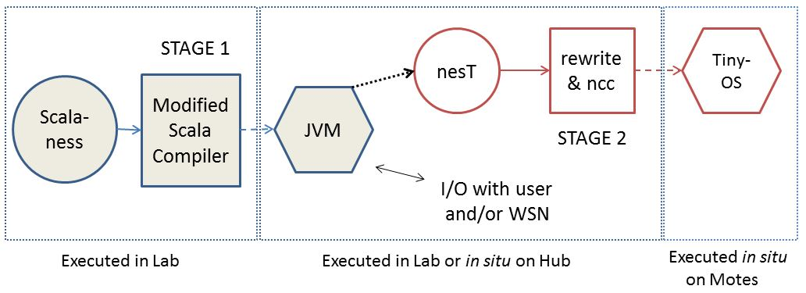
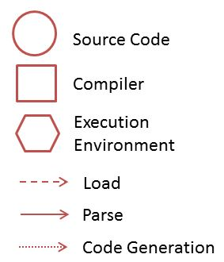
Key

Slide 3
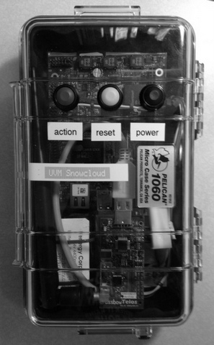
A Hub Device

