Slide 1
Distributed Authorization
Presented by Peter C. Chapin
University of Vermont
April 20, 2005

Slide 2
Outline
Overview of Trust Management
Introduction to RT
Trust but Verify

Slide 3
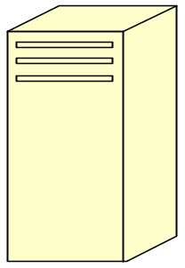
Distributed Processing
Nodes in different
Administrative domains
Access control potentially applied at every node.
Must be efficient, flexible, and support delegation

Slide 4
Traditional Authorization
Requester
Authorizer
(send identity certificate)
Requester authenticates (proves identity)
Requester makes request
Authorizer consults permission database
Authorizer grants access based on identity and
permissions afforded to that identity.
X.509 certificates are identity based

Slide 5
Problems with Identity
No comprehensive database of all potential users may exist.
Authorizer may not have access to the database even if one does exist.
Database membership may be highly volatile.
Authorizer must know entire access policy.

Slide 6
Trust Management*
Requester
Authorizer
(send credentials to prove compliance)
Authorizer writes access policy in policy language
Requester makes request; includes credentials
Authorizer checks “proof of compliance”
Authorizer grants access if check succeeds
*Blaze, Feigenbaum, and Lacy. Decentralized Trust Management.
Proceedings of the 1996 IEEE Symposium on Security and Privacy

Slide 7
Policy Oriented Authorization
Authorizer describes allowed requesters in terms of their attributes rather than their identity.
Attributes certified by third-parties according to policy potentially unknown to the authorizer.
Requesters do not necessarily authenticate but instead provide credentials that allow a proof of compliance with policy.

Slide 8
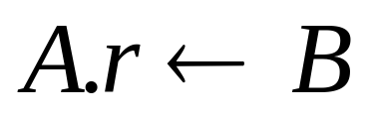
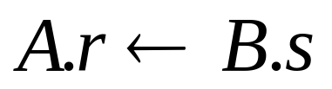

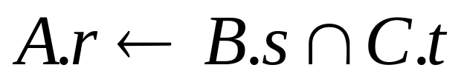
RT₀ Trust Management System*
Policy and Credential Language
*Li, Mitchell, and Winsborough. Design of a Role-based Trust Management
Framework. Proceedings of the 2002 IEEE Symposium on Security and Privacy

Slide 9
Example: VT Only
Authorizer wishes to only grant access to Vermont residents
A.g ← V.resident
Vermont delegates authority to determine residency to the towns
V.towns ← Tunbridge
V.resident ← V.towns.resident
Tunbridge delegates to neighborhood authorities
Tunbridge.locals ← JohnSmith
Tunbridge.resident ← Tunbridge.locals.resident
Requester has certificate signed by John Smith
JohnSmith.resident ← Peter

Slide 10
Authorization as Logic Program
mem(X, a, g) :-
mem(X, v, resident).
mem(X, v, resident) :-
mem(Y, v, towns), mem(X, Y, resident).
mem(tunbridge, v, towns).
mem(X, tunbridge, resident) :-
mem(Y, tunbridge, locals), mem(X, Y, resident).
mem(johnsmith, tunbridge, locals).
mem(peter, johnsmith, resident).
Query: mem(peter, a, g)

Slide 11
RT₀^{D}: Delegation
An entity is allowed to activate a subset of his/her roles and delegate those activations to an intermediary.
P →(P as A.g)→I₁
I₁ →(P as A.g)→I₂
I₂ passes P as A.g to the request.

Slide 12
Authorization is Expensive
Complex authorization decisions might be time consuming.
Fetch remote credentials.
Cryptographic operations (signature checks).
Proof of compliance check.

Slide 13
Trust but Verify (TbV)
Reliable, practical distributed authorization
Ideal security may take many details and relations into
account.
Practical security may require simplifications to achieve
efficiency.
Simplification during authorization introduces elements of trust
into online security decisions.
Essence of TbV: Online trust should be verifiable offline to
ensure that it is warranted. The relationship between trust and
verification should be described in a logically precise way.

Slide 14
TbV Examples
Simple, real life credit card transactions. Credit card com-
panies trust vendors without proof of delegation from card
holder.
Business Transaction Protocol. (enroll/prepare/commit)
Authorizers could potentially enroll quickly using trust.
TbV approach allows auditing of trusted transactions, in
case of disputes or as a matter of course, to verify trust
content.

Slide 15
A Formal Framework
Logically well-founded. Provides precise meaning of “trust” and “verification”, with provable guarantees.
General. Framework intended to be applicable to a variety of systems.
A TbV system is characterized by high level formal conditions.
TbV implementations must adhere to these conditions.
At UVM we are working on a TbV system using RT₀^{D}.

Slide 16
Summary
Trust management systems provide identity-free authorization in distributed environments.
RT framework supports a tractable, well founded policy language for trust management.
TbV seeks to streamline authorization by allowing some aspects of the decision to be trusted.
TbV provides logically precise notions of “trust” so that security is maintained.
Work at UVM in progress to apply TbV to RT.

