Slide 1

0802 Wrap Up
Peter H. Chen

Slide 2
0802 Wrap Up
https://www.ucsc-extension.edu/certificate-program/offering/python-programmers
Topics:
Exceptions
Namespaces
Nests
Pitfalls
Finding Modules and Help

Slide 3
0802.01 Lab17_1_1.py

Slide 4
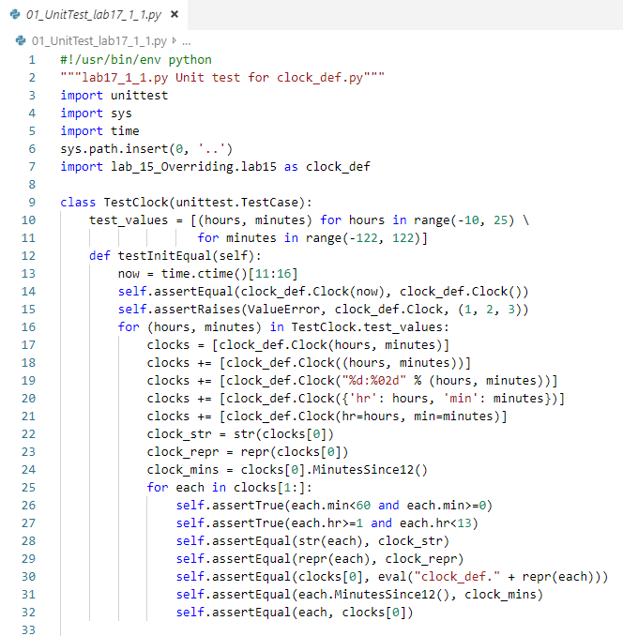
0802.01 Lab17_1_1.py
https://www.ucsc-extension.edu/certificate-program/offering/python-programmers
Lab17_1_1.py

Slide 5
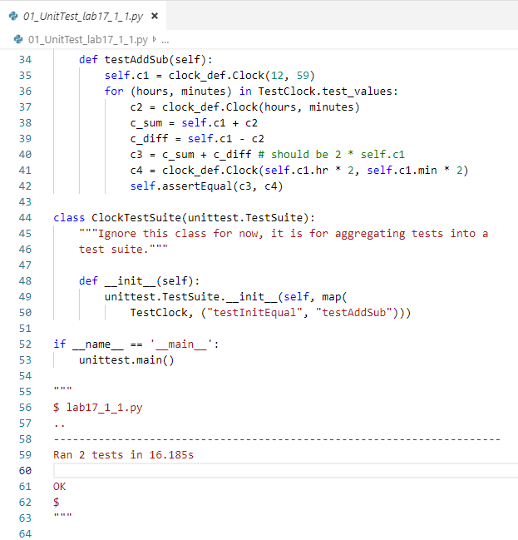
0802.01 Lab17_1_1.py
https://www.ucsc-extension.edu/certificate-program/offering/python-programmers
Lab17_1_1.py

Slide 6
0802.02 Lab17_1_2.py

Slide 7
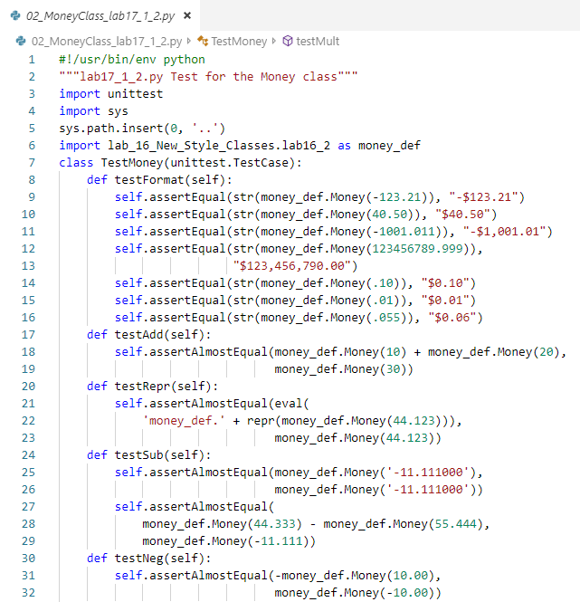
0802.02 Lab17_1_2.py
https://www.ucsc-extension.edu/certificate-program/offering/python-programmers
Lab17_1_2.py

Slide 8
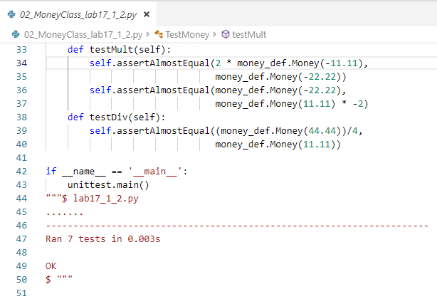
0802.02 Lab17_1_2.py
https://www.ucsc-extension.edu/certificate-program/offering/python-programmers
Lab17_1_2.py

Slide 9
0802.03 Testsuite.py

Slide 10
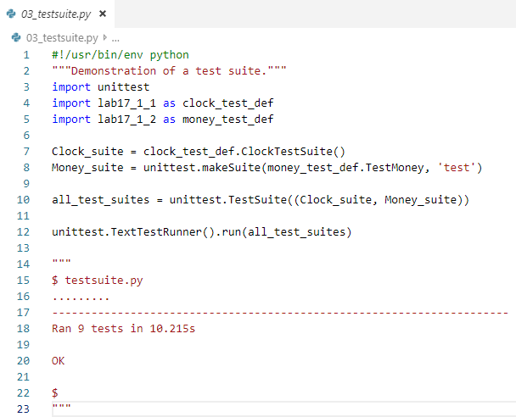
0802.03 Testsuite.py
https://www.ucsc-extension.edu/certificate-program/offering/python-programmers
Testsuite.py

Slide 11
0802.04 Lab17_2.py

Slide 12
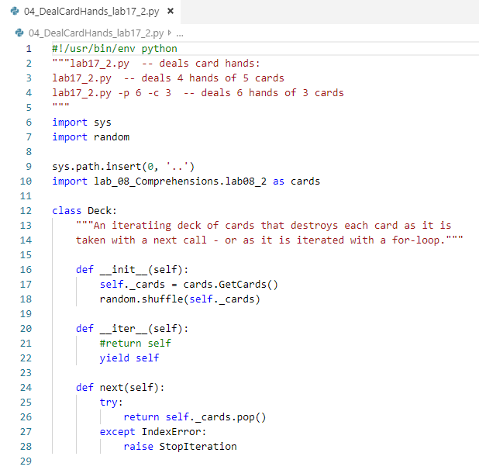
0802.04 Lab17_2.py
https://www.ucsc-extension.edu/certificate-program/offering/python-programmers
Lab17_2.py

Slide 13
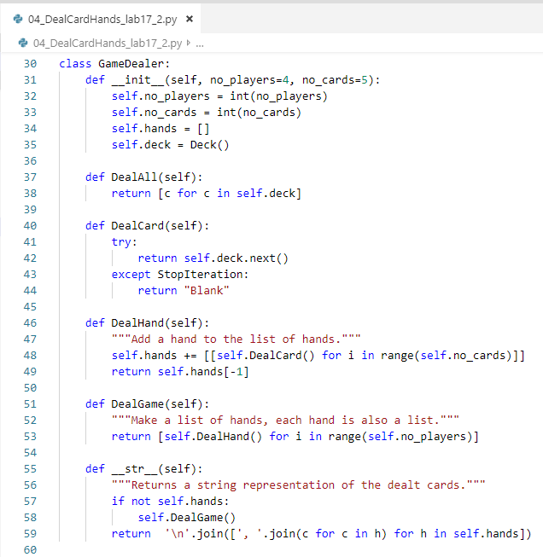
0802.04 Lab17_2.py
https://www.ucsc-extension.edu/certificate-program/offering/python-programmers
Lab17_2.py

Slide 14
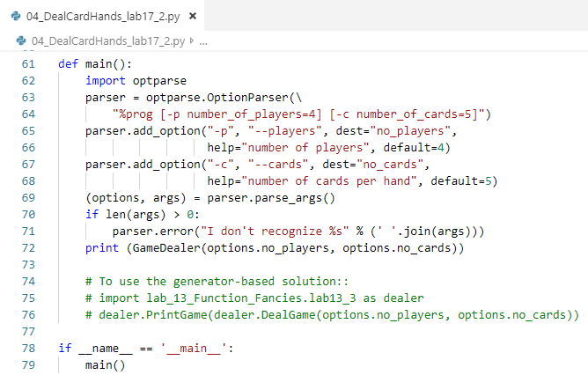
0802.04 Lab17_2.py
https://www.ucsc-extension.edu/certificate-program/offering/python-programmers
Lab17_2.py

Slide 15
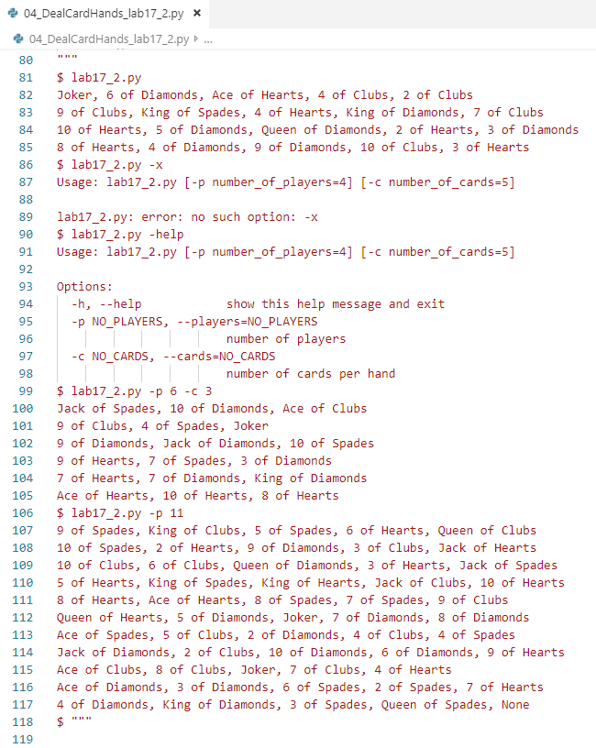
0802.04 Lab17_2.py
https://www.ucsc-extension.edu/certificate-program/offering/python-programmers
Lab17_2.py

Slide 16
0802.05 Lab17_3.py

Slide 17
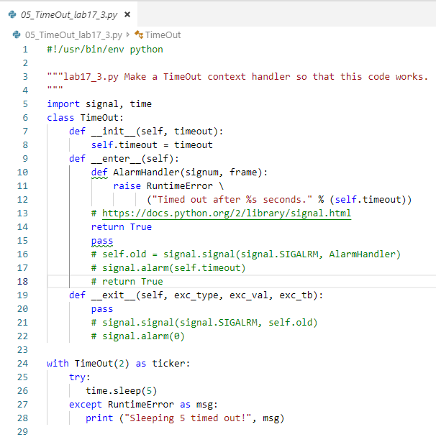
0802.05 Lab17_3.py
https://www.ucsc-extension.edu/certificate-program/offering/python-programmers
Lab17_3.py

Slide 18
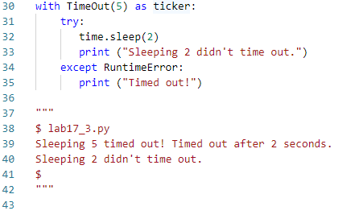
0802.05 Lab17_3.py
https://www.ucsc-extension.edu/certificate-program/offering/python-programmers
Lab17_3.py

Slide 19
0802.06 raise1.py

Slide 20
0802.06 raise1.py
https://www.ucsc-extension.edu/certificate-program/offering/python-programmers
raise1.py

Slide 21
0802.07 raise2.py
Peter H. Chen

Slide 22
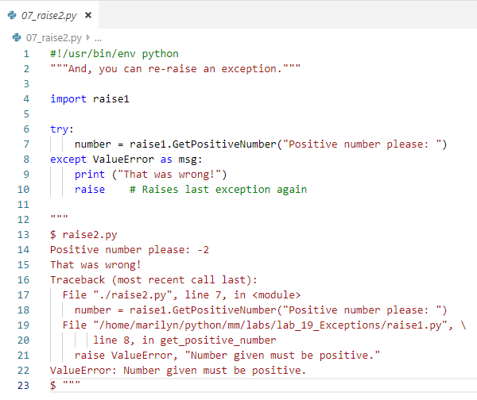
0802.07 raise2.py
https://www.ucsc-extension.edu/certificate-program/offering/python-programmers
raise2.py

Slide 23
0802.08 raise3.py

Slide 24
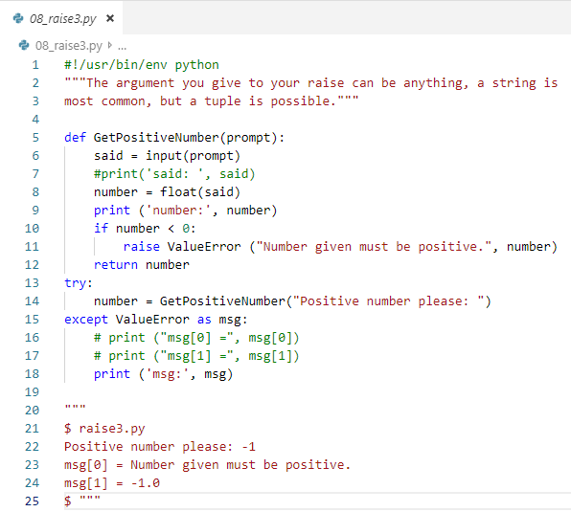
0802.08 raise3.py
https://www.ucsc-extension.edu/certificate-program/offering/python-programmers
raise3.py

Slide 25
0802.09 myexcept1.py

Slide 26
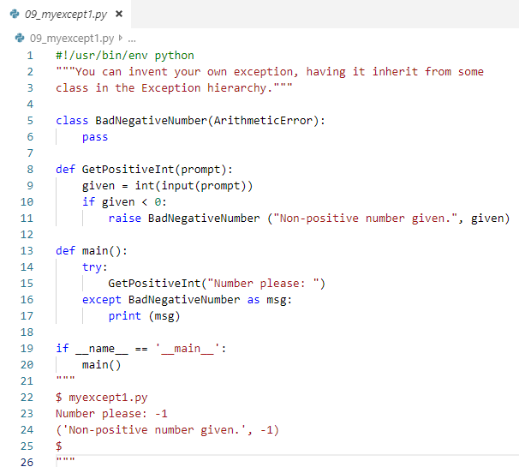
0802.09 myexcept1.py
https://www.ucsc-extension.edu/certificate-program/offering/python-programmers
myexcept1.py

Slide 27
0802.10 myexcept2.py

Slide 28
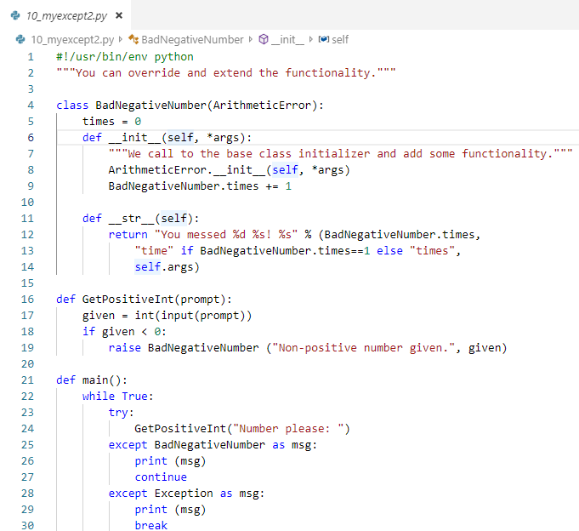
0802.10 myexcept2.py
https://www.ucsc-extension.edu/certificate-program/offering/python-programmers
myexcept2.py

Slide 29
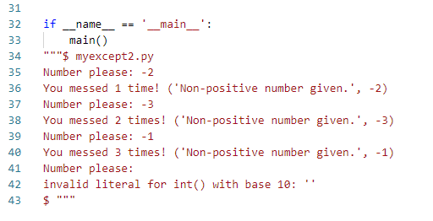
0802.10 myexcept2.py
https://www.ucsc-extension.edu/certificate-program/offering/python-programmers
myexcept2.py

Slide 30
0802.11 myexcept3.py
Peter H. Chen

Slide 31
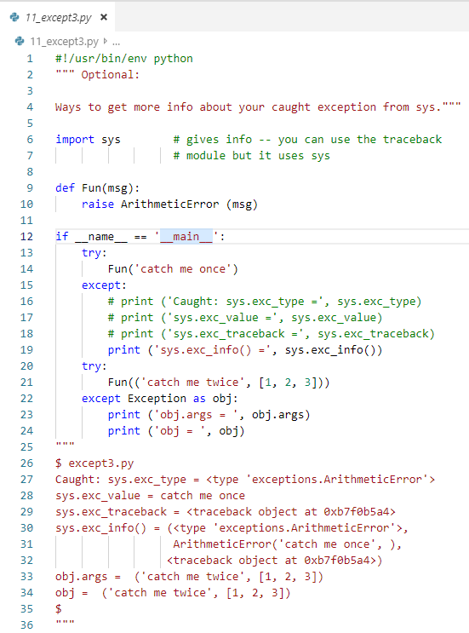
0802.11 myexcept3.py
https://www.ucsc-extension.edu/certificate-program/offering/python-programmers
myexcept3.py

Slide 32
0802.12 manynames.py

Slide 33
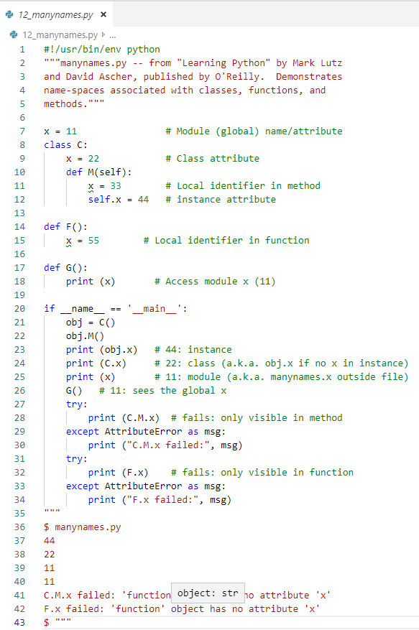
0802.12 manaynames.py
https://www.ucsc-extension.edu/certificate-program/offering/python-programmers
manynames.py

Slide 34
0802.13 function_nest.py

Slide 35
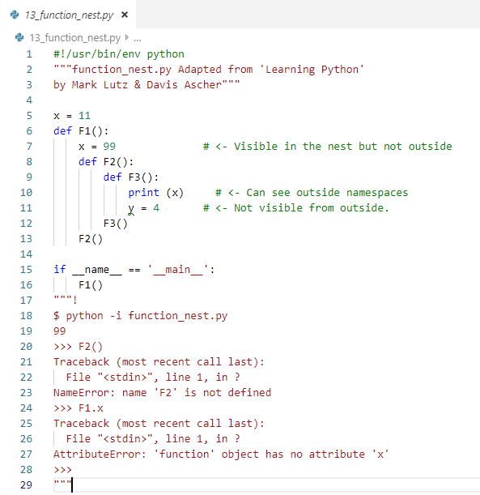
0802.13 function_nest.py
https://www.ucsc-extension.edu/certificate-program/offering/python-programmers
Function_nest.py

Slide 36
0802.14 class_nest.py

Slide 37
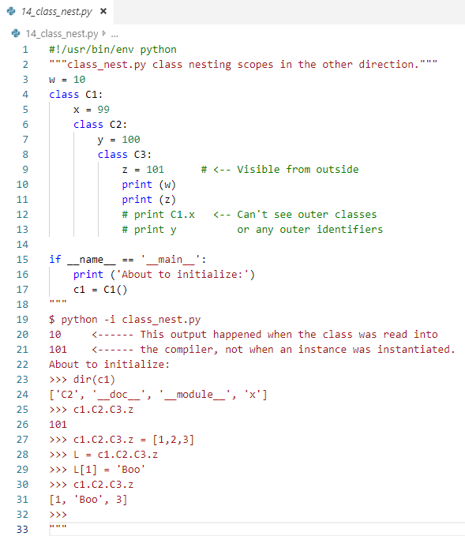
0802.14 class_nest.py
https://www.ucsc-extension.edu/certificate-program/offering/python-programmers
class_nest.py

Slide 38
End of Chapter

