Slide 1

02 Assignment: Lab 07
Peter H. Chen

Slide 2
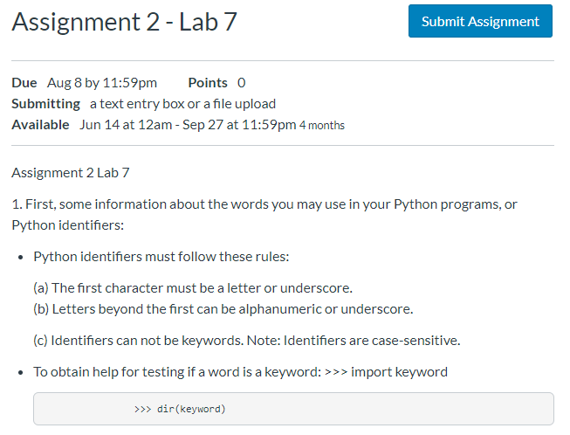
02 Assignment: Lab 07
https://www.ucsc-extension.edu/certificate-program/offering/python-programmers
Assignment 2: Lab 07 (1)

Slide 3
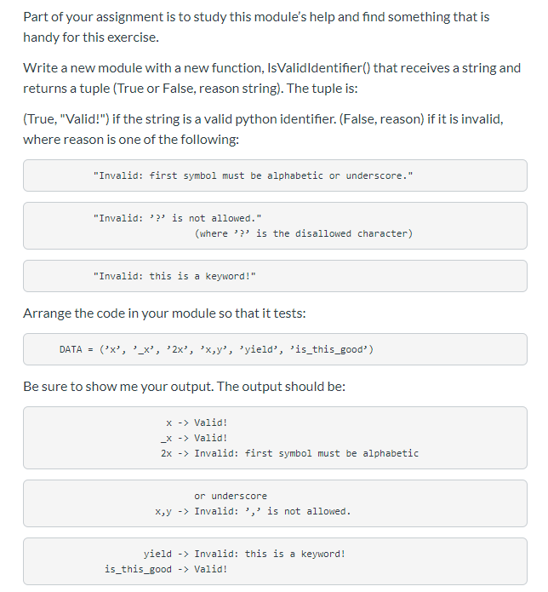
02 Assignment: Lab 07
https://www.ucsc-extension.edu/certificate-program/offering/python-programmers
Assignment 2: Lab 07 (2)

Slide 4
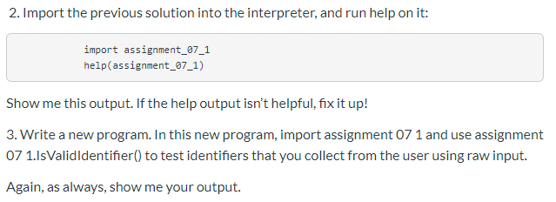
02 Assignment: Lab 07
https://www.ucsc-extension.edu/certificate-program/offering/python-programmers
Assignment 2: Lab 07 (3)

Slide 5
End of Chapter

