Slide 1

04 Assignment: Lab 17
Peter H. Chen

Slide 2
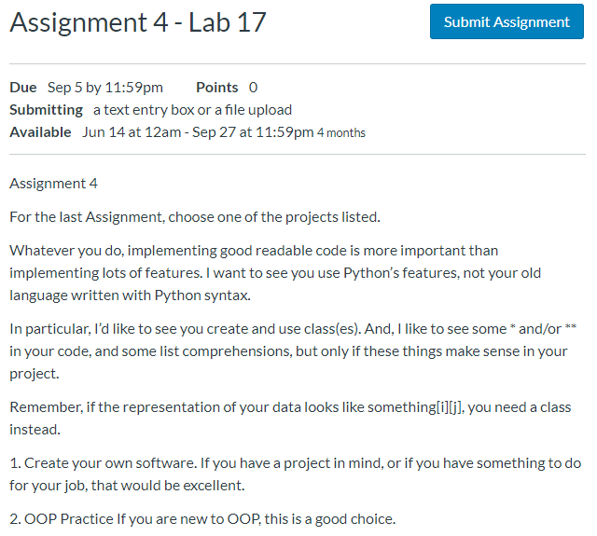
04 Assignment: Lab 17
https://www.ucsc-extension.edu/certificate-program/offering/python-programmers
Assignment 4: Lab 17 (1)

Slide 3
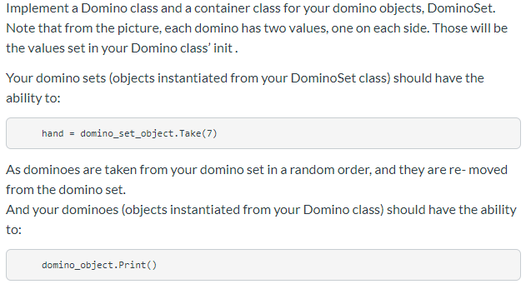
04 Assignment: Lab 17
https://www.ucsc-extension.edu/certificate-program/offering/python-programmers
Assignment 4: Lab 17 (2)

Slide 4
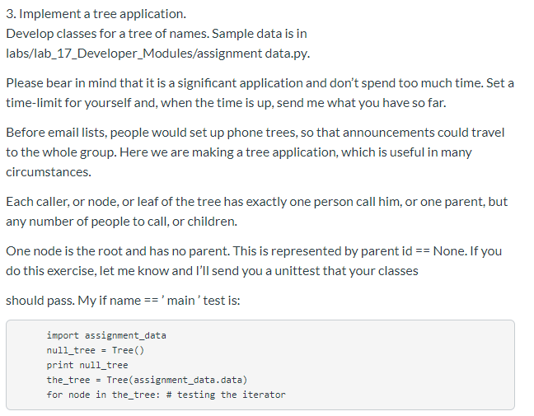
04 Assignment: Lab 17
https://www.ucsc-extension.edu/certificate-program/offering/python-programmers
Assignment 4: Lab 17 (3)

Slide 5
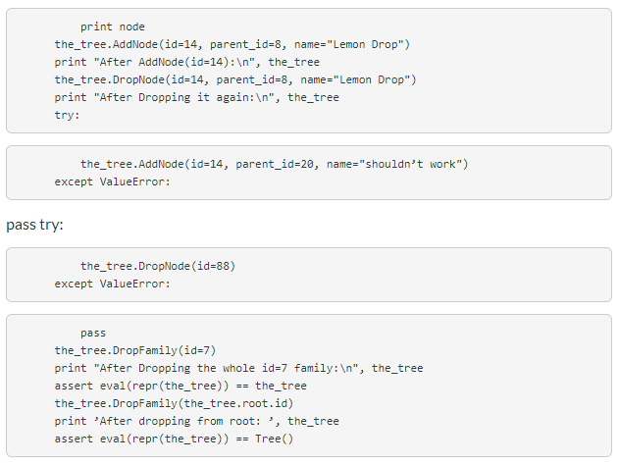
04 Assignment: Lab 17
https://www.ucsc-extension.edu/certificate-program/offering/python-programmers
Assignment 4: Lab 17 (4)

Slide 6
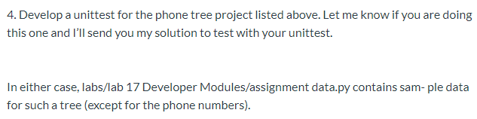
04 Assignment: Lab 17
https://www.ucsc-extension.edu/certificate-program/offering/python-programmers
Assignment 4: Lab 17 (5)

Slide 7
End of Chapter

