Slide 1

0801 Module
Peter H. Chen

Slide 2
0801 Module
https://www.ucsc-extension.edu/certificate-program/offering/python-programmers
Topics:
Context Manager Class
Module: unittest
Module: optparse

Slide 3
0801.1 lab16_1.py

Slide 4
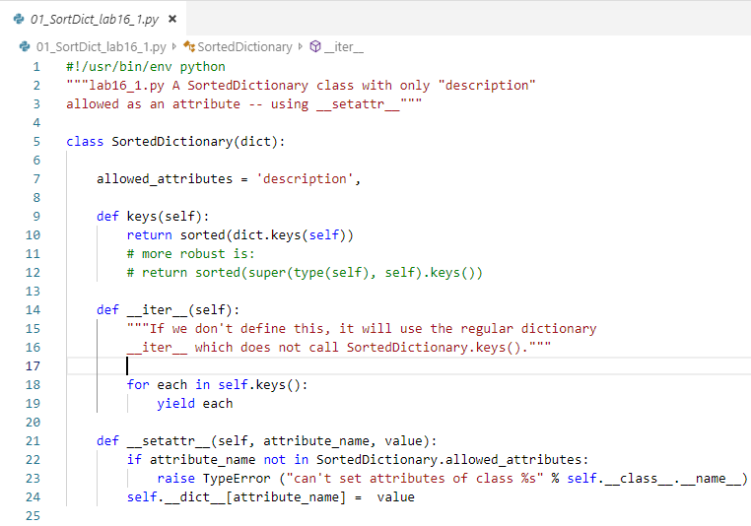
0801.1 lab16_1.py
https://www.ucsc-extension.edu/certificate-program/offering/python-programmers
Lab16_1.py:
Use regular dictionary key instead of super().
Define new iterator (__iter__) for the child class.
Magic __setattr__() for tuple setting.

Slide 5
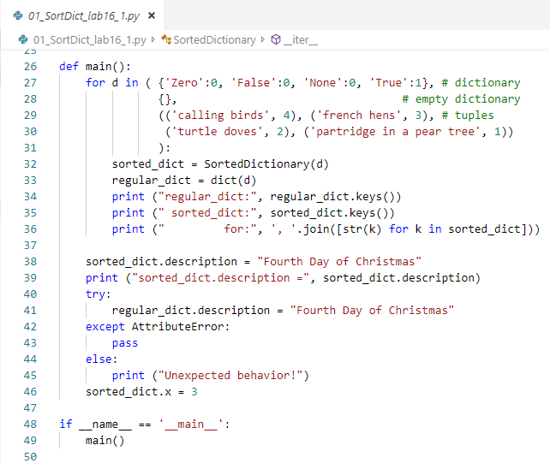
0801.1 lab16_1.py
https://www.ucsc-extension.edu/certificate-program/offering/python-programmers
Lab16_1.py:

Slide 6
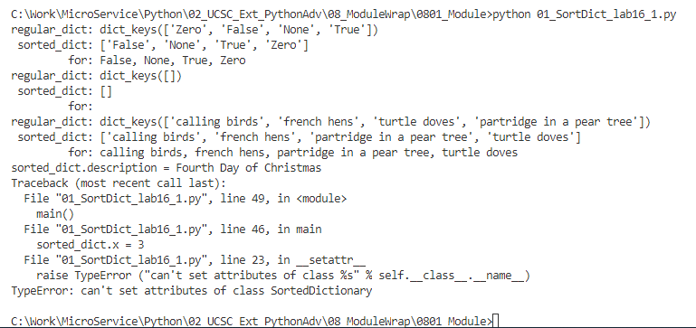
0801.1 lab16_1.py
https://www.ucsc-extension.edu/certificate-program/offering/python-programmers
Lab16_1.py:

Slide 7
0801.2 lab16_2.py

Slide 8
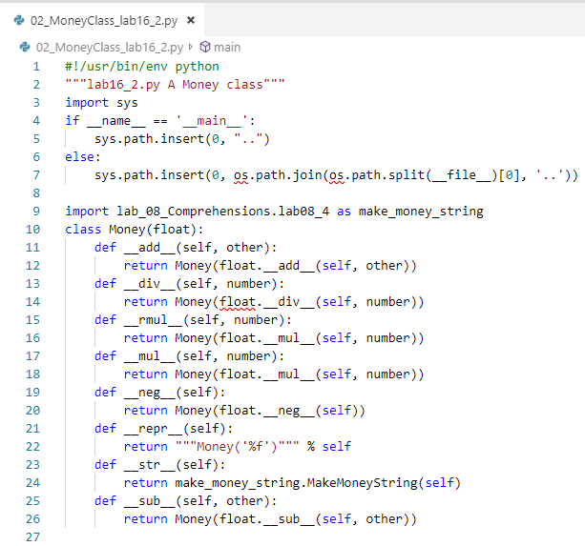
0801.2 lab16_2.py
https://www.ucsc-extension.edu/certificate-program/offering/python-programmers
Lab16_2.py: class Money provides the money format.

Slide 9
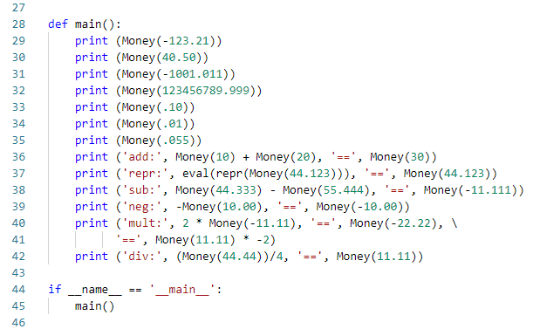
0801.2 lab16_2.py
https://www.ucsc-extension.edu/certificate-program/offering/python-programmers
Lab16_2.py:

Slide 10
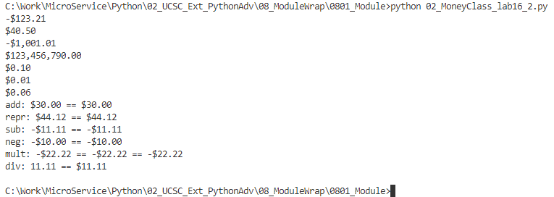
0801.2 lab16_2.py
https://www.ucsc-extension.edu/certificate-program/offering/python-programmers
Lab16_2.py:

Slide 11
0801.3 03_context.py

Slide 12
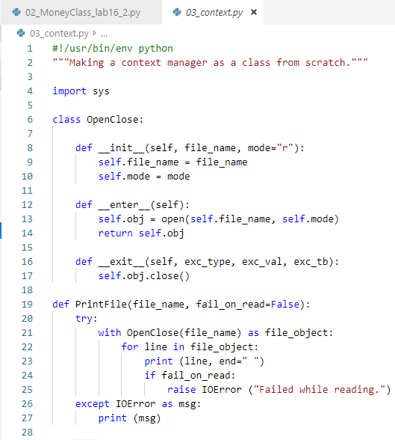
0801.3 context.py
https://www.ucsc-extension.edu/certificate-program/offering/python-programmers
Context.py: Context manager is similar to decorator. In that, it change the flow control.
Line 21 open file as file_object. Now, we need the context manager. The file open and close need the context manager.
The open and close need the magic enter, exit, and init.
The magic init is going to happen when we open or close the file.

Slide 13
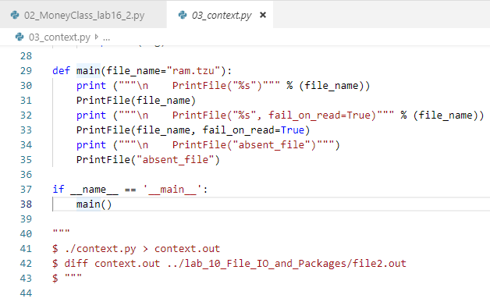
0801.3 context.py
https://www.ucsc-extension.edu/certificate-program/offering/python-programmers
Context.py:

Slide 14
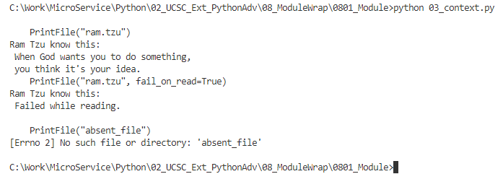
0801.3 context.py
https://www.ucsc-extension.edu/certificate-program/offering/python-programmers
Context.py:

Slide 15
0801.4 context2.py

Slide 16
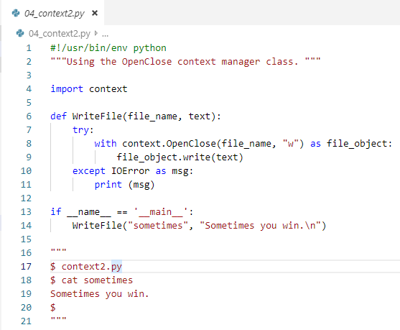
0801.4 context2.py
https://www.ucsc-extension.edu/certificate-program/offering/python-programmers
Contex2.py: Here we use our OpenClose().

Slide 17
0801.5 pyunit.py

Slide 18
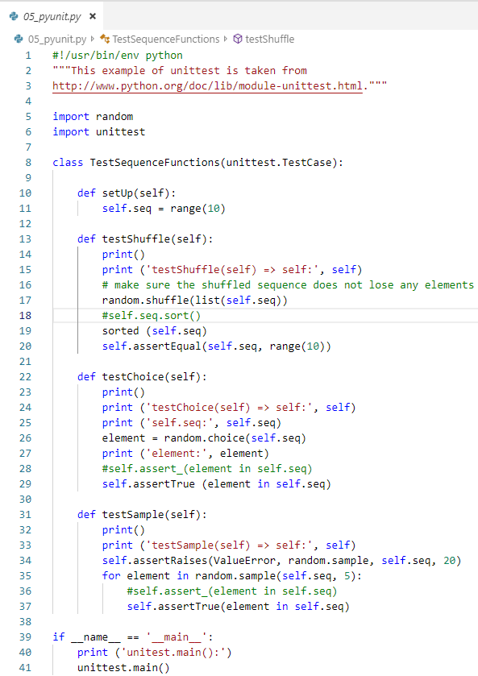
0801.5 pyunit.py
https://www.ucsc-extension.edu/certificate-program/offering/python-programmers
pyunit.py: This is an important unit test. In the development, we try to get the production code. We import the random module and unittest module.
We inheriting the unittest.TestCase. It provides the setup(), testShuffle(), testChoice(), and testSample() funcitons.
It calls assert_() and assertRaise().
The main () have to use unittest.main()

Slide 19
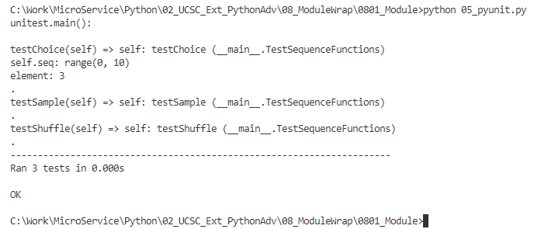
0801.5 pyunit.py
https://www.ucsc-extension.edu/certificate-program/offering/python-programmers
pyunit.py: When we run successfully, We got the run time message.

Slide 20
0801.6 parser.py

Slide 21
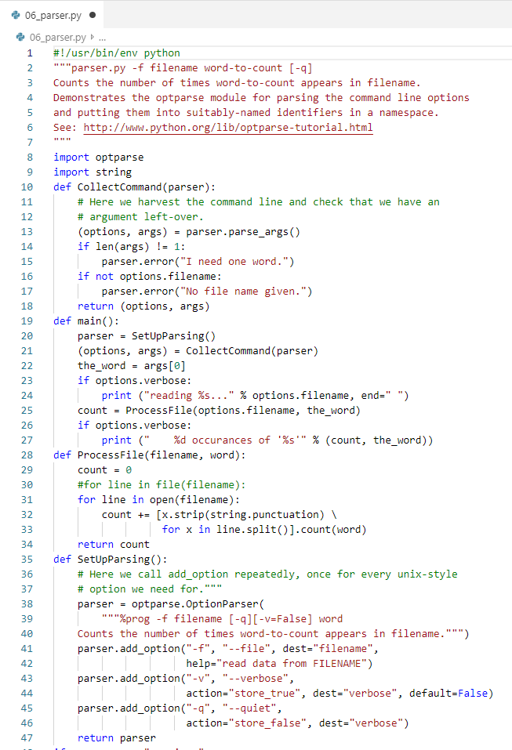
0801.6 parser.py
https://www.ucsc-extension.edu/certificate-program/offering/python-programmers
Parser.py: The parser module will parse the command line parse for you.
SetParsing() for command line argument.
SetupParsing(): setup the option for “-v” and etc.
(Options, args) are the tuple of command line.

Slide 22
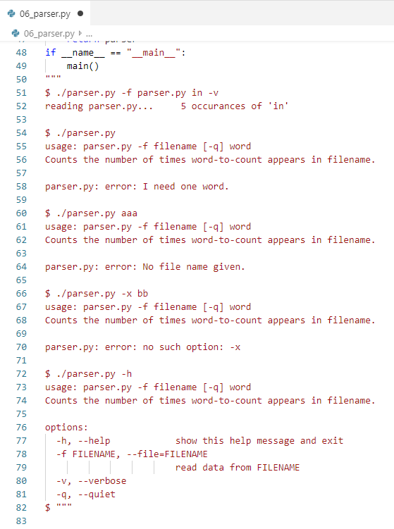
0801.6 parser.py
https://www.ucsc-extension.edu/certificate-program/offering/python-programmers
Parser.py: The command we use “-f”, “in” in this function, and “–v” for verbose.

Slide 23
0801.7 Quiz answer

Slide 24
0801.6 parser.py
https://www.ucsc-extension.edu/certificate-program/offering/python-programmers
Quiz answer:
Wheel
Motor
Bicycle Wheel
Car
Wheel
Gas
Motor
Electric
Motor
Bicycle
Car
Washing-
Machine

Slide 25
0801.6 parser.py
https://www.ucsc-extension.edu/certificate-program/offering/python-programmers
Quiz answer:
class BicycleWheel (Wheel)
pass
class Bicyle:
number_of_bicyles = 0
def __init__(self):
self.wheel =Bicyle.number_of_bicycles += 1
class Car:
def __init__ (self):
self.wheels = (CarWheel() for I in range(5)]
Self.motor = GasMotor()
class WashingMachine:
def __init__ (self):
self.motor = ElectricMotor()
class Motor:
pass
class GasMotor (Motor):
pass
class ElectricMotor (Motor):
pass

Slide 26
End of Chapter

