Slide 1

0402 File IO
Peter H. Chen

Slide 2
0402 File IO
https://www.ucsc-extension.edu/certificate-program/offering/python-programmers
Topics:
File IO
Module: os
Walking a Directory

Slide 3
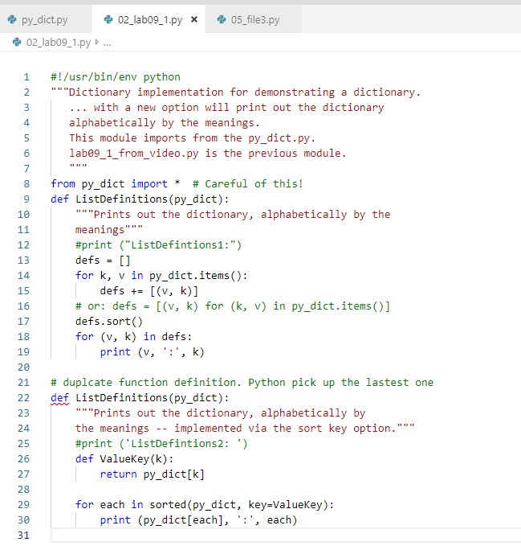
0402 File IO
https://www.ucsc-extension.edu/certificate-program/offering/python-programmers
Lab09_1.py:
There are two duplicated ListDefintitions() functions.
The latest defined function will be picked up.

Slide 4
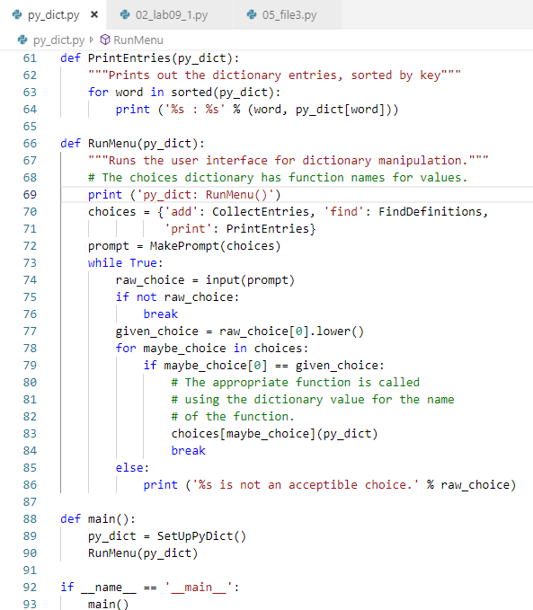
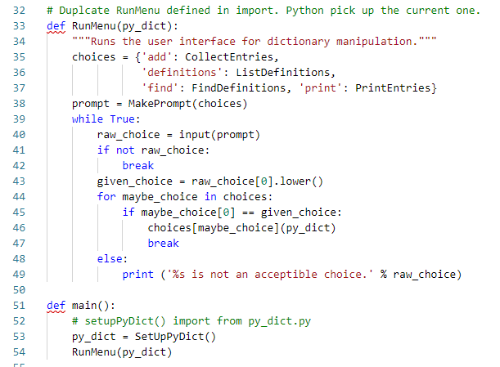
0402 File IO
https://www.ucsc-extension.edu/certificate-program/offering/python-programmers
Lab09_1.py:
There are two duplicated RunMenu(): One in py_dict.py. The other one in current Lab9_1.py
The current module will overwrite the import py_dict.py.

Slide 5
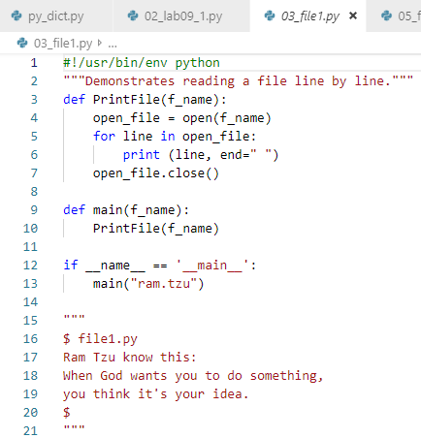
0402 File IO
https://www.ucsc-extension.edu/certificate-program/offering/python-programmers
File1.py: Open, close

Slide 6
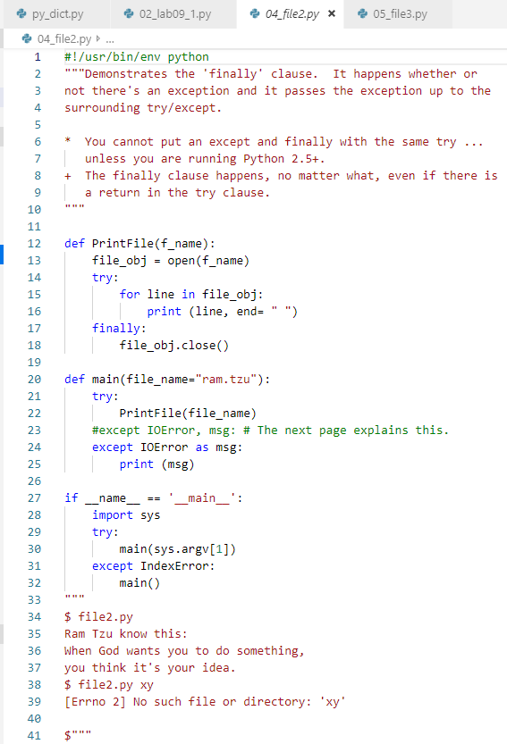
0402 File IO
https://www.ucsc-extension.edu/certificate-program/offering/python-programmers
File2.py:
Finally
except .. as

Slide 7
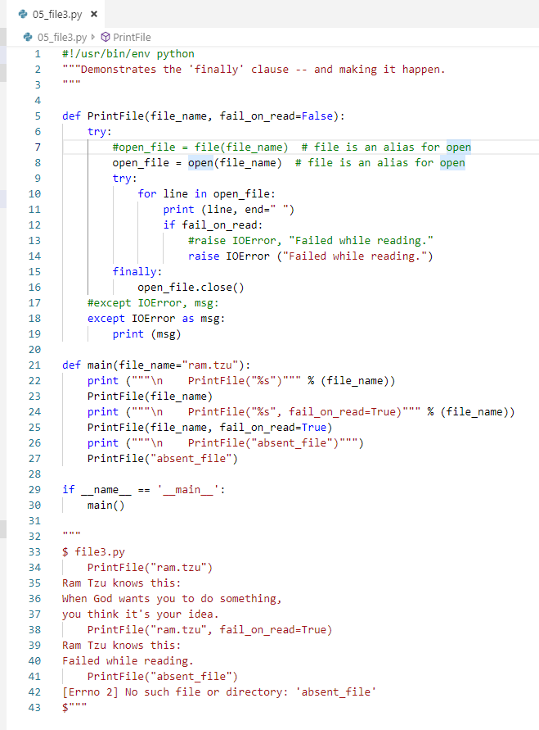
0402 File IO
https://www.ucsc-extension.edu/certificate-program/offering/python-programmers
File3.py:
Raise

Slide 8
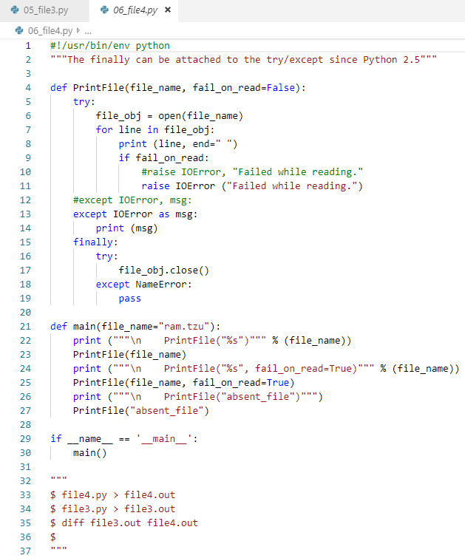
0402 File IO
https://www.ucsc-extension.edu/certificate-program/offering/python-programmers
File4.py:
Same as before except redirection under Linux.

Slide 9
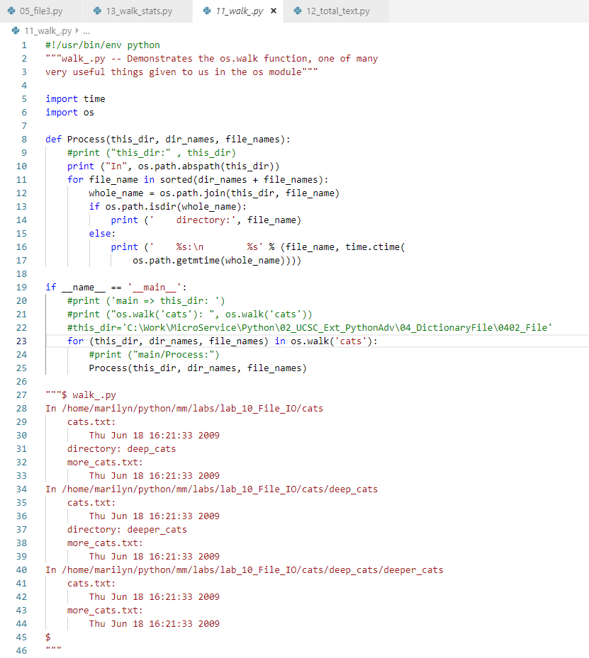
0402 File IO
https://www.ucsc-extension.edu/certificate-program/offering/python-programmers
Walk_.py:
Walking into the folder.

Slide 10
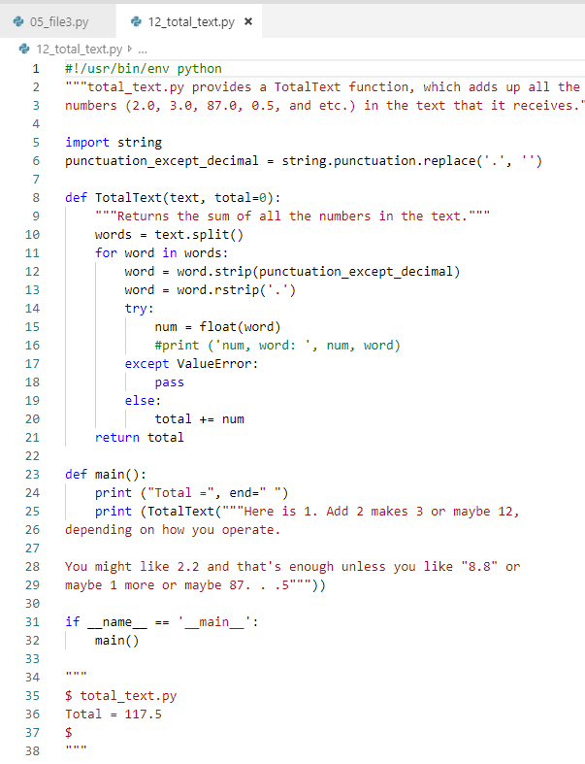
0402 File IO
https://www.ucsc-extension.edu/certificate-program/offering/python-programmers
Count total number in text strings.

Slide 11
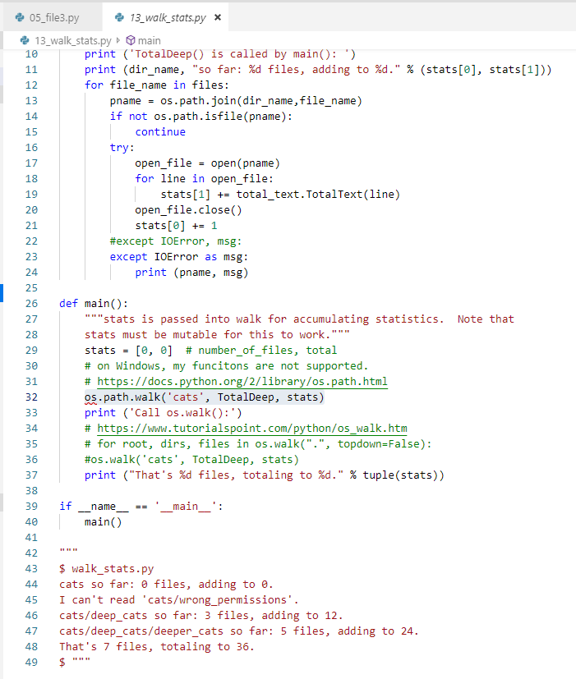
0402 File IO
https://www.ucsc-extension.edu/certificate-program/offering/python-programmers
Count total number in text strings.

Slide 12
End of Chapter

