Slide 1

04 Quiz
Peter H. Chen

Slide 2
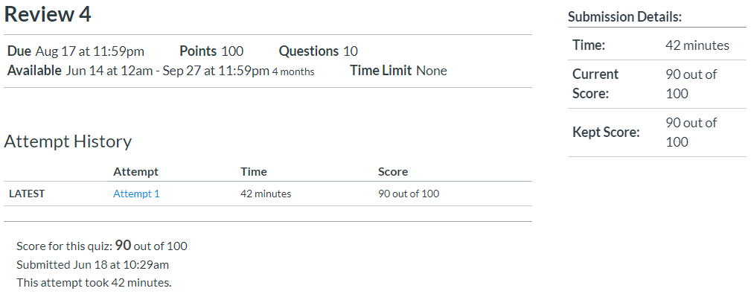
04 Quiz
https://www.ucsc-extension.edu/certificate-program/offering/python-programmers
Quiz:

Slide 3
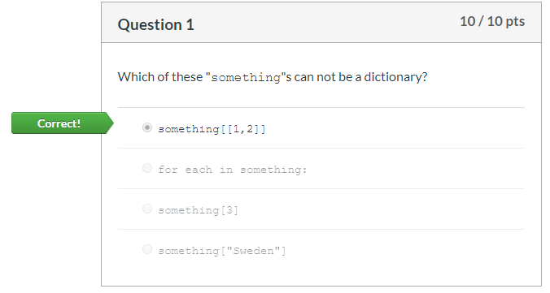
04 Quiz
https://www.ucsc-extension.edu/certificate-program/offering/python-programmers
Quiz:
List is mutable and cannot be a key for dictionary.
Tuple is immutable and can be a key for dictionary.

Slide 4
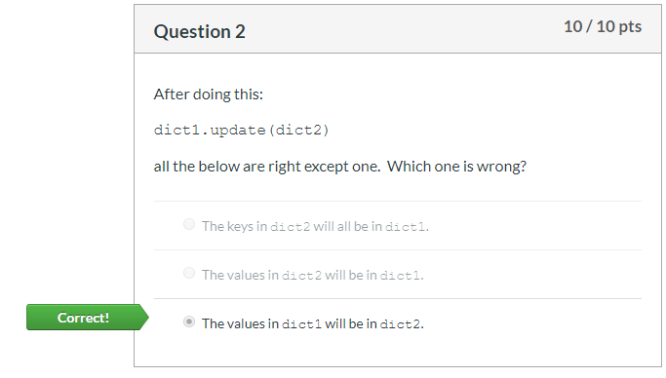
04 Quiz
https://www.ucsc-extension.edu/certificate-program/offering/python-programmers
Quiz:
The dict2 will be updated to dict1.

Slide 5
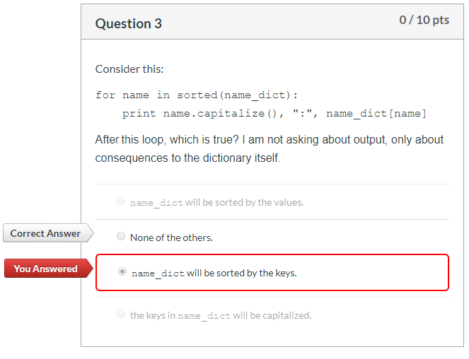
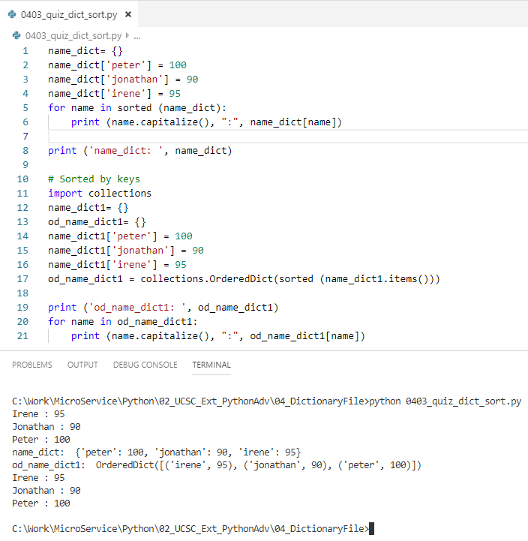
04 Quiz
https://www.ucsc-extension.edu/certificate-program/offering/python-programmers
Quiz: Sorted does not change the original dictionary.
How to sort the dictionary?
The dictionary is sorted by collections.OrderedDict (sorted (dict.items())).

Slide 6
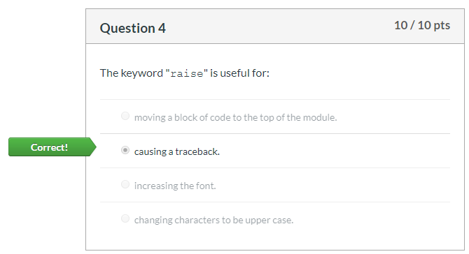
04 Quiz
https://www.ucsc-extension.edu/certificate-program/offering/python-programmers
Quiz: Raise

Slide 7
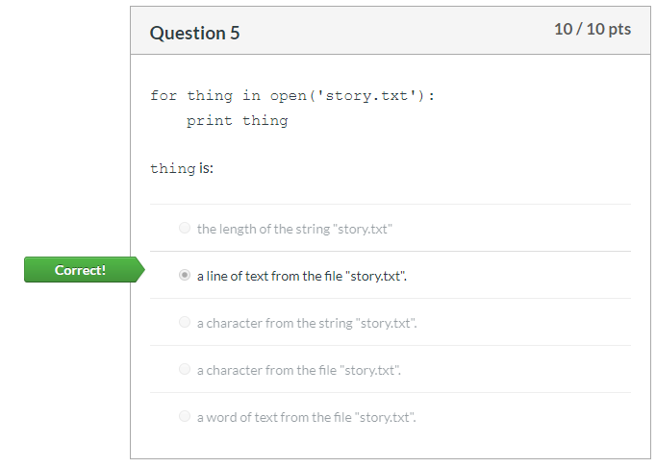
04 Quiz
https://www.ucsc-extension.edu/certificate-program/offering/python-programmers
Quiz: Read a line from file

Slide 8
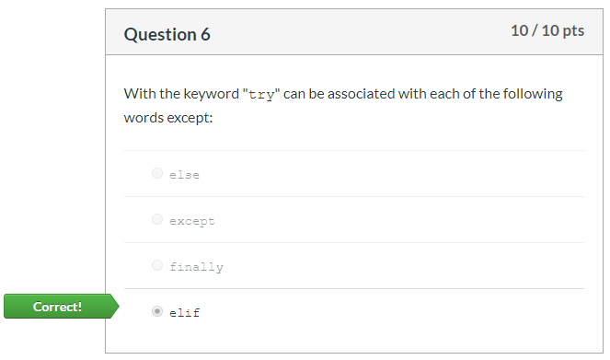
04 Quiz
https://www.ucsc-extension.edu/certificate-program/offering/python-programmers
Quiz: NO elif in the try block.
try …
except …
else …
finally

Slide 9
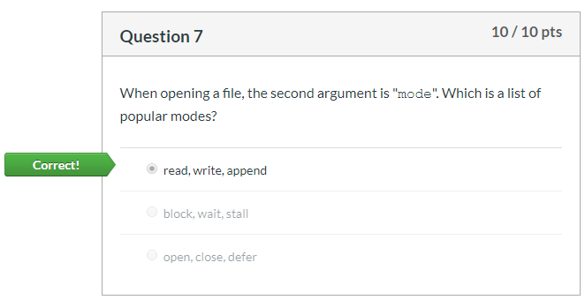
04 Quiz
https://www.ucsc-extension.edu/certificate-program/offering/python-programmers
Quiz: mode for read, write, and append.

Slide 10
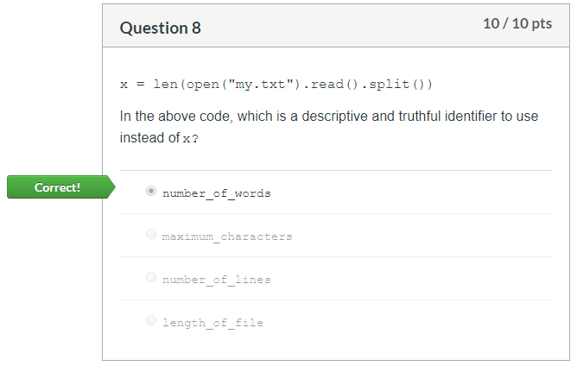
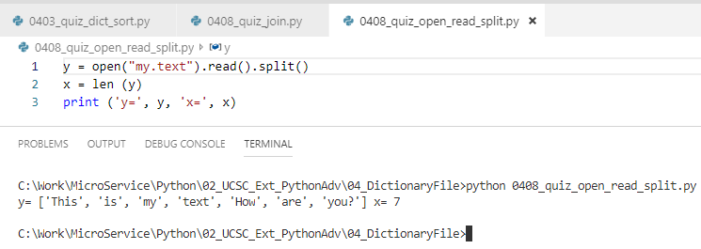
04 Quiz
https://www.ucsc-extension.edu/certificate-program/offering/python-programmers
Quiz: len (open(fn).read().split())

Slide 11
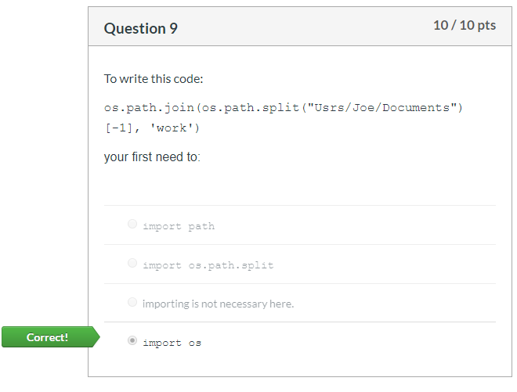
04 Quiz
https://www.ucsc-extension.edu/certificate-program/offering/python-programmers
Quiz: os.path

Slide 12
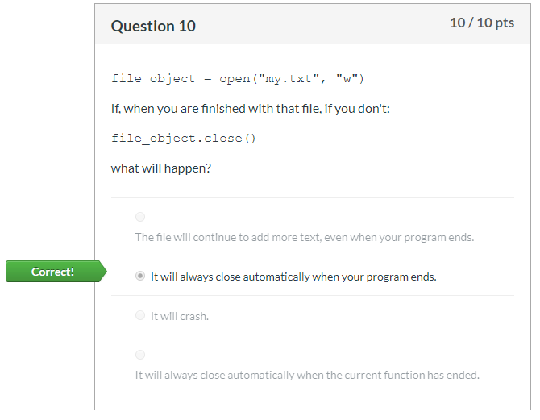
04 Quiz
https://www.ucsc-extension.edu/certificate-program/offering/python-programmers
Quiz: file automatically closed after program ends.

Slide 13
End of Chapter

