Slide 1

0502 Dynamic Code
Peter H. Chen

Slide 2
0502 Dynamic Code
https://www.ucsc-extension.edu/certificate-program/offering/python-programmers
Topics:
Dynamic Code Generation:
What is the Dynamic Code? Make the string exec (executable). See dyanmic.py example.
Modules:
subprocess
glob
profile

Slide 3
0502.1 Call External Code

Slide 4
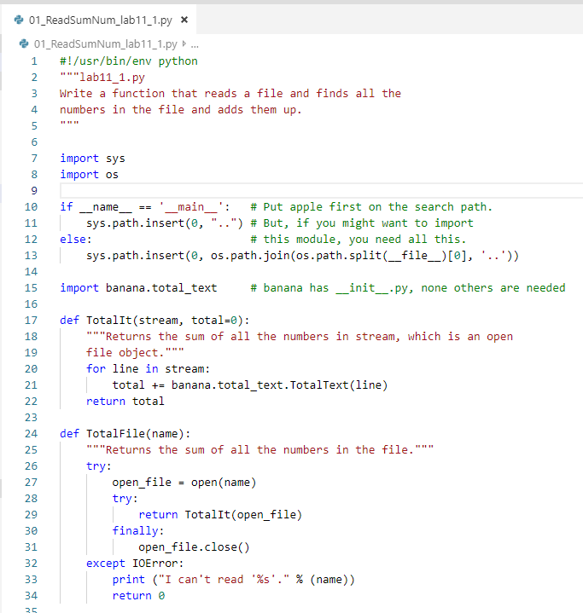
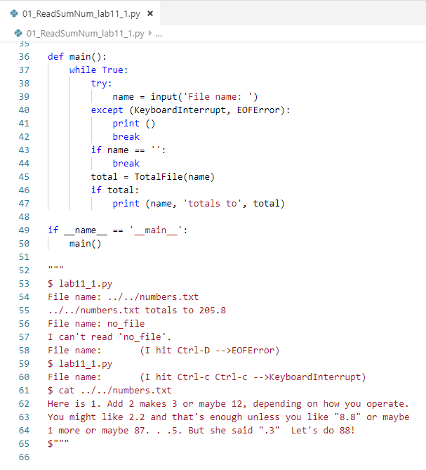
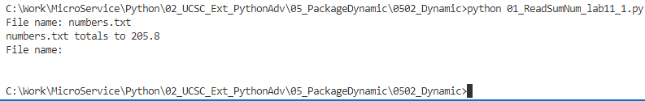
0502.1 Call External Code
https://www.ucsc-extension.edu/certificate-program/offering/python-programmers
01_lab11_1.py and external code “banaba/Total_text.py”
Find all the numbers in the file and adds up the number in the file.

Slide 5
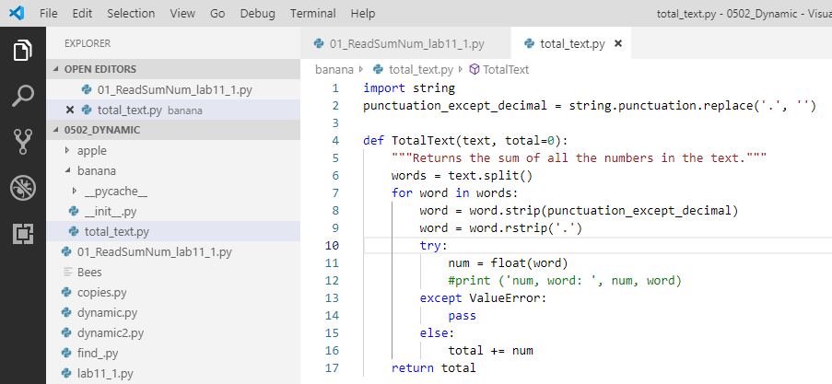
0202 Scope
https://www.ucsc-extension.edu/certificate-program/offering/python-programmers
01_lab11_1.py:
In the folder banana\total_text.py, add “def TotalText (…)”

Slide 6
0502.2 os.walk

Slide 7
0502.2 os.walk
https://www.ucsc-extension.edu/certificate-program/offering/python-programmers
Folder structure for lab11_2.py:
lab11_2.py
[TotalFile(path_name)]
apple
work_here
lab11_1.py
[def TotoalFile (path_name)]
banana
Total_text.py
[def TotalText(line)]

Slide 8
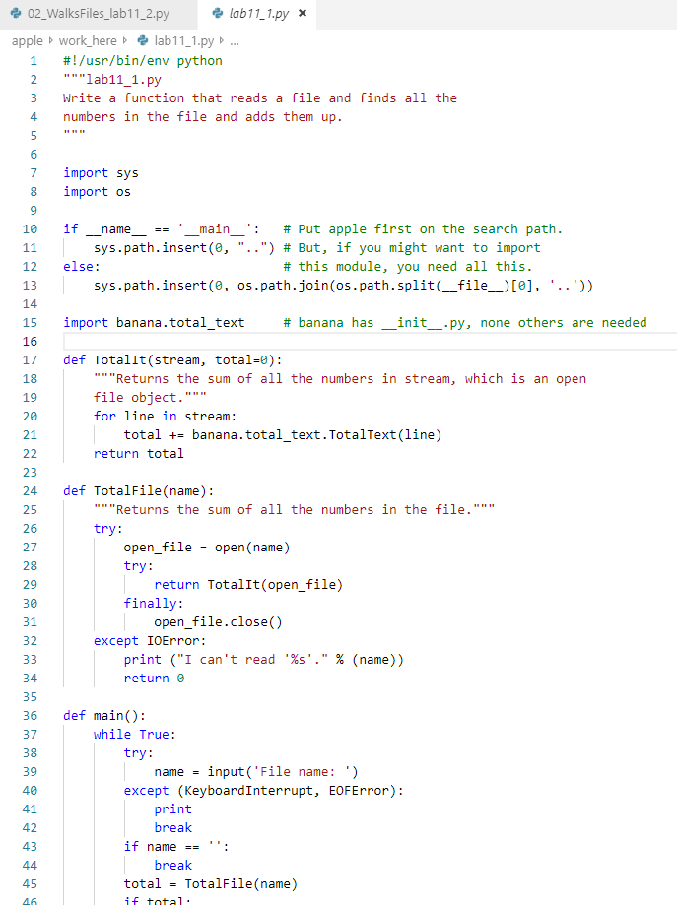
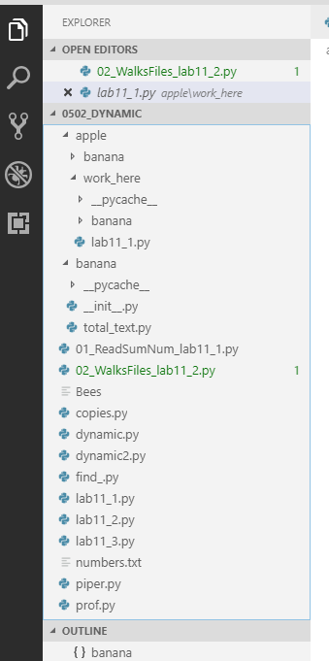
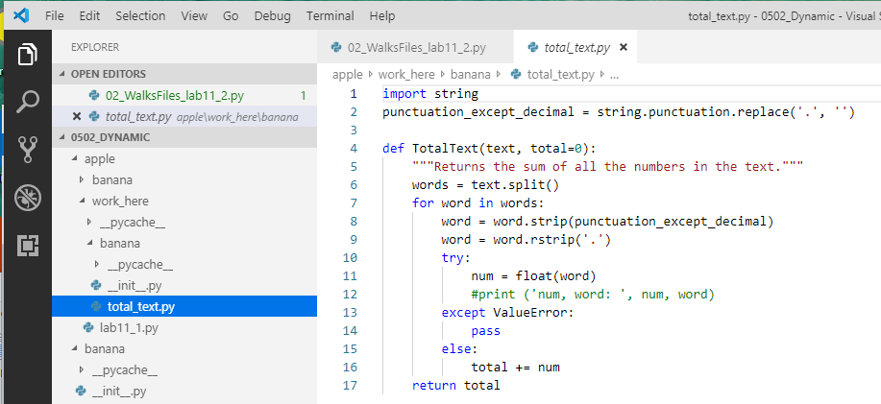
0502.2 os.walk
https://www.ucsc-extension.edu/certificate-program/offering/python-programmers
Copy the lab11_1.py to the folder apple/work_here/lab11_1.py.
In the “apple/work_here” folder, create folder “banana/totoal_txt.py”
os.path.insert(0, ‘path’), insert the path for OS.

Slide 9
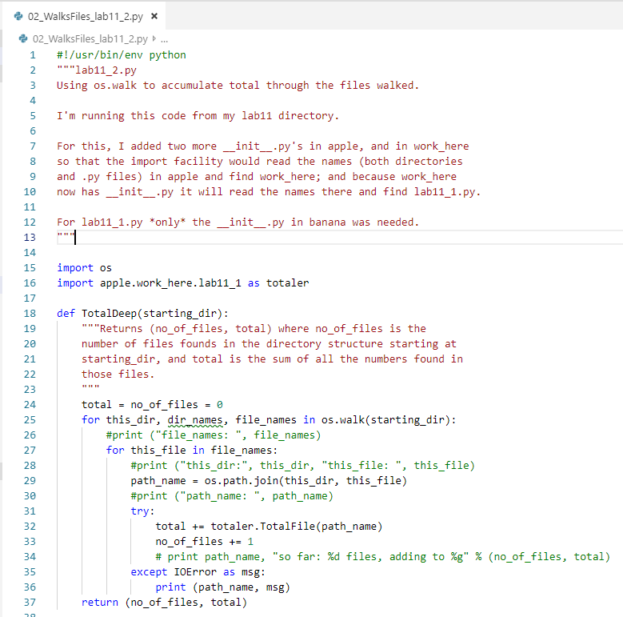
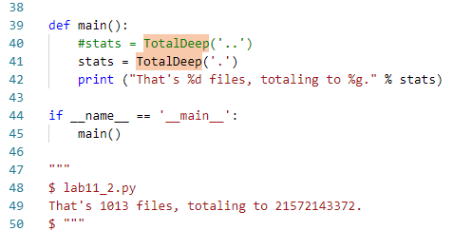

0502.2 os.walk
https://www.ucsc-extension.edu/certificate-program/offering/python-programmers
02_lab11_2.py:
TotalDeep(): Search all the text files in the specified directory path.

Slide 10
0502.3 Tree Command

Slide 11
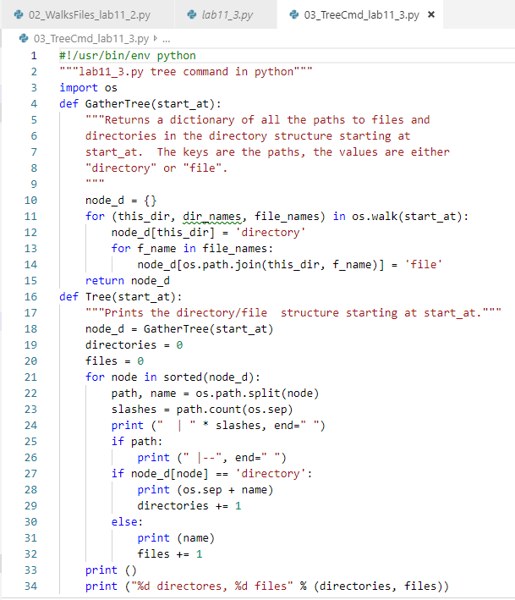
0502.3 Tree Command
https://www.ucsc-extension.edu/certificate-program/offering/python-programmers
02_lab11_3.py:
Tree Command

Slide 12
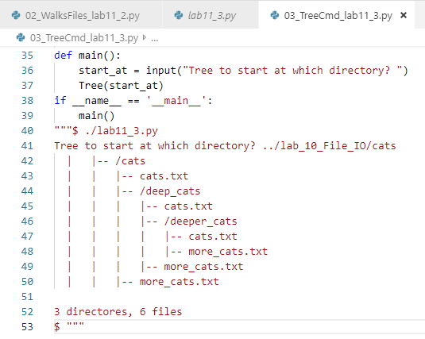
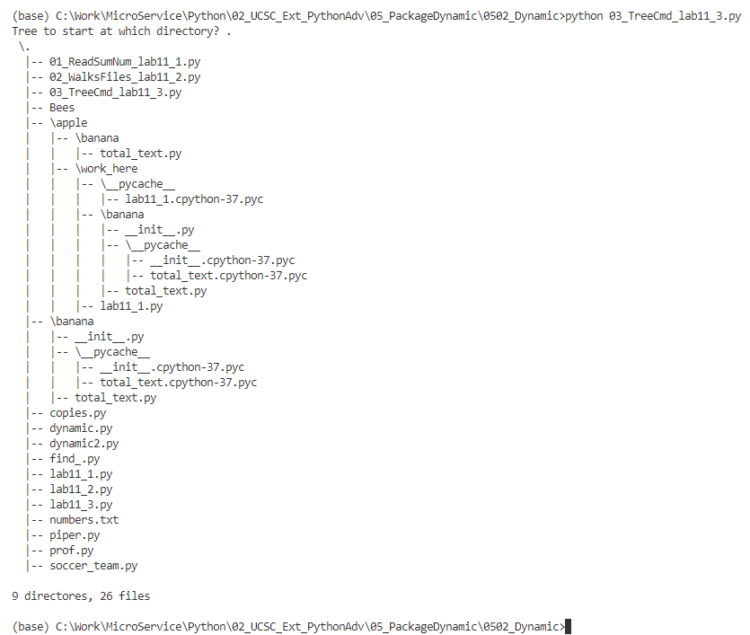
0502.3 Tree Command
https://www.ucsc-extension.edu/certificate-program/offering/python-programmers
03_lab11_3.py: Tree Command

Slide 13
0502.4 Deep Copy

Slide 14
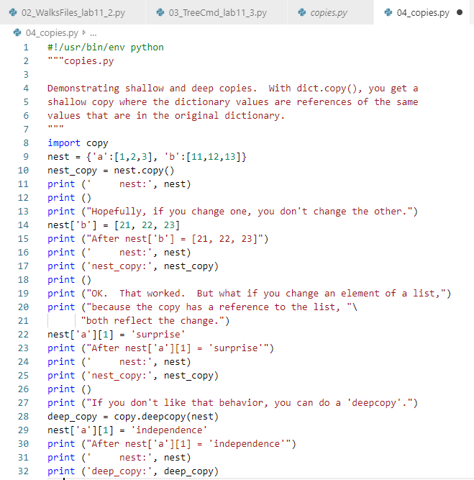
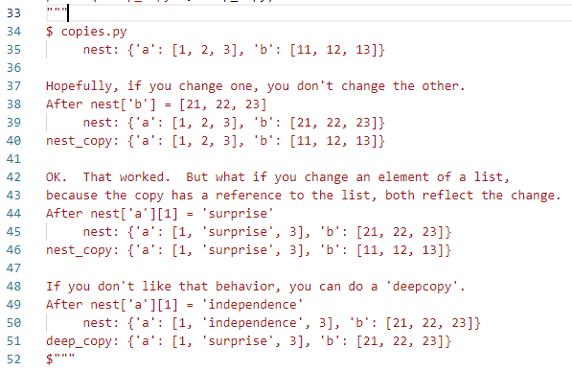
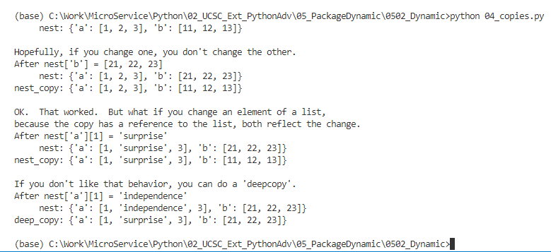
0502.4 Deep Copy
https://www.ucsc-extension.edu/certificate-program/offering/python-programmers
04_copies.py

Slide 15
0502.5 Dynamic Code Generation

Slide 16
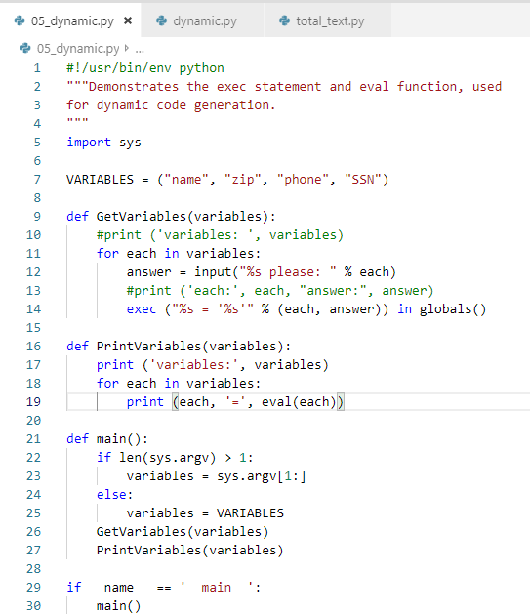
0502.5 Dynamic Code Generation
https://www.ucsc-extension.edu/certificate-program/offering/python-programmers
05_dynamic.py: “exec () in globals()” how to verify the exec command in the global namespace?

Slide 17
0502.6 Dynamic2 Code Generation

Slide 18
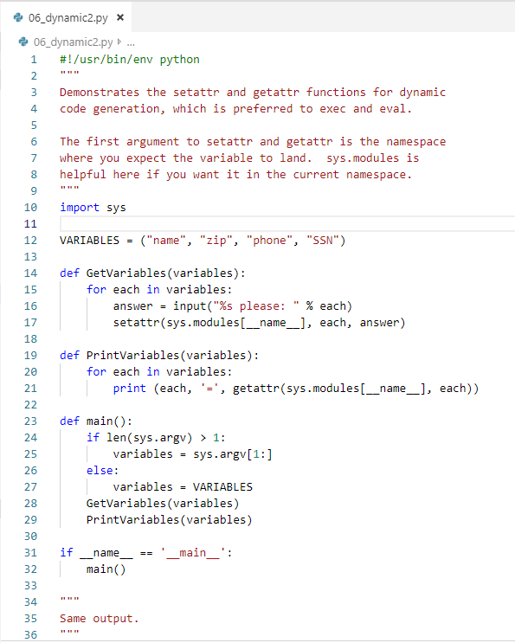
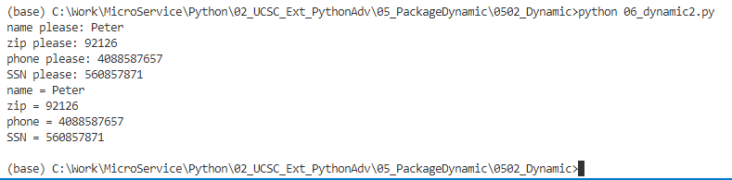
0502.6 Dynamic2 Code Generation
https://www.ucsc-extension.edu/certificate-program/offering/python-programmers
06_dynamic2.py

Slide 19
0502.7 Piper

Slide 20
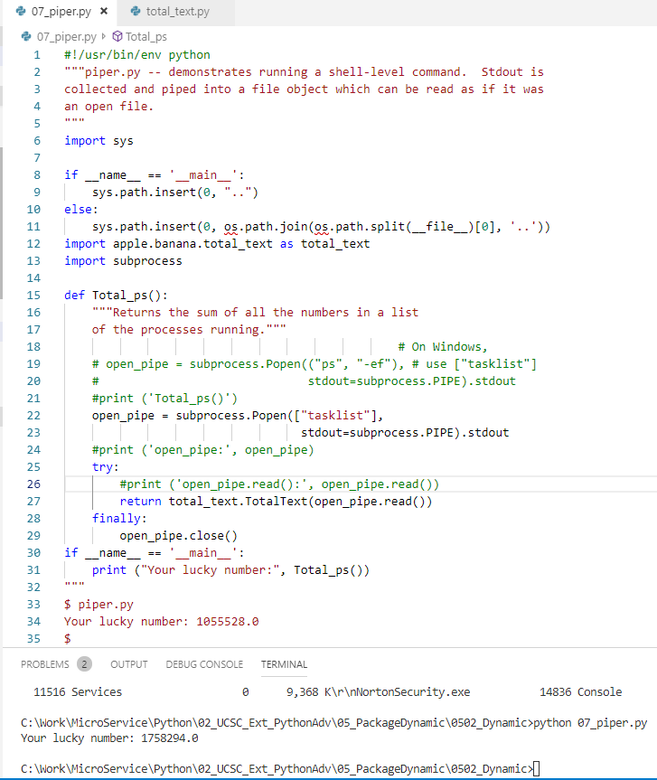
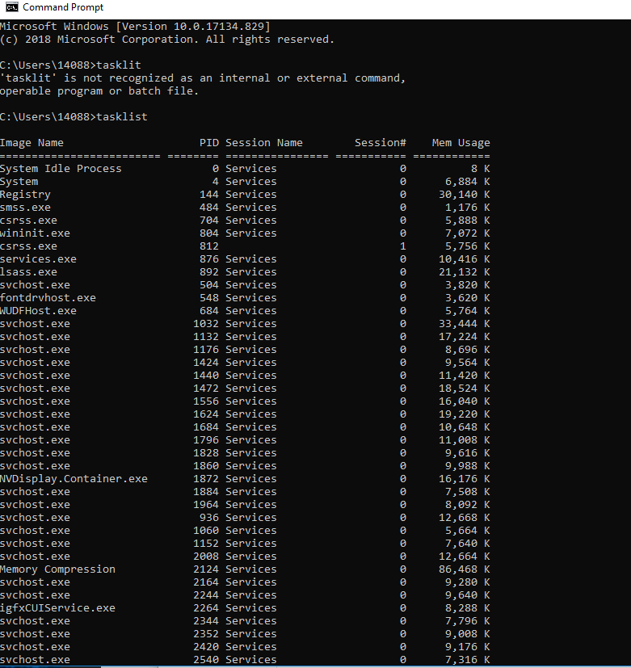
0502.7 Piper
https://www.ucsc-extension.edu/certificate-program/offering/python-programmers
07_piper.py

Slide 21
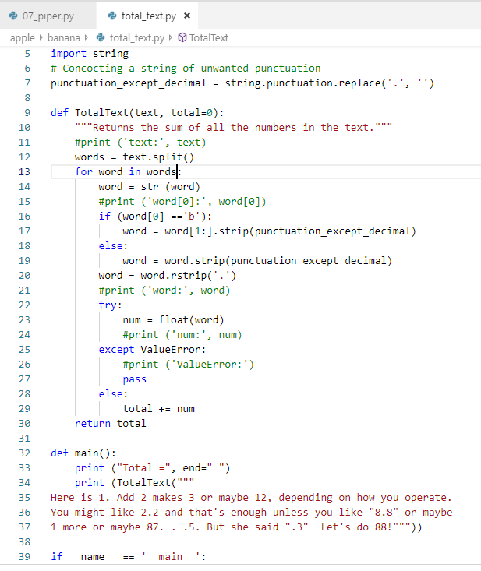
0502.7 Piper
https://www.ucsc-extension.edu/certificate-program/offering/python-programmers
07_piper.py

Slide 22
0502.8 Find

Slide 23
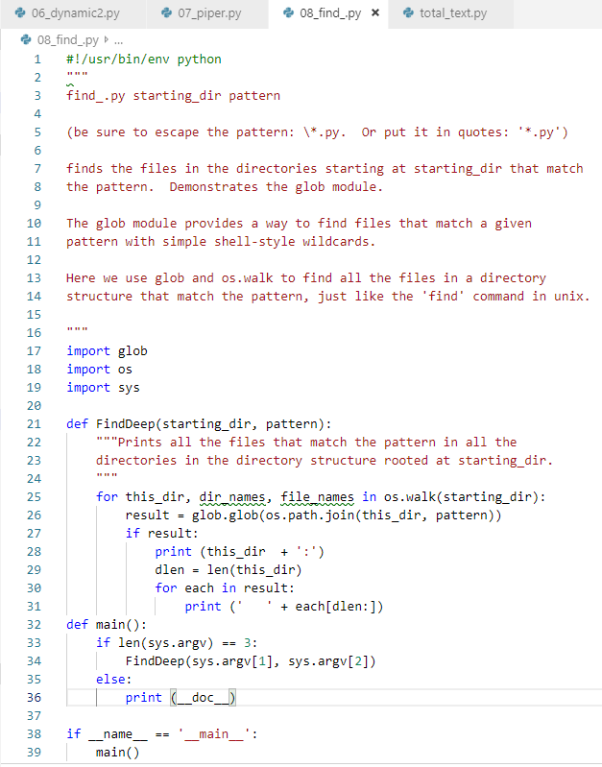
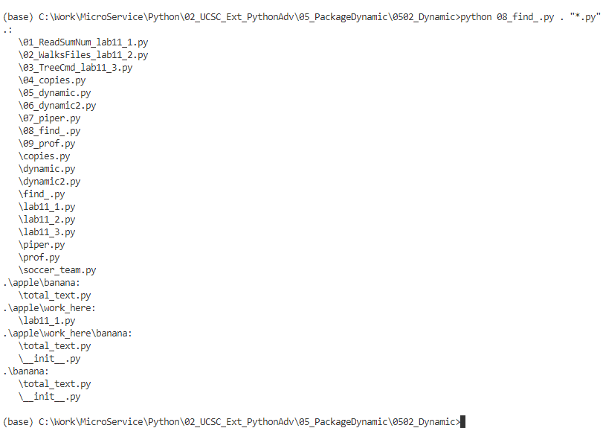
0502.8 Find
https://www.ucsc-extension.edu/certificate-program/offering/python-programmers
08_find_.py

Slide 24
0502.9 Prof

Slide 25
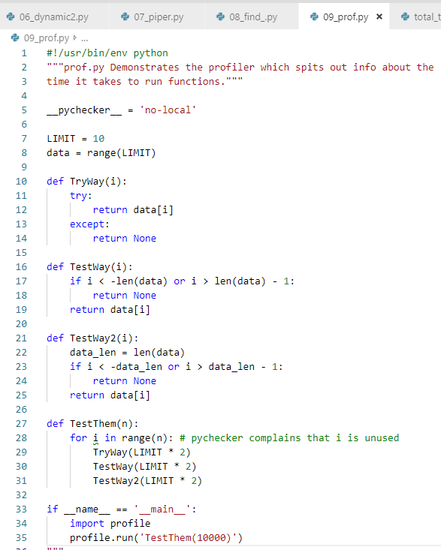
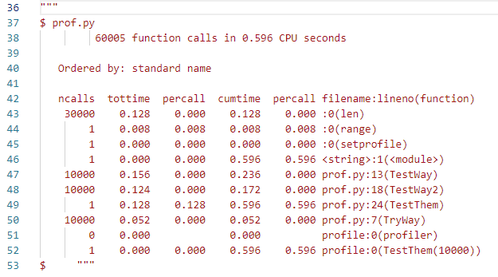
0502.9 Prof
https://www.ucsc-extension.edu/certificate-program/offering/python-programmers
09_prof.py

Slide 26
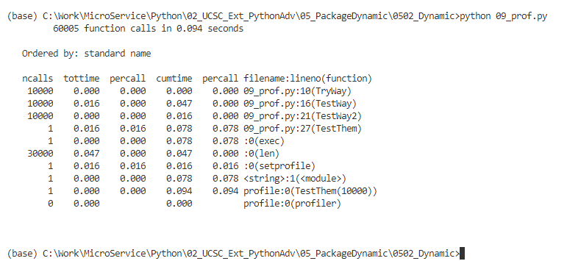
0502.9 Prof
https://www.ucsc-extension.edu/certificate-program/offering/python-programmers
09_prof.py

Slide 27
End of Chapter

