Slide 1

05 Quiz
Peter H. Chen

Slide 2
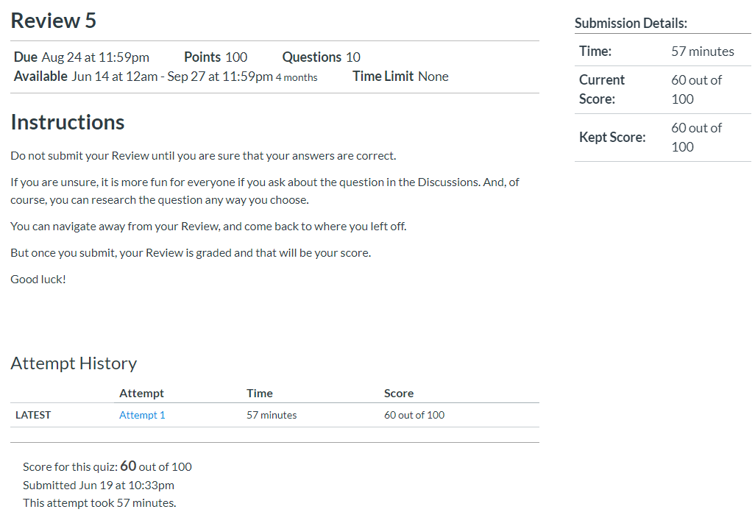
05 Quiz
https://www.ucsc-extension.edu/certificate-program/offering/python-programmers
Quiz:

Slide 3
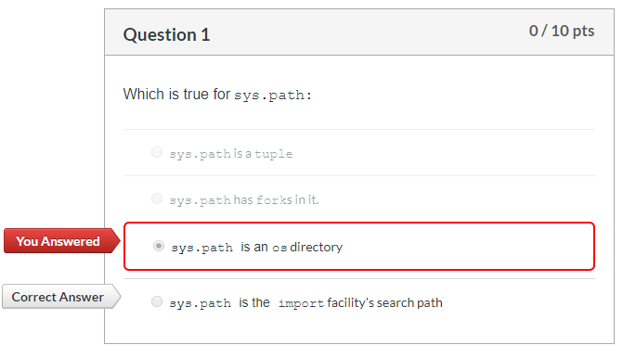
05 Quiz
https://www.ucsc-extension.edu/certificate-program/offering/python-programmers
Quiz:

Slide 4
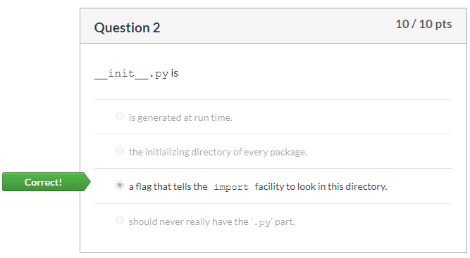
05 Quiz
https://www.ucsc-extension.edu/certificate-program/offering/python-programmers
Quiz:

Slide 5
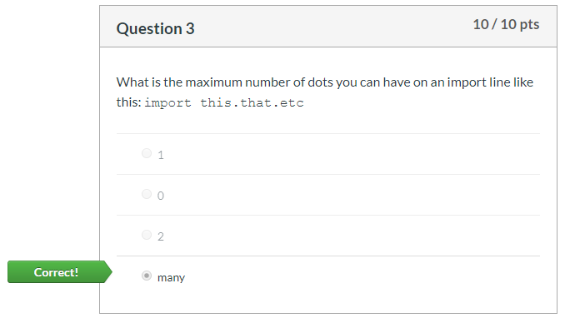
05 Quiz
https://www.ucsc-extension.edu/certificate-program/offering/python-programmers
Quiz:

Slide 6
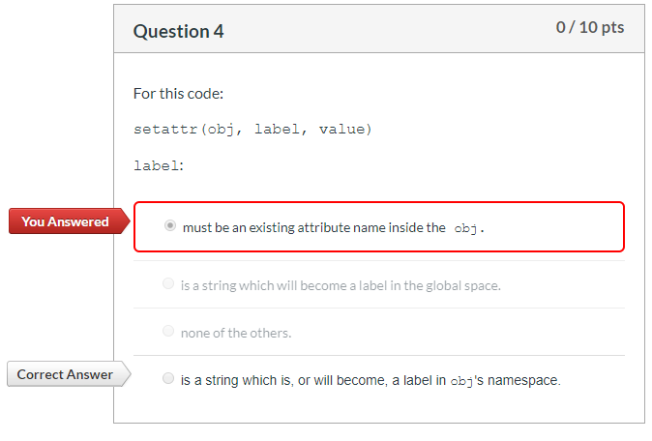
05 Quiz
https://www.ucsc-extension.edu/certificate-program/offering/python-programmers
Quiz:

Slide 7
05 Quiz
https://www.ucsc-extension.edu/certificate-program/offering/python-programmers
Quiz:

Slide 8
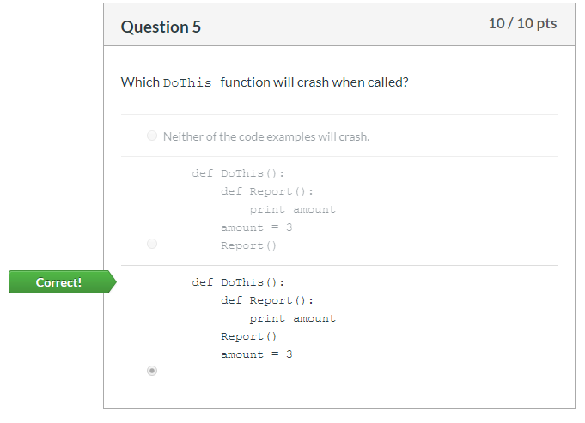
05 Quiz
https://www.ucsc-extension.edu/certificate-program/offering/python-programmers
Quiz:

Slide 9
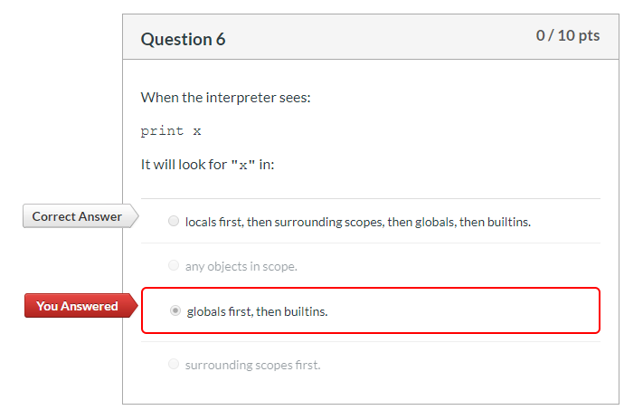
05 Quiz
https://www.ucsc-extension.edu/certificate-program/offering/python-programmers
Quiz:

Slide 10
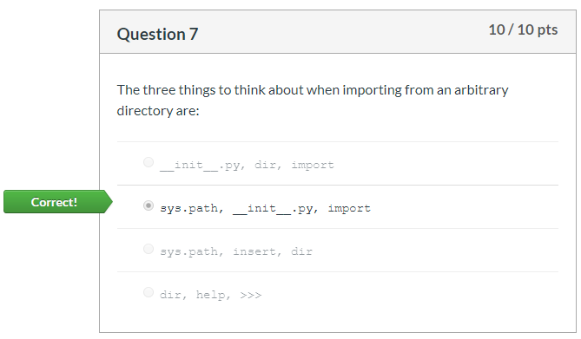
05 Quiz
https://www.ucsc-extension.edu/certificate-program/offering/python-programmers
Quiz:

Slide 11
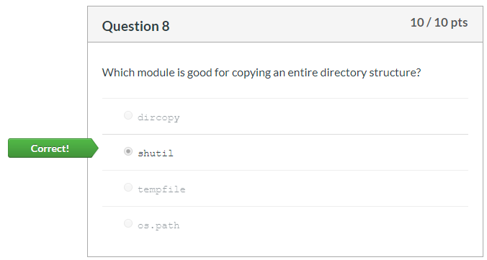
05 Quiz
https://www.ucsc-extension.edu/certificate-program/offering/python-programmers
Quiz:

Slide 12
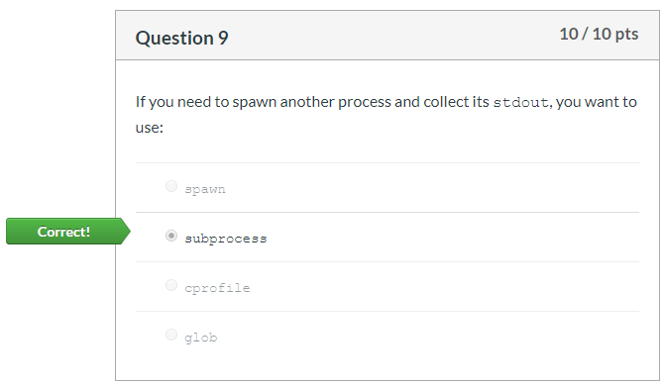
05 Quiz
https://www.ucsc-extension.edu/certificate-program/offering/python-programmers
Quiz:

Slide 13
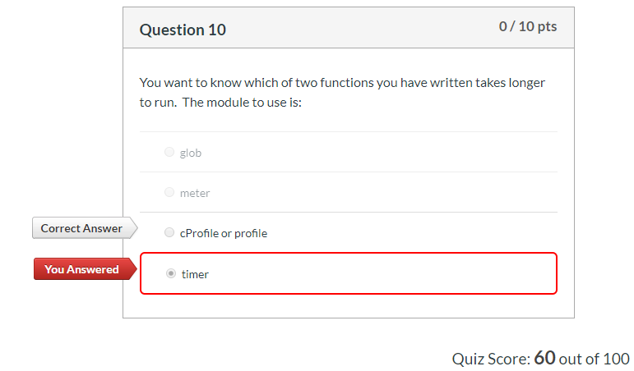
05 Quiz
https://www.ucsc-extension.edu/certificate-program/offering/python-programmers
Quiz:

Slide 14
End of Chapter

