Slide 1

0802 Wrap Up
Peter H. Chen

Slide 2
0802 Wrap Up
https://www.ucsc-extension.edu/certificate-program/offering/python-programmers
Topics:
Exceptions
Namespaces
Nests
Pitfalls
Finding Modules and Help

Slide 3
0802.01 Lab17_1_1.py

Slide 4
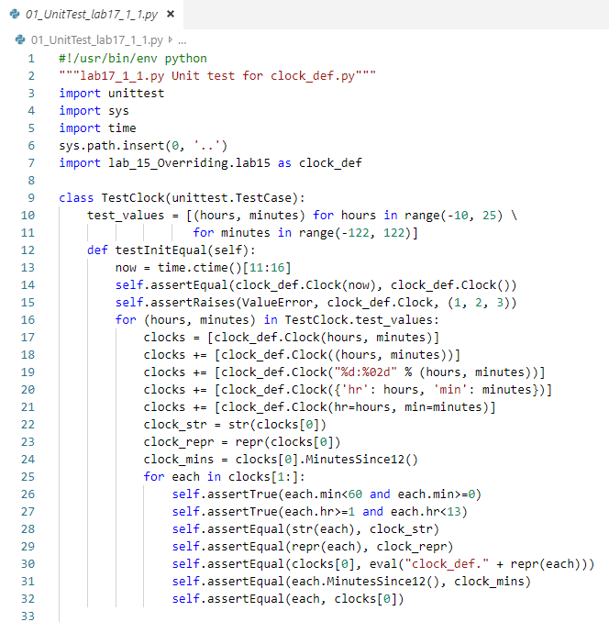
0802.01 Lab17_1_1.py
https://www.ucsc-extension.edu/certificate-program/offering/python-programmers
Lab17_1_1.py: Test Clock class.

Slide 5
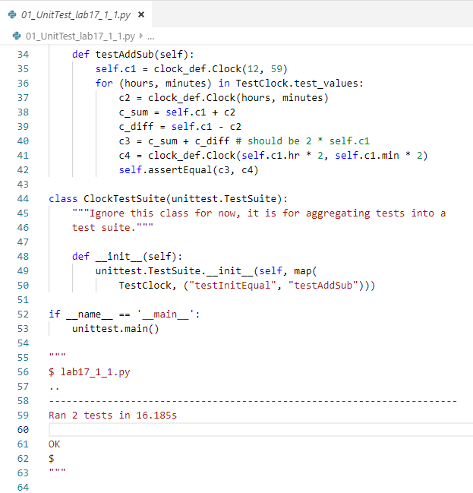
0802.01 Lab17_1_1.py
https://www.ucsc-extension.edu/certificate-program/offering/python-programmers
Lab17_1_1.py
Inherit a TestSuite
Assign Test Methods testInitEqual and TestAddSub to class TestClock.

Slide 6
0802.02 Lab17_1_2.py

Slide 7
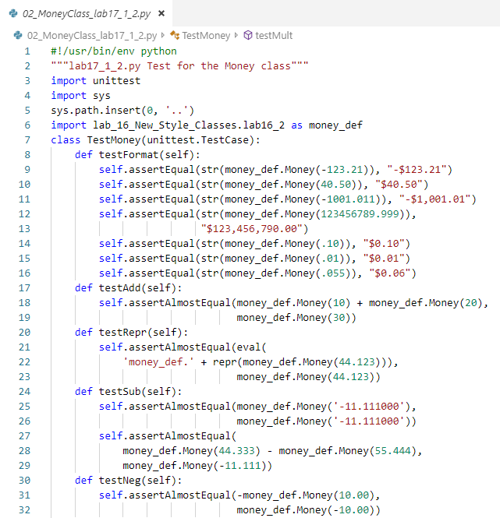
0802.02 Lab17_1_2.py
https://www.ucsc-extension.edu/certificate-program/offering/python-programmers
Lab17_1_2.py: Do the money testing.

Slide 8
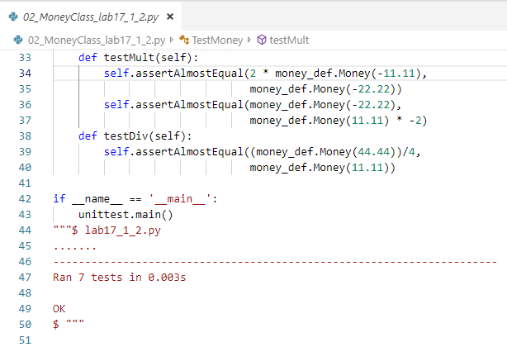
0802.02 Lab17_1_2.py
https://www.ucsc-extension.edu/certificate-program/offering/python-programmers
Lab17_1_2.py

Slide 9
0802.03 Testsuite.py

Slide 10
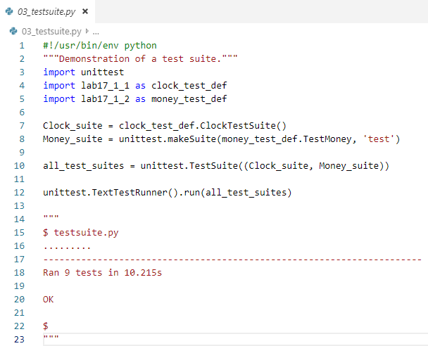
0802.03 Testsuite.py
https://www.ucsc-extension.edu/certificate-program/offering/python-programmers
Testsuite.py: Make the test suite for Clock class and Money class.

Slide 11
0802.04 Lab17_2.py

Slide 12
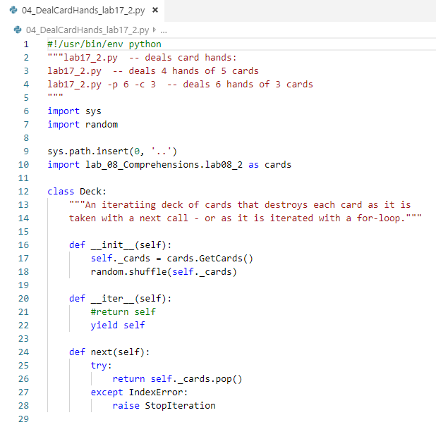
0802.04 Lab17_2.py
https://www.ucsc-extension.edu/certificate-program/offering/python-programmers
Lab17_2.py: Make card and shuffle.
Iterator and next()

Slide 13
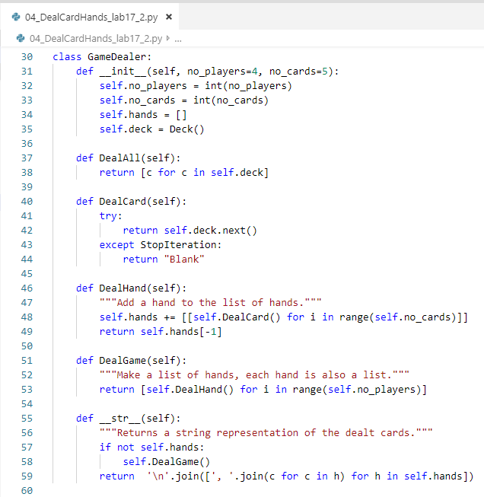
0802.04 Lab17_2.py
https://www.ucsc-extension.edu/certificate-program/offering/python-programmers
Lab17_2.py

Slide 14
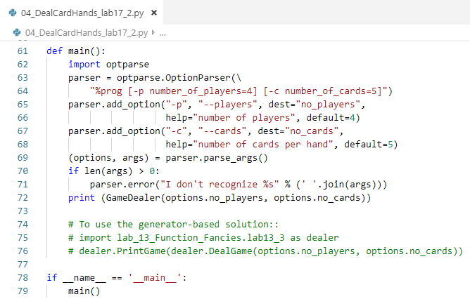
0802.04 Lab17_2.py
https://www.ucsc-extension.edu/certificate-program/offering/python-programmers
Lab17_2.py
Command line argument option.

Slide 15
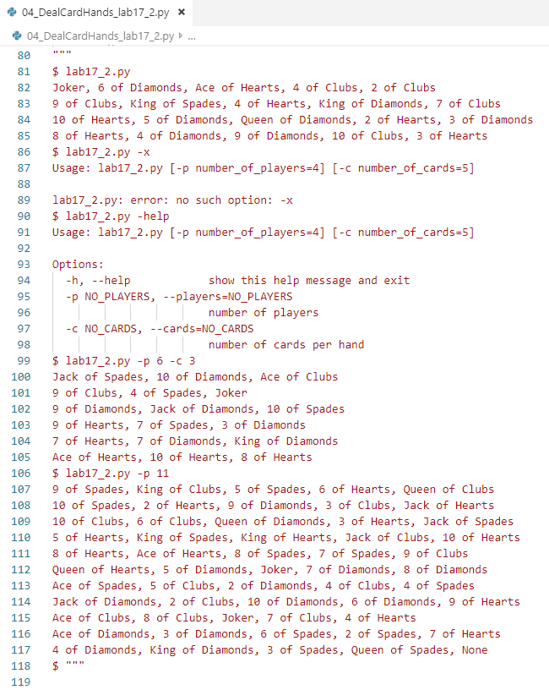
0802.04 Lab17_2.py
https://www.ucsc-extension.edu/certificate-program/offering/python-programmers
Lab17_2.py

Slide 16
0802.05 Lab17_3.py

Slide 17
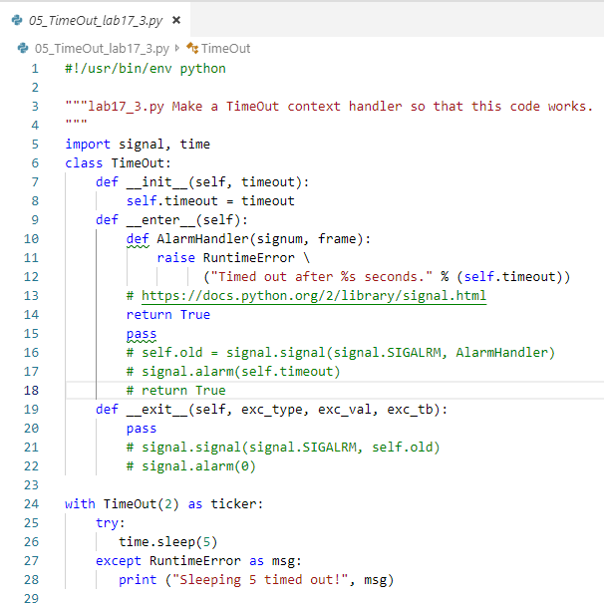
0802.05 Lab17_3.py
https://www.ucsc-extension.edu/certificate-program/offering/python-programmers
Lab17_3.py

Slide 18
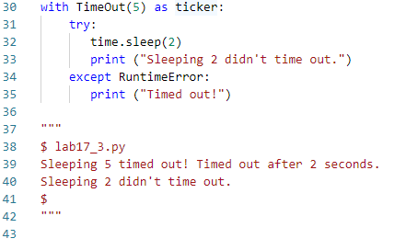
0802.05 Lab17_3.py
https://www.ucsc-extension.edu/certificate-program/offering/python-programmers
Lab17_3.py

Slide 19
0802.06 assert_.py

Slide 20
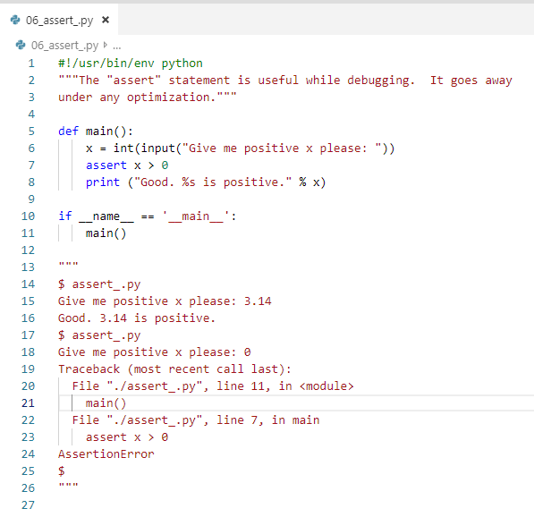
0802.06 assert_.py
https://www.ucsc-extension.edu/certificate-program/offering/python-programmers
assert_.py:
x > 0

Slide 21
0802.07 Help in Exceptions

Slide 22
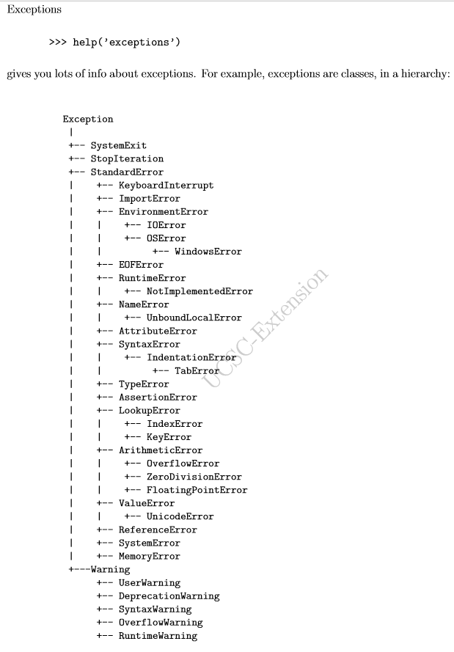
0802.07 Help in Exception
https://www.ucsc-extension.edu/certificate-program/offering/python-programmers
Help in Exceptions:
Exceptions are classes in a hierarchy.
Provide the Error handling.

Slide 23
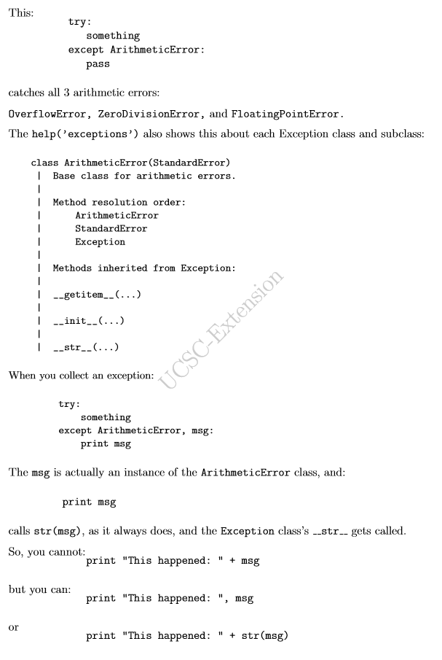
0802.07 Help in Exception
https://www.ucsc-extension.edu/certificate-program/offering/python-programmers
Help in Exceptions:
Examples in Error handling.
Three arithmetic errors:
OverflowError, ZeroDivisionError, and FloatingPointError.
Method inherited from Exception:
__getitem__(…): Magic getitem
__init__(…)
__str__(…)
Collect an Exception:
Try … exception
Print (msg)
Print (“error message” + str(msg))

Slide 24
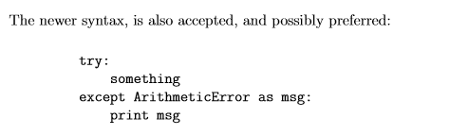
0802.07 Help in Exception
https://www.ucsc-extension.edu/certificate-program/offering/python-programmers
Help in Exceptions:
New syntax in Error handling:
Except keyword as msg

Slide 25
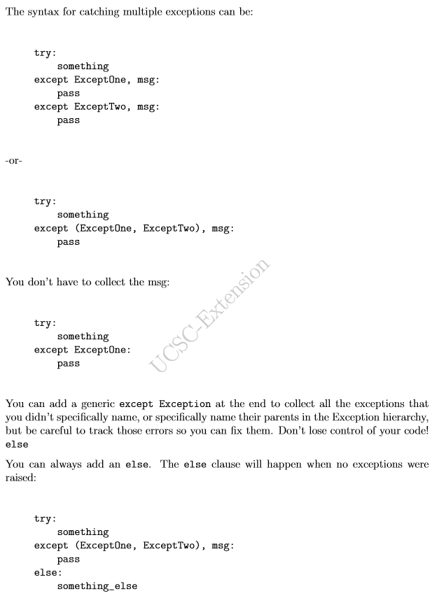
0802.07 Help in Exception
https://www.ucsc-extension.edu/certificate-program/offering/python-programmers
Help in Exceptions:
Try … except … except ,,,
You can line up the error keywords as “Try … except (… , …) …” and “pass” syntax.

Slide 26
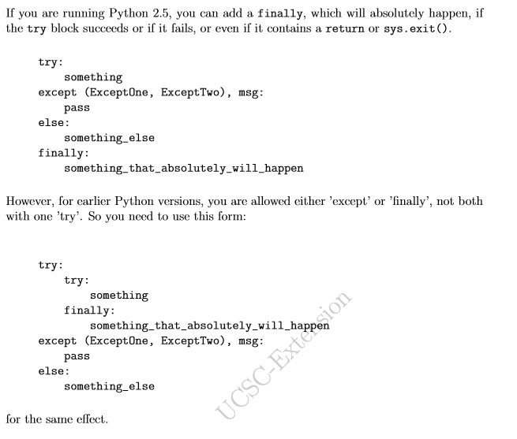
0802.07 Help in Exception
https://www.ucsc-extension.edu/certificate-program/offering/python-programmers
Help in Exceptions:
Try … except … except ,,,
Try … except … finally syntax.
Try.. Try …finally syntax

Slide 27
0802.08 raise1.py

Slide 28
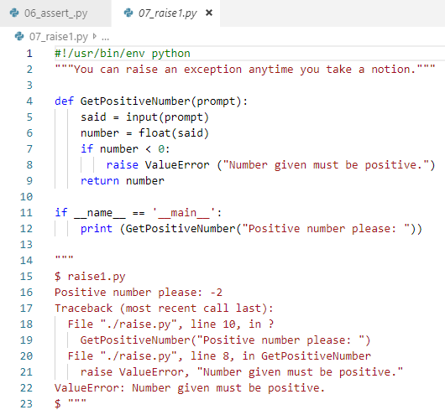
0802.08 raise1.py
https://www.ucsc-extension.edu/certificate-program/offering/python-programmers
raise1.py
Raise ValueError here

Slide 29
0802.09 raise2.py
Peter H. Chen

Slide 30
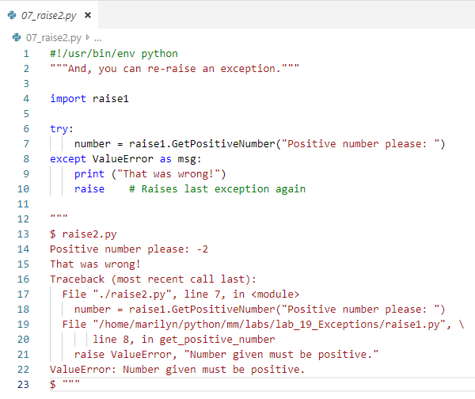
0802.10 raise2.py
https://www.ucsc-extension.edu/certificate-program/offering/python-programmers
raise2.py
Try … except
Raise the exception again.

Slide 31
0802.10 raise3.py

Slide 32
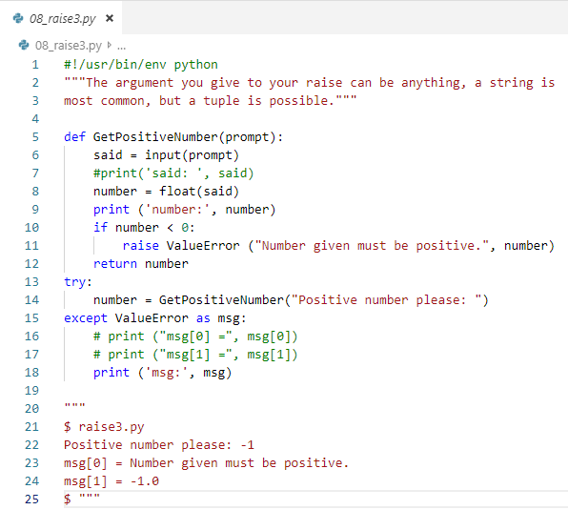
0802.10 raise3.py
https://www.ucsc-extension.edu/certificate-program/offering/python-programmers
raise3.py
Try … except as msg
Msg[0] = “message”
Msg[1] = -1.0

Slide 33
0802.11 myexcept1.py

Slide 34
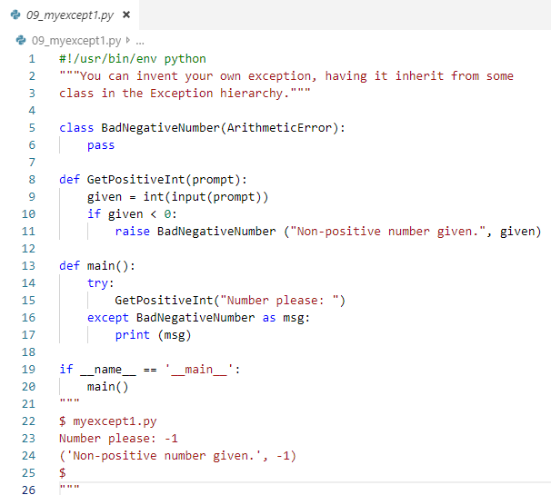
0802.11 myexcept1.py
https://www.ucsc-extension.edu/certificate-program/offering/python-programmers
myexcept1.py
Use class to bypass the error message.

Slide 35
0802.12 myexcept2.py

Slide 36
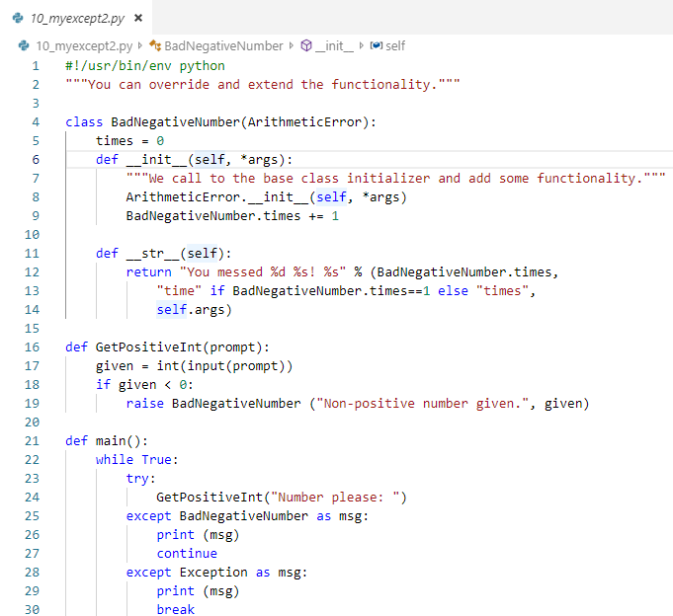
0802.12 myexcept2.py
https://www.ucsc-extension.edu/certificate-program/offering/python-programmers
myexcept2.py
In string print out, handle error count

Slide 37
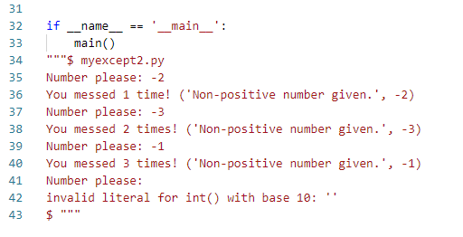
0802.12 myexcept2.py
https://www.ucsc-extension.edu/certificate-program/offering/python-programmers
myexcept2.py

Slide 38
0802.13 myexcept3.py
Peter H. Chen

Slide 39
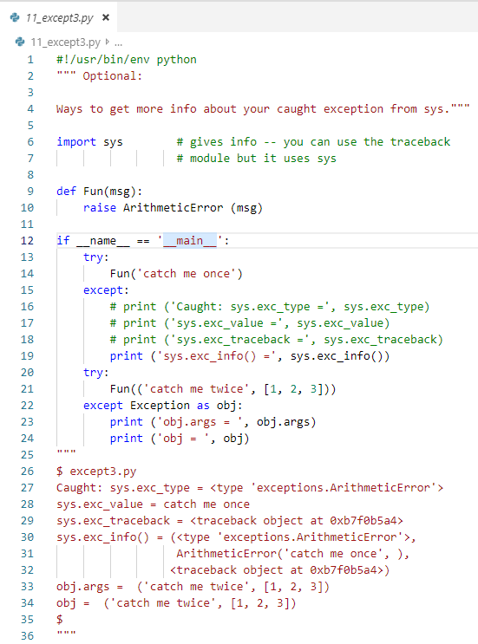
0802.13 myexcept3.py
https://www.ucsc-extension.edu/certificate-program/offering/python-programmers
myexcept3.py
Try .. except
Try … raise… except

Slide 40
0802.14 manynames.py

Slide 41
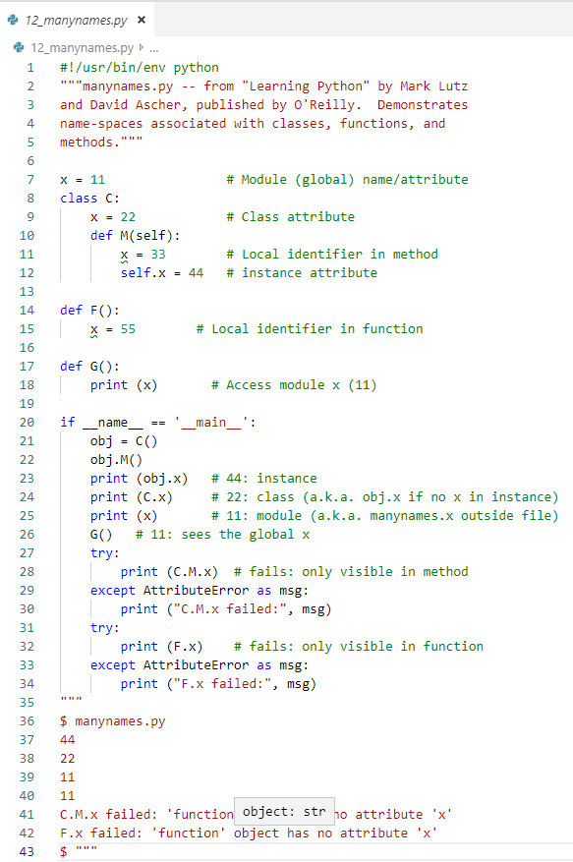
0802.14 manaynames.py
https://www.ucsc-extension.edu/certificate-program/offering/python-programmers
manynames.py
Global x = 1
Try … except print error message

Slide 42
0802.15 Python Namespaces

Slide 43
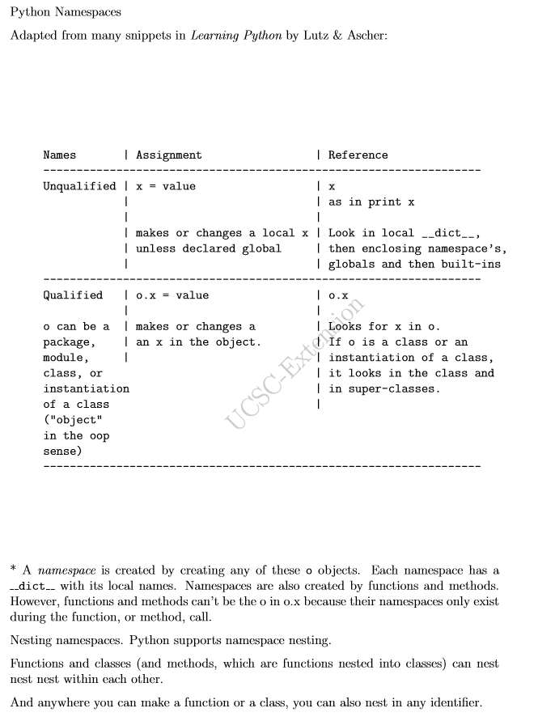
0802.15 Python Namespace
https://www.ucsc-extension.edu/certificate-program/offering/python-programmers
Python Namespace
unqualified
qualified

Slide 44
0802.16 function_nest.py

Slide 45
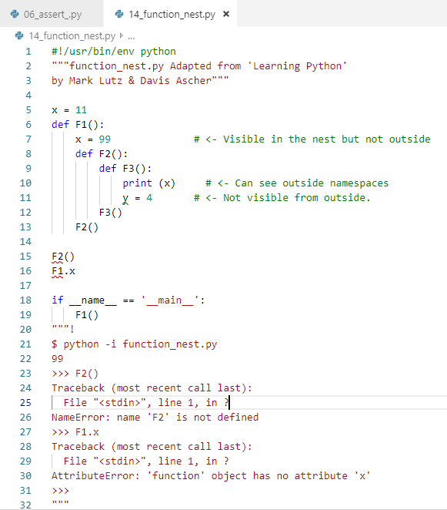
0802.16 function_nest.py
https://www.ucsc-extension.edu/certificate-program/offering/python-programmers
Function_nest.py
Some variable in function
Nothing happened until y = 4
F2()
F1.x
Have problem not found in scope.

Slide 46
0802.17 class_nest.py

Slide 47
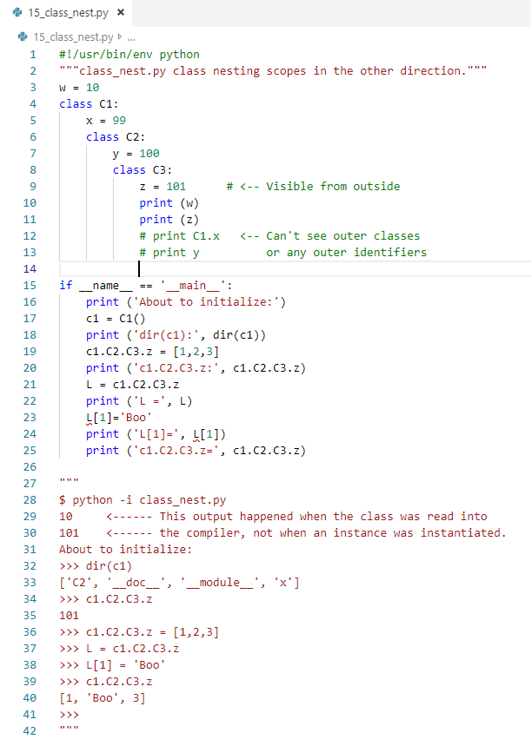
0802.17 class_nest.py
https://www.ucsc-extension.edu/certificate-program/offering/python-programmers
class_nest.py
c1
c1.C2.C3.z

Slide 48
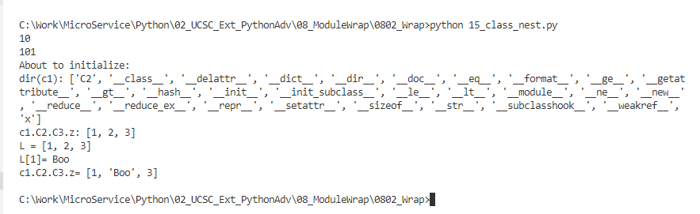
0802.17 class_nest.py
https://www.ucsc-extension.edu/certificate-program/offering/python-programmers
class_nest.py

Slide 49
0802.18 Finding Modules

Slide 50
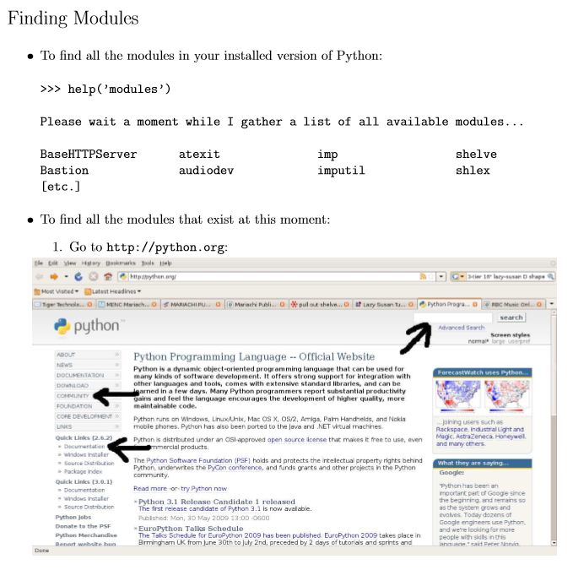
0802.18 Finding Modules
https://www.ucsc-extension.edu/certificate-program/offering/python-programmers
Finding Modules
help (‘modules’), you can see these information.
Go to ‘pyhton.org’, You can find more information.

Slide 51
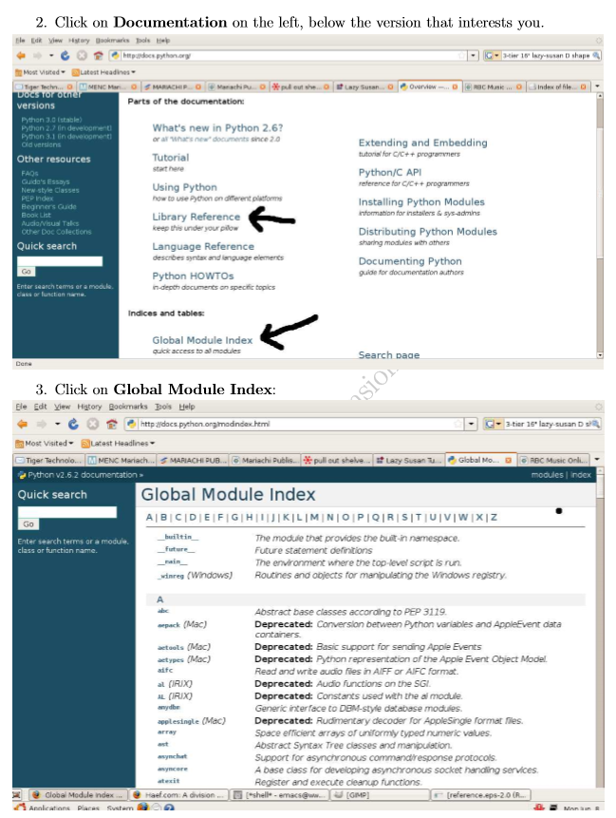
0802.18 Finding Modules
https://www.ucsc-extension.edu/certificate-program/offering/python-programmers
Finding Modules
Library reference
Global Module Index
Details of Global Module Index

Slide 52
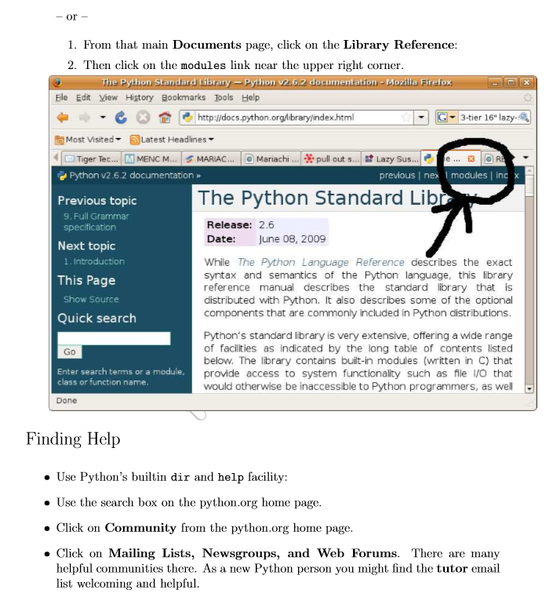
0802.18 Finding Modules
https://www.ucsc-extension.edu/certificate-program/offering/python-programmers
Finding Modules
Details of Library reference

Slide 53
0802.19 Lab

Slide 54
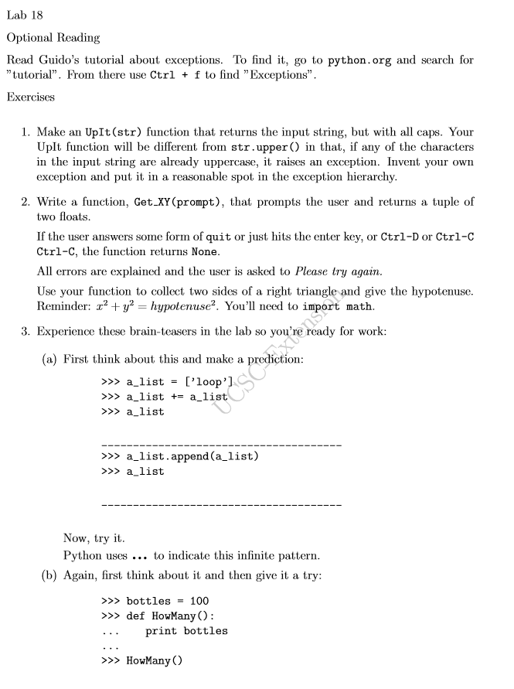
0802.19 Lab
https://www.ucsc-extension.edu/certificate-program/offering/python-programmers
Lab

Slide 55
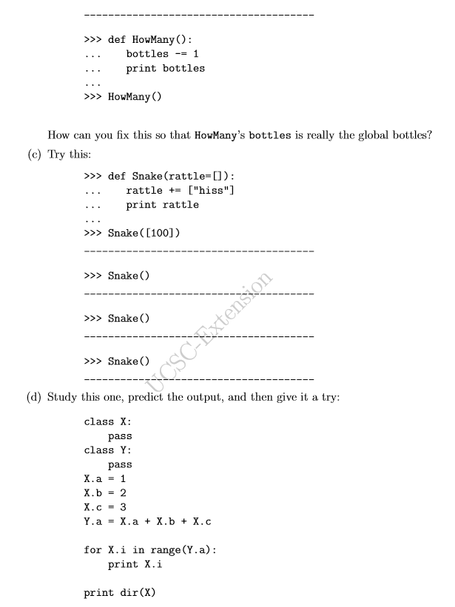
0802.19 Lab
https://www.ucsc-extension.edu/certificate-program/offering/python-programmers
Lab

Slide 56
End of Chapter

