Slide 1

08 Quiz
Peter H. Chen

Slide 2
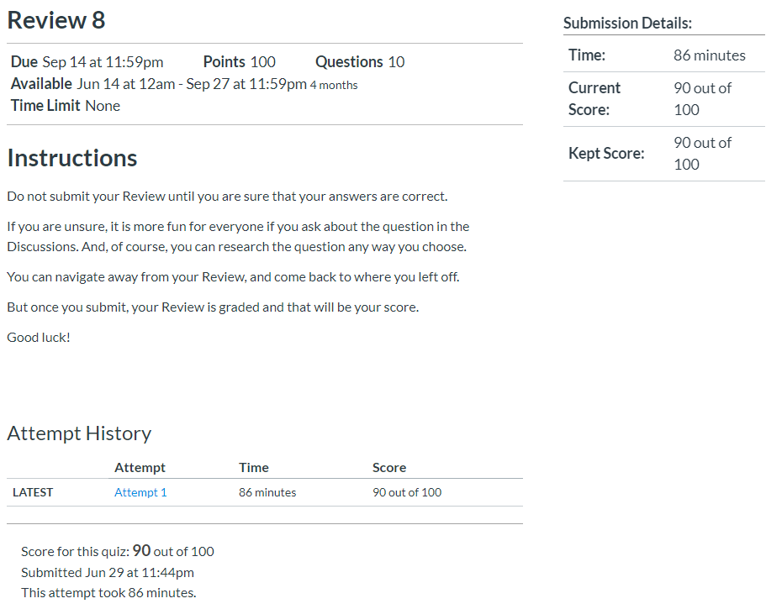
08 Quiz
https://www.ucsc-extension.edu/certificate-program/offering/python-programmers
Quiz:

Slide 3
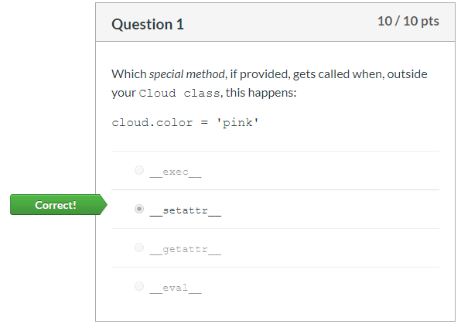
08 Quiz
https://www.ucsc-extension.edu/certificate-program/offering/python-programmers
Quiz:

Slide 4
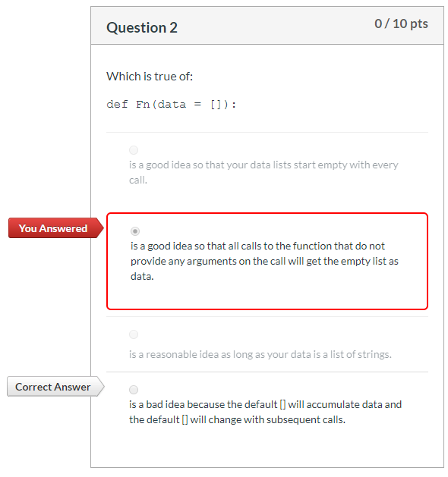
08 Quiz
https://www.ucsc-extension.edu/certificate-program/offering/python-programmers
Quiz:

Slide 5
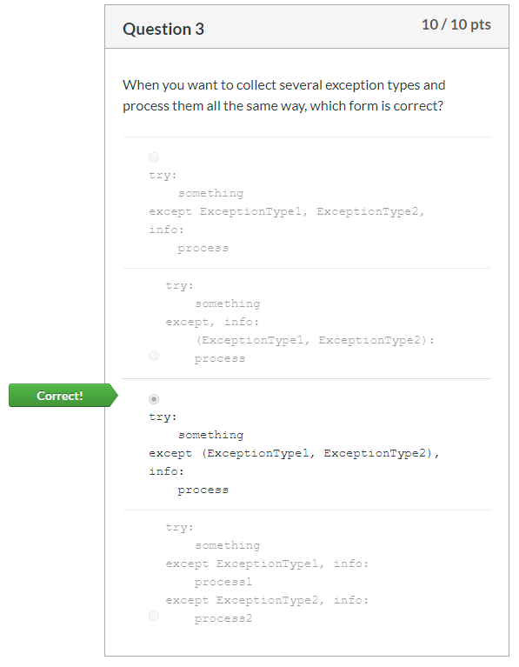
08 Quiz
https://www.ucsc-extension.edu/certificate-program/offering/python-programmers
Quiz:

Slide 6
08 Quiz
https://www.ucsc-extension.edu/certificate-program/offering/python-programmers
Quiz:

Slide 7
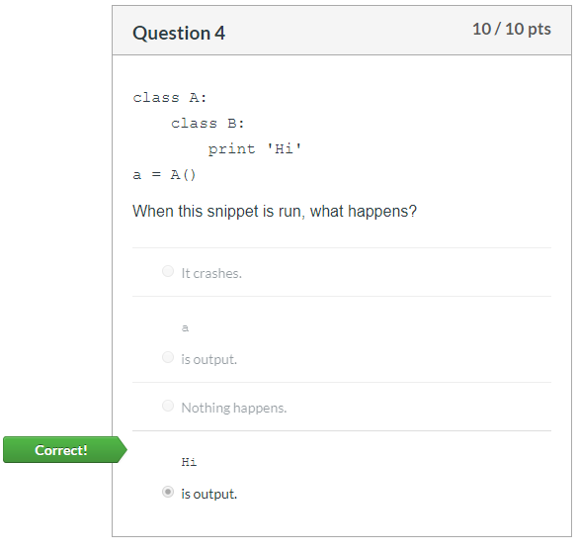
08 Quiz
https://www.ucsc-extension.edu/certificate-program/offering/python-programmers
Quiz:

Slide 8
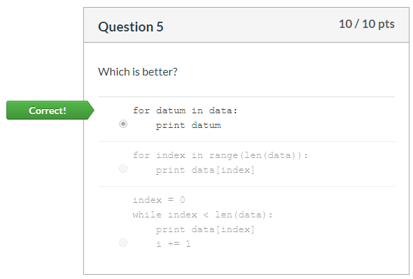
08 Quiz
https://www.ucsc-extension.edu/certificate-program/offering/python-programmers
Quiz:

Slide 9
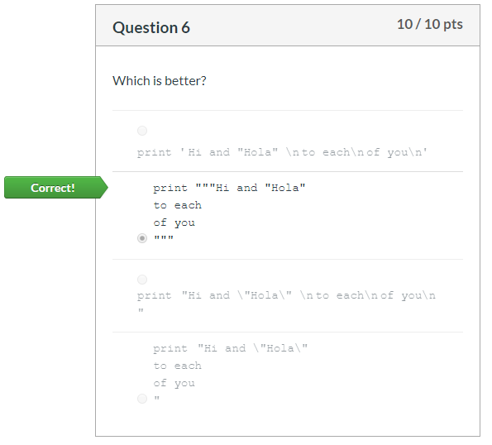
08 Quiz
https://www.ucsc-extension.edu/certificate-program/offering/python-programmers
Quiz:

Slide 10
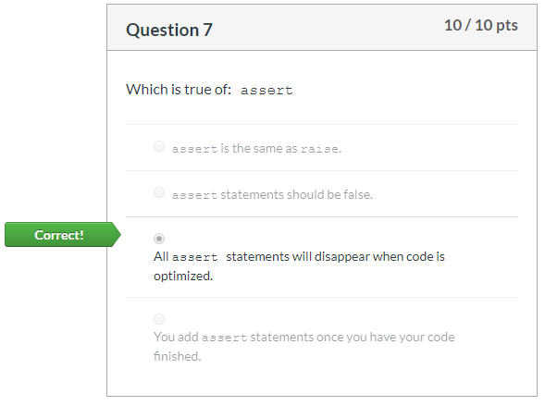
08 Quiz
https://www.ucsc-extension.edu/certificate-program/offering/python-programmers
Quiz:

Slide 11
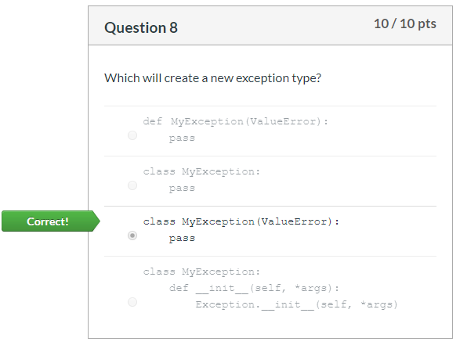
08 Quiz
https://www.ucsc-extension.edu/certificate-program/offering/python-programmers
Quiz:

Slide 12
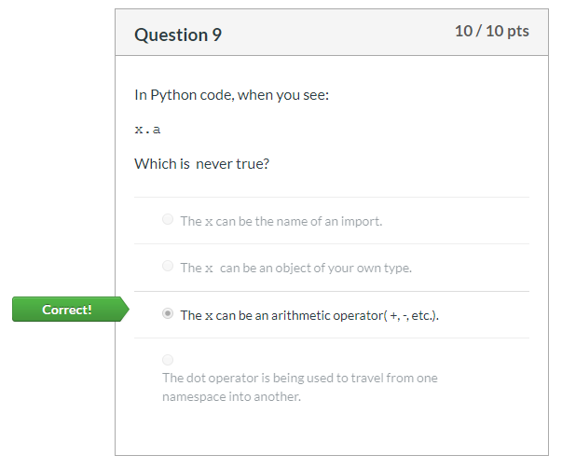
08 Quiz
https://www.ucsc-extension.edu/certificate-program/offering/python-programmers
Quiz:

Slide 13
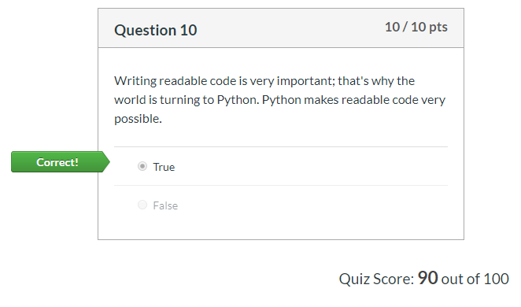
08 Quiz
https://www.ucsc-extension.edu/certificate-program/offering/python-programmers
Quiz:

Slide 14
End of Chapter

