Slide 1
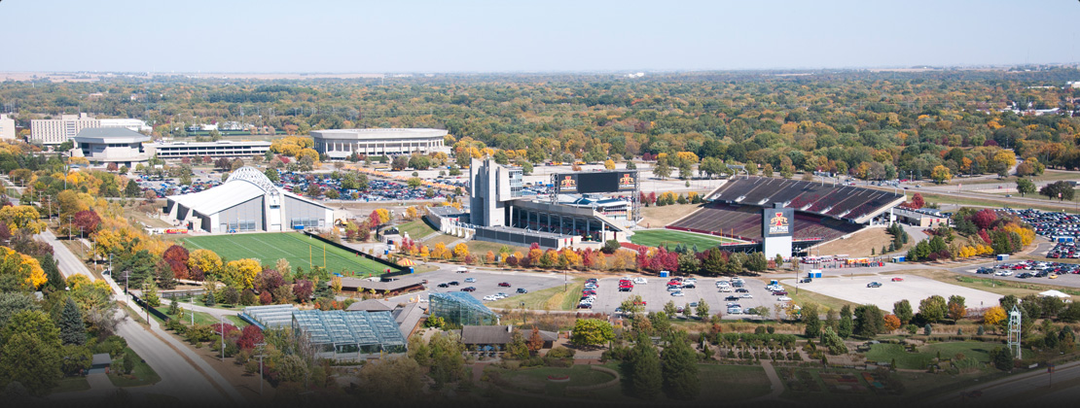
Housing Prices
Ames, Iowa

Slide 2

Problem Statement
Stakeholders
Property/Real Estate Investors and Home Sellers
Goals
Determine the valuation of a house
Find important features that impact housing prices
Success Criteria
Model Metrics
R^2 > 0.7
RMSE < 0.3

Slide 3
Outline
EDA/Data Munging
Insights and Findings
Recommendations
Modeling

Slide 4
EDA/Data Munging

Slide 5
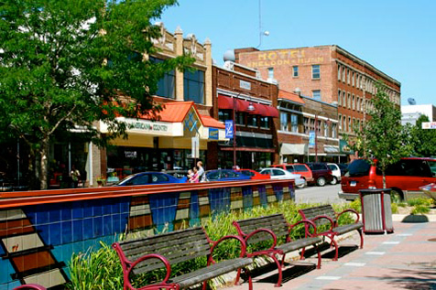
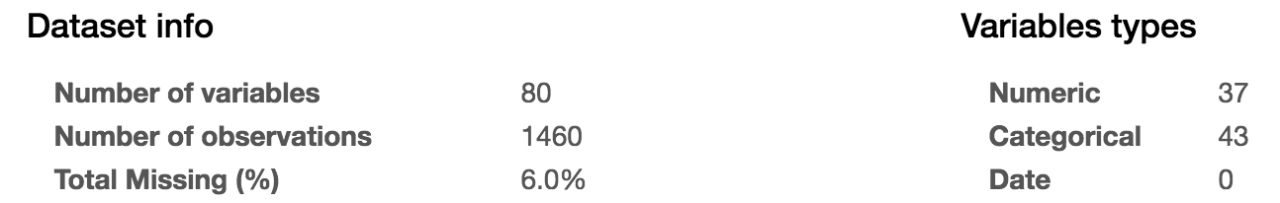
Describe Dataset
Housing Data for Ames, Iowa
Timeline (2006-2010)
1460 Observations
80 Features

Slide 6
Data Munging
Numerical to Categorical
Fill Null Values
Identify/Eliminate Outliers
Get Dummies
Notes:
when doing EDA noticed numerical features were actually

Slide 7
Numerical to Categorical
Numerical that are actually Categorical
Numerical that act like Categorical
Categorical

Slide 8
Fill Null Values
Features
79
Nulls
18
Non-Nulls
61
Categorical
16
Numerical
2
Fill None
4
Fill Most
12
Fill with mean

Slide 9
Identify/Eliminate outliers
1448 Observations
Box Plots & Scatter Plots used to detect outliers
12 outliers were removed
Notes:
12 outliers were removed

Slide 10
Get Dummies
59 Categorical & 20 Numerical
Get Dummies
331 Features

Slide 11
Modeling

Slide 12
Models
Test Size 30%
Train Size 70%
1448 Observations
331 Features
Ridge with Grid Search
Lasso with Grid Search
XGBoost with Grid Search
Notes:
Chose 3 models
Ridge & Lasso – both regression models that regularize data and help remove features
XGBoost – used by many kagglers
Best alpha ridge (alpha = 4.4)
Lasso (alpha = 0.0009)
XGBoost (best params {'n_estimators': 200, 'reg_lambda': 5, 'learning_rate': 0.10000000000000001, 'reg_alpha': 0, 'max_depth': 2})
Owen Zheng - ‘if you are using regression without regularization, you have to be very special!’.

Slide 13
MODEL Metric: R^2
Notes:
Correlation

Slide 14
Model Metric: RMSE
Notes:
Error for each model

Slide 15
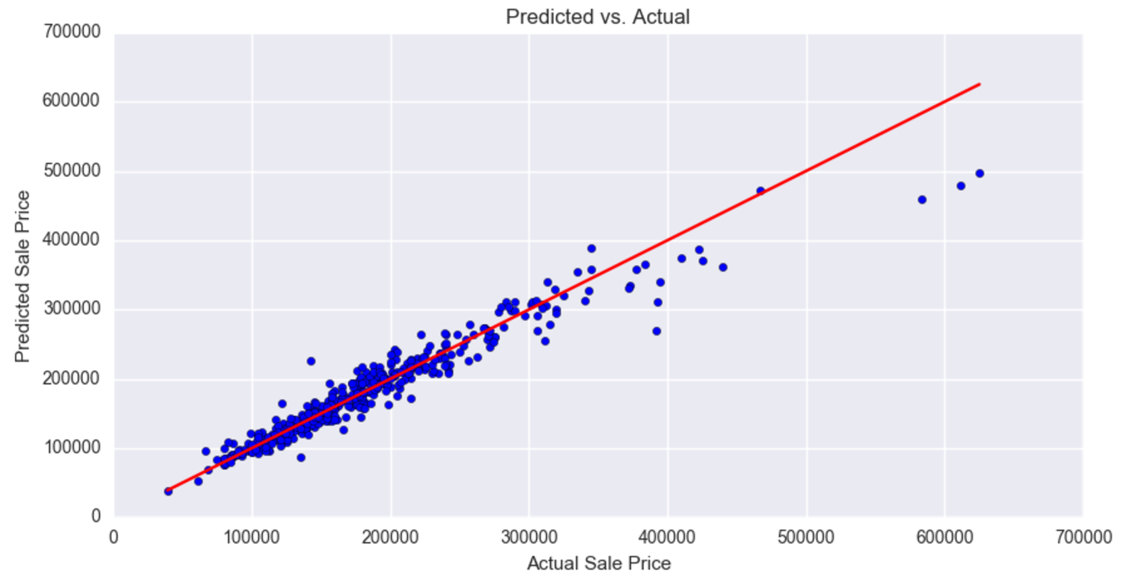
Model accuracy

Slide 16
Insights and Findings

Slide 17
Ridge Coefficients
TOP POSTIVE FEATURES
GrLivArea | 0.239817
OverallQual | 0.228893
OverallCond | 0.1797
1stFlrSF | 0.161436
GarageCars | 0.096772
Functional_Typ | 0.093668
FullBath | 0.092822
Neighborhood_StoneBr | 0.091786
Neighborhood_Crawfor | 0.09124
KitchenQual_Ex | 0.088182
TOP NEGATIVE FEATURES
MSZoning_C (all) | -0.119078
Neighborhood_Edwards | -0.072331
SaleCondition_Abnorml | -0.06291
Neighborhood_IDOTRR | -0.057679
Neighborhood_MeadowV | -0.052585
MSSubClass_30 | -0.052068
Functional_Maj2 | -0.049359
Exterior1st_Wd Sdng | -0.047577
Foundation_BrkTil | -0.047538
KitchenQual_TA | -0.047048
Notes:
Seems like neighborhoods and quality/condition were largest factor
I would have assumed bedroom or bathroom

Slide 18
Positive Vs Negative
Notes:
Positivecoefficients out weight negative coefficients

Slide 19
Recommendations

Slide 20
Recommendations
Model is accurate for houses valued below 350,000
Focus on more positive features that have the greatest impact
GrLivArea
OverallQual
OverallCond
1stFlrSF
Avoid
MSZoning_C (all)

Slide 21
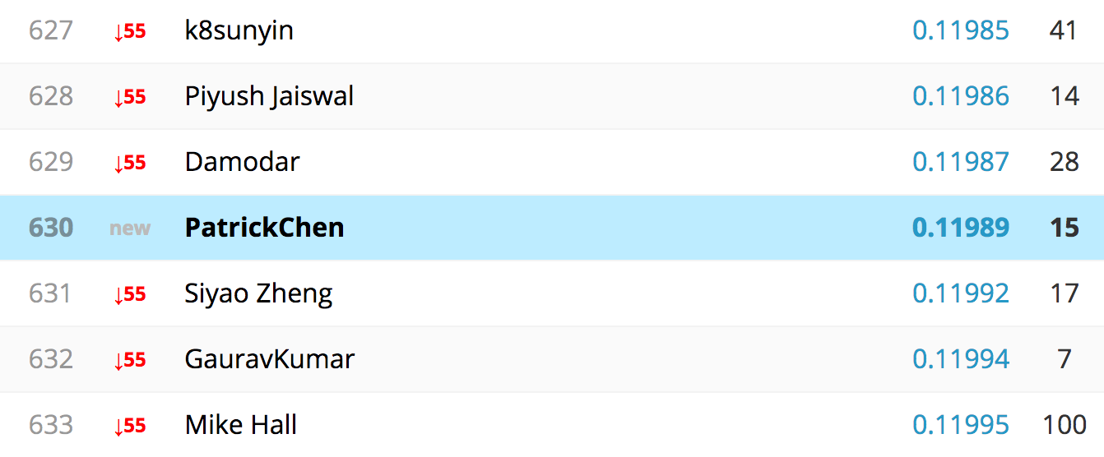
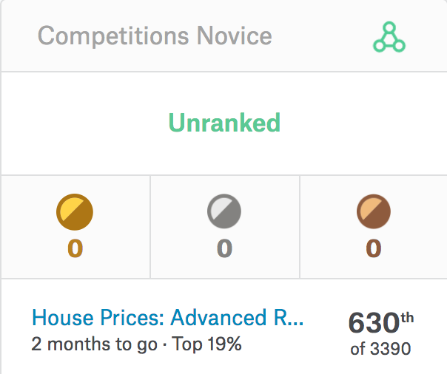
Kaggle Submission

Slide 22

QUESTIONS?
ANSWERS

Slide 23
APPENDEX

Slide 24
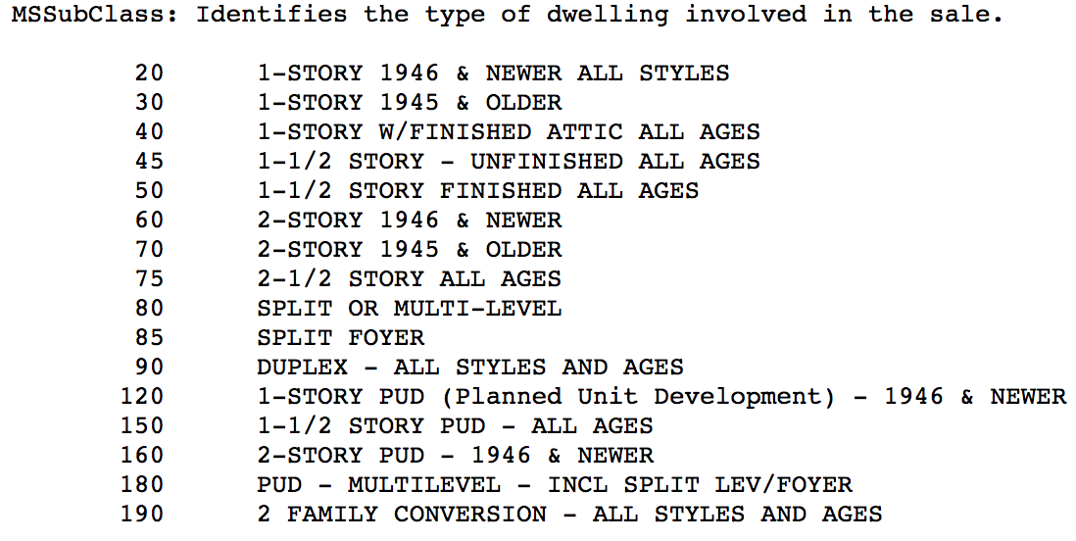
Actually Categorical
Numerical features that are actually categorical
MSSubClass (20-190)
MoSold (1-12)
KitchenAbvGr (1-2)

Slide 25
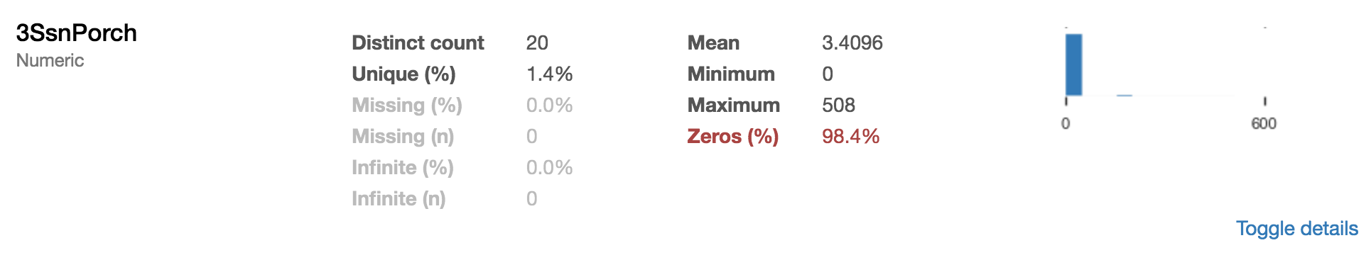
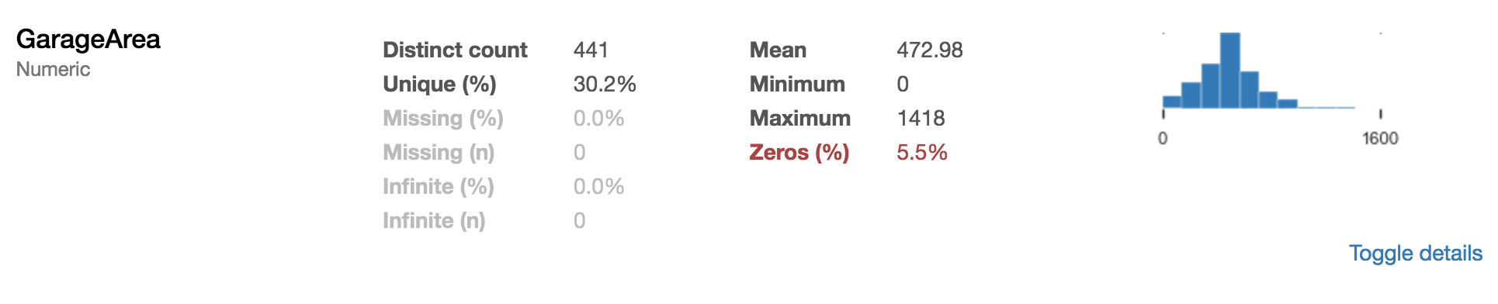
Resembles Categorical
Numerical features more than 50% of zeros
Zero changed to “No”
Non-zero changed to “Yes”
Numerical features with less than 50% of zeros
Left alone
Notes:
3SsnPorch: Three season porch area in square feet

Slide 26
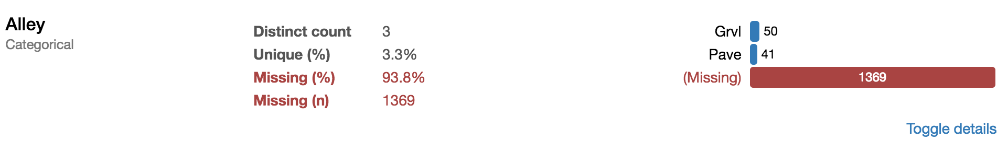
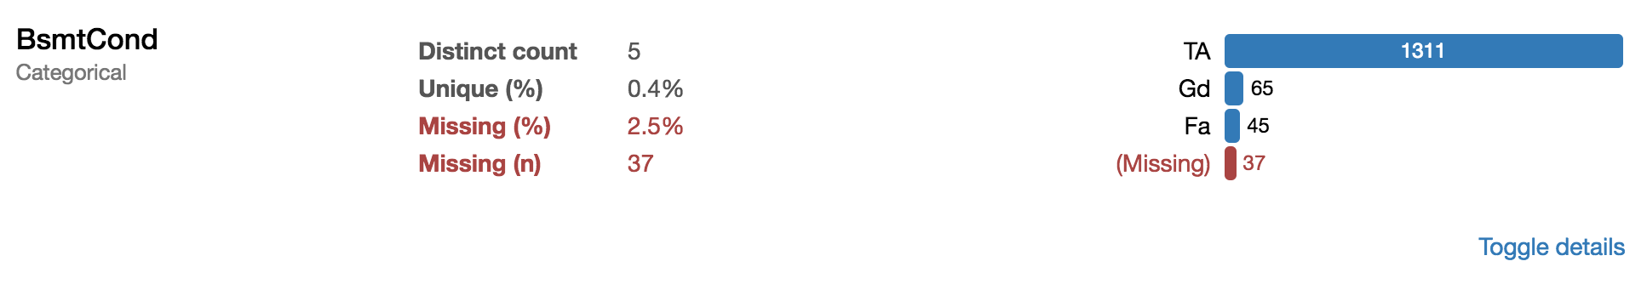
Fill nulls (categorical)
Fill with “None”
When category is more than 50% nulls
Fill with “Most”
When category is less than 50% nulls
Notes:
Fill “None” 4
Fill “Most” 12 Features

Slide 27
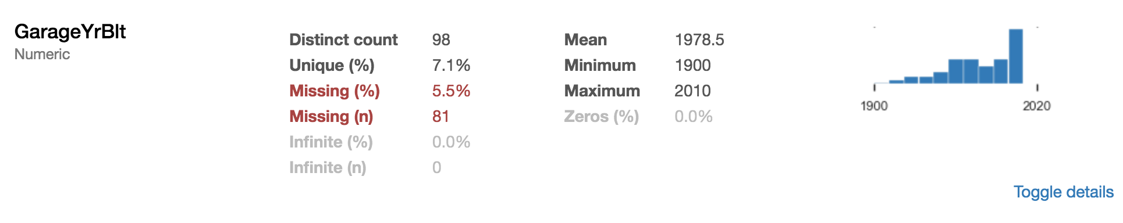
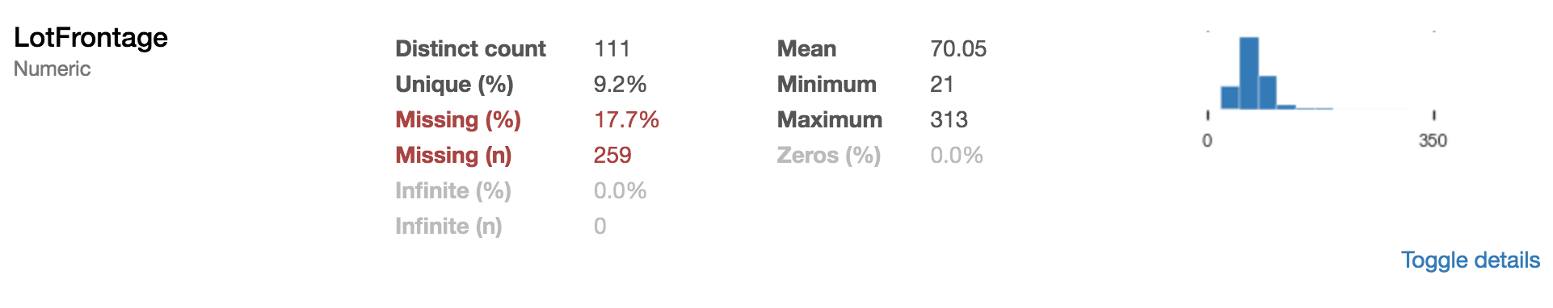
Fill nulls (Numerical)
Fill numerical nulls with mean values
Notes:
Fill with mean 2

Slide 28
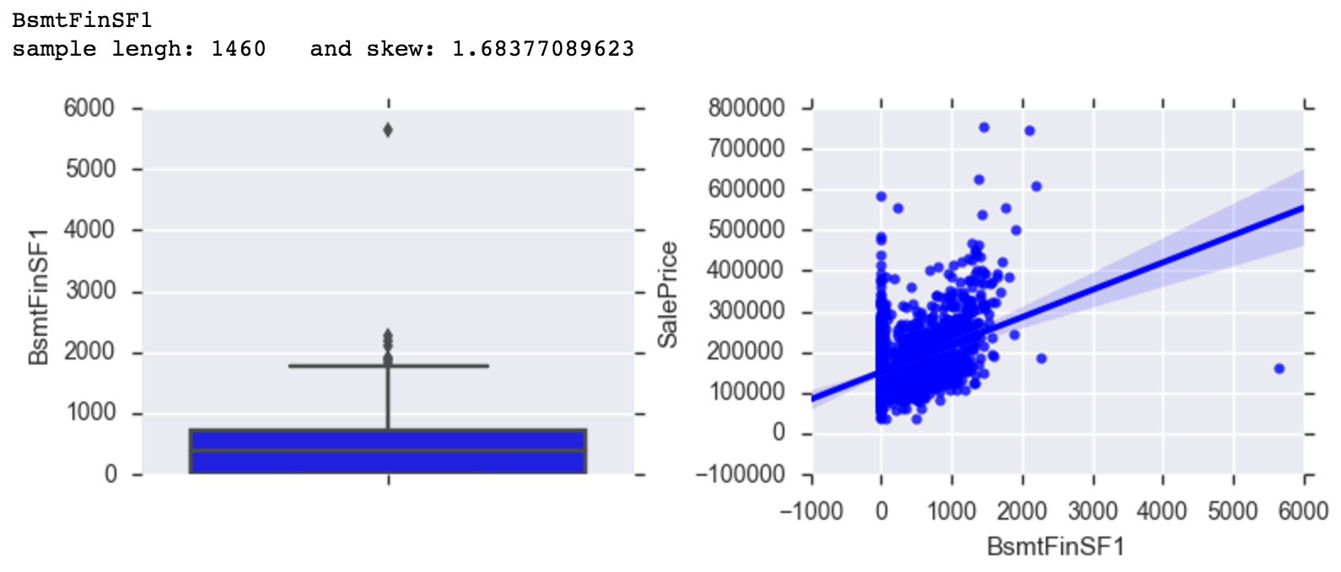
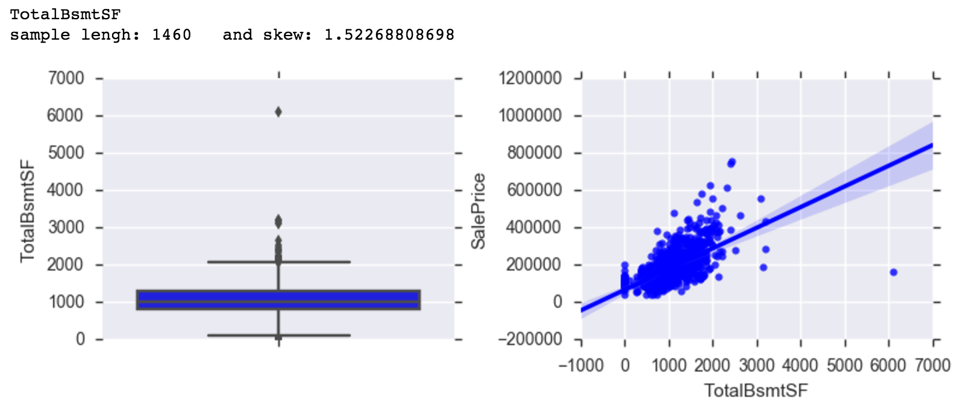
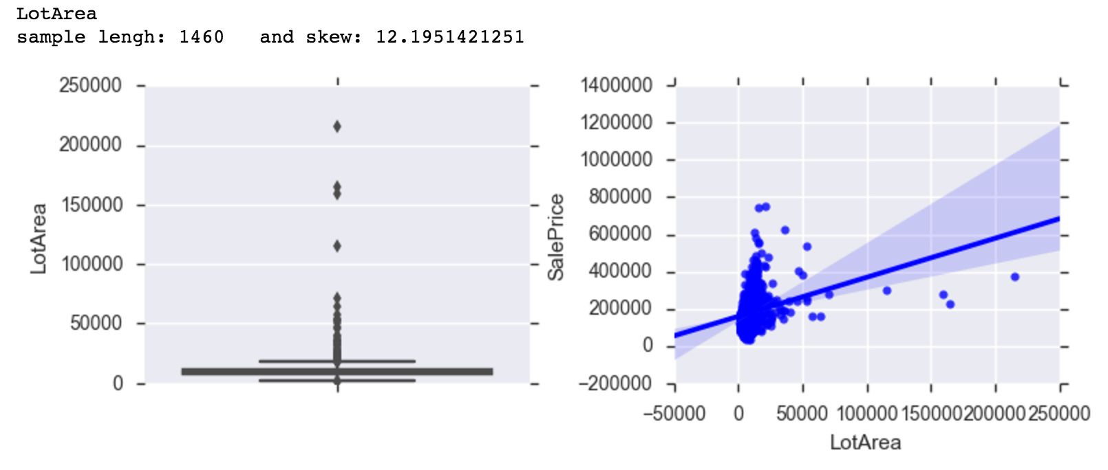
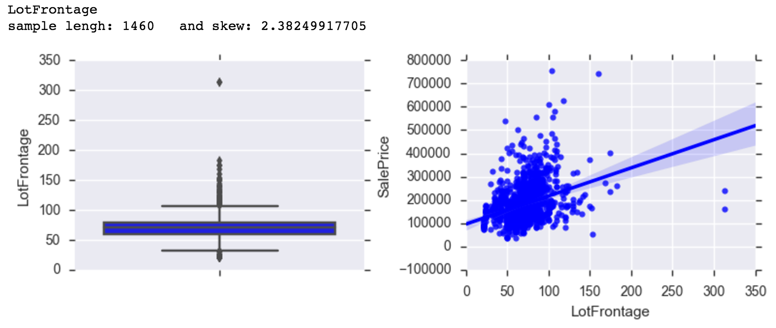
Identify/Eliminate outliers
Eliminated 12 observations considered outliers

