Slide 1


PatientPop Assignment
Patrick Chen
February 18, 2019

Slide 2
Questions
Do the “long” surveys result in significantly more reviews than the “short” surveys? Which “long” survey has a greater impact (v1 or v2)?
What kinds of practices do best with “long” survey v1? Would you recommend “long” survey v2 to any specific kinds of practices?
Do ratings change significantly with either “long” survey? How would you predict which practices will have success, defined as at least a 0.3 star increase in their “long” survey average monthly rating vs their “short” survey average monthly rating?
Would you recommend replacing the “short” survey with either (or both) of the “long” surveys for any or all practices? Provide reasons to support your answer. If you do not have enough data to make a recommendation, what additional data would you need?

Slide 3

Question 1
Do the “long” surveys result in significantly more reviews than the “short” surveys?
Which “long” survey has a greater impact (v1 or v2)?

Slide 4
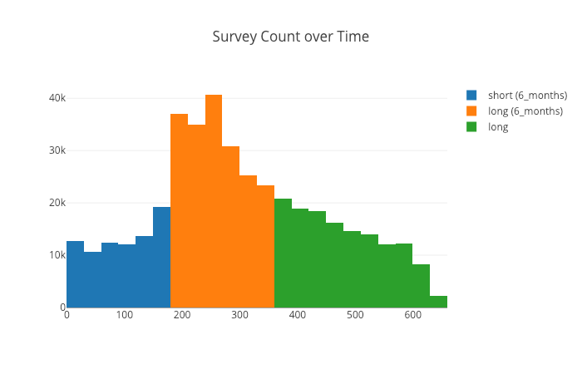
Do the “long” surveys result in significantly more reviews than the “short” surveys?
There are more long surveys than short surveys overall (329,755 vs 80,656)
If long surveys and short surveys were on the same time frame (6 months), long surveys will still have more reviews than short surveys
Long surveys did result in more reviews than short surveys overall and on the same time frame

Slide 5
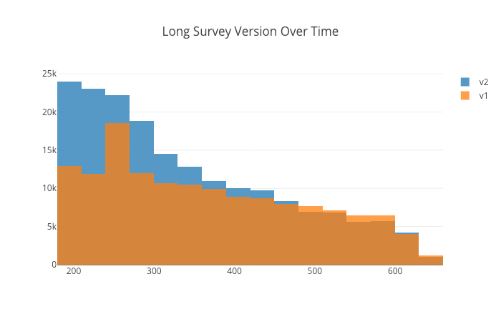
Which “long” survey has a greater impact (v1 or v2)?
V2 has more reviews than V1 overall
Even though more practices adopted V1 than V2 (2856 vs 953), V2 still has more reviews
V2 is more efficient and also more impactful than V1

Slide 6
Question 2
What kinds of practices do best with “long” survey v1?
Would you recommend “long” survey v2 to any specific kinds of practices?

Slide 7
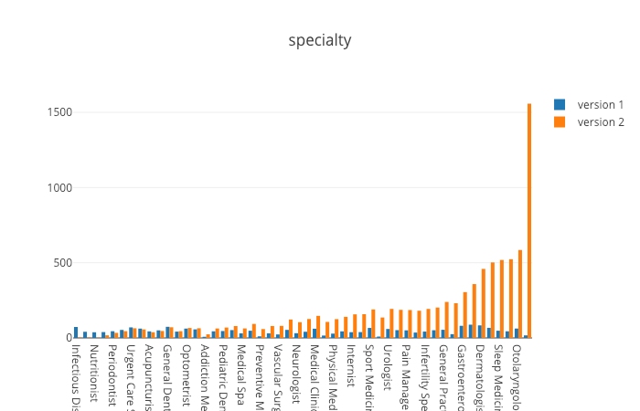
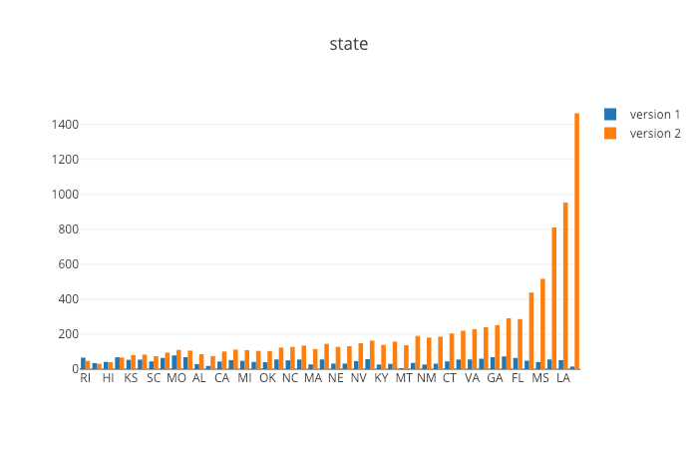
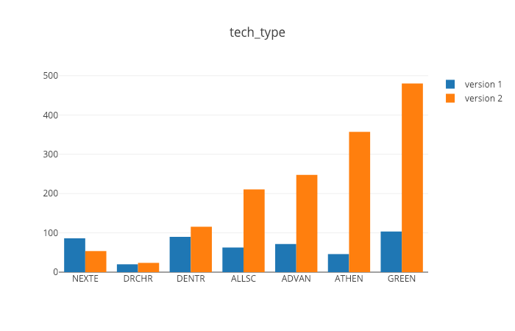
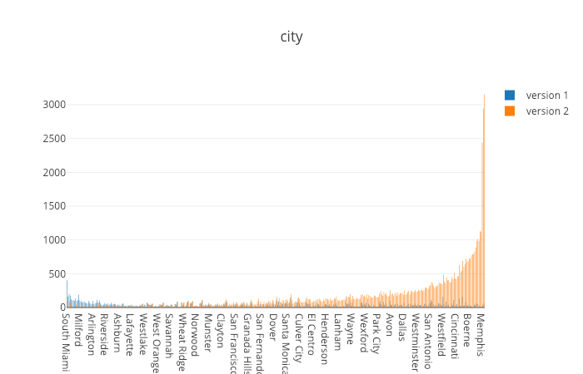
What kinds of practices do best with “long” survey v1? Would you recommend “long” survey v2 to any specific kinds of practices?
These are 4 attributes of practices and their respective categories
The graphs shows an attribute and the most reviews for the attributes category based on the version used.
The measurement is based on a ratio between # of surveys and the # of unique categories in each attribute.
Using a ratio allows for a proportional view of each category
Some practices may be more prevalent in one category and therefore giving an disproportional view of the # of surveys received
The categories on the left side of the graph shows categories for a practice that do best with “Long Version 1”
The categories on the right side of the graph shows attributes for a practice that do best with “Long Version 2”

Slide 8
Question 3
Do ratings change significantly with either “long” survey?
How would you predict which practices will have success, defined as at least a 0.3 star increase in their “long” survey average monthly rating vs their “short” survey average monthly rating?

Slide 9
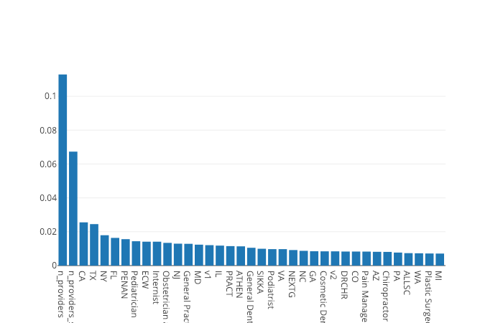
Do ratings change significantly with either “long” survey?
Ratings are higher with Version 2 (3.75) than Version 1 (3.14)
This is 20% more than Version 1 and would infer that it is a significant difference
How would you predict which practices will have success, defined as at least a 0.3 star increase in their “long” survey average monthly rating vs their “short” survey average monthly rating?
First I found the average monthly rating for long and short surveys for each practice
I then created a ”improve” flag that determined if a practice had increased by at least 0.3 from short to long
Using this flag I combined it with the rest of the data and created a random forest model
Using this model I can predict which practices will have success and can define the most important features of the model which is represented on the left

Slide 10
Question 4
Do the “long” surveys result in significantly more reviews than the “short” surveys?
Which “long” survey has a greater impact (v1 or v2)?

Slide 11
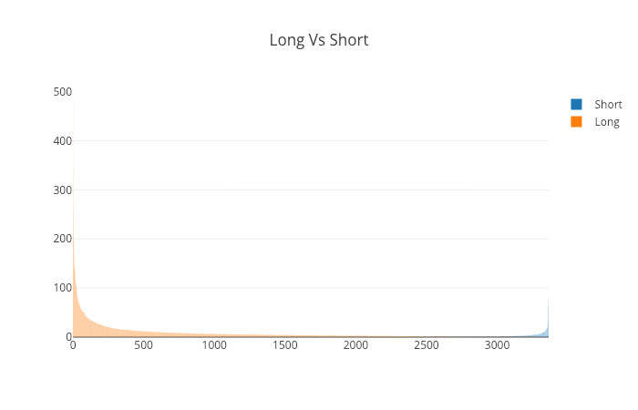
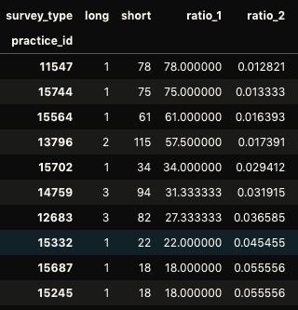
Would you recommend replacing the “short” survey with either (or both) of the “long” surveys for any or all practices?
Generally I would not recommend replacing long surveys with short surveys
Majority of practices do better with long surveys but there are a few practices where short surveys do better than long

