Slide 1
TEXAS BIOFUEL SUPPORT NETWORK
BY
CHIBUEZE ENYINNAYA

Slide 2
SUPPLY NETWORK
SUPPLIERS
ROAD
SUPPLY
HUBS
RAIL
SUPPLY
PLANTS
254
County
Suppliers
1303
Potential
Hubs
167
Potential
Biorefineries

Slide 3
ASSUMPTIONS
The centroid of the county is considered as the county supplier
3rd party supply costs to hubs are regarded as insignificant
Road and Rail distances are not accounted for since they correlate with the costs
2nd Law of Thermodynamics is ignored since there is no energy loss from Biomass conversion to liters
Cleaned data errors and redundancies are considered as bonuses and policy issues

Slide 4
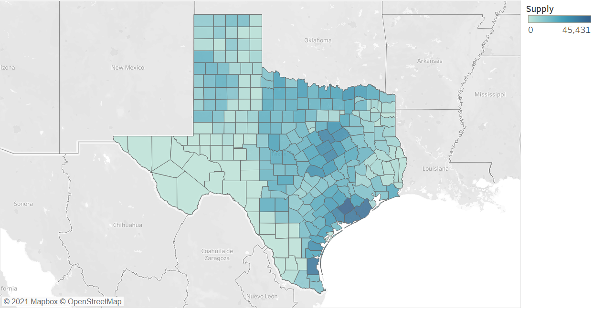
Supply by County

Slide 5
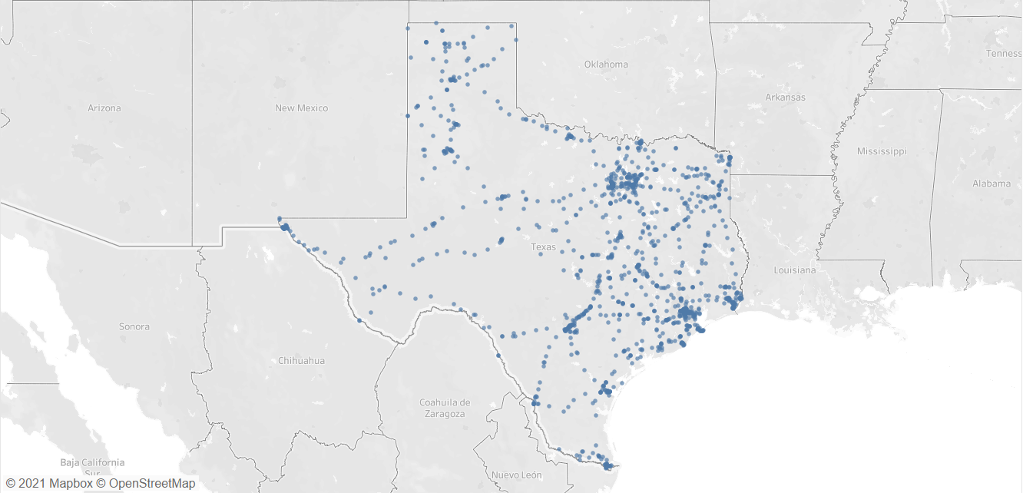
Hub Potential Locations

Slide 6
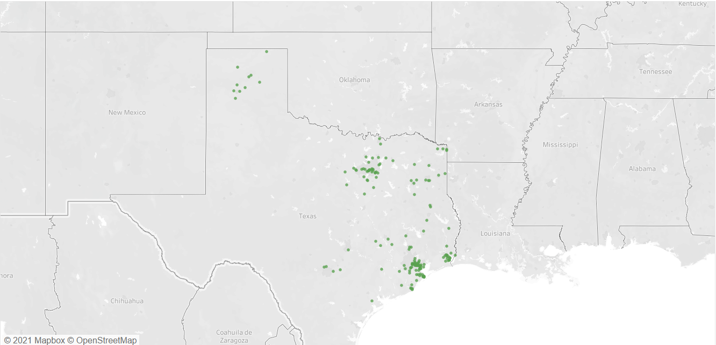
Plant Potential Locations

Slide 7
PARAMATERS
HUB PARAMETERS
Investment cost | $ 3,476,219
Preprocessing capacity | 300,000 Mg
PLANT PARAMETERS
Investment cost | $ 130,956,797
Annual conversion capacity | 152,063,705 liters
Conversion yield | 232 liters/Mg
DEMAND
Network demand | 1,476,310,602 liters
Note: All the parameters are considered for a period of time of one year.

Slide 8
CALCULATIONS
From the datasets and parameters:
Total Supply = 3,053,377.71 Mg
Demand in Mg = Network demand in liters / Conversion yield
= 1,476,310,602 liters / 232 liters/Mg
= 6,363,407.77 Mg
Since the demand supersedes the total supply a third-party supplier is to be introduced:
3rd party Supply = Demand – Total Supply = 3,310,030.06 Mg

Slide 9
CALCULATIONS
Number of plants to meet demand
= Demand / Annual Conversion Capacity = 9.7085 ≈ 10 plants
Total Plant Investment Cost = 10 x $ 130,956,797 = $ 1,309,567,970
Number of hubs to meet plant requirement
= Demand / Hub Capacity = 21.21 ≈ 22 hubs
Total Hub Investment Cost = 22 x $ 3,476,219 = $ 76,476,818

Slide 10
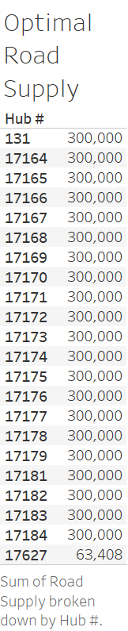
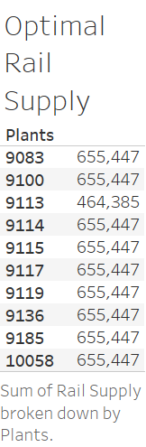

Slide 11
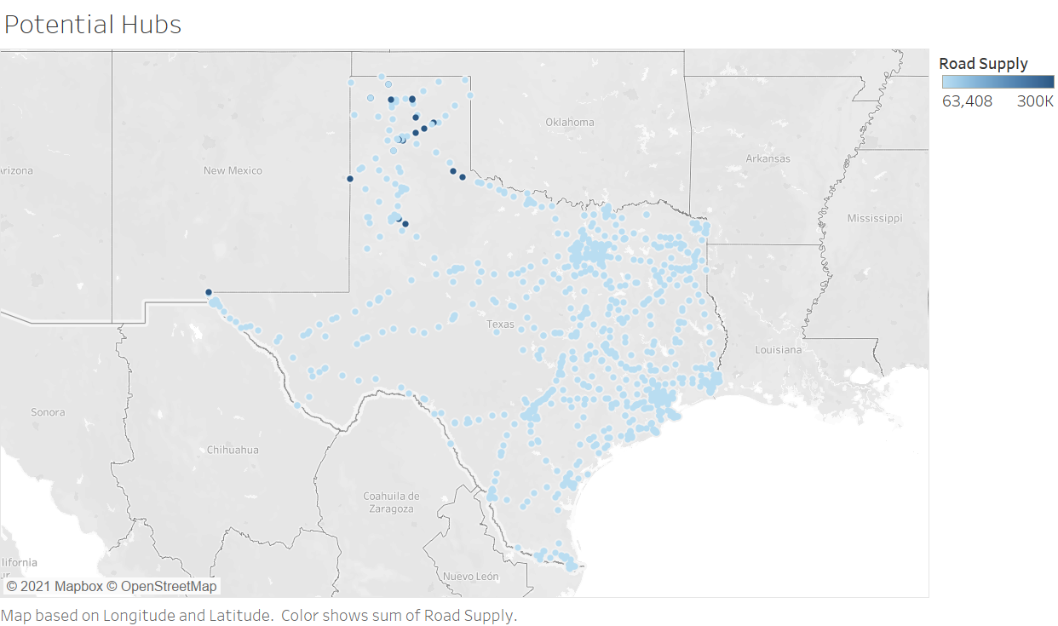

Slide 12
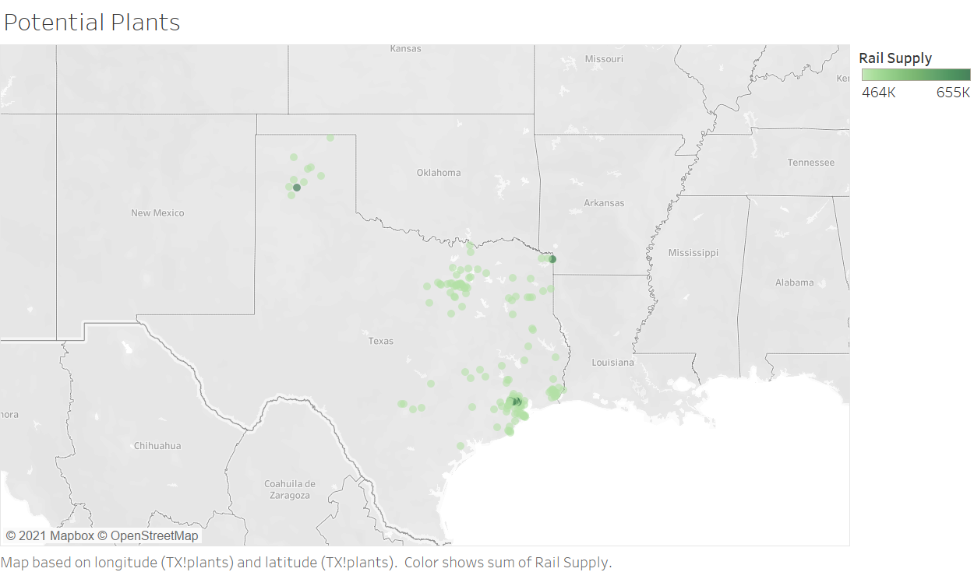

Slide 13
RESULTS
Optimal Minimized Total Supply-Hub Costs = $ 19,501,588,590
Optimal Minimized Total Hub-Plant Costs = $ 28,810,495,340
Overall Costs = $ 48,321,083,930
CONCLUSION AND RECOMMENDATIONS
The optimal number of 22 hubs and 10 plants were obtained for an overall network (investment and transportation) cost of $ 48,321,083,930
With 0.025% and 0.215% error rate from the TX_roads and TX_railroad datasets we retrieved these results, but with more accurate data better results would have been reached

Slide 14
