Slide 1
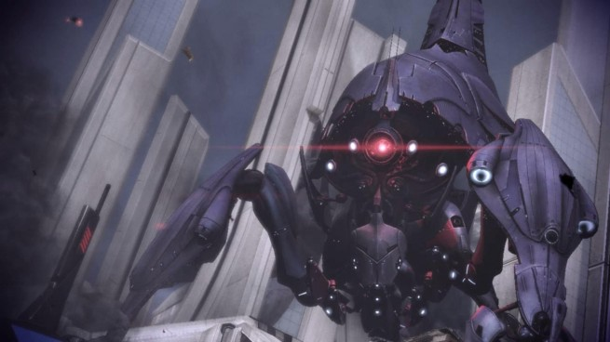
ML&NN Homework

Slide 2
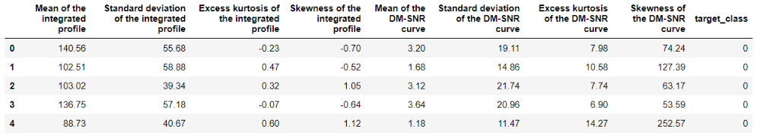
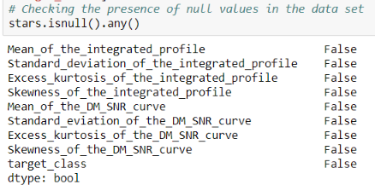
Part 1: predicting a pulsar star
First of all, let’s check the data:
✔There is no missing data

Slide 3
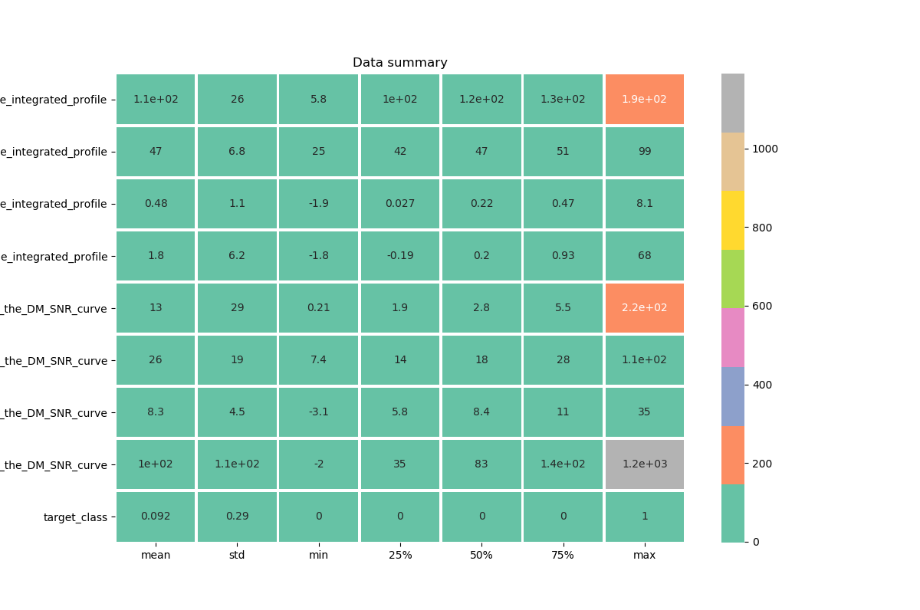
Get the data summary

Slide 4
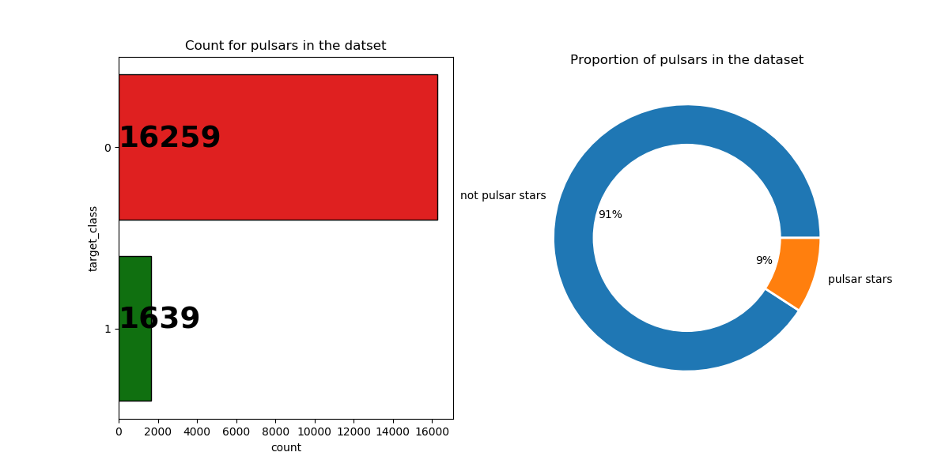
Let’s check how many pulsars in the dataset
✔We are facing an imbalanced dataset, where most of the observations are not pulsars

Slide 5
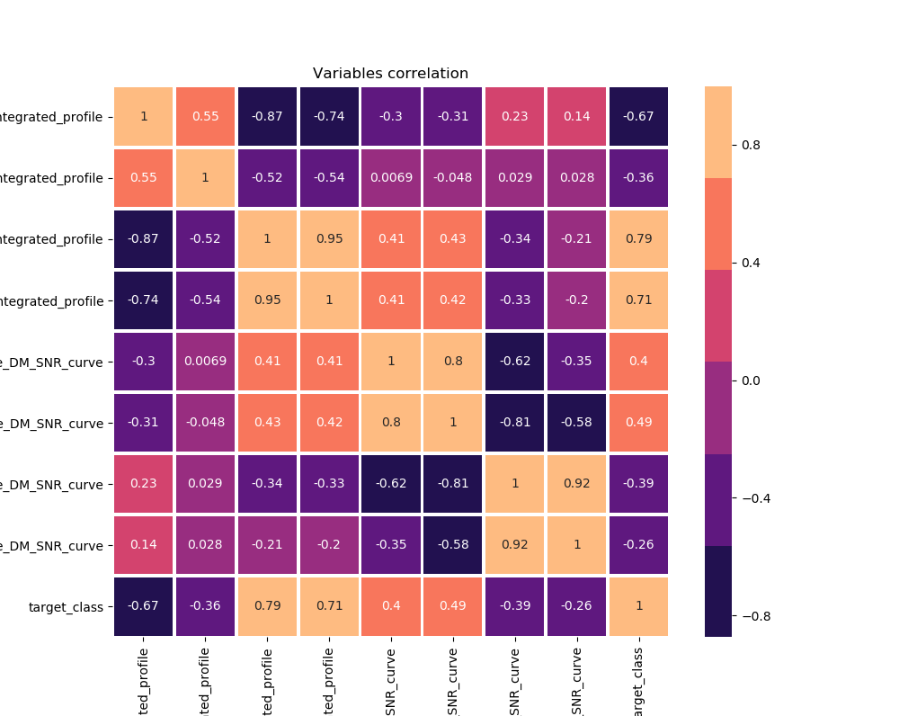

Slide 6
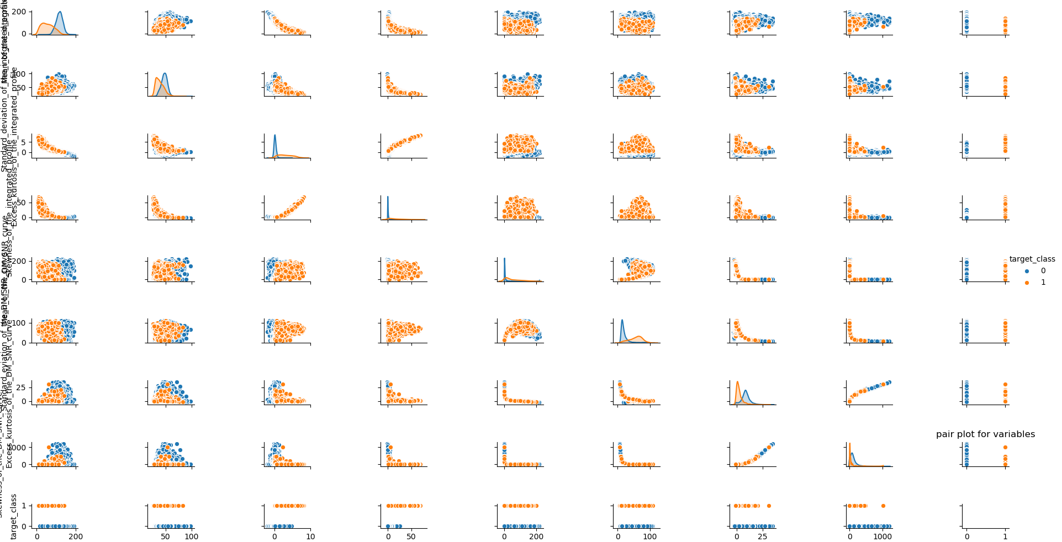
Pair plot

Slide 7
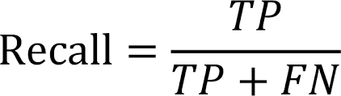
All variables have a relevant role in their ability to identify our target variable, let’s keep them all for now
Scaling dataset
Let’s test different models
Random Forest
Linear Support Vector Classifier
Stochastic Gradient Descent
We will use Recall as our main criteria (we don’t want to miss pulsars)
In information retrieval, recall is the fraction of the relevant documents that are successfully retrieved.

Slide 8
With cross-validation we will have:
Random Forest
Linear Support Vector Classifier
Stochastic Gradient Descent
Cross validation:
Recall: 98.21%
[[4840 28]
[ 69 433]]
Cross validation:
Recall: 98.14%
[[4844 24]
[ 68 434]]
Cross validation:
Recall: 97.97%
[[4843 25]
[ 90 412]]

Slide 9
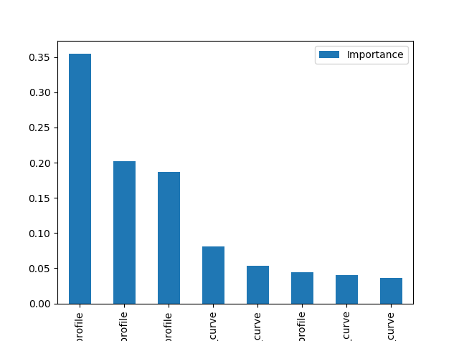
Going on RF
Checking features importance and dropping last one
Feature Importance
Excess_kurtosis_of_the_integrated_profile 0.355146
Skewness_of_the_integrated_profile 0.202583
Mean_of_the_integrated_profile 0.187301
Standard_eviation_of_the_DM_SNR_curve 0.080540
Mean_of_the_DM_SNR_curve 0.053932
Standard_deviation_of_the_integrated_profile 0.044018
Skewness_of_the_DM_SNR_curve 0.040423
Excess_kurtosis_of_the_DM_SNR_curve 0.036056
Using Grid Search to get best params
Best result I got is:
Recall: 98.17%
[[4840 28]
[ 68 434]]

Slide 10
Part 2: chest xray pneumonia
Using CNN

Slide 11
Rescale images for train and test datasets
train_datagen = ImageDataGenerator(rescale = 1./255,
shear_range = 0.2,
zoom_range = 0.2,
horizontal_flip = True)
test_datagen = ImageDataGenerator(rescale = 1./255)

Slide 12
Creating CNN
# Build the CNN
classifier = Sequential()
# Convolution
classifier.add(Conv2D(32, (3, 3), activation="relu", input_shape=(64, 64, 3)))
# Pooling
classifier.add(MaxPooling2D(pool_size = (2, 2)))
# Add 2nd convolutional layer with the same structure as the 1st to improve predictions
classifier.add(Conv2D(32, (3, 3), activation="relu"))
classifier.add(MaxPooling2D(pool_size = (2, 2)))
# Flattening
classifier.add(Flatten())
# Full Connection
classifier.add(Dense(activation = 'relu', units = 128))
classifier.add(Dense(activation = 'sigmoid', units = 1))
# Compile the CNN
classifier.compile(optimizer = 'adam', loss = 'binary_crossentropy', metrics = ['accuracy'])

Slide 13
And running the model
# 163/163 [==============================] - 655s 4s/step - loss: 0.3563 - acc: 0.8407 - val_loss: 0.3026 - val_acc: 0.8784
# Epoch 2/10
# 163/163 [==============================] - 479s 3s/step - loss: 0.2258 - acc: 0.9049 - val_loss: 0.4853 - val_acc: 0.7933
# Epoch 3/10
# 163/163 [==============================] - 479s 3s/step - loss: 0.1989 - acc: 0.9212 - val_loss: 0.2789 - val_acc: 0.8893
# Epoch 4/10
# 163/163 [==============================] - 480s 3s/step - loss: 0.2075 - acc: 0.9189 - val_loss: 0.4403 - val_acc: 0.8353
# Epoch 5/10
# 163/163 [==============================] - 1076s 7s/step - loss: 0.1673 - acc: 0.9356 - val_loss: 0.2661 - val_acc: 0.8990
# Epoch 6/10
# 163/163 [==============================] - 728s 4s/step - loss: 0.1635 - acc: 0.9367 - val_loss: 0.2696 - val_acc: 0.8909
# Epoch 7/10
# 163/163 [==============================] - 666s 4s/step - loss: 0.1631 - acc: 0.9367 - val_loss: 0.3588 - val_acc: 0.8796
# Epoch 8/10
# 163/163 [==============================] - 673s 4s/step - loss: 0.1449 - acc: 0.9431 - val_loss: 0.3136 - val_acc: 0.8910
# Epoch 9/10
# 163/163 [==============================] - 530s 3s/step - loss: 0.1406 - acc: 0.9463 - val_loss: 0.3288 - val_acc: 0.8832
# Epoch 10/10
# 163/163 [==============================] - 515s 3s/step - loss: 0.1393 - acc: 0.9477 - val_loss: 0.5068 - val_acc: 0.8399

Slide 14
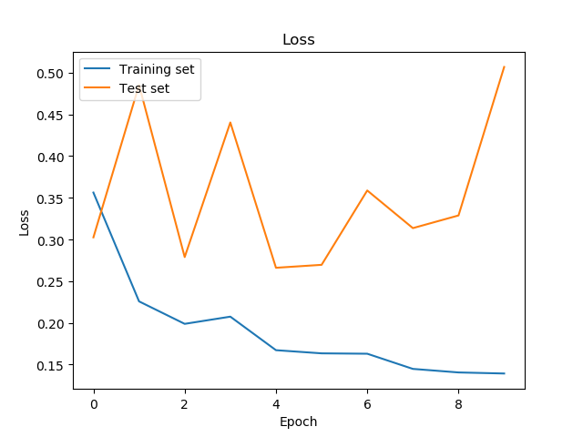
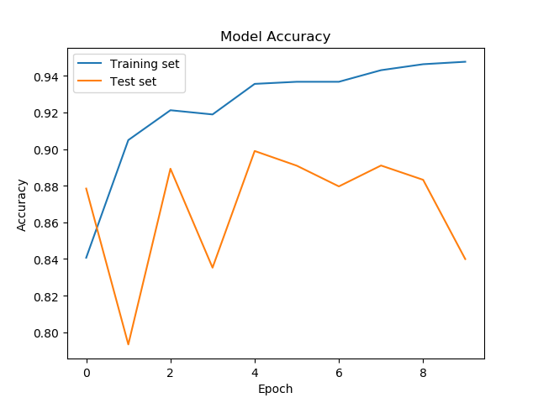
And running the model

Slide 15
Testing manually on new data (from “val”)
img = image.load_img('./chest-xray-pneumonia/chest_xray/val/PNEUMONIA/person1946_bacteria_4874.jpeg', target_size=(64, 64))
x = image.img_to_array(img)
x = np.expand_dims(x, axis=0)
x = preprocess_input(x)
preds = classifier.predict(x)
PNEUMONIA = [[1.]]
NORMAL = [[0.]]
PNEUMONIA = [[0.]]
NORMAL = [[0.]]
PNEUMONIA = [[1.]]
NORMAL = [[0.]]

